Slide 1
Asset Liability Management
Wylie Tollette, Chief Operating Investment Officer
November 30, 2017
California State Association of Counties Annual Meeting
Notes:
Brad:
Good morning
Thank you for joining us today for the California Special District Association Webinar.
As our valued participating employers, it is important for us to talk with you about issues that affect CalPERS, other stakeholders, and members who are counting on a secure retirement and quality health care.

Slide 2
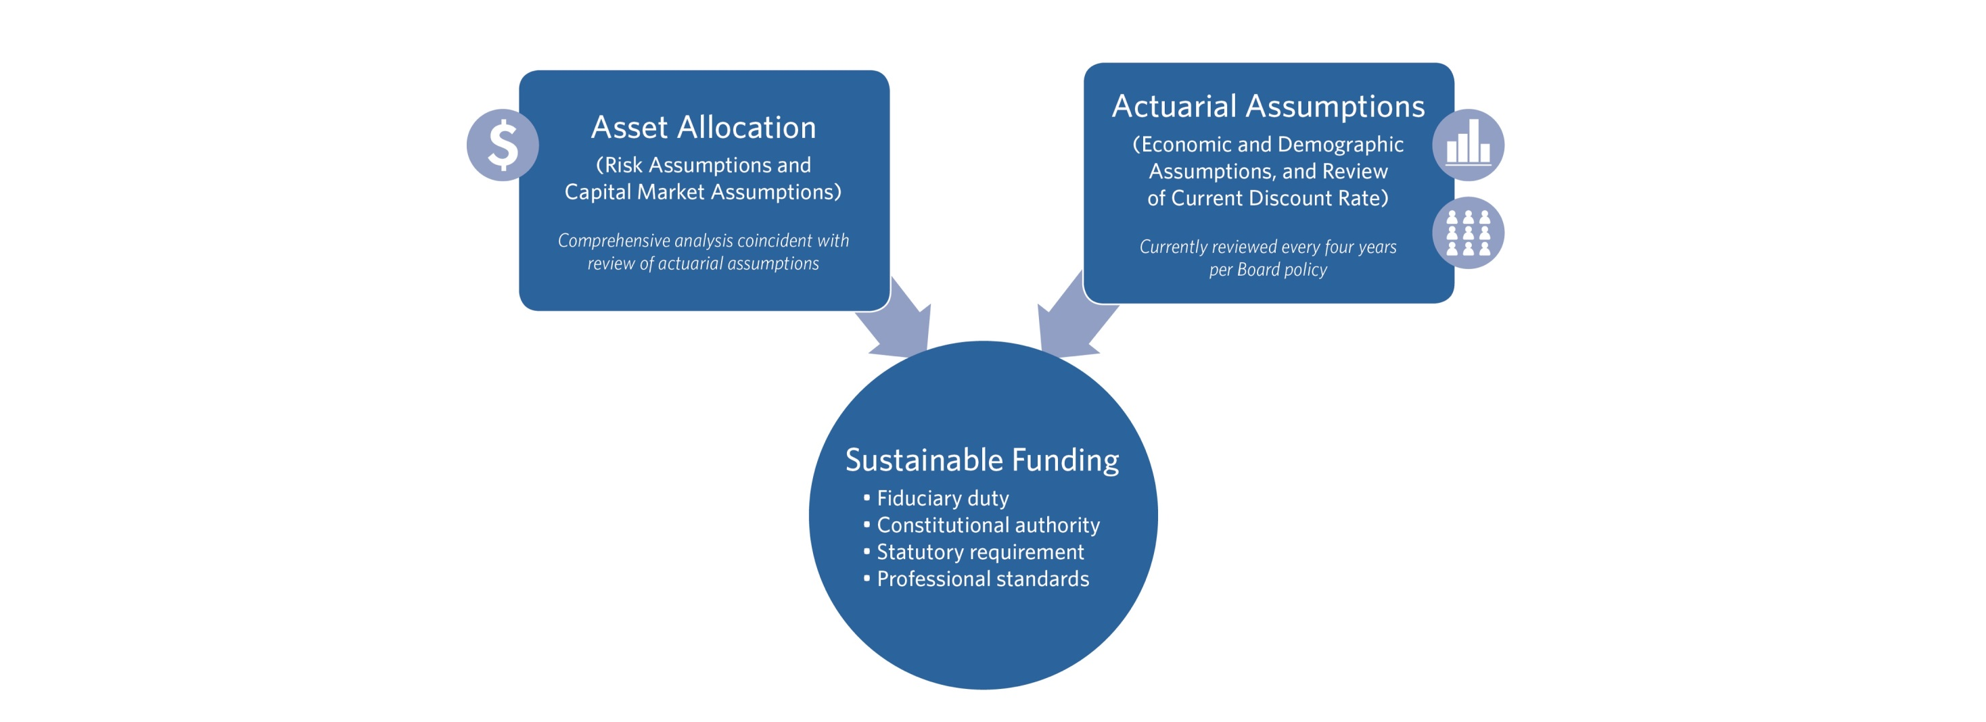
Asset Liability Management Process
Notes:
Brad:
Our Fund is currently valued at nearly $335 billion and in fiscal year ending June 2016, we saw a 11.2% return.
We don’t get too worked up over this one-year return, just as we didn’t get too worked up over the 18.4 percent return we saw in 2014.
Over half of our portfolio is invested in stocks, meaning our 1-year returns are going to be volatile – there is no way to avoid volatility yet earn high long-term rewards. This is why we focus on the long term, 5-, 10-, 20- year returns in order to manage our fund. As you can see here, our annualized return since 1988 is 8.4 percent.
It’s critical to remember that CalPERS is a long-term investor.

Slide 3
ALM Model Building Blocks
Starting Point
Assets and Liabilities at June 30, 2016
Benefit payments for FY 2016-2017
Contributions for FY 2016-2017
Investment return for FY 2016-17 (11.2%)
Liability Projection for 30 Years
Liabilities projected for each discount rate
Open Group (New members join in future years)
Asset Projection for 30 Years
For each discount rate 5,000 investment return paths over 30 years are randomly simulated

Slide 4
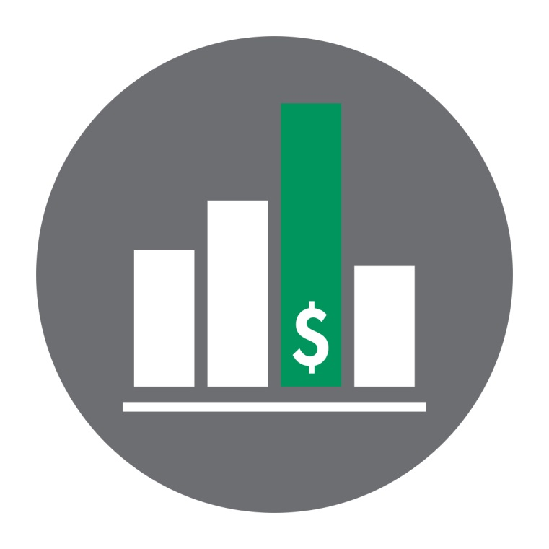
Economic Assumptions
Price Inflation
Wage Inflation
Payroll Growth
Long-term Expected Return on Assets

Slide 5
Demographic Assumptions
Workforce Demographics
Disability Retirement
Mortality

Slide 6
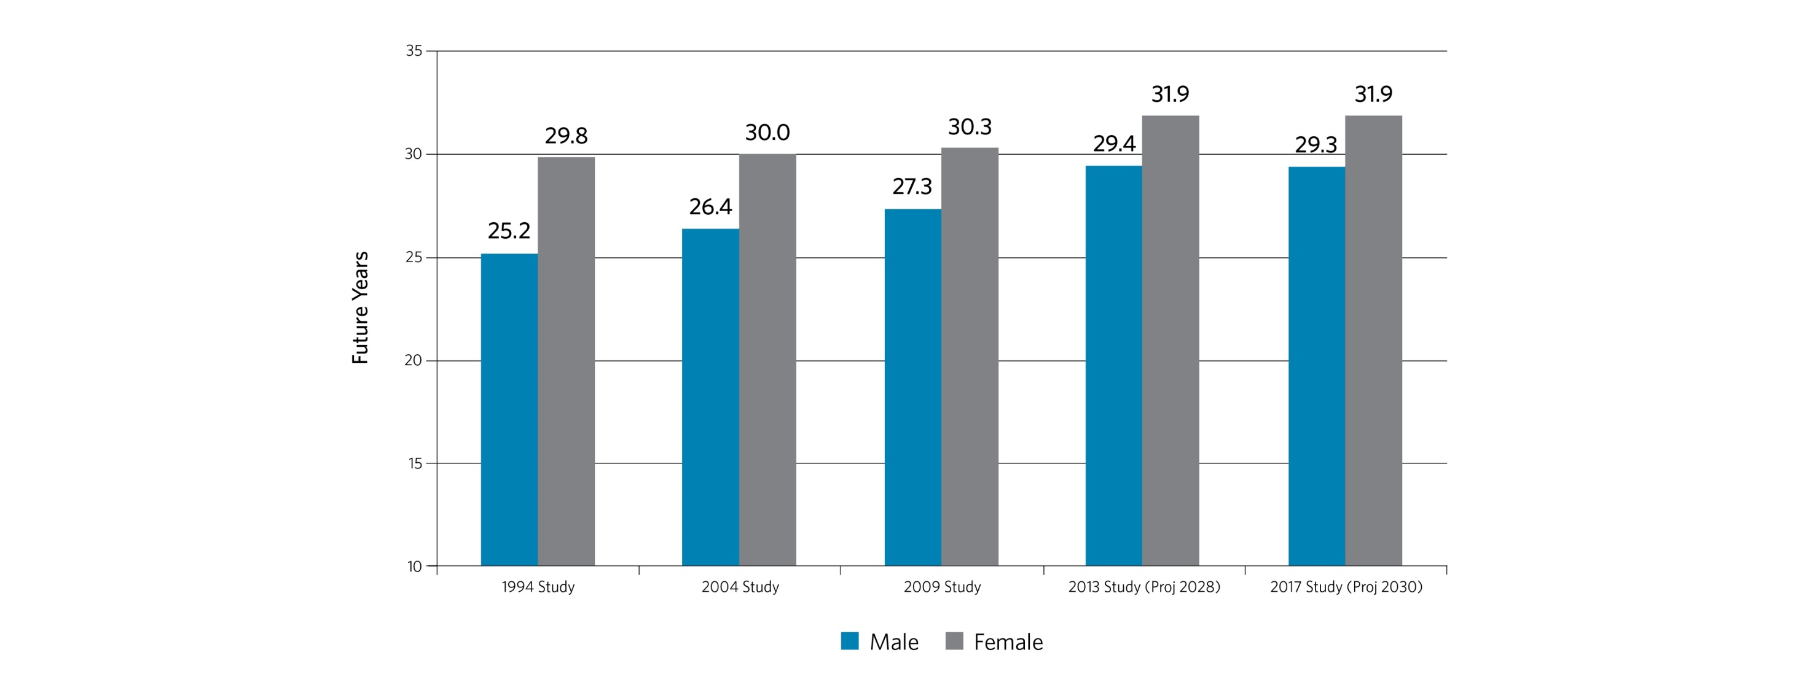
Male and Female Life Expectancy at Age 55 for Healthy Recipients

Slide 7
Financial Highlights
Current Value $345 billion*
11.20%
8.83%
4.39%
6.60%
8.40%
2016/17 Portfolio Return
5-yr Annualized Return
10-yr Annualized Return
20-yr Annualized Return
Annualized Return Since 1988
* As of 11/28/2017
Notes:
Brad:
Our Fund is currently valued at nearly $335 billion and in fiscal year ending June 2016, we saw a 11.2% return.
We don’t get too worked up over this one-year return, just as we didn’t get too worked up over the 18.4 percent return we saw in 2014.
Over half of our portfolio is invested in stocks, meaning our 1-year returns are going to be volatile – there is no way to avoid volatility yet earn high long-term rewards. This is why we focus on the long term, 5-, 10-, 20- year returns in order to manage our fund. As you can see here, our annualized return since 1988 is 8.4 percent.
It’s critical to remember that CalPERS is a long-term investor.

Slide 8
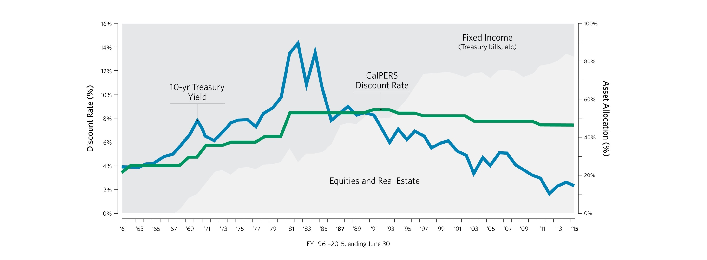
Interest Rates vs CalPERS Investment Mix

Slide 9
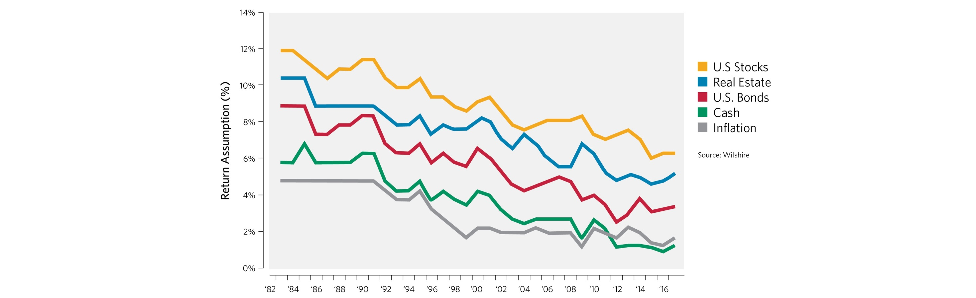
Wilshire Forecasts through Time
Return prospects have been declining for decades, following the downward trend in interest rates

Slide 10
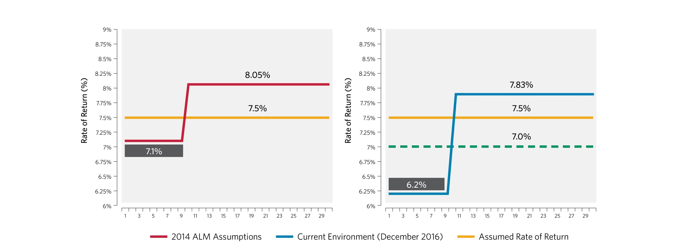
Change in CalPERS Market Forecasts

Slide 11
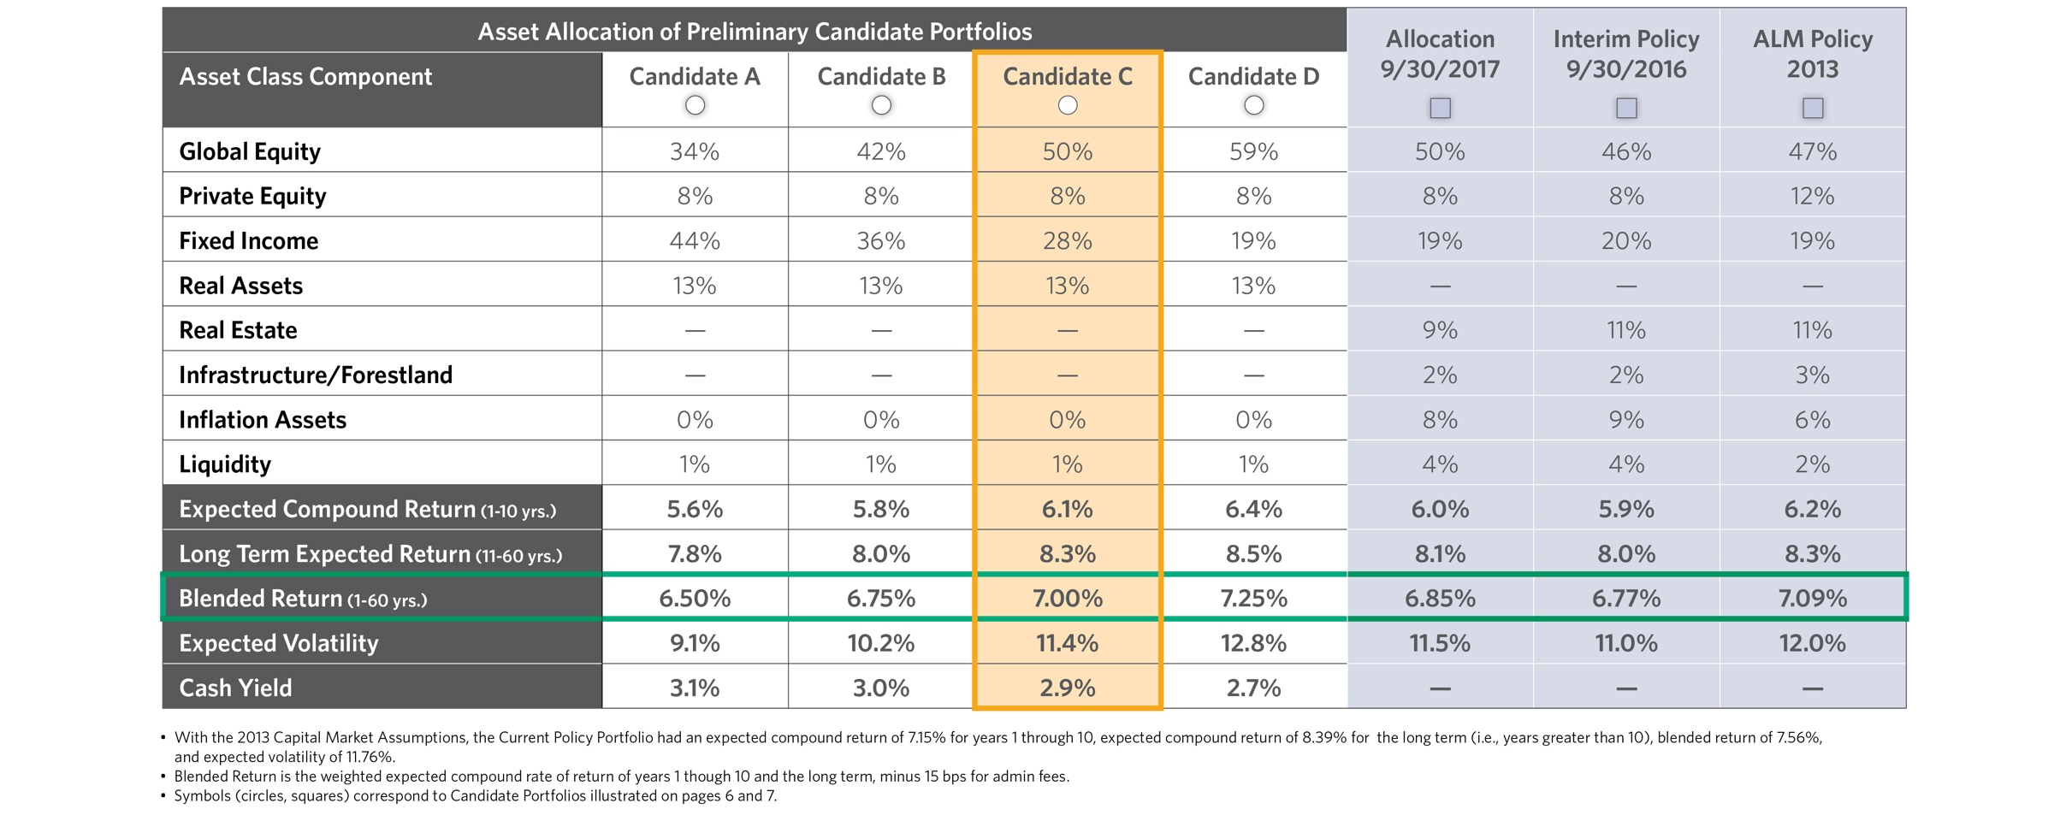
Candidate Portfolios

Slide 12
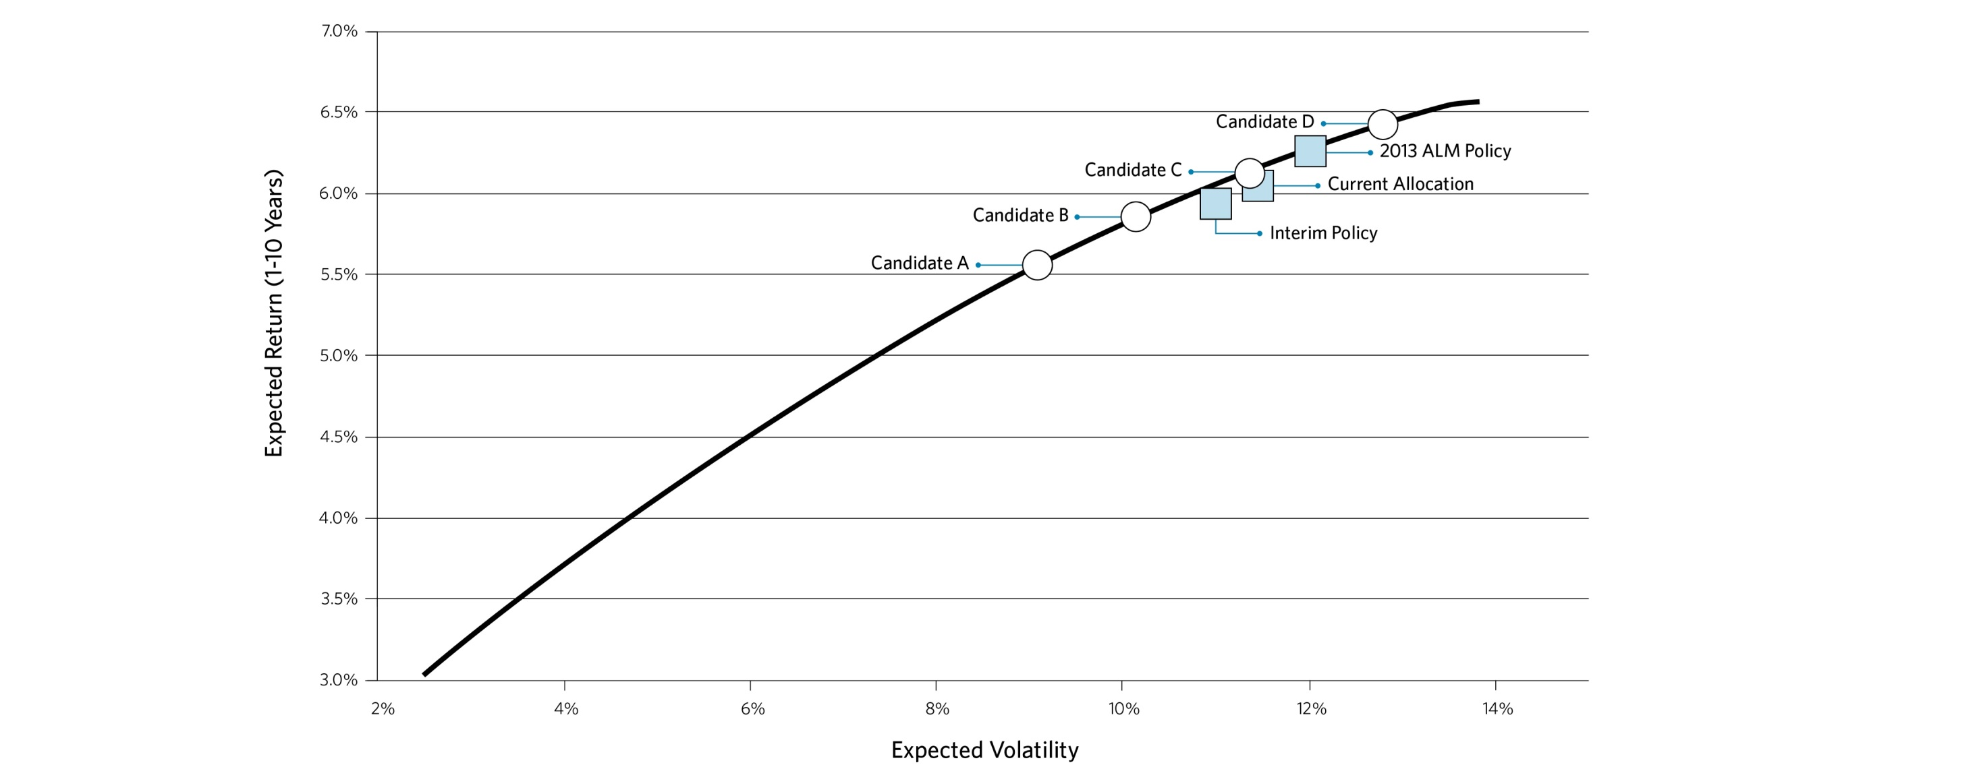
Candidate Portfolios - Efficient Frontier

Slide 13
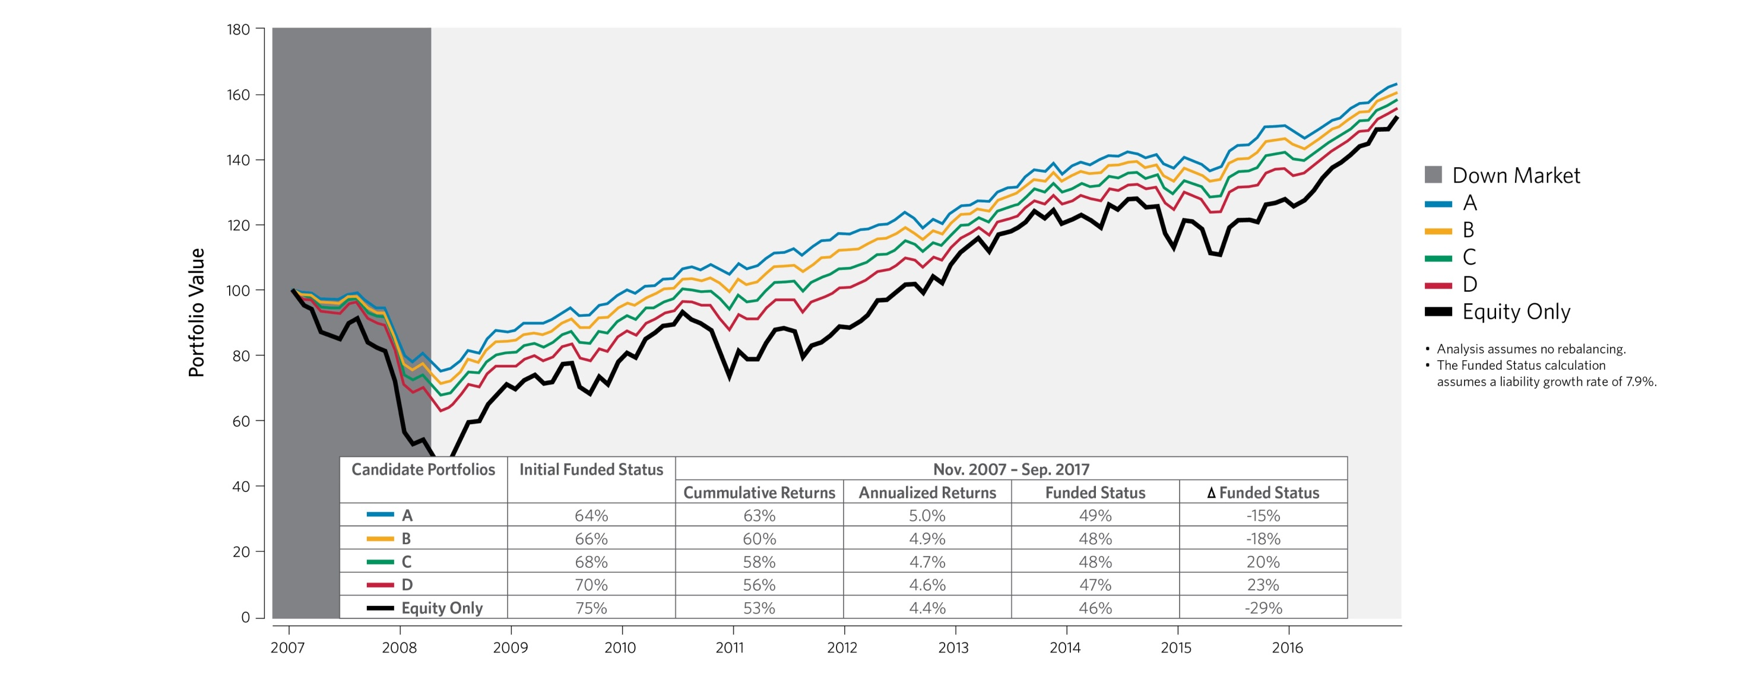
Scenario Analysis (Global Financial Crisis & Recovery)

Slide 14
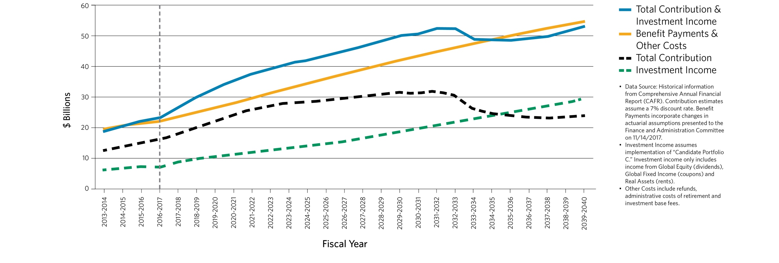
Total Fund Cash Flows are Improving
Historic & Projected PERF Cash Flow Analysis

Slide 15
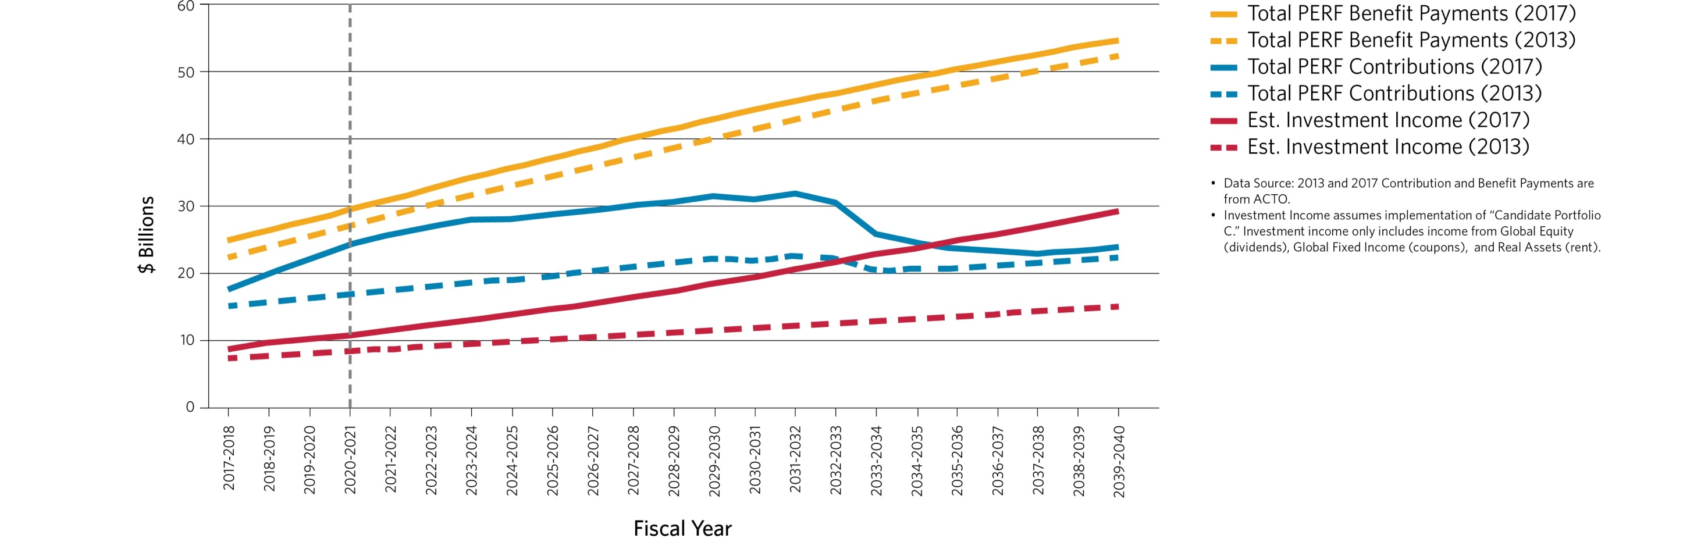
Contribution, Benefit Payments and Investment Income
2013 and Today

Slide 16
Discount Rate Determination
Based on Blended CMA rates and projected Cash Flows
Portfolio | Discount Rate¹ | Portfolio Volatility
A | 6.50% | 9.1%
B | 6.75% | 10.2%
C | 7.00% | 11.4%
D | 7.25% | 12.8%
¹ Does not include any provision for adverse deviation.

Slide 17
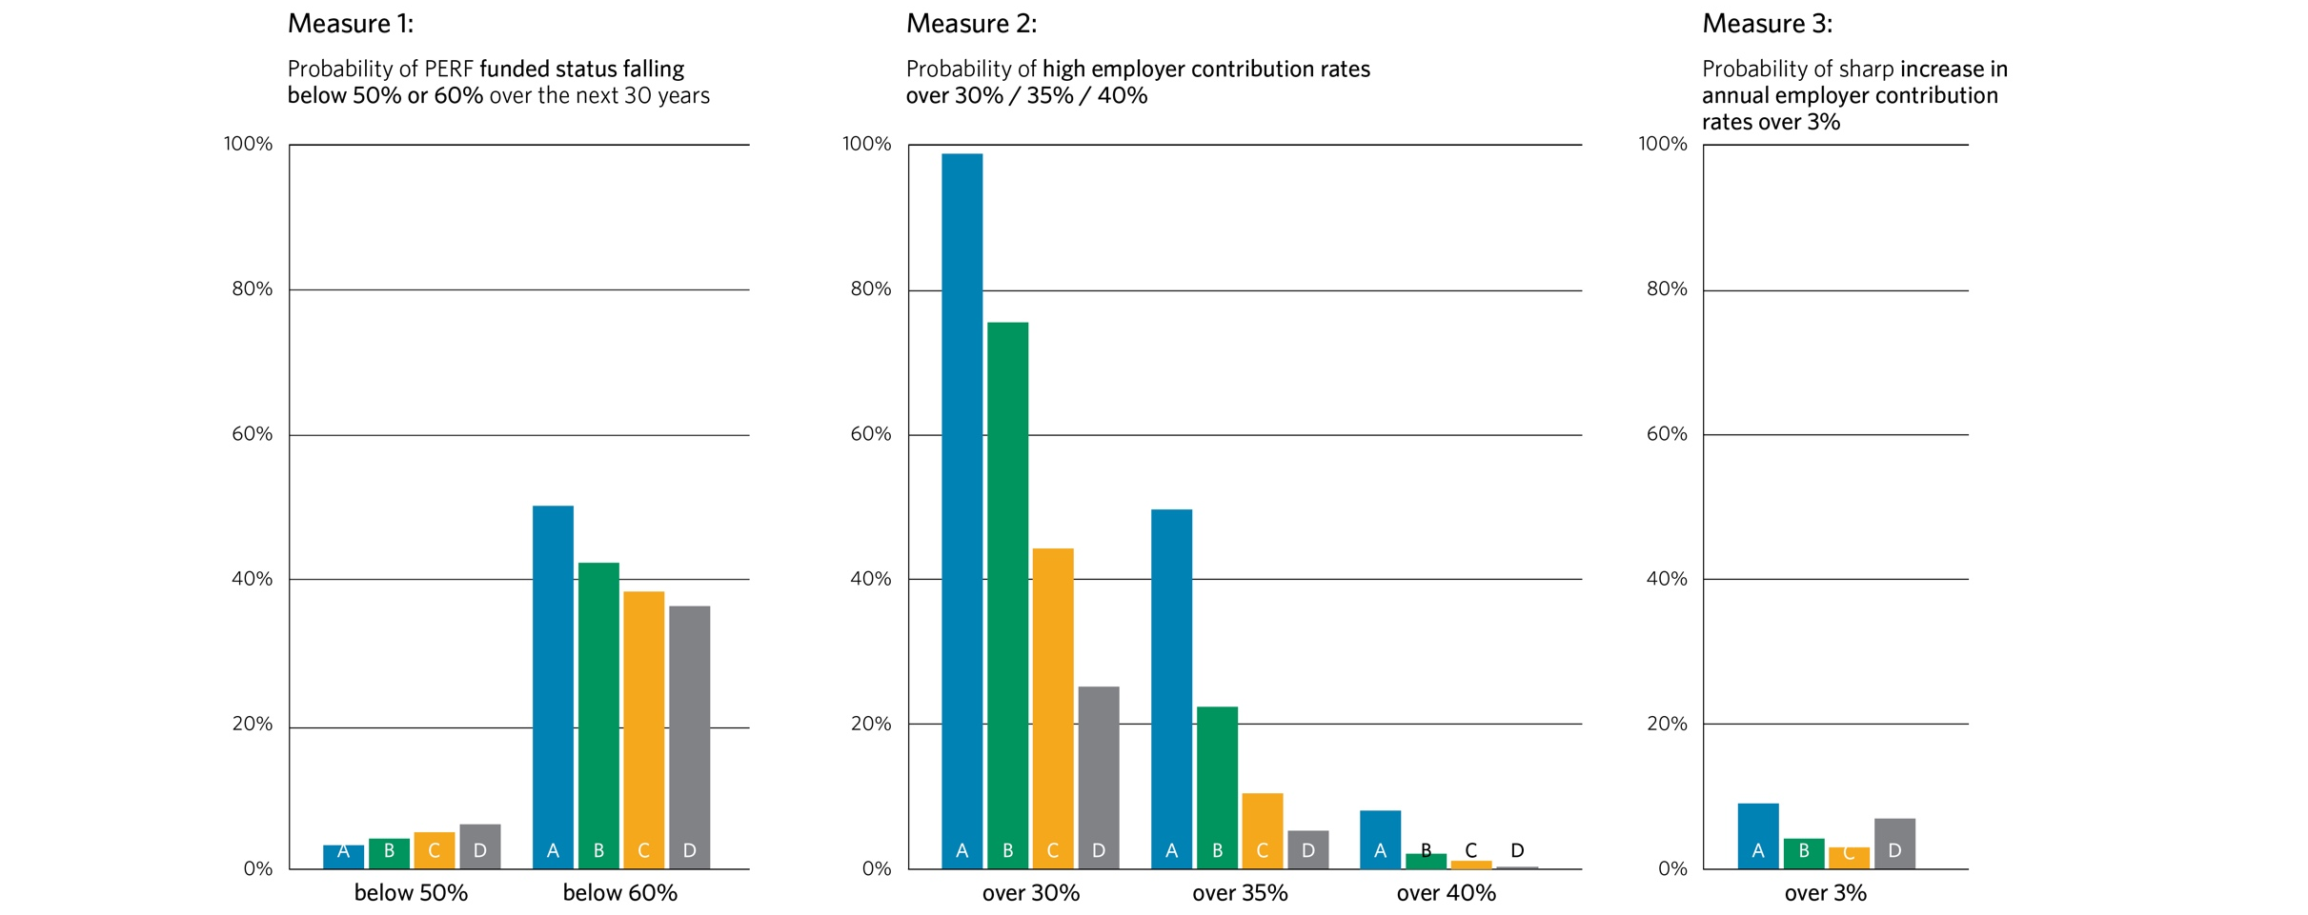
Public Agency Miscellaneous

Slide 18
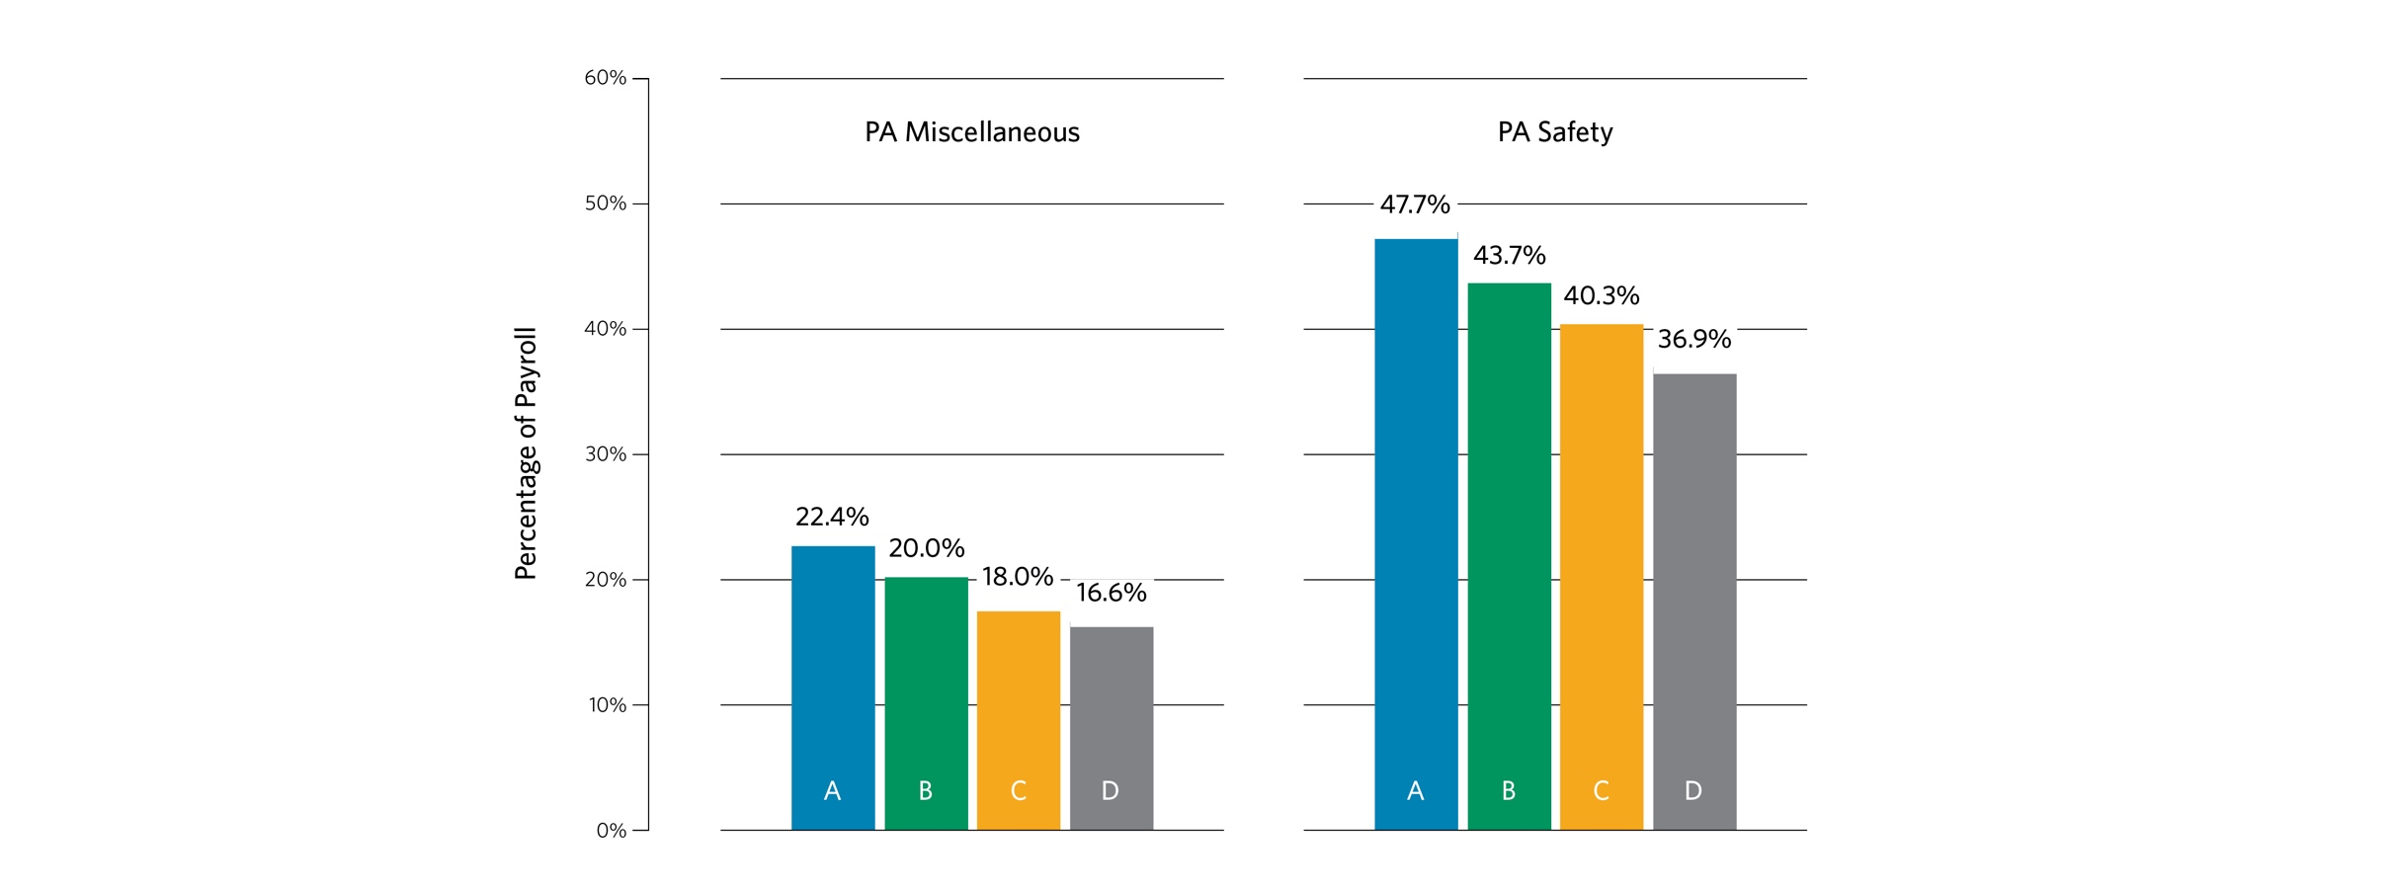
Average Employer Contribution Rates Over Next 30 Years

Slide 19
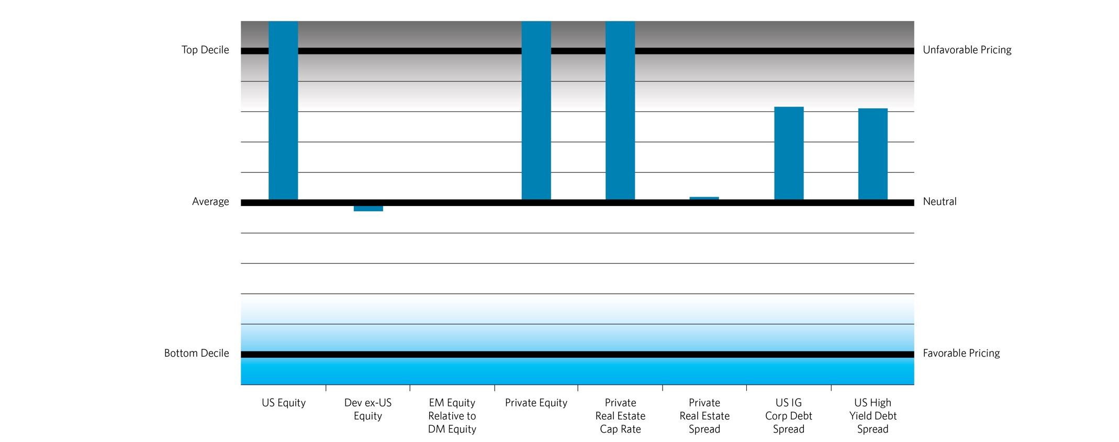
Market Valuations
Valuation Metrics vs. Historical Range – A Measure of Risk (as of September 2017)
Source: Pension Consulting Alliance

Slide 20
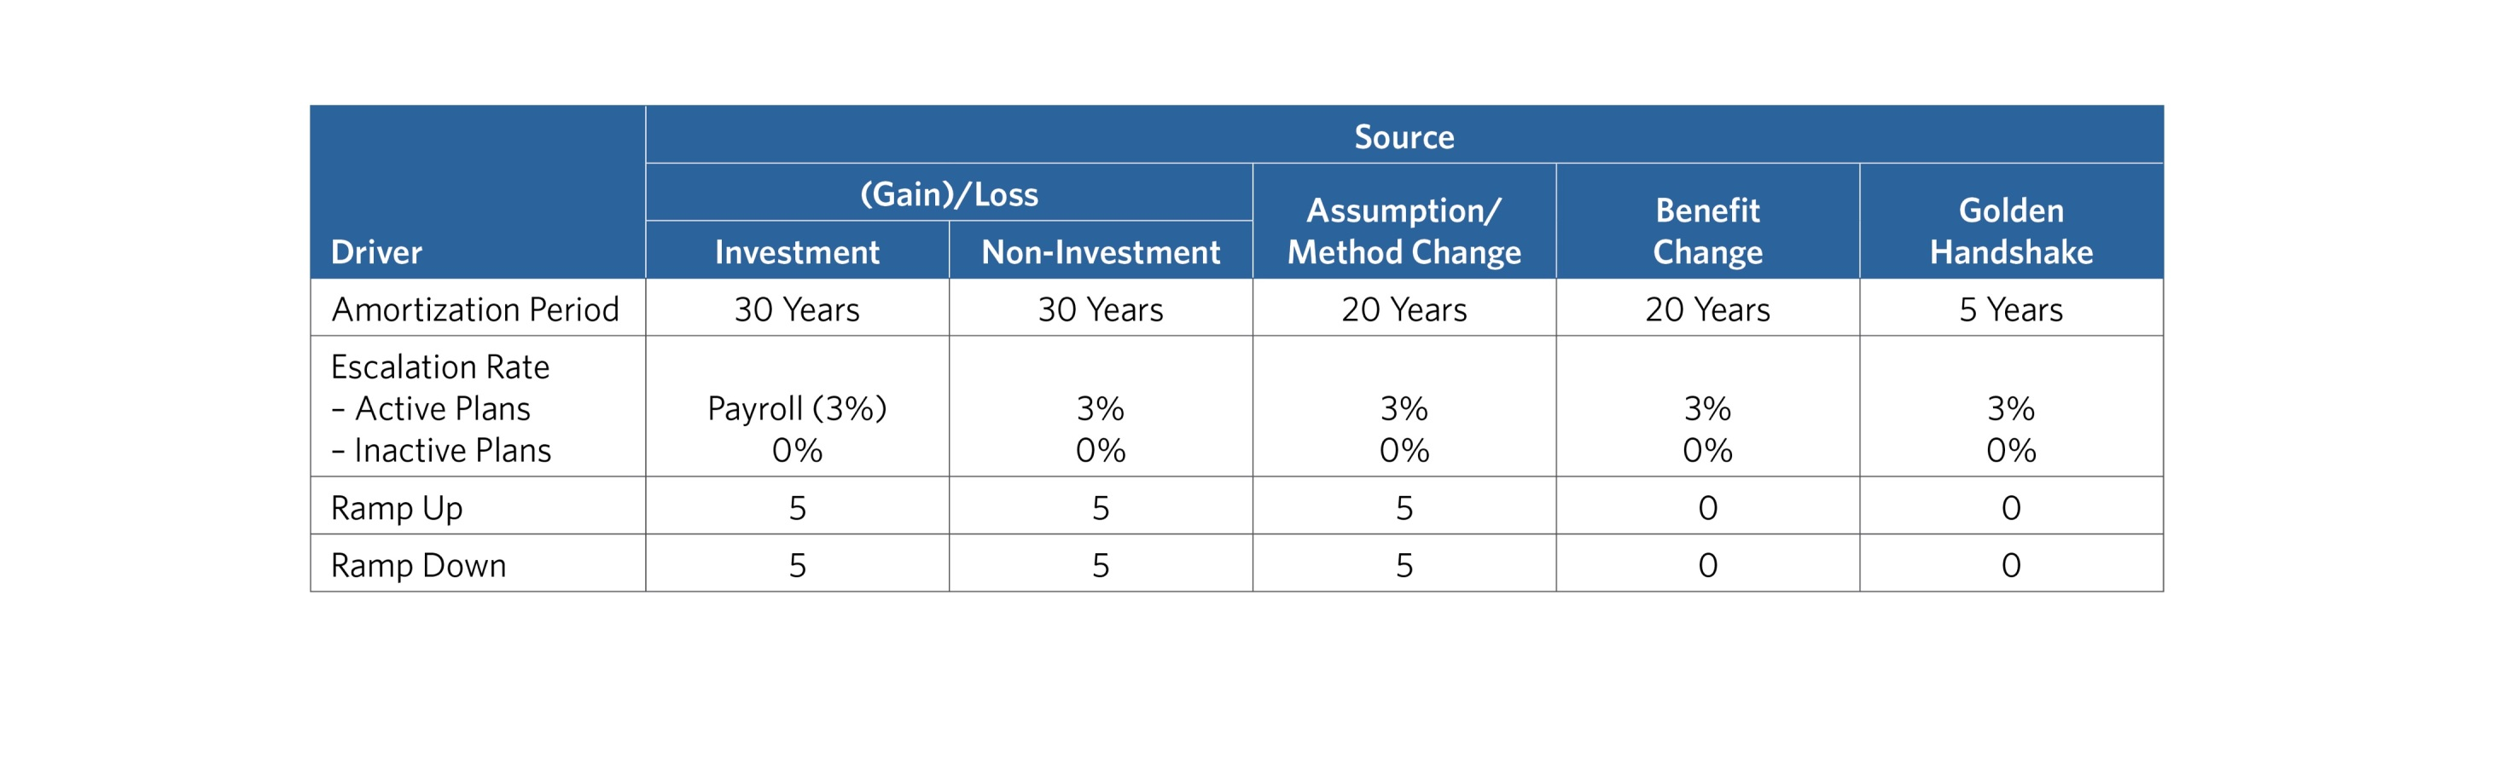
Current Actuarial Amortization Policy

Slide 21
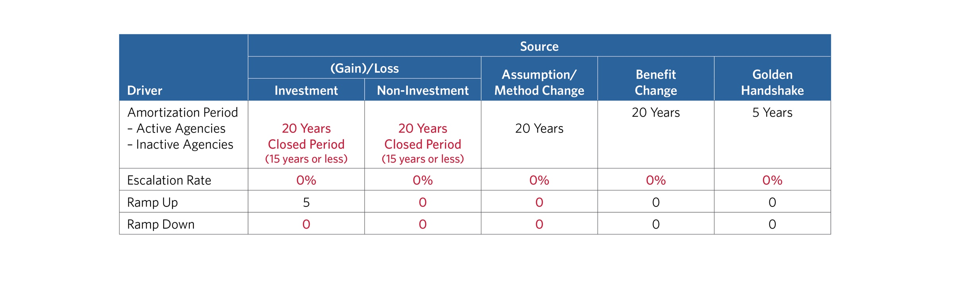
Proposed Actuarial Amortization Policy

Slide 22
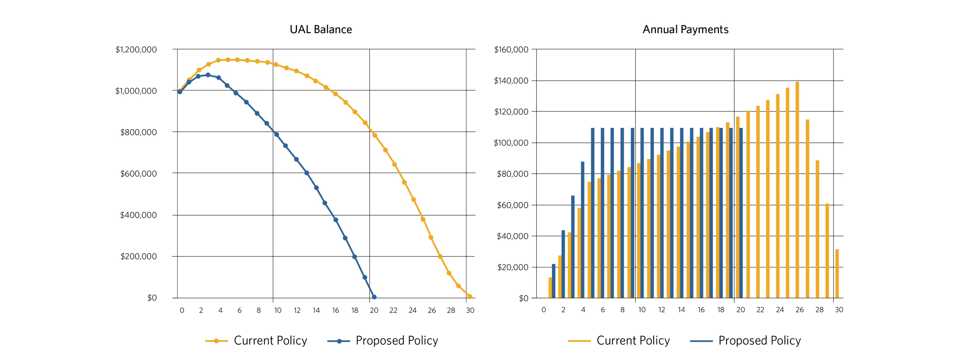
Investment Gain or Loss ($1,000,000 Loss)

Slide 23
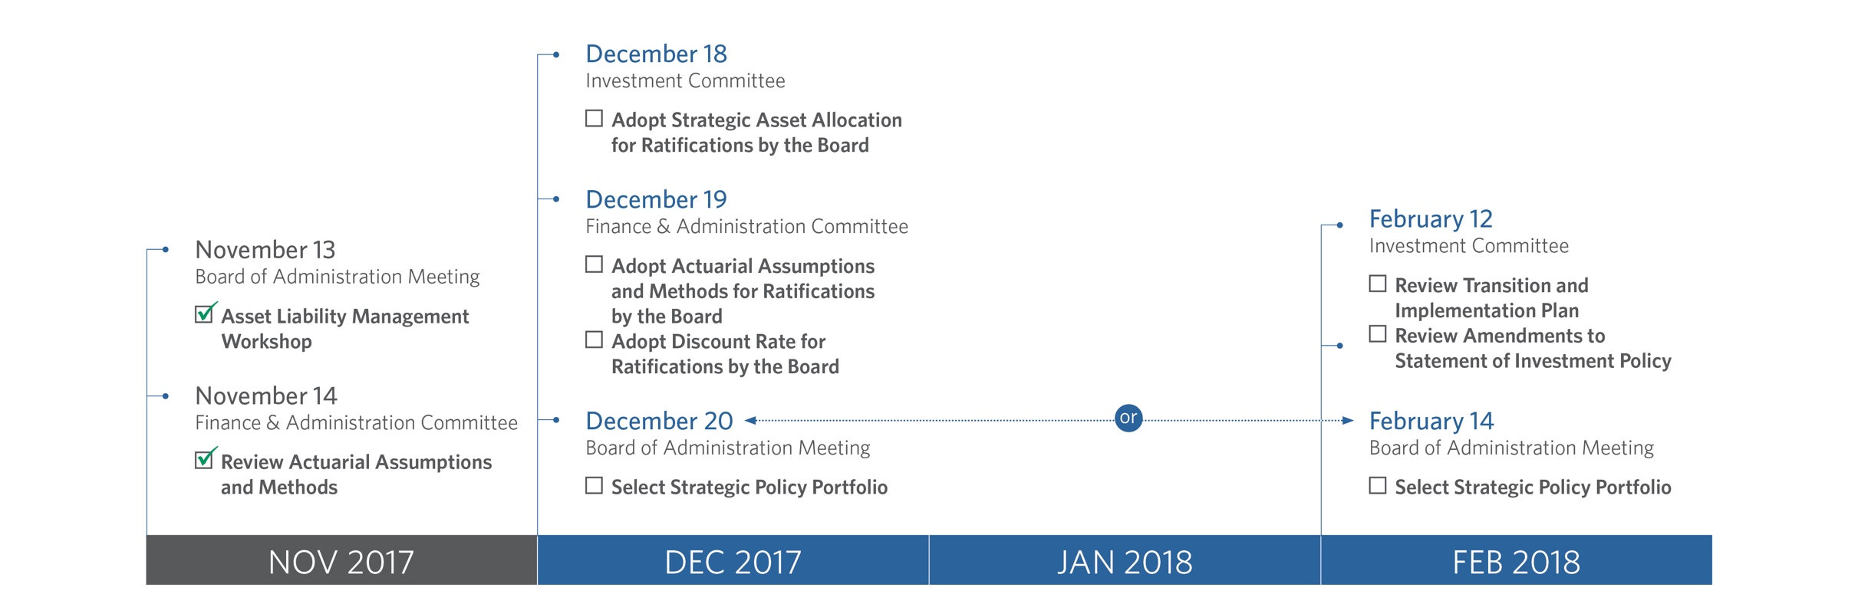
2017-18 ALM Timeline

Slide 24
Appendix

Slide 25
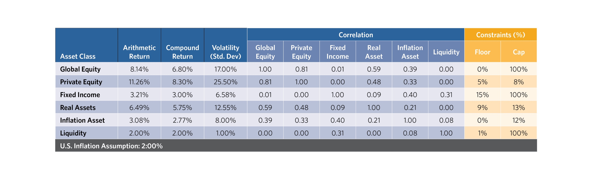
2017 Capital Market Assumptions

