Slide 1
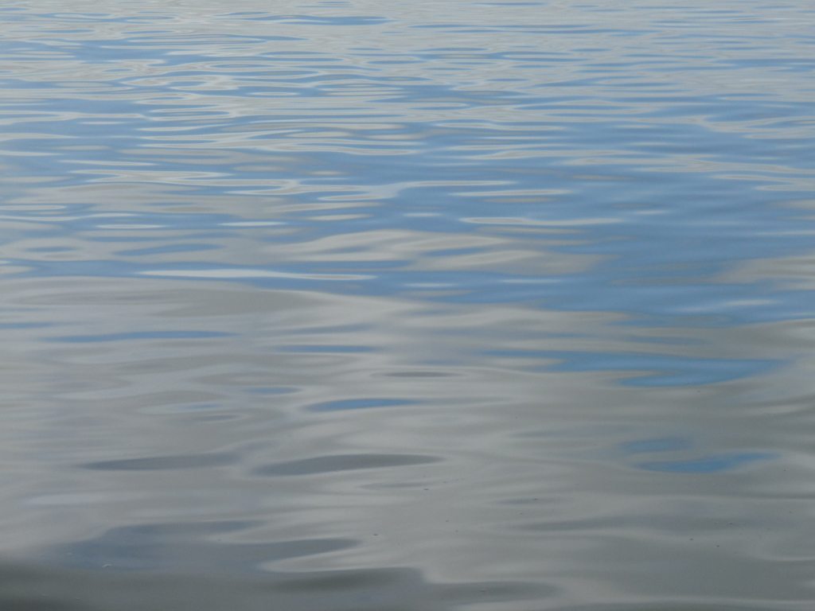
HUMBOLDT BAY SEA LEVEL RISE ADAPTATION PLANNING PROJECT: A State and Local Collaboration
Aldaron Laird
Sea Level Rise Planner

Slide 2
HUMBOLDT BAY Shoreline Inventory, Mapping, and Sea Level Rise Vulnerability Assessment
Tuluwat Wiyot World Renewal Site, 2010, 1’ sea level rise

Slide 3
Shoreline Type
Artificial=75%, 77 miles
Natural=25%, 26 miles

Slide 4
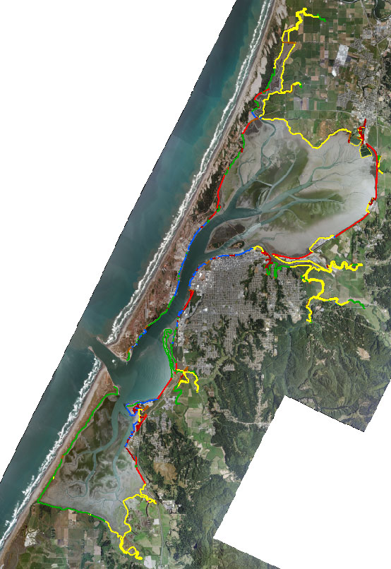
Shoreline Structure
Dike = 53%, 41 miles
Railroad = 14 %, 11 miles

Slide 5
Shoreline Cover
Exposed = 9 miles
Vegetated = 65 miles
Fortified = 27 miles

Slide 6
King High Tide and Storm Surge New Years Eve 2005 Arcata Bay
1.7’ sea level rise, 2005

Slide 7
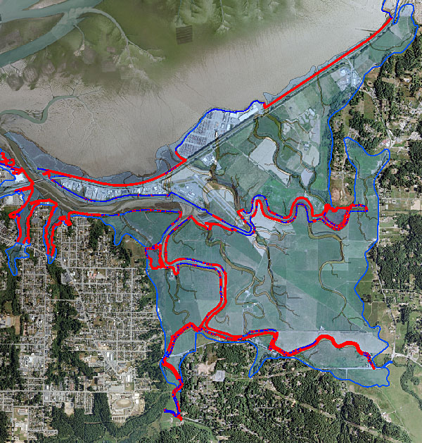
Diked Shoreline 2.0’ SLR vs. 3.0’ SLR

Slide 8
Diked Shoreline Overtopping (miles)
Sea Level Rise
0’, 1’, 2’, 3’, & 6’

Slide 9
3.0’ Sea Level Rise

Slide 10
HUMBOLDT BAY SEA LEVEL RISE ADAPTATION PLANNING PROJECT
Purpose: Support informed decision-making and encourage a unified, consistent regional adaptation strategy to address the hazards associated with sea level rise in the Humboldt Bay region.
Partners:
Humboldt County
Cities of Eureka and Arcata
Humboldt Bay Harbor District
North District Coastal Commission

Slide 11
WHY COLLABORATE
Coastal Hazards and Sea Level Rise Do Not Recognize Political Boundaries

Slide 12
Basic Adaptation Planning Strategy
We Cannot Manage or Protect the Shoreline Parcel by Parcel, We Need to Address Entire Hydrologic Units

Slide 13
WHY COLLABORATE
Sea Level Rise Adaption Planning Will Require Integration of Coastal Commission Development Permit and Local Coastal Program: Policies and Standards.
Complimentary and Overlapping Jurisdictions.

Slide 14
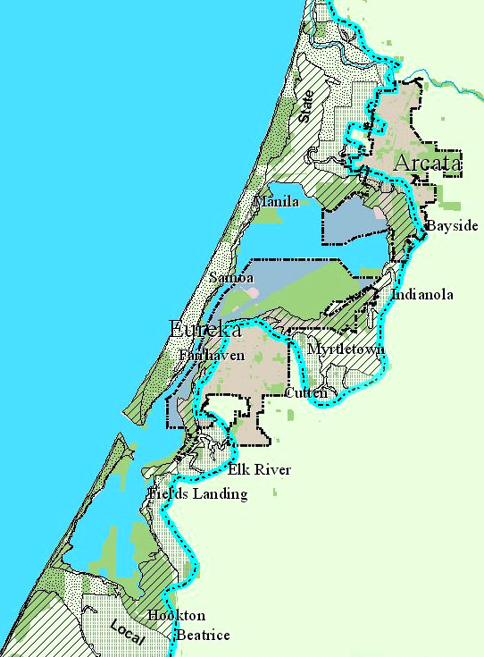
Mosaic of Permitting and Planning Jurisdictions
Coastal Commission: Retained and Federal
Humboldt County
City of Eureka
City of Arcata

Slide 15
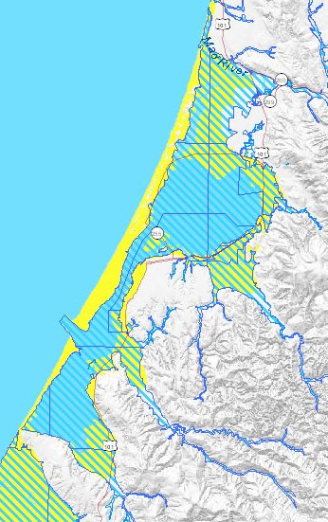
Affected Planning Areas Coastal Hazards vs. Sea Level Rise
Tsunami & Flood Zones
6 foot Inundation
3.0 meters
6.0 meters
2.0 meters

Slide 16
Sea Level Rise Adaptation Planning Process
PREPARE VULNERABILITY ASSESSMENT
IMPLEMENT STRATEGIES
DEVELOP ADAPTATION STRATEGIES

Slide 17
SCOPE
Identify Climate Change Exposures
Describe Existing Conditions
Identify Vulnerabilities
Identify Assets at Risk
Analyze Risks/Impacts
Evaluate Adaptive Capacity
PLAN
Prioritize Adaptation Needs
Identify Adaptation Strategies
Prioritize Adaptation Strategies
Integrate Adaptation Strategies & LCP/HMP
ASSESS
Identify Impacts
Adopt Adaptation Planning Process
Assemble Planning Group

Slide 18
Coastal Commission Strategic Plan Climate Change Goal & Objective
Address Climate Change through LCP Planning, Coastal Permitting, Inter-Agency Collaboration, and Public Education
Develop Planning and Permitting Policy Guidance [Document] for Addressing the Effects of Climate Change on Coastal Resources

Slide 19
Coastal Planning & Permitting
Planning: Land Use Policies & Standards
Local Coastal Programs : County & Cities
Permitting: Regulatory Policies & Standards
Retained Jurisdiction Areas: Commission- Chapter 3 Policies; Coastal Development Permit
Federal Lands/Actions: Commission- Chapter 3 Policies; Consistency Determination
Local Coastal Programs: County & Cities- LCP Policies; Coastal Development Permit

Slide 20
ADAPTATION PLANNING STRATEGIES
Integrate Adaptation Plan with Local Hazard Mitigation Plans
ADAPTION REGULATORY STRATEGIES
Incorporate Adaptation Standards in Coastal Development Permits and Consistency Determinations
Protect [TDR & CE] Future Coastal Habitat Areas
Managed Retreat
Protect [TDR & CE] Undeveloped and Vulnerable Shorelines
Integrate Adaptation Plans within Hydrologic Units
Incorporate Adaptation Plans with Local Coastal Programs
Fortify-Elevate Shoreline

