Slide 1
Opportunities to Address Homelessness in California Danielle Wildkress, CSH

Slide 2
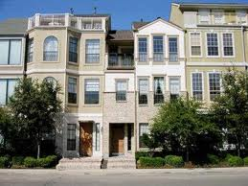
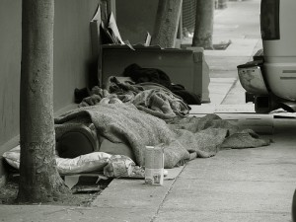
1980s

Slide 3
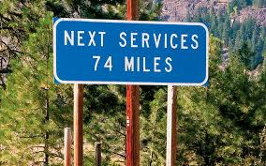
Initial response to homelessness
Ad hoc responses, often by faith-based and community groups, aimed at meeting basic needs
Efforts are volunteer-driven and disjointed
1987—Congress passes the McKinney-Vento Act

Slide 4
Continuum of Care: old definition
How a homeless person moved through programs
System emphasized “housing readiness”
Barriers to permanent housing: sobriety requirements, excluded people with history of incarceration
Streets
Transitional Housing
Permanent Housing
Emergency Housing

Slide 5
Housing First: the 1990’s to today
Emphasizes rapid access to permanent housing
Support services focused on housing stability
No “housing readiness” standards or other barriers to housing
Embraced by the Bush Administration as part of their commitment to end chronic homelessness
Homeless Emergency Assistance & Rapid Transition to Housing Act (HEARTH Act) (2009), emphasized housing first
Immediate access to housing
Housing is the platform for stabilization.

Slide 6
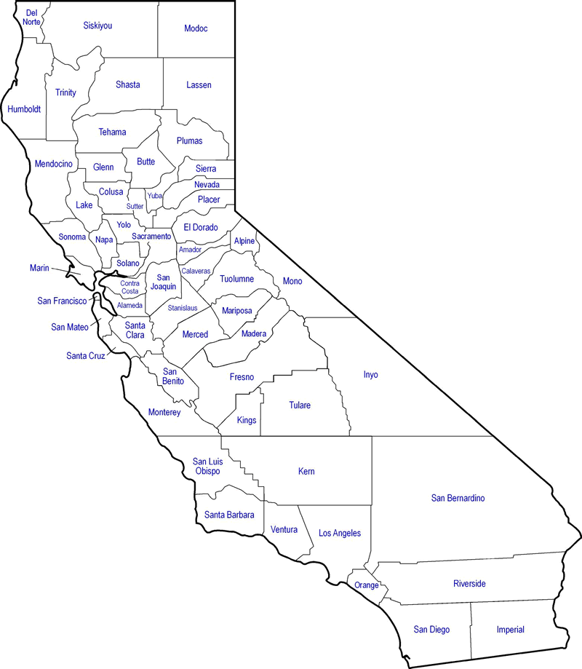
Homelessness in California
1,180
115,738 on a single night
(about 250,000 in one year)
21% of nation’s homeless,
1/3 with mental illness
12,789 children are homeless,
898 unaccompanied
36% of nation’s
chronically
homeless
136
138
591
571
947
796
315
716
498
269
3,097
293
2,659
1,318
1,082
430
2,031
1,708
6,775
1,483
4,040
1,408
53
1,964
6,556
898
862
2,959
1,722
1,515
954
1,729
2,149
1,417
44,359
4,452
2,372
554
8,742
Notes:
Homelessness decreasing nationwide, while increasing in California, coinciding with decreased funding for housing Matt discussed, and federal funding cuts for rental assistance programs.
Greatest driver is increase in rental housing costs and stagnation in incomes

Slide 7
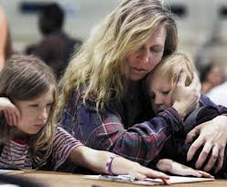
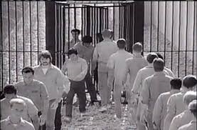
Impact of Homelessness on Californians with Behavioral Health Disorders
1/3 of children in foster care cannot be reunified with birth parents because parents lack a home.
Each homeless person costs Medi-Cal over $21,500 a year. Those with SUD average over $60,000.
Homeless parolees/ probationers are 7 times more likely to recidivate.
Notes:
Homelessness has significant impact at local, state, and federal levels

Slide 8
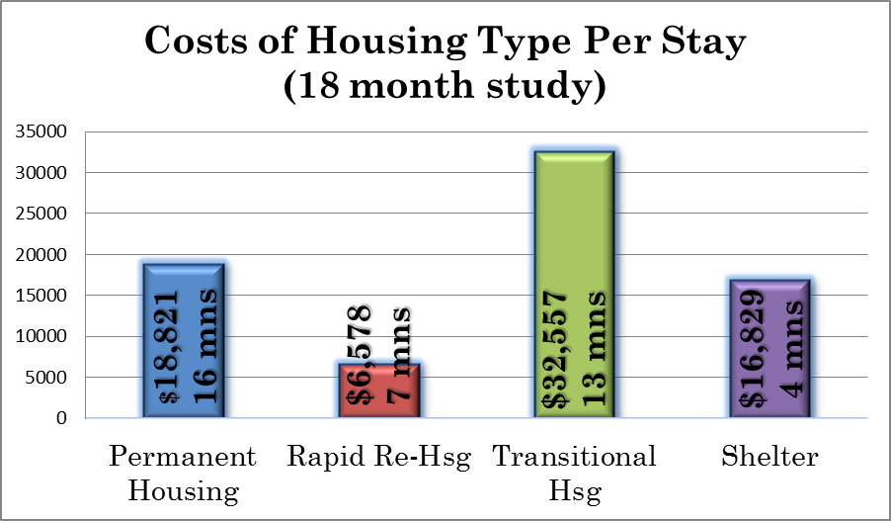
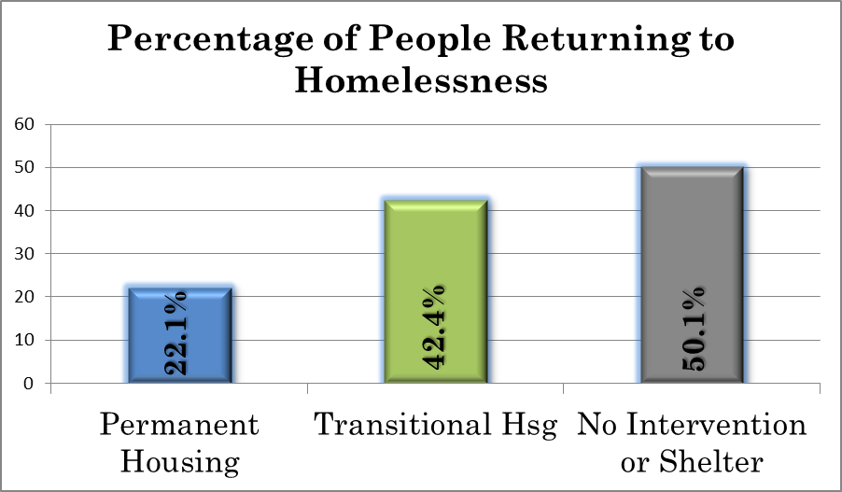
Effectiveness of Housing Interventions
Data Source: HUD Family Options Study

Slide 9
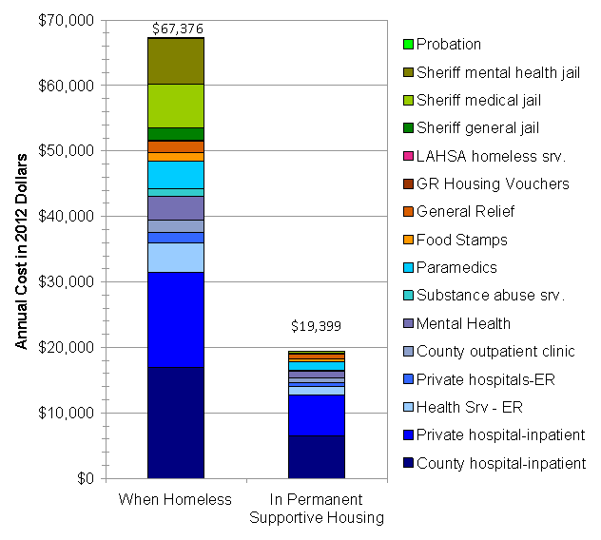
Cost-Effectiveness of Supportive Housing
Estimated annual
public cost per
10th decile patient:
$67,376 when homeless
v.
$19,399 when in PSH

Slide 10
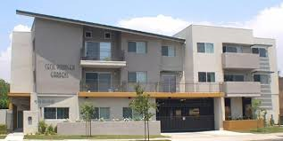
Community Responses: Get People Housed, Coordinate Resources
Assess Housing Needs, Coordinate Existing Resources
No Wrong Door: Any Entry Point
Available Permanent Housing
Linked to Services
Notes:
Communities are housing thousands of homeless people each year, but the inflow of people falling into homelessness is greater than people communities can house on their own, without State help
States successful in significantly reducing homelessness is partnership between state and local government in a coordinated response

Slide 11
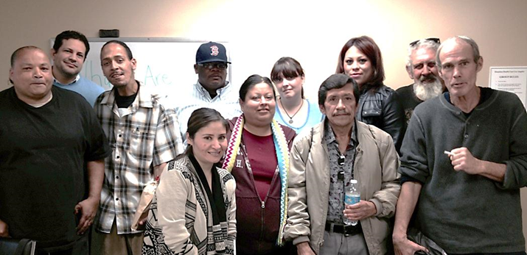
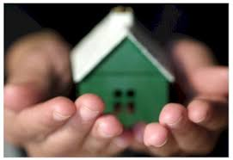
Funding Required for Rapid Re-Housing & Supportive Housing: Capital, Operating, Servs.
Search assistance
Capital to build
Services to outreach, engage, build housing stability
Rental assistance to operate
Landlord incentives
Notes:
Immediate responses: rental assistance, services, landlord incentives
With incredibly low vacancy rates, most communities need long-term investment—capital to build

Slide 12
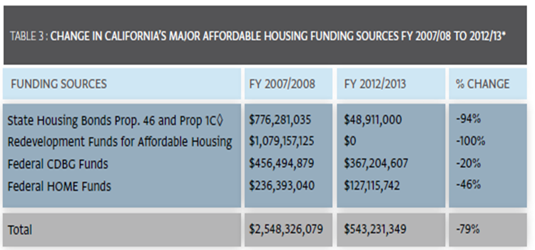
Available Funding for Capital to Build

Slide 13
Contact
Danielle Wildkress
Danielle.Wildkress@csh.org
213.623.4342 ext 20

