Slide 1
County of Los Angeles
City of Los Angeles
Homeless Strategies
Presentation to the Joint CSAC/LCC Homelessness Task Force
November 28, 2016

Slide 2
Government Collaboration
Homelessness is a regional, cross jurisdictional issue
The solution requires the State, County, Cities and partners to commit to action

Slide 3
Greater Los Angeles Homeless Count
Total Homeless Population
(includes Glendale, Long Beach and Pasadena)
Total Homeless Population -
Sheltered and Unsheltered
39,461
Data provided by Los Angeles Homeless Services Authority

Slide 4
Homeless Housing Gap
Total Gap (Units)*
LA City | Balance of County
9,894 | 5,447
3,434 | 4,945
552 | 2,129
1,230 | 1,325
Housing Type
Description
Permanent Supportive Housing
Provides intensive support services to chronically homeless persons
Rapid Re-Housing
Provides short-term housing assistance. Each unit can potentially house 2 households per year
Provides crisis housing to unsheltered persons on the path to permanent housing
Emergency Shelter
Provides stabilizing housing assistance that keeps people and families from falling out of housing and into the homeless system
Homeless Prevention
$450 million per year* needed to fill the homeless housing gap (not counting construction costs)
*Homeless Housing Gaps in the County of Los Angeles, Los Angeles Homeless Services Authority, January 2016

Slide 5
Los Angeles Homeless Services Authority
The Los Angeles Homeless Services Authority (LAHSA) is a Joint Powers Authority formed by the City and County of Los Angeles
LAHSA administers the HUD Continuum of Care on behalf of the County, the City of Los Angeles and 84 other Cities in the County
Most City and County homeless shelter and emergency services programs are funded through LAHSA

Slide 6
Los Angeles County
Homeless Initiative
Launched in August 2015
Seizing the moment: Historic opportunity to combat homelessness throughout Los Angeles County
Initial Goal: Develop a comprehensive set of recommended County strategies to combat homelessness, including strategies in which cities can participate
Inclusive and collaborative planning process – 25 County departments, 30 cities, over 100 community organizations

Slide 7
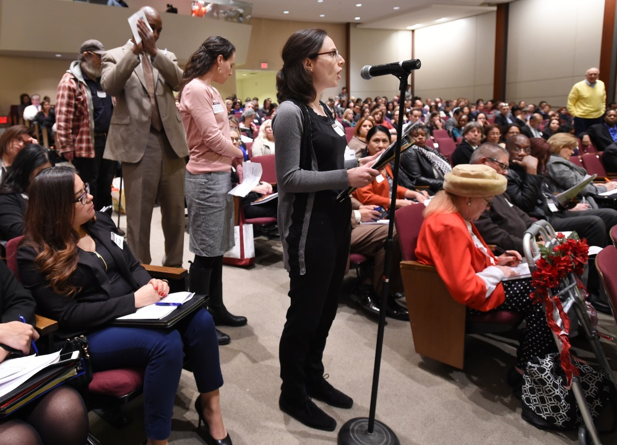
County Community Engagement

Slide 8
City of Los Angeles Strategy Process
City Council created the standing Homelessness and Poverty Committee to focus on homelessness
The Committee
Held public meetings on specific topics related to homelessness
Instructed Staff to prepare a strategy for Council and Mayor consideration
City of Los Angeles participated actively in the 18 policy summits convened by the County
Strategies were developed through interdepartmental collaboration

Slide 9
Approved Strategies
(Approved by the Board of Supervisors and LA City Council on 2/9/2016)
County | City
47 strategies in six areas: Prevent Homelessness Subsidize Housing Increase Income Provide Case Management and Services Create a Coordinated System Increase Affordable/Homeless Housing | 64 Strategies in 9 areas: No Wrong Door Coordinated Entry System Governance Facilities Housing Land Use Additional Strategies Budget

Slide 10
City/County Shared Strategies
County and City commitments to the same or complementary efforts
Shared Strategies in a number of categories:
Prevention
Employment
Land Use
Coordinated Entry System (CES)
Housing

Slide 11
Coordinated Entry System
City and Count Jointly supporting (through LAHSA)
Strengthened technology, staffing and standardization
Increased support for case managers
Strengthened data sharing and tracking
Regional service coordination
Regional Homelessness Advisory Council

Slide 12
Housing: Immediate needs
County and City jointly supporting:
Rapid Rehousing
Winter Shelter
Increase year-round emergency shelter capacity
More shelter beds
24 hour shelter operations
Bridge Housing
Rental assistance for permanent supportive housing
Alignment of homeless rental subsidy programs

Slide 13
Housing: Long-Term Solution
County
City
Supportive Services for Permanent Supportive Housing
Affordable and Permanent Supportive Housing Construction
Use of HUD subsidies for PSH
Potential linkage Fee
Second Dwelling Units
Commitment to fund new permanent supportive housing construction
Ongoing Affordable Housing Construction
Long-term rental subsidies
Linkage Fee proposal under consideration
Second Dwelling Units
City and County intend to ensure permanent supportive housing is developed with essential support services and rental assistance

Slide 14
Other Key County Strategies
SSI and veterans benefits advocacy
Leveraging Affordable Care Act opportunities
Subsidized employment for CalWORKs homeless families
Bridge housing for those exiting institutions/ jail in-reach/discharge planning guidelines
Increase Employment for Homeless Adults by Supporting Social Enterprise

Slide 15
Other Key City Strategies
Diversion –
Interdisciplinary Homeless Outreach Partnership Endeavor Teams
Facilities
Storage
Safe Parking
Mobile Showers
Land Use – Ordinances in development to streamline the development process for permanent supportive housing
Created Homeless Strategy Committee
Hired Homeless Coordinator

Slide 16
Opportunities & Challenges
Newly approved City $1.2 billion bond for supportive and affordable housing
Proposed County ballot measure to raise $355 million annually to combat homelessness
Need strategies and tools to gain community support for new homeless service and housing locations
Work with State to develop legislation to facilitate funding for services and housing development

Slide 17
Contact Us
County Homeless Initiative
LA City Homeless Coordinator
Kenneth Hahn Hall of Administration County of Los Angeles
500 West Temple Street, Room 493 Los Angeles, CA 90012
(213) 974 - 2326 homelessinitiative@lacounty.gov
Meg Barclay
City Homeless Coordinator
Office of the City Administrative Officer
200 N. Main Street Room 1500
Los Angeles, CA 90012-4190
(213) 978-1681
meg.barclay@lacity.org

