Slide 1
Covered California Overview
David Panush
Director, Government Relations
Covered California
November 28, 2012
CSAC Annual Meeting

Slide 2
Covered California Governance Independent Public Entity with Qualified Board
Board Members:
Diana Dooley, Board Chair and Secretary of the California Health and Human Services Agency, which provides a range of health care services, social services, mental health services, alcohol and drug treatment services, income assistance and public health services to Californians
Kim Belshé, Senior Policy Advisor of the Public Policy Institute of California, former Secretary of California Health and Human Services Agency, and former Director of the California Department of Health Services
Paul Fearer, Senior Executive Vice President and Director of Human Resources of UnionBanCalCorporation and its primary subsidiary, Union Bank N.A., Board Chair of Pacific Business Group on Health, and former board chair of Pacific Health Advantage
Robert Ross, M.D., President and Chief Executive Officer of The California Endowment, previous director of the San Diego County Health and Human Services Agency from 1993 to 2000, and previous Commissioner of Public Health for the City of Philadelphia from 1990 to 1993
Susan Kennedy, Nationally-recognized policy consultant, former Deputy Chief of Staff and Cabinet Secretary to Governor Gray Davis, former Chief of Staff to Governor Arnold Schwarzenegger, former Communications Director for U.S. Senator Dianne Feinstein, and former Executive Director of the California Democratic Party

Slide 3
Vision & Mission
Vision
The vision of Covered California is to improve the health of all Californians by assuring their access to affordable, high quality care.
Mission
The mission of the Covered California is to increase the number of insured Californians, improve health care quality, lower costs, and reduce health disparities through an innovative, competitive marketplace that empowers consumers to choose the health plan and providers that give them the best value.

Slide 4
Key Dates
October 1, 2013
Pre Enrollment begins
January 1, 2014
Coverage begins
January 1, 2015 Federal funding ends

Slide 5
Major Activities 2013 - 2014
Qualified Health Plans (QHPs). Evaluate, select, certify and contract with QHP issuers to provide coverage through the individual and SHOP exchanges.
Marketing, Outreach, Education. Refine and implement marketing, outreach, and public education program leading to the first open enrollment period in 2013 and 2014.
California Health Eligibility, Enrollment & Retention System (CalHEERS). Refine, test and bring online.
Small Business Health Options Program (SHOP). Establish to serve small employers and their employees.
Notes:
.

Slide 6
Subsidies Available to help with Cost
A “sliding scale” subsidy will be provided based on income for individuals and families earning between 138 and 400 percent of the federal poverty level. The size of the subsidy depends on both the income and family size of eligible individuals.
The table below illustrates the tax credit subsidy for a family of four at several income levels.
Assumes: 2014 projected income of a 45 year-old policyholder and the family buys a plan that has a 70 percent actuarial value (the policyholder would be responsible for 30 percent of all covered benefits, the health insurer would be responsible for the remaining 70 percent). Does not include cost-sharing which is also available.
Percent of FPL | Annual Income | Unsubsidized Annual Premium | Annual Tax Credit | Annual Premium after Tax Credit | Unsubsidized Monthly Premium | Monthly Premium Credit | Monthly Premium after Credit
150% | $35,137 | $14,245 | $12,840 | $1,405 | $1,187 | $1,070 | $117
200% | $46,850 | $14,245 | $11,294 | $2,952 | $1,187 | $941 | $246
300% | $70,275 | $14,245 | $7,569 | $6,676 | $1,187 | $631 | $556
399% | $93,700 | $14,245 | $5,344 | $8,901 | $1,187 | $445 | $742

Slide 7
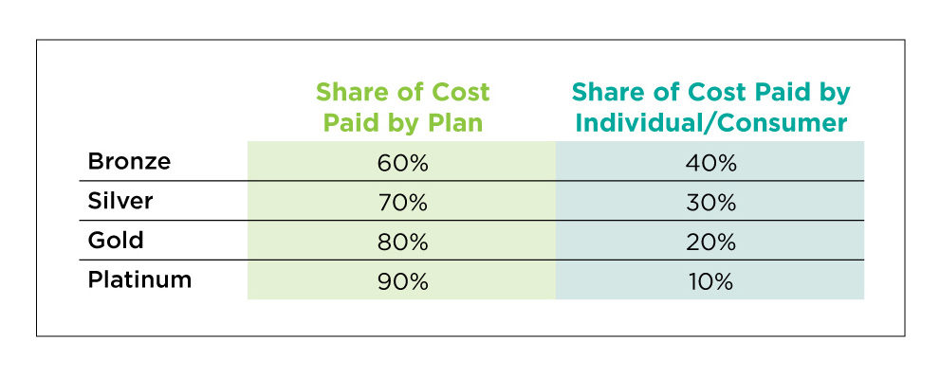
Metal Tiers by Share of Cost

Slide 8
Covered California’s Primary Targets
The primary target of marketing and outreach efforts of Covered California are the more than 5.3 million California residents as of 2014:
2.6 million who qualify for subsidies in Covered California; and
2.7 million who do not qualify for subsidies but now benefit from guaranteed coverage and can enroll inside or outside of Covered California.
There are an additional 2.4 million Californians who may be newly eligible for Medi-Cal.

Slide 9
Covered California’s Annual Enrollment Goals
By 2015:
Enrollment of 1.4 million Californians in subsidized coverage in Covered California or enrolling in the marketplace without subsidies
By 2016:
Enrollment of 1.9 million Californians in subsidized coverage in Covered California or enrolling in the marketplace without subsidies
By 2017:
Enrollment of 2.3 million Californians in subsidized coverage in the marketplace or enrolling in the marketplace without subsidies

Slide 10
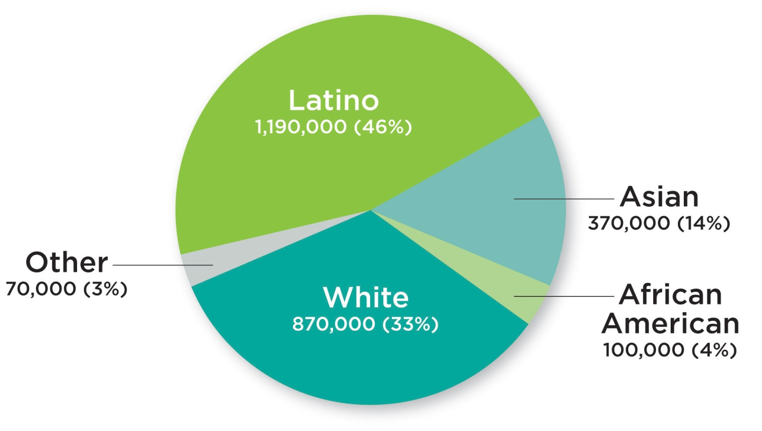
Ethnic Mix of Exchange Subsidy Eligible Californians

Slide 11
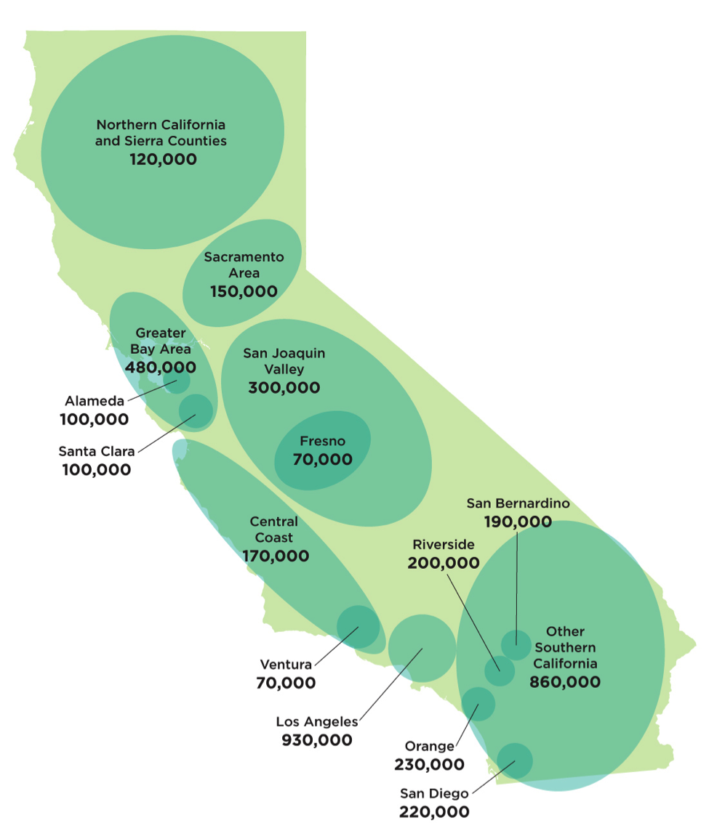
California’s Uninsured Population is Spread Throughout the State
California’s expanse, diverse geography and mix of rural and urban areas are unique and present outreach challenges.

Slide 12
Typical Individual Consumer Process
Two Primary Access Channels: CalHEERS Consumer Portal and Service Center
Set up account
Identify household members (mother, father, child)
Request consideration for health subsidy
Enter income and other required information (both parents working)
Income information is verified on Federal Data Services Hub
Result: Household qualifies for subsidy (advanced premium tax credit)
Confirm which family members are enrolling in health insurance
Compare and select health plans
Enroll each household member into the selected health plan(s)
Follow-up Processing
CalHEERS sends information to carrier(s) for fulfillment
CalHEERS generates notice to members
Carriers contact members for premium payment
Members pay premium to carriers
Carriers send out ID cards and enrollment fulfillment kits to members
Members can begin accessing health care network after insurance effective date

Slide 13
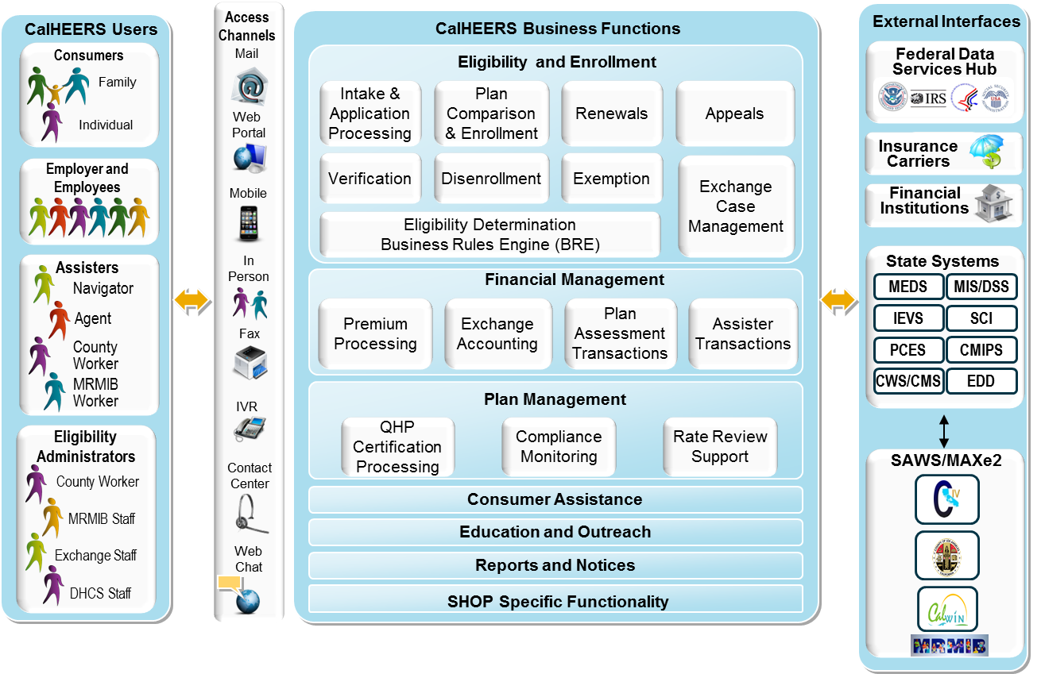
CalHEERS Business Function Overview

Slide 14
CalHEERS Releases

Slide 15
Outreach and Marketing
Maximize the enrollment of uninsured Californians:
Provide a one-stop marketplace for affordable, quality health care options and health insurance information
Educate Californians to understand the benefits of coverage
Encourage insured Californians to retain their coverage
Ensure the availability of affordable health insurance coverage for all eligible Californians
Ultimately, the goal is to have every eligible Californian get health insurance coverage

Slide 16
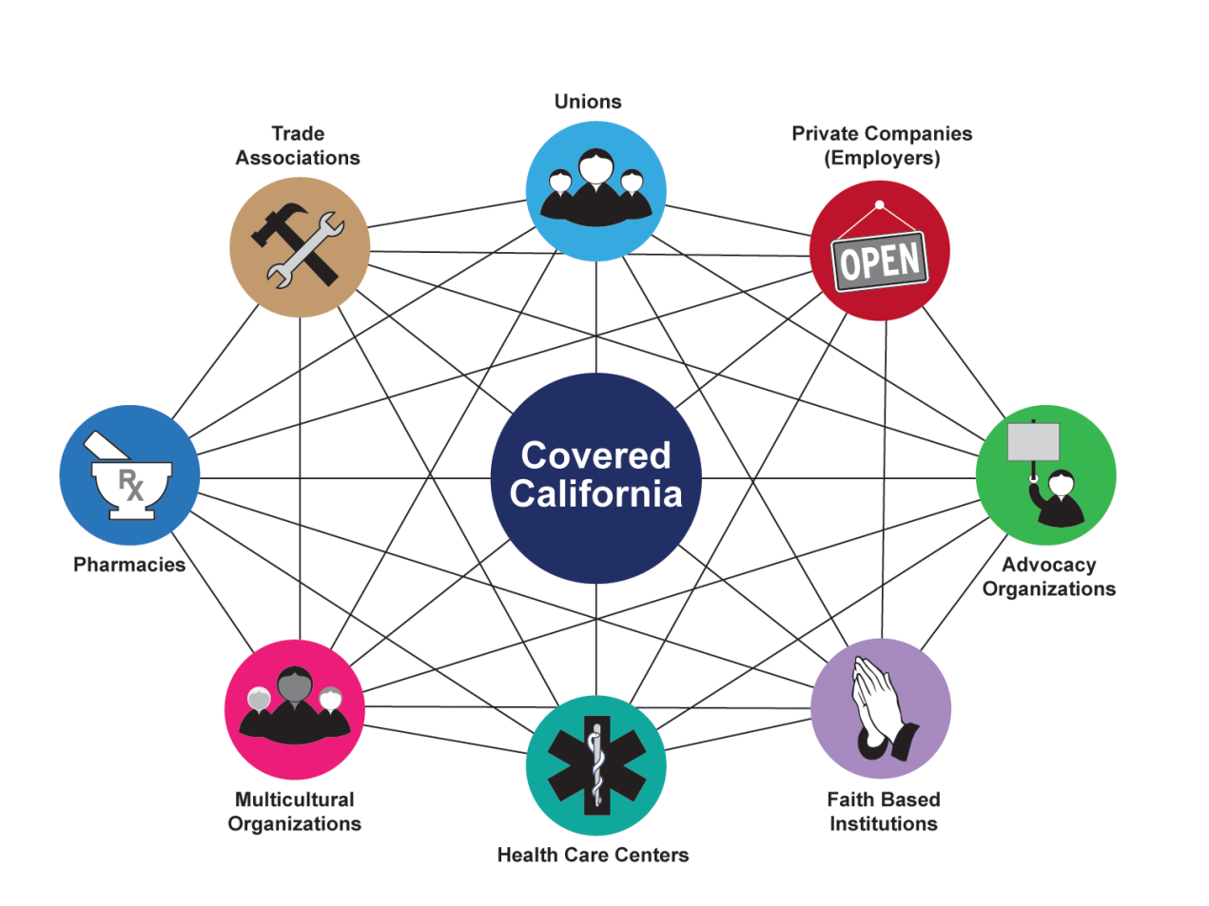
Community Mobilization
Providing a stakeholder engagement framework for our Community Based grants and In-person Assisters program to reach strategic points of entry where people “live, work, shop, and play.”

Slide 17
Community Mobilization
Extending paid media through grassroots public relations, media relations and community outreach.
Community-based grants program, funded at $43M over 2013-2014
Mobilizing and Educating key influencers
Launching key milestone events
Establishing market driven partnerships
Managing educational outreach and enrollment

Slide 18
In-person Assistance & Navigator Programs
Assistance delivered through trusted and known channels will be critical to building a culture of coverage to ensure as many consumers as possible enroll in and retain affordable health insurance.
The need for assistance will be high during the early years, with some estimates ranging from 50% to 75% of applicants needing assistance to enroll.
The in-person assisters and navigators will be trained, certified and registered with the Exchange in order to enroll consumers in Covered California products and programs.
Notes:
.

Slide 19
Paid Media
Paid media is designed to reach broad and targeted audiences in urban and rural markets across the state.
Will target all multicultural channels and allow messages in 13 threshold languages.
Paid media has a “halo” effect on all aspects of the outreach and education program, improving performance in those areas.

Slide 20
Customer Service Center
The Service Center will respond to general inquiries, provide assistance with enrollment, support retention and help those who enroll in Covered California
Estimate 850 staff for the period from initial implementation in 2013 through December 31, 2014
A significant share of staff will be hired as permanent intermittent staff to accommodate fluctuations in demand between open enrollment periods and other times of the year
Current plans call for staff to be located in 3 separate facilities:
The main facility will be in Sacramento
A secondary facility targeted for southern/central California
A third facility will be located at a County-based site
Notes:
.

Slide 21
Small Business Health Options Program
California is creating a separate exchange to serve small businesses and their employees, the Small Business Health Options Program (SHOP).
The Exchange has undertaken a solicitation for a qualified vendor to administer the California SHOP and support its business functions.

Slide 22
For More Information:
Visit our website at
http://www.hbex.ca.gov
And join our listserv

