Slide 1
California’s Fiscal Outlook
Legislative Analyst’s Office
www.lao.ca.gov

Slide 2
Basics of the State’s Budget
Revenues:
Big Three – personal income tax, sales tax, and corporate tax
Expenditures:
About half of General Fund spending is for education
Majority of other half is for health and human services and corrections

Slide 3
Our Forecast
Estimate revenues and expenditures for 6 years and subtract
Estimates based on current law and current policy
Economic Assumptions:
Current economic recovery continues
Housing market will return to historical norms

Slide 5
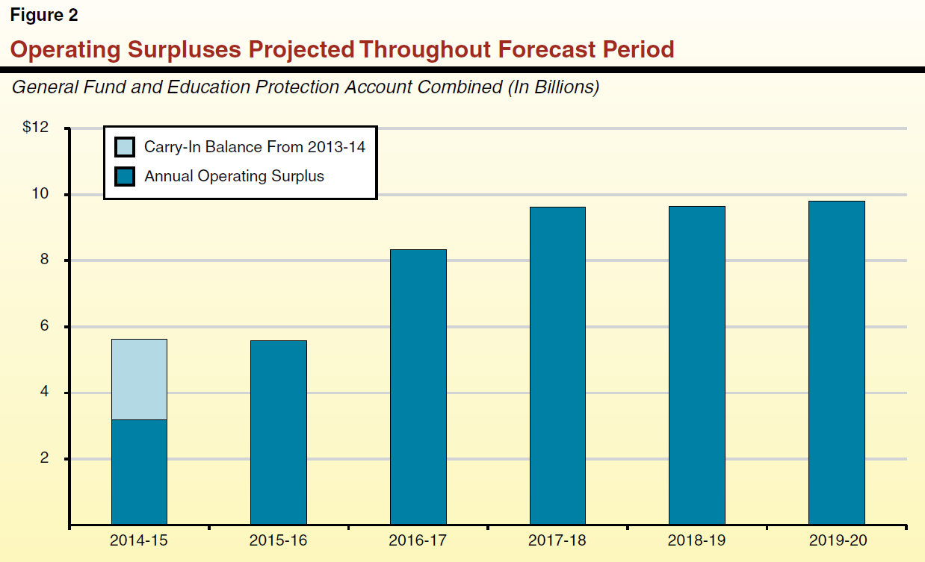

Slide 14
Contact
Brian Uhler, Local Government Finance Analyst, LAO
Brian.Uhler@lao.ca.gov

