Slide 1
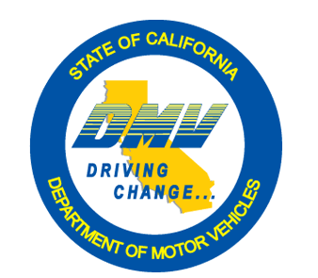
Autonomous Vehicles in California
November 27, 2018
Miguel Acosta
Chief, Autonomous Vehicles Branch
California Department of Motor Vehicles

Slide 2
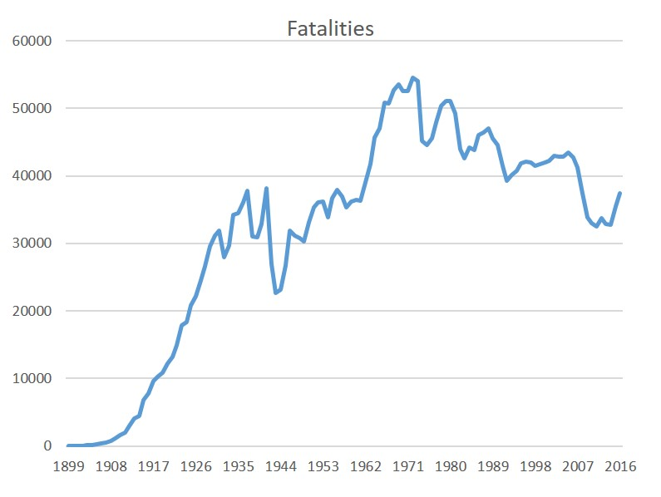
Why Autonomous Vehicles?
Safety
  37,133 people killed in crashes on U.S. roadways (2017)
    30% of fatalities attributed to alcohol-impaired driving
    10% because of distracted driving
    27% due to speeding-related crashes
    18% were non-occupants (pedestrians, cyclists, etc.)
  Estimated that 94% of fatalities due to human choice
  ~7K injured per day
Mobility
Efficiency (Time, resources, traffic flow, land use, etc.)
Source: NHTSA National Center for Statistics and Analysis
Notes:
There are many potential benefits for Automated Driving Systems. 2017 Stats- 37,133
According to the NHTSA, the major factor in 94% of all fatal crashes are a result of driving related factors- impaired driving, distraction, speeding, illegal maneuvers.
Automated Driving systems have the potential to reduce highway fatalities.
Mobility- potential for elderly driver or those with disabilities can gain greater access to transportation. An estimated 25.5 million Americans have disabilities, which make travelling outside the home difficult. US DOT 2017 National Household Travel Survey- 70% of respondents with travel limiting disabilities reduce their day-day travel.
Efficiency – 2017 National Household Travel Survey- US DOT, Americans take over 220 billion vehicle trips per year- approx. 20% of those trips were for shopping with another 23% for other errands.

Slide 3
Important Distinction
The federal government, through the National Highway Traffic Safety Administration (NHTSA), is responsible for ensuring the safety of vehicles.
State governments, in contrast, are responsible for ensuring the safe operation of vehicles on public roads.

Slide 4
Source: NHTSA Automated Driving Systems 2.0: A Vision For Safety
Notes:
Autonomous vehicles specifically exclude vehicles that are “merely” equipped with collision avoidance systems (e.g., blind spot assistance, emergency braking, park assist, adaptive cruise control, lane keep assist, lane departure warning, and traffic jam and queuing assist) that together or in combination cannot perform the dynamic driving task on a sustained basis without the control or active monitoring of a natural person.
Level 1 and 2 are on the roadways now- Tesla autopilot is considered a level 2. In level 2, the driver still needs to have hands on the wheel. These are not covered by DMV regulations- only level 3 and above.
Level 3 and 4 are limited in some way- the operational domain, speed, city/rural, time of day, weather, geofencing). Level 3 vehicles are being tested on California Roadways.
Level 5 is fully autonomous

Slide 5


California Vehicle Code
VC Section 38750:
  Defines key terms
  Develops regulations for the testing and operation of autonomous vehicles on public roadways
  Outlines requirements the department concludes are necessary to ensure the safe operation of autonomous vehicles.
Notes:
In 2012, SB 1298 added Division 16.6. Autonomous Vehicles (starting with Section 38750) to the Vehicle Code.
Legislative Intent-
Establishment of specific safety requirements for testing and operation of autonomous vehicles.
SB 1298--
Department of Motor Vehicles must adopt regulations setting forth requirements for:
Manufacturers’ testing of autonomous vehicles on public roadways
Operation of autonomous vehicles on public roadways
Codified in Vehicle Code § 38750
Responsibility to ensure the safe operation

Slide 6
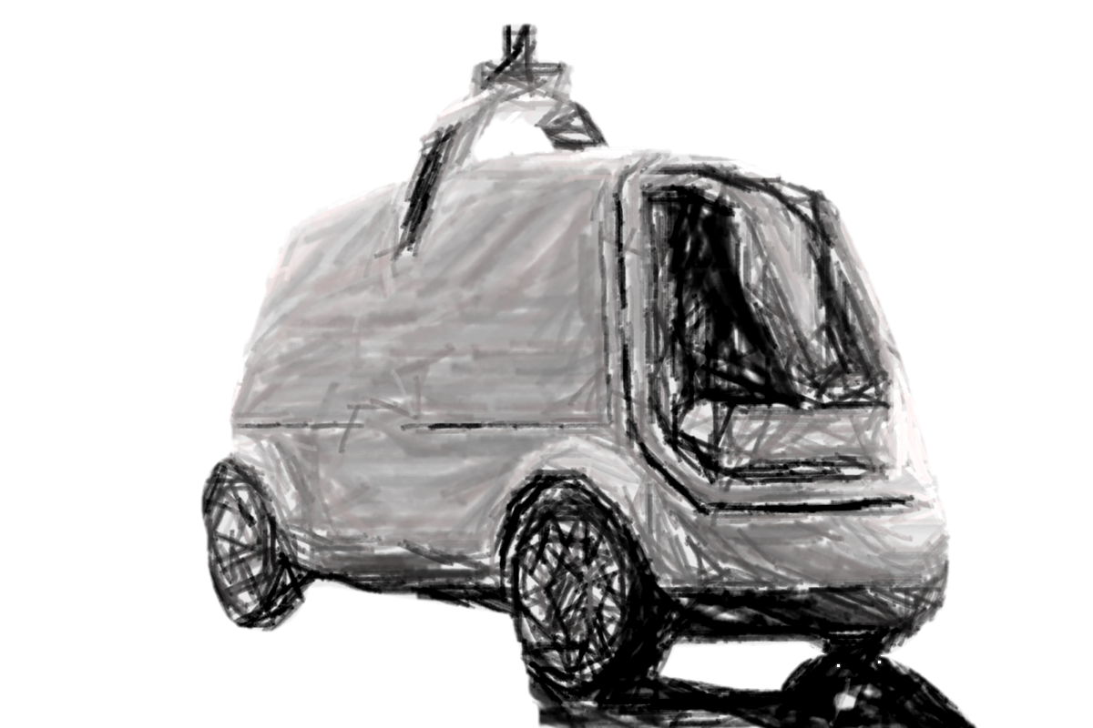
California’s Definition of Autonomous Vehicle
“Autonomous technology”: technology that has the capability to drive a vehicle without the active physical control or monitoring by a human operator.
“Autonomous vehicle”: any vehicle equipped with autonomous technology that has been integrated into that vehicle.
Notes:
Autonomous mode- where technology (combo of hardware/software, remote and/or on-board), performs the DYNAMIC DRIVING TASK with or without a person actively supervising the performance of the DYNAMIC DRIVING TASK.
DYNAMIC DRIVING TASK- All the real time functions required to operate a vehicle in on-road traffic…object/event detection, recognition, maneuvering, steering, lane keeping/lane changing

Slide 7
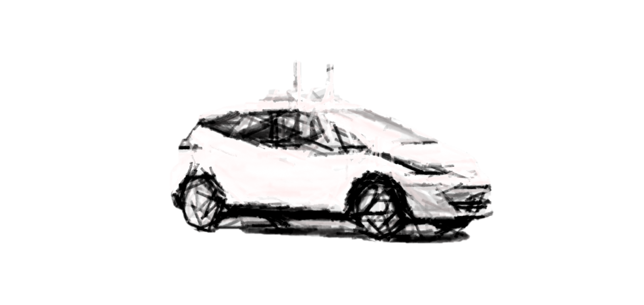
A (Very) Brief History of California AV Regulation
September 25,2012: Senate Bill 1298 authorizes the DMV to adopt regulations for the operation of autonomous vehicles in California.
September 16, 2014: First set of regulations governing how manufacturers could test autonomous vehicles (with a driver) on California roads went into effect.
April 2, 2018: DMV can begin approving applications for autonomous vehicle testing without a driver and deployment (public use).

Slide 8
Title 13, Division 1, Chapter 1 Article 3.7 – Testing of Autonomous Vehicles
Testing with a driver
Testing without a driver
Deployment (public use)

Slide 9
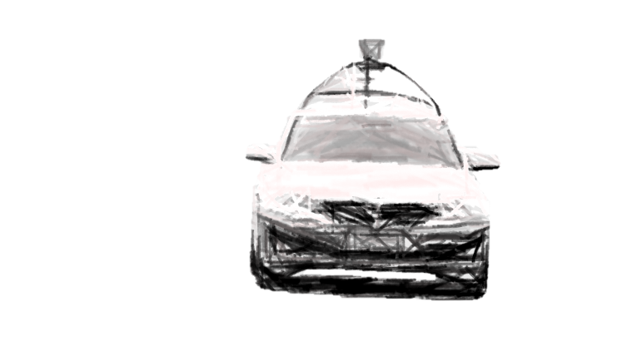
Regulations Summary: Testing with a Driver
$5 million in insurance, bond, or self-insurance
Test driver requirements:
  No DUI, not an at-fault driver, and no more than 1 point
  Successful completion of test driver training program
  Employee, contractor, or designee of manufacturer
Test driver must be seated in driver seat during testing
Report any accident within 10 days
Report unanticipated disengagements of autonomous technology annually
Testing permit valid for two years
Vehicles excluded from testing:
    Commercial vehicles
    > 10,000 lbs GVW
    Motorcycles
Notes:
-The manufacturer has in place the ability to respond to a judgement for damages for personal injury or property damages arising from operating an AV in the amount of $5million.
-driver training- instruction on technology/ capabilities & limitations of driving system
-no driving violations (DUI, failure to stop accident, reckless driving, vehicular manslaughter, speed contests, driving while suspended/revoked).
- Vehicles excluded: IRP vehicles, motortrucks- vehicles used for transporting property.

Slide 10
Regulations Summary: Testing Without a Driver
$5 million insurance, bond, or self-insurance
Communication link with the remote operator.
Process to display or communicate vehicle owner or operator information to a law enforcement officer.
AV complies with all FMVSS and CVC Div. 12 (Equipment of Vehicles), or NHTSA has approved an exemption.
Meets the description of level 4 or 5 automated driving system.
Law enforcement interaction plan
Remote operators + training program
Passengers that are not employees/contractors will be notified what personal information, if any, may be collected and how it will be used.
Annual report of disengagements to the DMV.
Report collision resulting in damage of property, bodily injury, or death to DMV within 10 days.
No charging of a fee or receiving other compensation for providing a ride to members of the public.
Notes:
Communication link- if the vehicle experiences any failures that would endanger the safety of the vehicles passengers or other road users, or would prevent vehicle from function as intended. Manufacturer will continuously monitor the status of the vehicle.
-LE interaction plan- how to communicate with remote operator, how to safely remove the vehicle fro the road, safely disengage autonomous mode, provide other LE and first responders in the vicinity of the operational domain a website to access the plan.

Slide 11
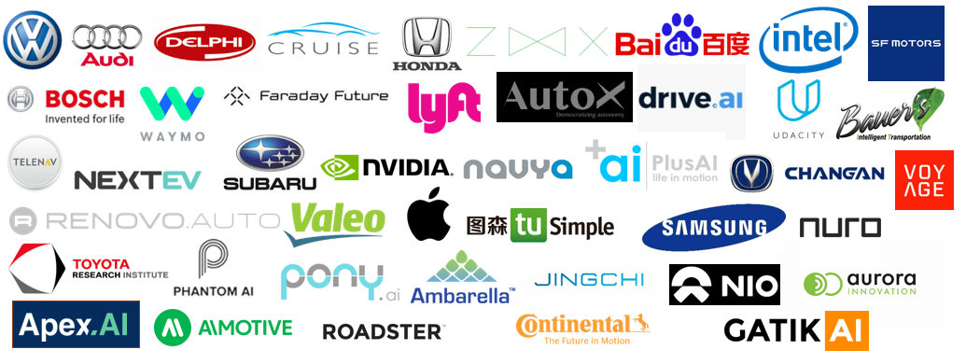
Approved Testing Permits Today (64)
Notes:
Companies vary, from original equipment manufacturers (Ford, VW, Mercedes, to tech companies like Google- Waymo, to small companies). Most are in the Bay Area, some are in southern California.

Slide 12

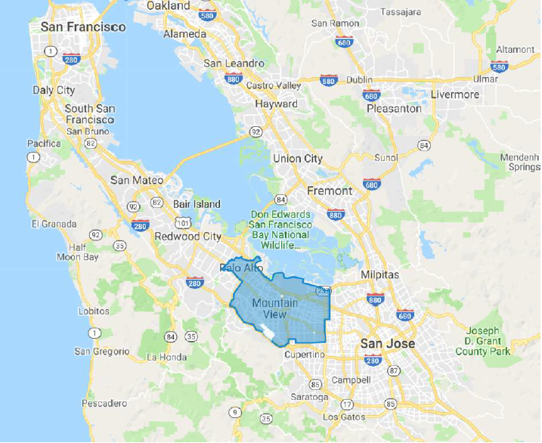
Approved Driverless Testing Permits (1)
Fleet – 39
Operational Design Domain
  Level 4 Automation
    Minimal Risk Condition
    Freeways, highways, city streets, rural roads, and parking lots
    Up to 65 mph
    Excludes heavy rain
    All times of day and night
Notes:
Companies vary, from original equipment manufacturers (Ford, VW, Mercedes, to tech companies like Google- Waymo, to small companies). Most are in the Bay Area, some are in southern California.

Slide 13
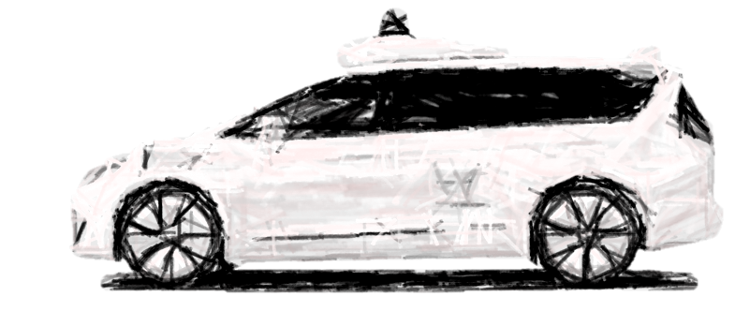
California by the Numbers
61 active permits to test with a driver
1 active permit to test without a driver
647 autonomous vehicles permitted
2117 test drivers
1.6 million+
autonomous miles driven
118 collisions
Notes:
Updated numbers- 611 vehicles 2016 safety drivers approved, Updated collisions 103
Companies with largest fleets of Avs and drivers:
GM Cruise 199 vehicles/ 556 drivers
Waymo 103vehicles/ 395 drivers
Apple 70 vehicles/ 144 drivers

Slide 14
Current state of AV testing in California: Disengagements
Manufacturers required to submit an annual report to DMV
-Circumstances or testing conditions
-Location
-Description of the facts causing the Disengagement
-Party that initiated the Disengagement (Autonomous Technology, Test Driver, Remote Operator)
2017: 2309 disengagements reported*
*these numbers do not include testing by companies that did not submit disengagement reports
Notes:
Disengagement- a Deactivation of the autonomous mode when a failure of the technology is detected or when safe operation of the vehicle requires the test driver take immediate control of the vehicle.
Companies must submit an annual report summarizing disengagements by January 1 of each year.
1st report covers the period from the date of permit issuance to November 30th of the following year..
Report also includes the total number of miles each AV were tested on the public roadways.
Disengagements important- allows DMV to monitor progress manufacturers make each year. Prevention and mitigation of these factors is in the interest of traffic safety.

Slide 15
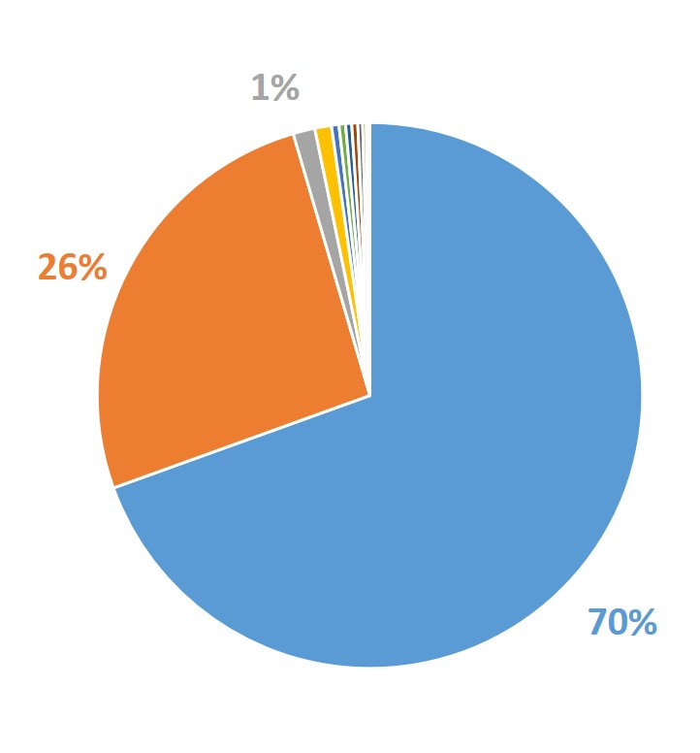
Autonomous Miles Reported- 2017
Total: 507,271 miles
Top Three in 2017:
Waymo = 352,545 miles
GM Cruise = 131,675
Drive.Ai = 6,572 miles
Notes:
Drive.Ai = 1 %
Zoox, Baidu, Telenav, Delphi, Bosch, Mercedes, Valeo, Nvidia, Nissan = 3%

Slide 16
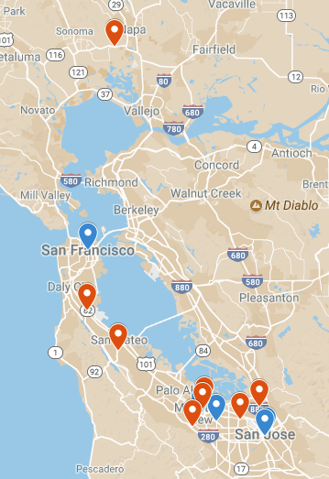
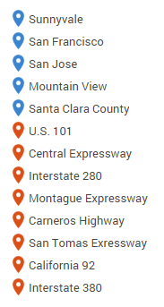
Where Disengagements Occur
Cities & Highways

Slide 17
MPD Averaged Over Entire Reporting Period
MPD Final Month of Testing
Waymo = 5,596 MPD
GM Cruise = 1,254 MPD
Nissan = 209 MPD
Waymo = 30,517 MPD
GM Cruise = 4,630 MPD
Zoox = 430 MPD
Notes:
All companies report an average of less than one second for test driver to take control of the car.
It’s hard to tell if vehicles are performing better just from observing the changes in Miles per Disengagement (MPD). A change in MPD could indicate the car is becoming better/worse at driving or it could indicate that the company has changed the testing environment. For example, one company showed patterns of increasing MPD as they tested on the highway over time, then a sudden decrease in MPD when they switched to testing on urban streets.

Slide 18
Greatest Increase in MPD over the 2017 Reporting Period
Waymo = Increase of 25,279 MPD over 12 months
GM Cruise = Increase of 4,261 MPD over 12 months
Zoox = Increase of 149 MPD over 9 months
Notes:
Change was calculated as the difference between the MPD of the first month that a disengagement occurred and last month that a disengagement occurred during the reporting period.

Slide 19
Top Causes of Disengagement: 2017
Perception discrepancy
Other road user behaving poorly
Traffic light detection; Pedestrian traffic
Undesired motion planning behavior
AV system fails and requires driver to take over
Distance keeping problem
Unwanted maneuver of the vehicle
Notes:
Perception discrepancy- A component of the vehicles perception system (e.g. camera, radar/lidar) failed to detect an object correctly. For example, failure to recognize a “no right on red” lighted sign that was activated. Driver disengaged to prevent car from making a right on red even though no risk of collision.
Undesired motion planning behavior- caused by an error in the path planning system. Examples include swerving in lane and jerky or uncomfortable braking
Unwanted maneuver of vehicle- self driving car was performing a driving behavior that was undesirable under the circumstances. Example, vehicle makes a shallow left turn and came close to vehicle in adjacent turn lane.
CA DMV Monitors Disengagements in order to monitor progress that manufacturers make each year (specifically system failures).
Prevention and mitigation of these factors improves traffic safety

Slide 20
Current state of AV testing in California: Collisions
118 total collisions since testing regulations in effect.
  GM Cruise – 57
  Waymo (Google) – 43
  Zoox – 6
  Nissan – 1
  Delphi Automotive – 1
  Apple Inc. – 2
  Drive.ai – 1
  Uber - 3
Notes:
Update numbers- 107 collisions
GM Cruise 53
Waymo-37
Required to report to DMV within 10 days after collision, when the vehicle is any manner involved in a collision originating from the operation of the AV on a public road.

Slide 21
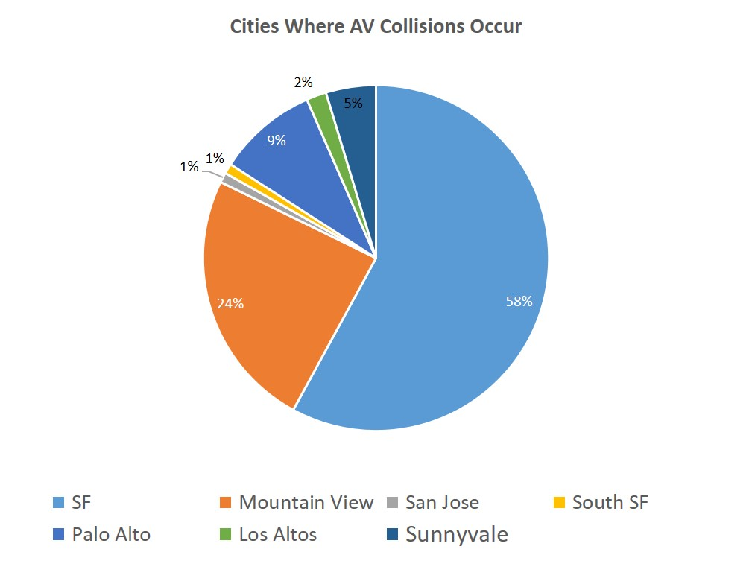
Current state of AV testing in California: Collisions
Notes:
9/10 of collisions reported, occurred when the AV was struck. Some of these are not by vehicles- golf ball in front driver windshield, a jaywalker in SF walked onto the hood of the vehicle.
the cases where AV hit another vehicle- 2018- most occurred in manual/conventional mode where driver made an error.
2016- AV was in autonomous mode and while merging into a lane after driving around sandbags surrounding a storm drain, hit a bus on the side. Another instance an AV going 20mph began moving in its lane to the left and then corrected to the right. The safety driver took control, but didn’t correct the path of the vehicle and struck a parked car.

Slide 22
Current state of AV testing in California: Collisions
Notes:
62% of these collisions- rear bumper fender benders. The AV was at or close to zero speed.
Some collisions involved the AV braking (slowing/stopping) for what appears to be a drifting vehicle towards them, but no confirmation on alleged vehicle entering AV’s lane.
Some collisions involved the AV creeping out further into an intersection to gain a better view of approaching vehicles and then were struck from the rear. Is AV panic braking or a quick start followed by a quick stop after being stopped at the limit line?

Slide 23
AB 87- Removal of AV on Public Roadways
Amends CVC 22651- Peace Officer can remove vehicle from public roadway if:
  Operator does not provide a valid AV permit issued by the CA DMV
  The vehicle is operating with a suspended or revoked AV Permit
Notes:
If the vehicle has been removed from the public roadway, it may be released to the registered owner, or person in control of the vehicle, upon the following being provided:
Proof of a valid AV permit required to operate the autonomous vehicle or
A declaration or sworn statement to the CA DMV stating that the autonomous vehicle will not be operated using autonomous technology on public roads without first obtaining a valid AV permit from the CA DMV.

Slide 24
Miguel.Acosta@dmv.ca.gov
(916) 657-9735
Notes:
We continue to learn as data becomes available. The 2018 disengagement data will be available in January of 2019. We will continue to take a collaborative approach with the industry and all stakeholders to ensure the safe operation of these vehicles.

