Slide 1
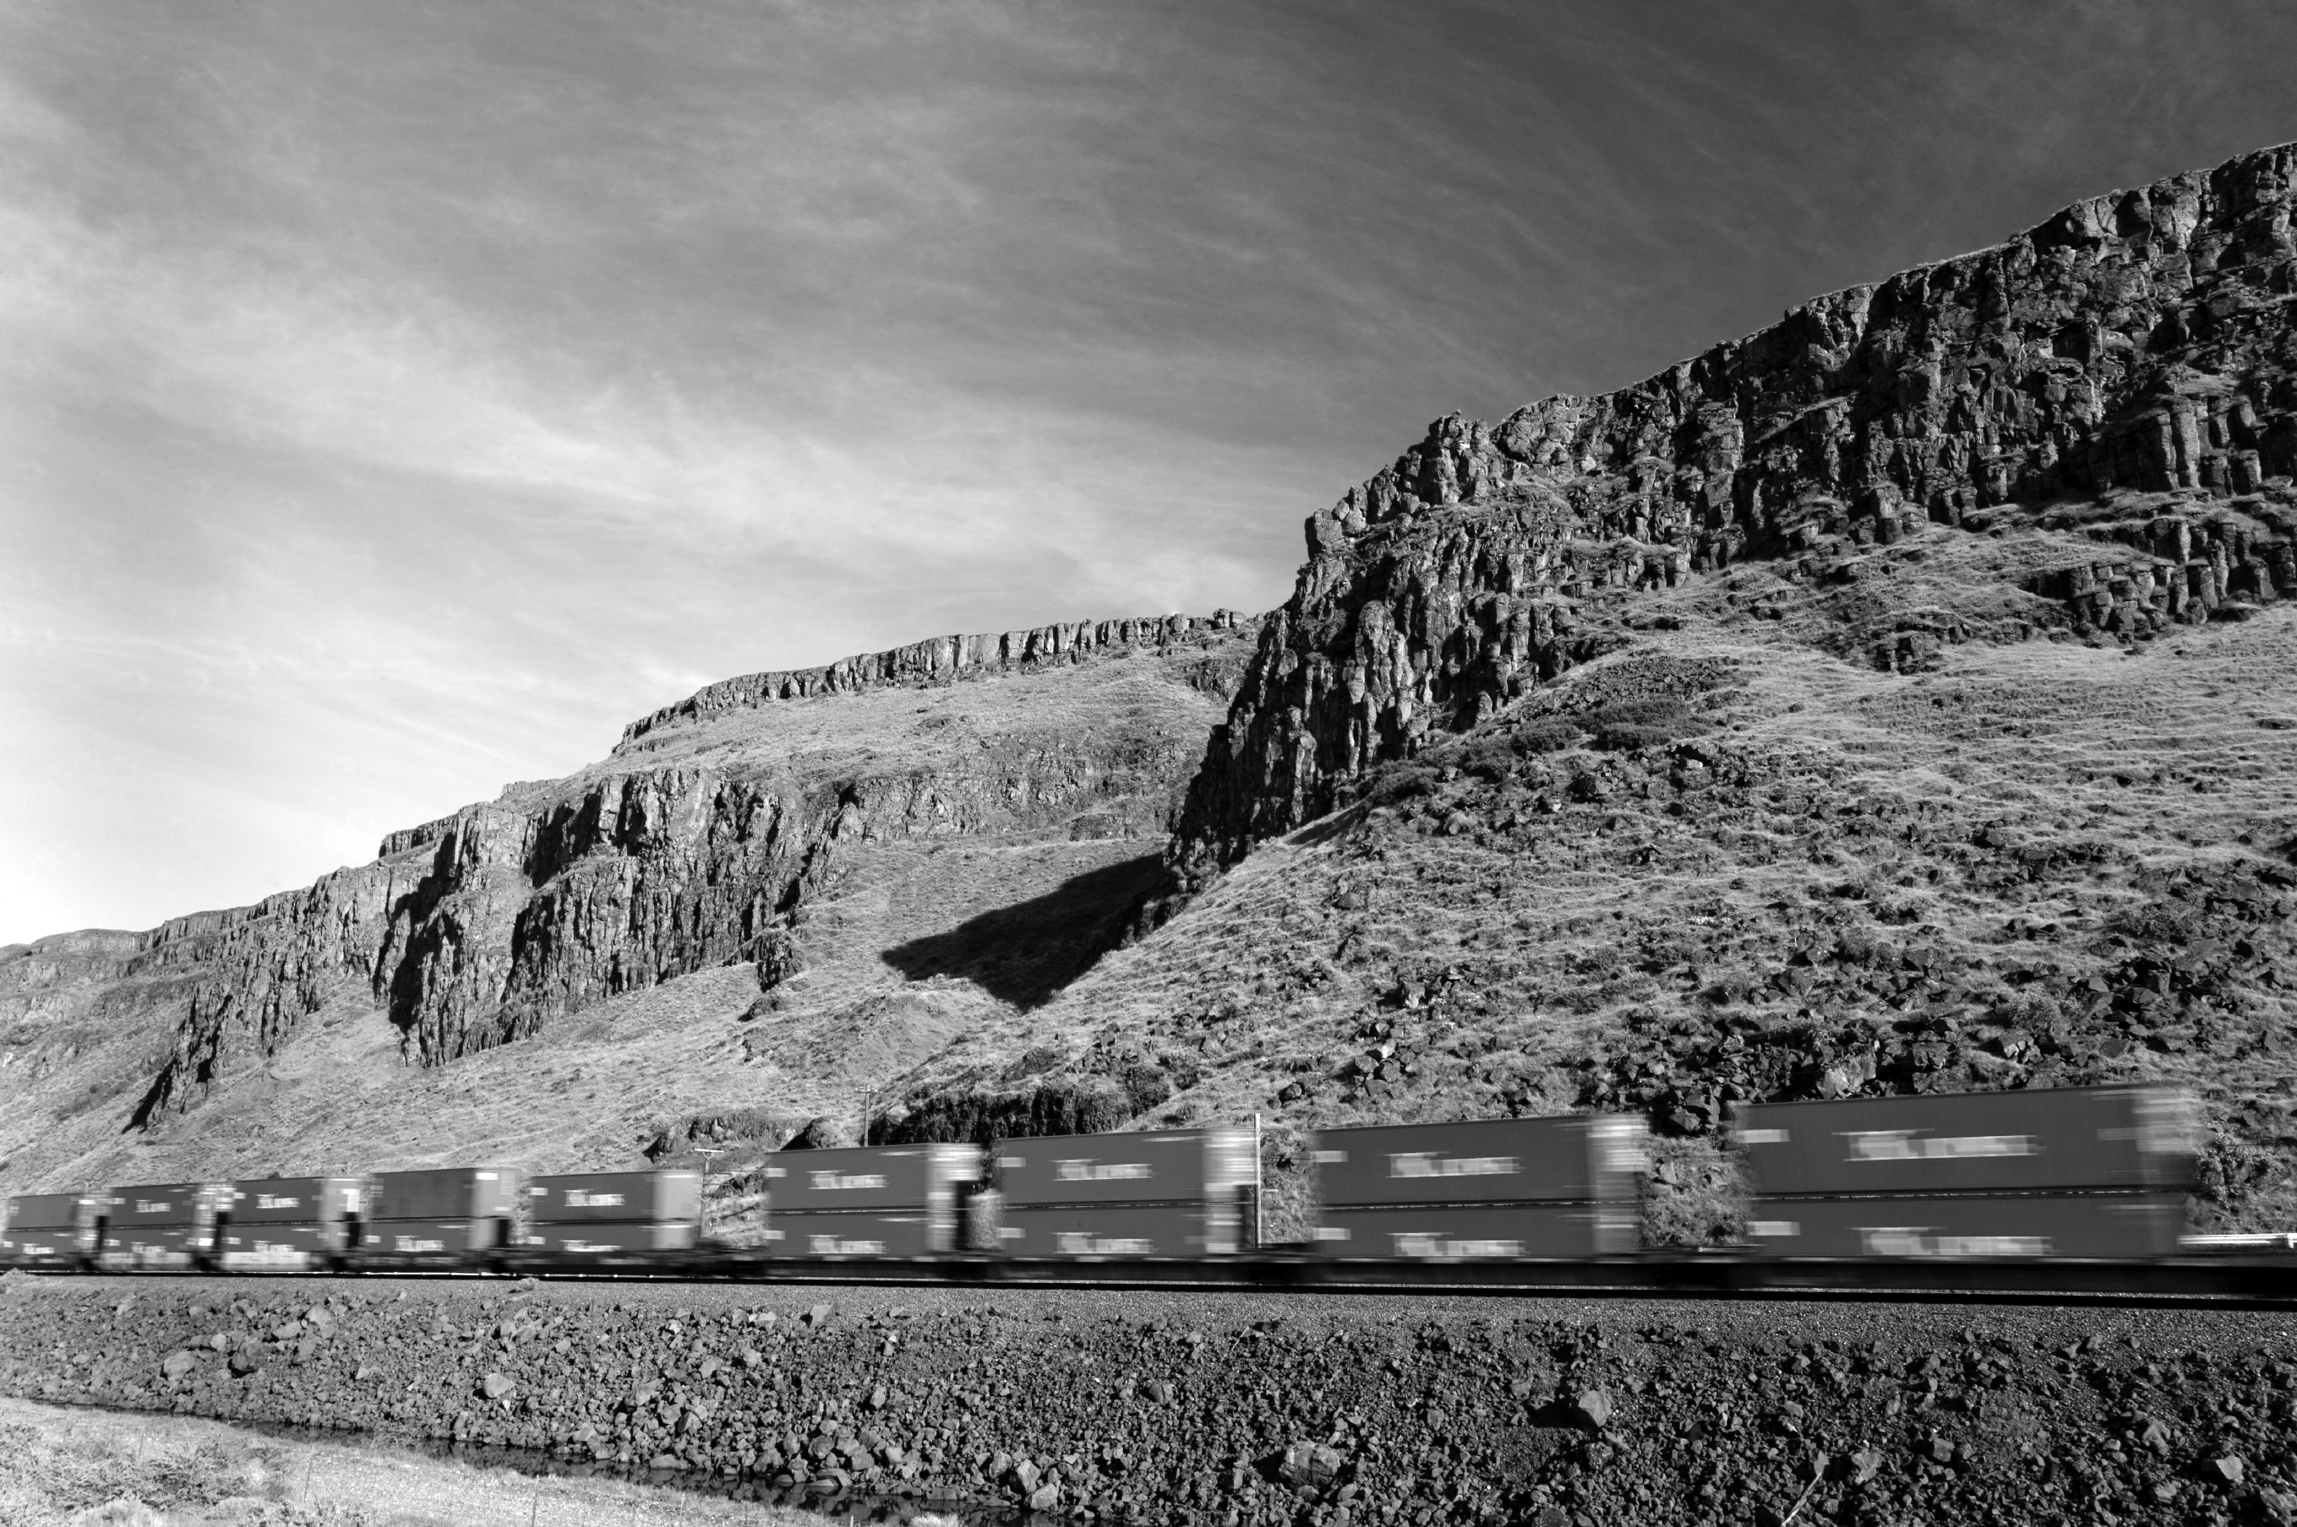
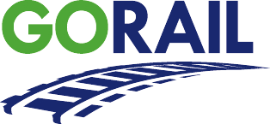
&
Where PUBLIC BENEFITS
PRIVATE ENTERPRISE Intersect

Slide 2


GoRail Mission
National non-profit grassroots organization promoting the public benefits of rail.
Building public support for policies to expand rail.
Supporting legislation to expand rail capacity.
Opposing legislation that would shrink capacity.

Slide 3
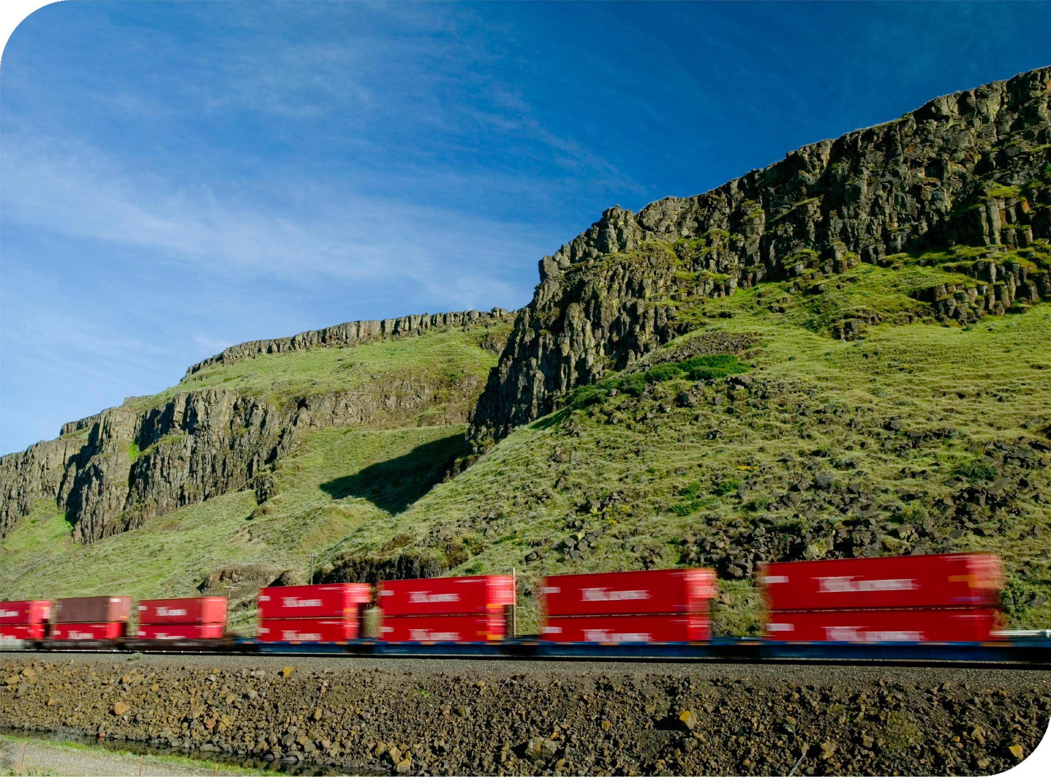
Today
Railroads provide 43 percent of the nation's intercity freight transportation—more than any other mode.
Through intermodal service—freight shared by trucks and trains—railroads move almost 12 million trailers or containers a year.
$500 Billion in private capital investment since 1980.
$12.5 Billion in capital expenditures in 2011.
Average rail rates are 45% lower today than they were in 1981.

Slide 4
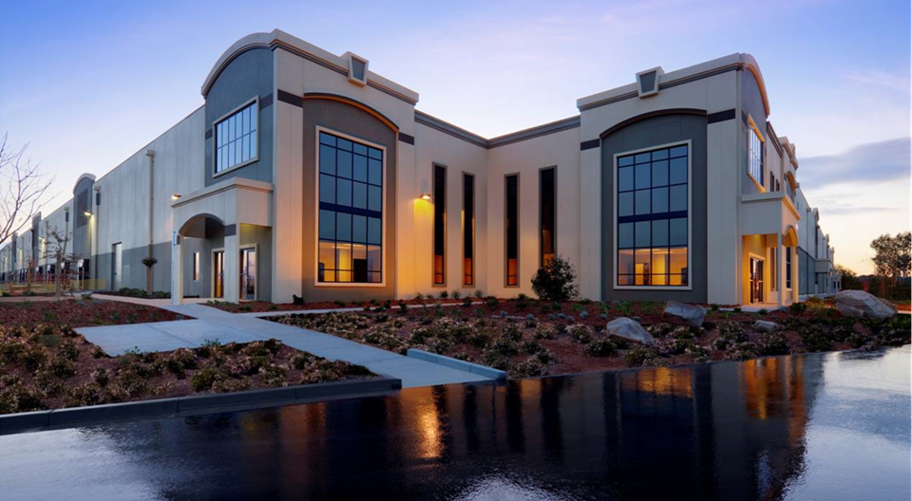
Rail Proves Attractive as
California Winemakers
Seek to go Green
Access to freight rail was key in the decision to locate the Jackson Family Wines/Biagi Bros. Distribution Center recently built in American Canyon where today they are shipping more than 5,000 carloads each year on new environmentally friendly, American-made equipment.
The connection between freight trains and wine is driving economic development. The area’s production of about 30 million cases of wine per year creates jobs in bottling, packaging, distribution facilities, warehouses, and boutique winemaking.
City Manager Dana Shigley said that while other cities have been hit for years with catastrophic police and fire service cuts, American Canyon has been spared. “The boom in wine storage warehouses has been in part fueled by freight rail’s ability to ship case goods to major markets nationwide.”
“Each boxcar equals three to five truckloads of wine and one locomotive moves a number of cars, so this promotes carbon footprint reduction” states Kathryn Zepaltas, director of logistics for Jackson Family Wines.

Slide 5
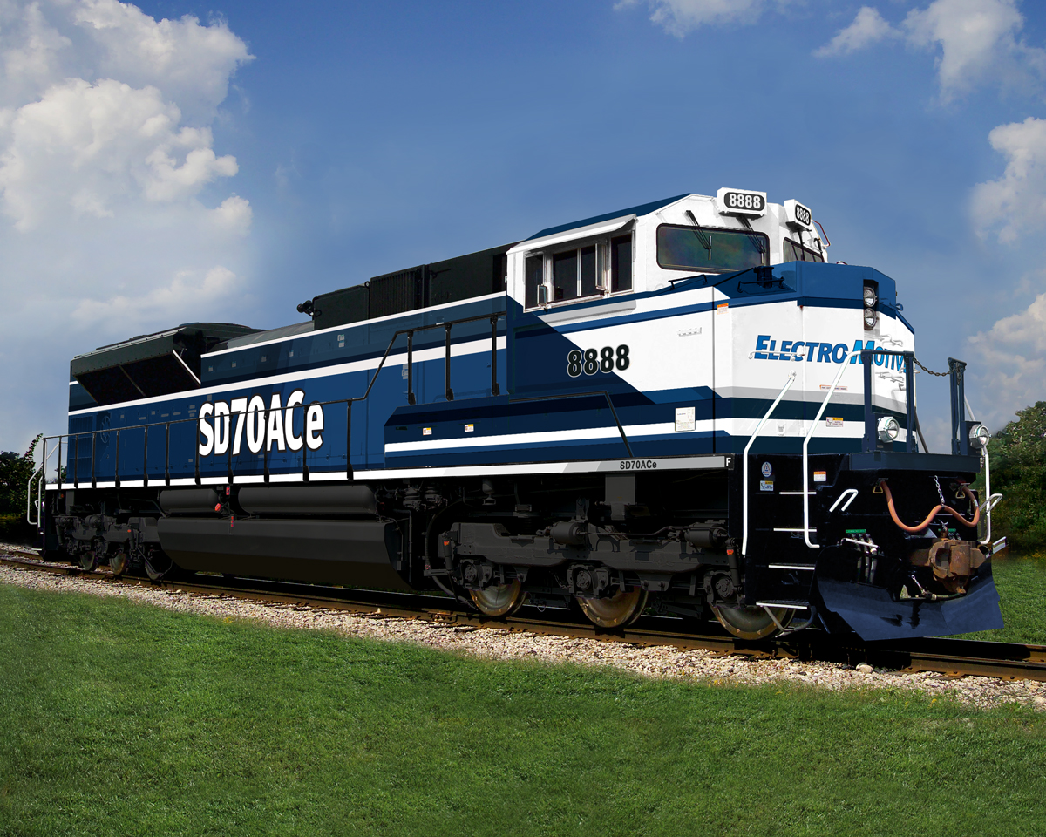
Freight Rail Creates Jobs
Every freight rail job sustains another 4.5 jobs across the economy.
Freight railroads generate nearly $265 billion in economic activity each year.
Every $1 billion of new rail investment creates 20,000 jobs.
Every $1 of rail infrastructure investment that adds new capacity generates more than $3 in total economic output.
Freight rail will hire an additional 11,000 people this year alone – many of them veterans.

Slide 6
States Co-operate to Bring
Freight Rail & Jobs to
Northwest
Knowing the importance of freight rail to the regional economy, stakeholders in California and Oregon worked to find a solution to restore regular train traffic along the Siskiyou Rail line, which closed in 2008.
“Opening the Siskiyou line will have strong ripple effects across the entire Siskiyou County and will help reduce our high unemployment” said Jim Cook, Siskiyou County Supervisor. “We hope to see the repairs done by the end of 2014.”
Most raw materials from timber producing northern CA move into Oregon’s forest products industry region by truck,” added Cook. “The rail option will remove millions of unnecessary highway truck miles.”

Slide 7
Freight Rail Creates Jobs in Counties
CA’s total of 13,134 freight rail employees work in 53 of CA’s 58 counties. San Bernardino County has the most with 2,883 rail employees.
These are good jobs that support families, communities and local governments. Average wage and benefits per freight rail employee in CA is $105, 504.
The 27,276 railroad retirement beneficiaries in CA received $506 million in retirement benefits funded by railroads.
There are 5,307 mileages of track and 25 freight railroads who moved 148.0 million tons of freight in CA in 2010. Saving infrastructure, it would have taken approximately 8.2 million additional trucks to handle that freight.

Slide 8
GoRail ‘Job Stories’
Alameda County–new intermodal rail yard & logistics facility will bring jobs & improve air quality for Oakland… more than 9,000 total jobs attributed to OHIT & 2,800 project construction & 2,000 permanent jobs.
Yolo County – freight rail is part of renaissance at Port of West Sacramento.
San Diego County – keeping maritime operations & port tenants viable supporting 42,000 regional jobs.
Contra Costa County – attracting new business & 200 full-time jobs at the Port of Richmond.

Slide 9
Public Benefits of Freight Rail
Freight railroads provide good paying jobs.
Freight rail saves American consumers billions of dollars.
Investing in the rail network boosts the nation’s economy.
Moving more freight by rail reduces congestion on our highways.
Rail is the most energy-efficient way to move goods.
More freight moving by rail means less pollution.

Slide 10
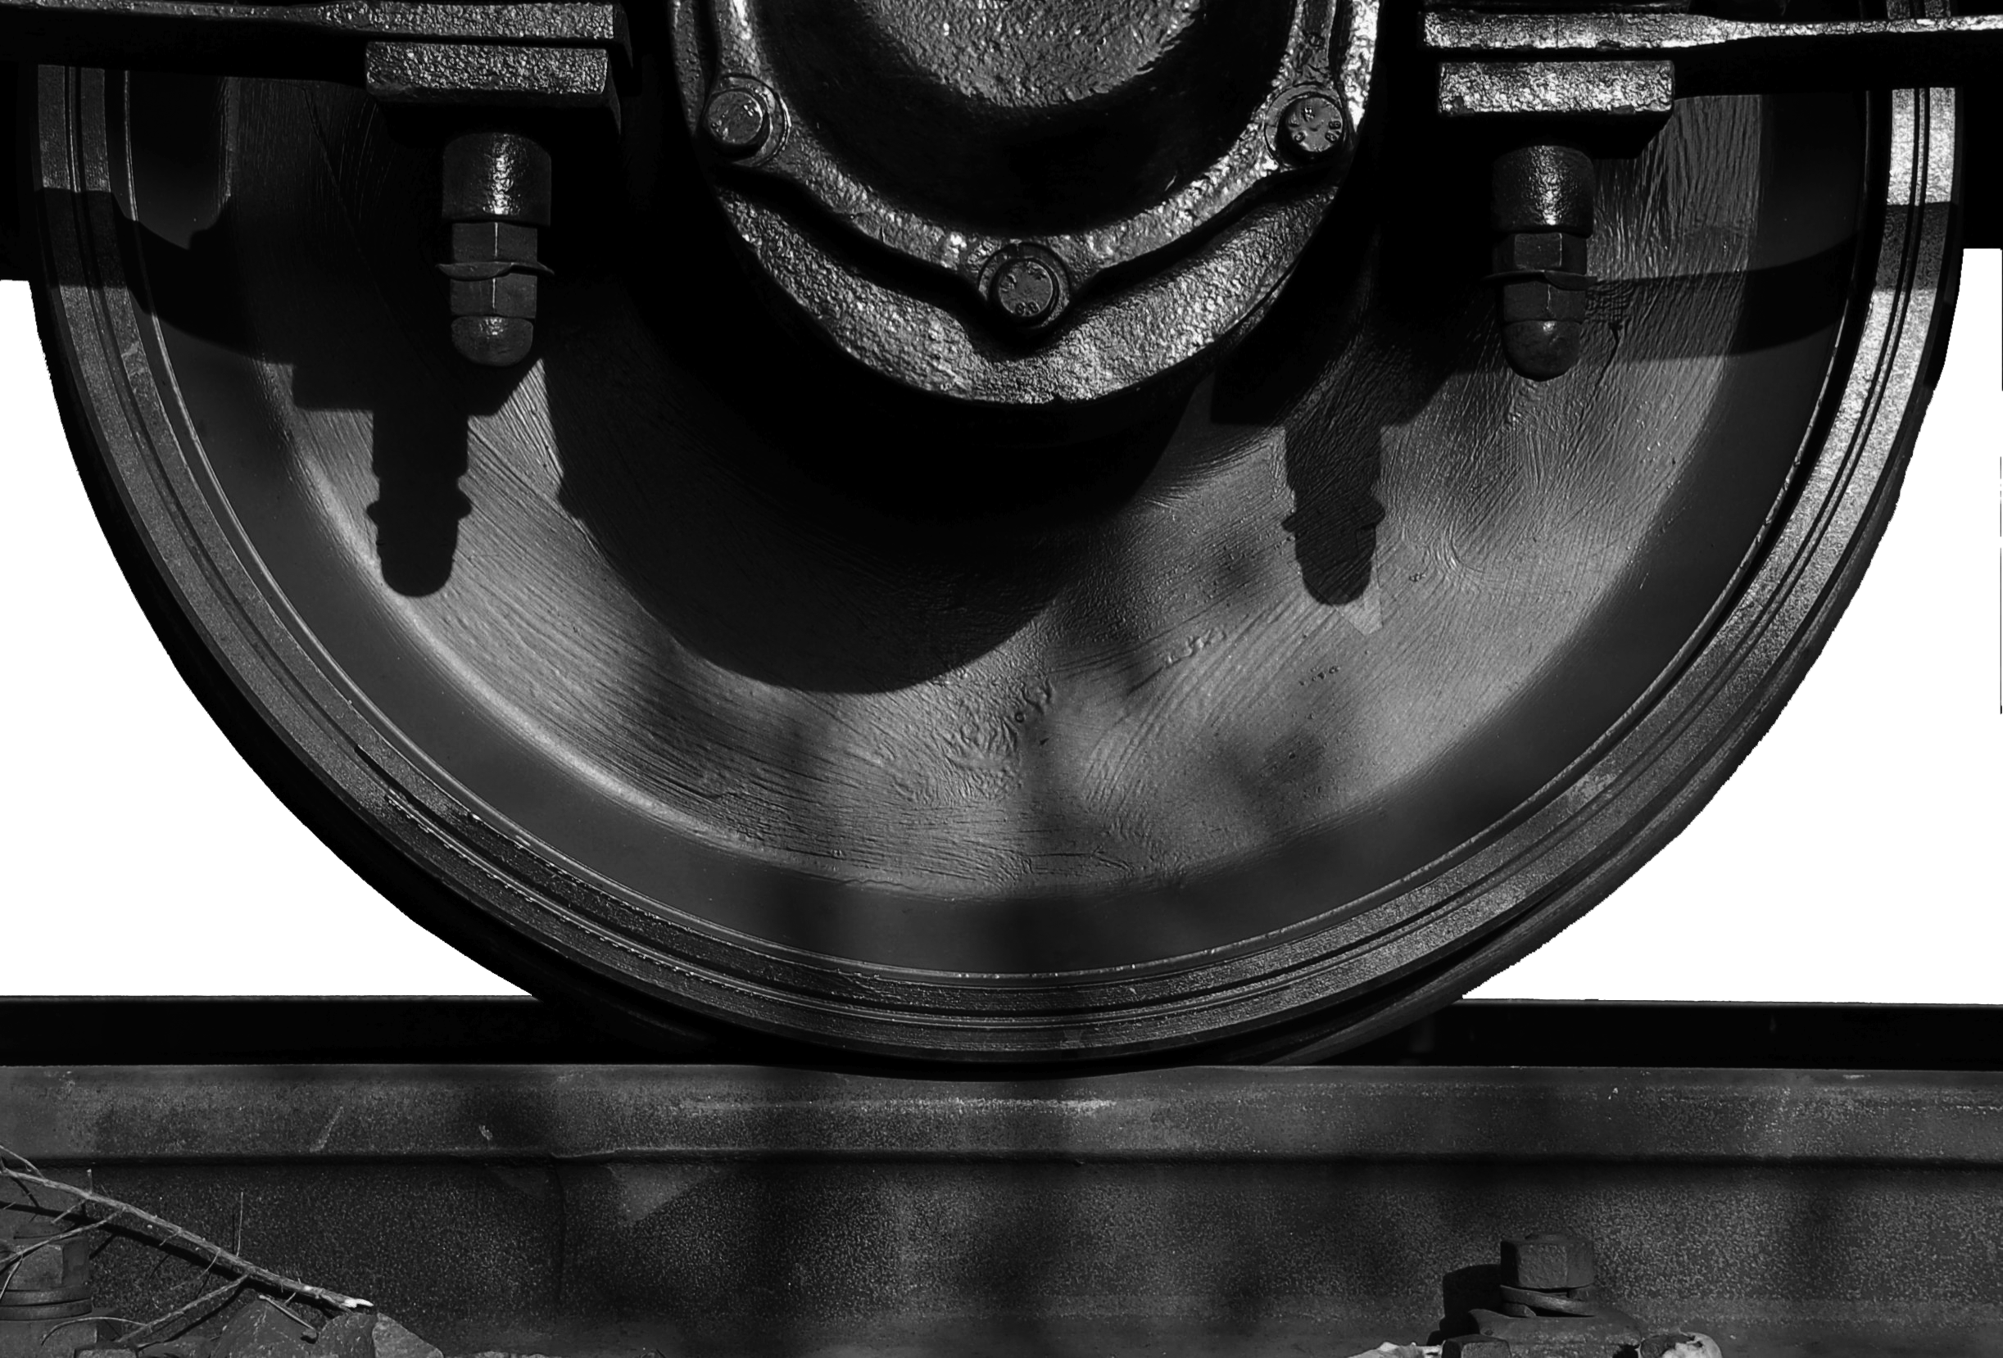
Freight Rail Pulls Its Own Weight
Please join hundreds of elected county officials across the US who support GoRail & the MN & FL State County Associations by
‘Resolving’ to support the
Public Benefits of Freight Rail
(delivered free of charge to
taxpayers).
www.gorail.org

Slide 11
GoRail
Roberta Mendonca
State Director
rmendonca@gorail.org
571-480-5467
Cell 916-204-9864
www.gorail.org

