Slide 1
Considerations for Returning Employees to the Workplace
Presentation for CSAC
July 23, 2020

Slide 2
Agenda and Speakers
Introduction Kathryn Reilly
SVP, Public Sector Industry Leader
1.202.494.9104, kathryn.reilly@aon.com
Communications and Training Matthew Howes
VP, Time Away and Life Solutions Expert
1.847.442.0973, matthew.howes@aon.com
Impact Modeling Tool Laura Peck, FSA, MAAA
VP, Health Actuary, California Market
1.949.400.7862,laura.peck@aon.com
Screening for COVID-19 Neal Mills, MD MBA
Chief Medical Office
1.972.540.7655,neal.mills@aon.com
Q&A Julie Theirl, Public Sector Leader, California
1.909.967.9091, julie.theirl@aon.com

Slide 3
The Benefits of a Formal Return to Workplace Plan Are Undeniable
It is time for businesses to initiate reopening in a thoughtful and meaningful manner that takes employees’ health and wellbeing into consideration.
The reopening process should be methodical and considerate to both employees and customers.
Businesses should define their short- and long-term objectives and the steps that will help them achieve these goals.
Notes:
The impact of the coronavirus (COVID-19) pandemic in the United States has been devastating, bringing businesses and people’s lives to a halt. As the U.S. implements mitigation programs to reduce and limit the spread of COVID-19, it is time for businesses to initiate reopening in a thoughtful and meaningful manner that takes employees’ health and well-being into consideration. The reopening process must be methodical and considerate to the employees and customers. Business must now define their new short and long-term objectives and the steps that will help them achieve these goals. The benefits of a formal reopening and return to work plan is undeniable..

Slide 4
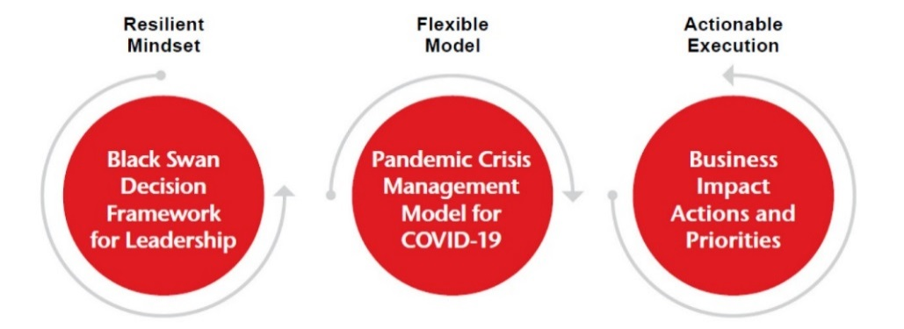
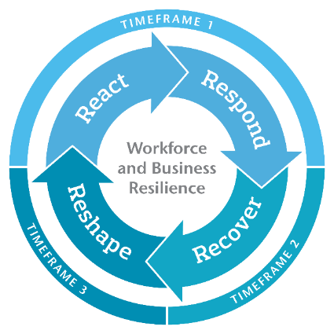
Setting the Stage – Enabling Employers to Enhance COVID-19 Response Understanding the unique event arc of COVID-19 and its influence on employer response
COVID-19’s Unique Event Arc
Historically, crisis events have
typically unfolded with an event
arc that includes identified start/stop dates, followed by a period of recovery and return to normal. However, COVID-19’s event arc is different – the arc is fluid and the disease will continue to be present until such time as a vaccine becomes available or a treatment protocol is found to be effective. In the meantime, waves of infections may be experienced in different geographies at different times and different intensities.
An employer that recognizes this fluid nature and understands how their organization’s unique footprint and business profile may be impacted can make more strategic decisions about how to manage Workforce and Business Resilience and plan for Return to Workplace strategies. Aon is the partner who has knowledge, tools and resources to help bring this nuanced insight into an Employer’s key decisions. This document is part of that broader conversation.
How Aon is helping Employers respond to COVID-19
COVID-19 arc
Aon’s suggested COVID-19 Response Framework for Employers enables an organization to make decisions in an uncertain environment, flex with evolving impacts and take action with timing and priorities designed to fit each stage of the organization’s unique COVID-19 experience.
A closer look at the Pandemic Crisis Management Model for COVID-19:
Note: Model flexes with waves in the event arc and introduces timeframes for Business Impact Actions

Slide 5
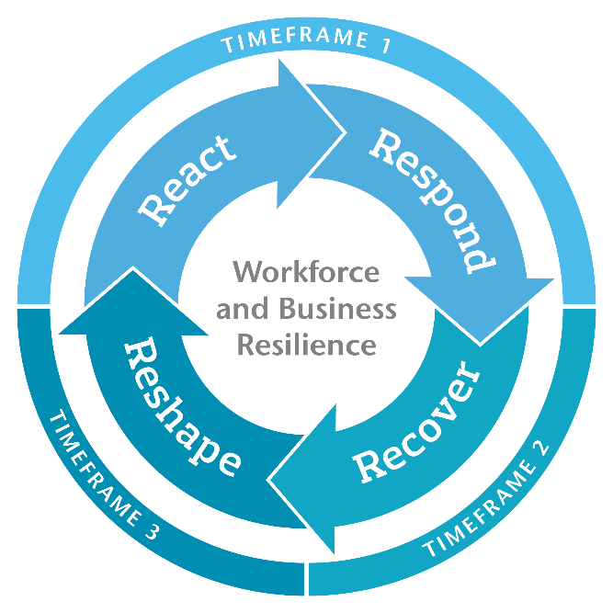
Business Impact Actions Actions require short- and long-term focus that can flex to accommodate the fluid event
Return to Workplace planning is a key consideration in COVID-19 Business Recovery
TIMEFRAME 1
React
Emergency Action
Confirm and demonstrate duty of care
Business continuity implementation
Workforce strategy
Impact validation and resilience
Ensure liquidity and solvency
Shareholder/investor commitment
Crisis communications internally and externally
Government liaison
Respond
Manage the Crisis
TIMEFRAME 2
Recover
Stabilize Business
Return to Workplace plan
Establish protocols on workplace environment
Mobility of employees
Customer/client retention
Business plan adjustments
Reforecasting
Investor engagement
Recapitalizing
TIMEFRAME 3
Reshape
Plan for the Future
Respond to potential regulatory and operational changes
Commit to financial stability
Workforce and workplace planning
Commit to resilience for future events
Redefine business strategy & goals

Slide 6
Business Areas Required to Develop your Return To Workplace Plan Be prepared to flex as the organization’s unique COVID-19 experience unfolds
Health & Safety
Human Resources
Protect employees’ health & wellbeing, workforce planning, talent & rewards (Benefits, Retirement, Compensation), Human Resource policies and Communications to ensure the COVID-19 Return to Workplace aligns with needs of employees and the business
Health & Safety is the goal
Business Operations
Focus on operational readiness of the business and the workplace to resume operations. Ensure customers are
ready to consume and suppliers are ready to supply; ensure locations, processes, business systems, equipment, facilities are prepared and operational; pay attention to liquidity and financial flexibility; identification of new business opportunities
Human Resources
Business Operations
Risk Management / Legal & Ethical
Manage risk and insurance needs as the operations resume. Reassess exposure changes, claims and strategies to mitigate risk. Consider legal and financial implications of restoring the business including policies for employee relations, regulatory/legislative updates, privacy etc.
Risk Management/
Legal & Ethical
Facilities Management/ Physical Security
Facilities Management / Physical Security
Prepare possibly idled facilities to receive employees and customers, ensure cleanliness and sanitation, review security controls for deliveries and visitor/vendor screening, reassess security posture against refreshed understanding of risk environment for employee footprint and the business for COVID-19 and other risks
COVID-19 arc
Purchasing/
Supply Chain
IT BRP and Cyber Security
Purchasing / Supply Chain
Re-engage with suppliers to confirm recovery priorities and production/capacity levels, identify any adjustments required to audit and address identified gaps, confirm quarantine requirements or other safety protocols for suppliers/materials, identify temporary government restrictions on import/export for geographies involved in the business
IT BRP and Cyber Security
Focus on IT BRP (business resumption planning) to resume priority IT system functions which may have been frozen due
\to emergency work-from-home protocols, reassess cyber risk profile to identify changes that may require attention, identify control gaps for authentication and BYO device security that may arise with return to workplace, surveil for and respond to cyber threats
Communication
Communication binds everything together
Note: For employers with footprint that includes US, consider impact of CARES Act and other federal, state, and/or local legislation before taking action.
For employers with footprint that includes other countries, consider impact of any local legislative/regulatory changes before taking action.

Slide 7
Communications and Training
Matthew Howes
VP, Time Away and Life Solutions Expert

Slide 8
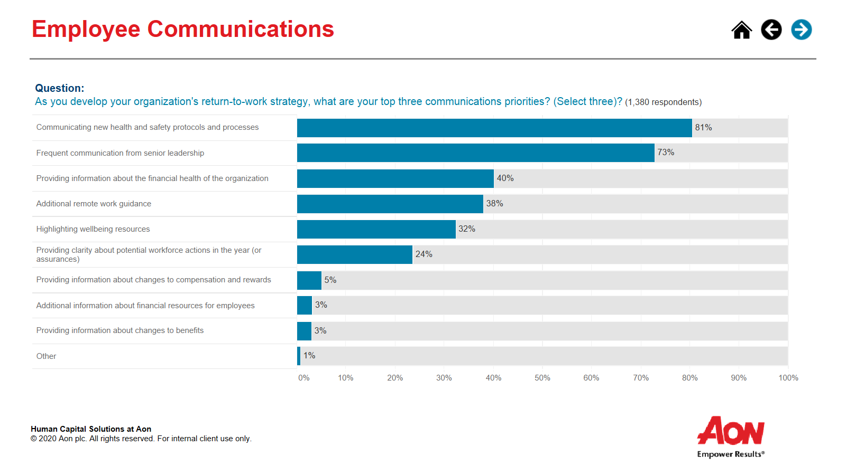
Pulse Survey: Employee Communications for Return to Workplace

Slide 9
Components of a Strategic Communication Plan
It is important to create and follow a comprehensive communication plan to ensure that messages are coordinated and centrally-controlled so employees won’t be overwhelmed or confused.
Key Objectives
Clear Ownership
Establish key objectives on how return to workplace communication will align with other important communications.
Identify clear ownership and responsibility for the communication plan and execution.
Audience & Stakeholders
Assess the needs of all audiences and stakeholders, especially as different employee groups may be impacted at different times and in different ways.
Select Channels
Select communication channels and tactics that fit the environment, situation and nature of the messages.
Informed Managers
Concise Messages
Create clear and concise messages, as employees will be overwhelmed and possibly anxious, and many protocols and processes may be new.
Ensure managers are kept informed, as they are a critical audience and resource.
Regular Cadence
Establish a regular cadence and centralized source for communication, so all audiences and stakeholders are informed (changes could be frequent).
Notes:
Transitioning back to normal and on-site operations will require timely, accurate, and appropriate Crisis and Recovery Communications. It important to maintain information flow and accurate instructions and guidance to all employees during this transition.
It is critical for organizations to maintain clear lines of communications with their employees, as well as customers, clients and third-party entities. Let’s breakdown the key components of a successful plan.
Read the slide components of a successful plan

Slide 10
COVID-19 Impact Modeler
Laura Peck, FSA, MAAA
VP, Consulting Actuary

Slide 11
An Overview of the Covid-19 Employee Impact Model
Forecasts the impact of the COVID-19 virus on your employee population and dependents
Model versions:
US workforce only
Global workforce – includes US, Canada, and key EMEA, APAC and LATAM countries
Methodology:
Simple, non-identifiable census data from the employer
Combine with geographic-specific infection rates
Informed by epidemiologic model sources, including additional consultation with national carriers and labs
Reflects social distancing measures taken by local governments
Developed by Actuarial & Analytics, Aon Reinsurance and Retirement & Investments

Slide 12
An Overview of the Covid-19 Employee Impact Model
Features:
Adjust for essential employees and industry-specific infection exposure
View population impact by geographic area over time
Model infection peak for each employer group
Estimate the number of mild cases, hospitalizations, ICU visits, and fatalities based on specific population demographics
Adjust for future lockdown and mitigation controls to model future COVID-19 infection waves by geography
Estimate health care costs associated with testing and treatment, as well as health care cost offsets due to utilization reductions (US only)
Estimate employee days lost by case severity
Estimate the cost of time away by case severity inclusive of sick time, Short-Term Disability, caregiving time away, and worker replacement costs (US only)
Project hypothetical Workers Compensation costs for medical and lost time for COVID-19 claims (US only)
Advanced filtering and custom subgrouping
Powered by a cloud-based platform always updated with latest data and forecasts

Slide 13
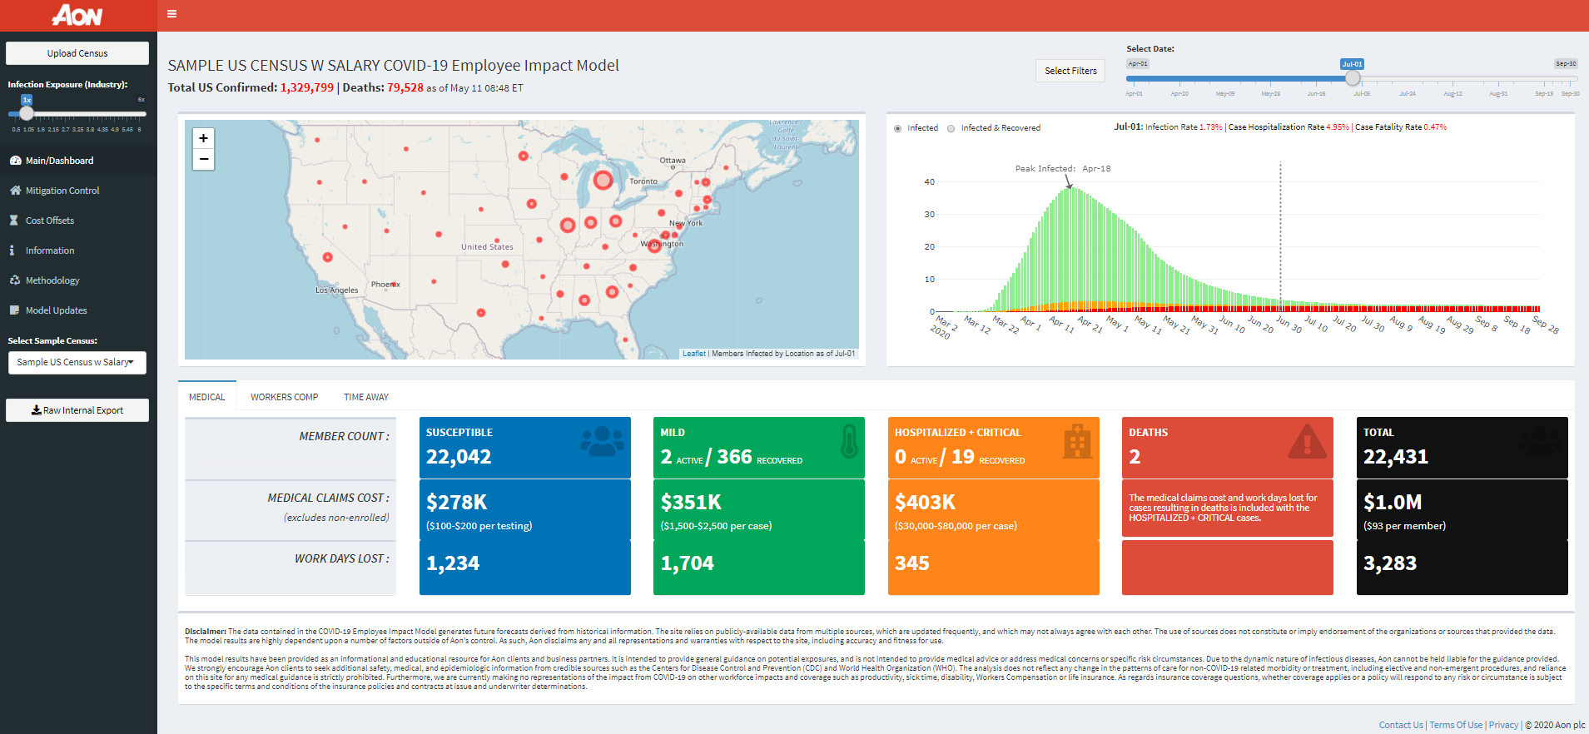
An Overview of the Covid-19 Employee Impact Model
Display Summary
Client data upload, industry adjustment, and mitigation end date modeling
Dynamic projection date slider
Population impact by location
Population impact by severity and peak infection projection
Workers Compensation and Time Away impact tabs
Estimate treatment categories and
associated health costs and employee days lost

Slide 14
Screening for COVID-19
Neal Mills, MD, MBA
Chief Medical Officer

Slide 15
Key Success Factors and Anticipated Challenges for COVID-19
Key Success Factors
Anticipated Challenges for COVID-19
COVID-19 Response Framework for Clients
Epidemiology/ Public Health and Medical expertise
Practical solutions and tools
COVID-19 Testing types, availability and credibility
Disease
waves across geographic sites
Economic uncertainty globally
Strong leadership engagement
Proper communication and education
Customers not ready to receive services
Suppliers not ready to supply products or services
Having limited access to support to help meet goals
Having
reliable
support
Comprehensive strategic planning
Research and preparation
Being reactive vs. a proactive approach
Employee Fear and Mental Health Considerations
This information has been provided as an informational and educational resource for Aon clients and business partners. It is intended to provide general guidance about return to work processes and is not intended to provide medical advice or address medical concerns or specific risk circumstances.

Slide 16
EEOC, CDC, and State Directives: Preparing to Manage COVID-19 in the Workplace
Workplace Screenings
Define, communicate and implement fit for work requirements and screening protocols
For some essential workers, employers may choose to modify requirements in keeping with CDC guidelines
Develop a thoughtful process on handling and isolating employees who exhibit symptoms including; consideration of taking temperatures, separating employees who exhibit symptoms from the larger workforce population, advising the employee to seek medical advice
Ensure this process includes protecting employee medical information
Calling Out Sick
Develop a defined process for employees to follow when calling out sick
Identify designated representatives to receive and register the call
Provide designated representatives a questionnaire to confirm if an employee is experiencing symptoms of COVID-19
Review your regulated Paid Sick Leave (PSL) geographies to ensure the questionnaire and administrative practices are in compliance
Maintain the employee’s confidential information by developing a repository system. Ensure process consistency to avoid discrimination
Provide the employee with next steps including; seeking care from a medical provider, follow up protocols and expectations of the employee
This information has been provided as an informational and educational resource for Aon clients and business partners. It is intended to provide general guidance about return to work processes and is not intended to provide medical advice or address medical concerns or specific risk circumstances.

Slide 17
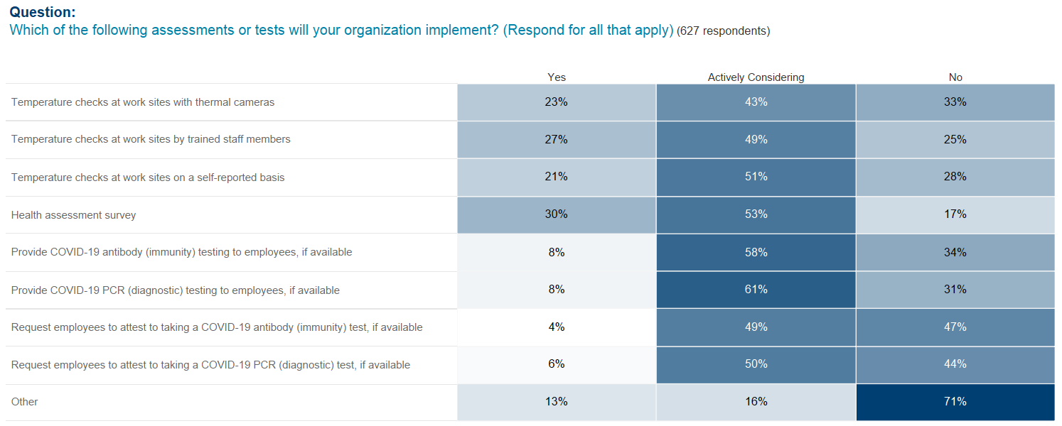
Pulse Survey: Return-to-Workplace Strategies

Slide 18
The Goals and Types of Screening for Return to the Workplace
Goals:
Reassure employees that a thoughtful Return to Workplace plan is in place
Reduce the potential of transmission at the workplace
Follow the regulatory guidelines
The five screening types that employers can leverage are:
Employee Attestation
Temperature Screenings
Polymerase Chain Reaction (PCR) tests
Antibody Test
Antigen Testing
+
Contact Tracing
This information has been provided as an informational and educational resource for Aon clients and business partners. It is intended to provide general guidance about return to work processes and is not intended to provide medical advice or address medical concerns or specific risk circumstances.

Slide 19
Screenings
Screening Type | Description | Strengths | Considerations
 | Individual attests that they have no key symptoms associated with COVID-19, based on CDC definitions Attestation can be done via app, written statement, and/or often as a checkpoint at entry | Low cost for minimal effort and can be done frequently (daily) Technology can be leveraged | Only measures symptomatic, not asymptomatic carriers or pre-symptomatic individuals (CDC estimates that more than 25% of COVID-19 cases are asymptomatic)¹ Based on employees subjective feedback for symptoms
 | Measurement of an individual’s body temperature prior to entry onsite Multiple modalities exist, including thermal cameras at entry, personal thermometers and Bluetooth thermometers Temperature thresholds may vary based on local guidelines | Inexpensive way to identify symptomatic individuals Thermal cameras and other technology allows for screening multiple people at the same time and data collection Employees can be asked to do temperature check before coming to workplace and stay home if temperature > threshold EEOC has confirmed that employers can measure body temperature before allowing access to the workplace² | Only a baseline qualitative measurement for illness Only identifies symptomatic individuals¹ Not all symptomatic individuals have fever or may be treating fever with medication Limitations to the accuracy of some thermometers If in person, screeners should be wearing appropriate PPE
Employee Attestation
Temperature Screenings
This information has been provided as an informational and educational resource for Aon clients and business partners. It is intended to provide general guidance about return to work processes and is not intended to provide medical advice or address medical concerns or specific risk circumstances.
Sources: 1. Centers for Disease Control and Prevention (2020). Symptoms of Coronavirus.; 2. The U.S. Equal Employment Opportunity Commission (2020). Pandemic Preparedness in the Workplace and the Americans with Disabilities Act. ; 3. Medical Device Network (2020). Different paths to the same destination: screening for Covid-19.

Slide 20
Diagnostic Testing (determines active infection)
Diagnostic tests determine if the virus or components of the virus are present in an individual
Diagnostic Testing Type | Description | Strengths | Considerations
 | PCR Uses genetic material from virus through mucous, saliva or lung tissue (swab of nose or throat) | Most are FDA approved Most reliable diagnostic test | Provider order required Must be done in a CLIA certified lab 24-72 hours to receive results 30% false negative rate
 | rrT – PCR Rapid real-time test that uses genetic material from mucous or saliva (nasal canal swab) | Runs on analysis equipment widely available in high and moderate complexity labs < 24 hours to receive results Can be self-administered through a nasal swab | Select few have FDA EUA approval Provider order required – even for at home tests Reporting to FDA is required to validate continued reliability and efficacy Reliability similar to PCR
 | Rapid test through mucous, saliva, or throat swab | Uses similar technology currently available in doctor’s office for other rapid tests such as strep testing Results available in just minutes Positive results highly accurate | Only one FDA EUA approved Provider order required Higher chance of false negatives PCR test required as a follow up for positive or negative results, but treatment may begin for positive results
Polymerase Chain Reaction (PCR) Tests
Antigen Test
This information has been provided as an informational and educational resource for Aon clients and business partners. It is intended to provide general guidance about return to work processes and is not intended to provide medical advice or address medical concerns or specific risk circumstances.

Slide 21
Antibody Testing
Typically antibody testing is used to determine if an individual has mounted an immune response to a virus in the past. For COVID-19, it is not confirmed that the presence of antibodies indicates immunity.
Antibody Testing Type | Description | Strengths | Considerations
 | Venipuncture Blood test analyzed in lab (ELIZA - Enzyme-linked immunoassay) done through blood draw Blood draw must be done by credentialed provider | Many have FDA or FDA EUA approval Results available in < 24 hours Effective way to track spread of the virus in a population | Provider order required Further evidence needed on quality of tests Does not diagnose current infection Likelihood and duration of immunity unknown
 | Fingerstick Rapid test via blood droplet (finger prick) Processing will likely need a moderate complexity facility | Processing depends on test manufacturer and may be done in any environment Results available in a few minutes | Further evidence needed on quality of tests Provider approval required Does not diagnose current infection Likelihood and duration of immunity unknown Select few FDA EUA approved
Antibody Test
This information has been provided as an informational and educational resource for Aon clients and business partners. It is intended to provide general guidance about return to work processes and is not intended to provide medical advice or address medical concerns or specific risk circumstances.

Slide 22
Contact Tracing Overview
What is it?¹
Traces and monitors contact of infected people and notifies of exposure
Supports the quarantine of contacts to prevent additional transition
States, tribes, localities and territories are establishing large cadres of contact tracers
Adoption of digital tools may expand reach and efficacy
Impact
If done efficiently, holds significant promise in reducing spread of the virus – in some populations can reduce infectivity by up to 85%²
Current Uses
Traditional public health tactic used when a diagnosed individual with a communicable disease is deemed highly infectious and has high risk of morbidity and or mortality
Employers currently support contract tracing based on public health, safety and labor regulations; typically a manual function
Opportunities and Considerations
Digital applications are likely to improve accuracy and speed, enhancing the efforts to control spread COVID-19³, thereby contributing to economic recovery
CDC issued guidelines to help evaluate digital contact tracing apps on May 20^{th1}
Biggest challenge will be to balance protecting workforce/public health risk and personal privacy rights
Contact Tracing App Considerations³
Necessity & Proportionate Value
Accuracy, Efficiency & Appeal
Choice, Consent, Control & Opt-out
Universally available, Interoperable
Define & Limited Purpose
Privacy & Anonymity
¹ https://www.cdc.gov/coronavirus/2019-ncov/php/open-america/contact-tracing-resources.html
² Ferretti L, Wymant C, Kendall M, et al. Quantifying SARS-CoV-2 transmission suggests epidemic control with digital contact tracing. Science. 2020
³Morely, J et al, Ethical guidelines for COVID-19 tracing Apps, Nature 582: 29-31 4 June 2020:
This information has been provided as an informational and educational resource for Aon clients and business partners. It is intended to provide general guidance about return to work processes and is not intended to provide medical advice or address medical concerns or specific risk circumstances.

Slide 23
QUESTIONS?
This information has been provided as an informational and educational resource for Aon clients and business partners. It is intended to provide general guidance about return to work processes and is not intended to provide medical advice or address medical concerns or specific risk circumstances.

Slide 24
Legal Disclaimer
This information has been provided as an informational and educational resource for Aon clients and business partners. It is intended to provide general guidance about return to workplace processes and is not intended to provide medical advice or address medical concerns or specific risk circumstances.
This document has been provided as an informational resource for Aon clients and business partners. It is intended to provide general guidance on potential exposures, and is not intended to provide medical advice or address medical concerns or specific risk circumstances. Due to the dynamic nature of infectious diseases, Aon cannot be held liable for the guidance provided. We strongly encourage visitors to seek additional safety, medical and epidemiologic information from credible sources such as the Centers for Disease Control and Prevention and World Health Organization. As regards insurance coverage questions, whether coverage applies or a policy will respond to any risk or circumstance is subject to the specific terms and conditions of the insurance policies and contracts at issue and underwriter determinations.
While care has been taken in the production of this document and the information contained within it has been obtained from sources that Aon believes to be reliable, Aon does not warrant, represent or guarantee the accuracy, adequacy, completeness or fitness for any purpose of the report or any part of it and can accept no liability for any loss incurred in any way by any person who may rely on it. Any recipient shall be responsible for the use to which it puts this document. This document has been compiled using information available to us up to its date of publication.
All descriptions, summaries or highlights of coverage are for general informational purposes only and do not amend, alter or modify the actual terms or conditions of any insurance policy. Coverage is governed only by the terms and conditions of the relevant policy.

