Slide 1
The Future Hybrid Workforce What we know, what is needed,
and what is still to come.
Deanna Potter, M.A.
Notes:
The Future Hybrid Workforce: What We Know, what is needed, and what is still to come.
How bad do things have to get for an employee to leave their current job without a new job in place? What amount of pressure does it take to push a person to leave the workforce entirely? When these types of resignations began, they were surprising and now they are commonplace. Organizations struggle to meet the needs of staff against the rising demands and responsibilities to the communities they serve. The workforce has changed and is still changing which means the workplace is in a state of flux. The good and bad news is that research shows employees left (and continue to leave) for reasons that are within the organization’s control. The pandemic has created a ripple effect of continued pressures and dynamic workforce challenges that lead organizations to wonder: Is there a sweet spot where a fully staffed organization is able to provide a flexible workplace, manageable workloads, and excel at strategic deliverables? In this high-energy session we will review the latest data to understand why staff continue to leave, what culture shifts must take place to retain top talent, and what leaders can do right now to make a difference.
LEVEL SET:
What I know and what I don’t know
What we can agree on today
Reflection time

Slide 2
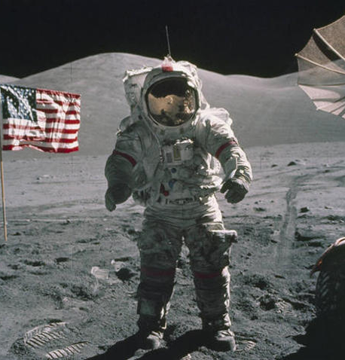
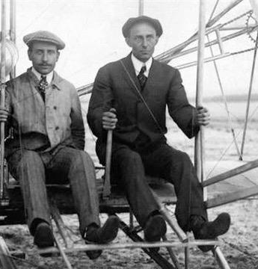
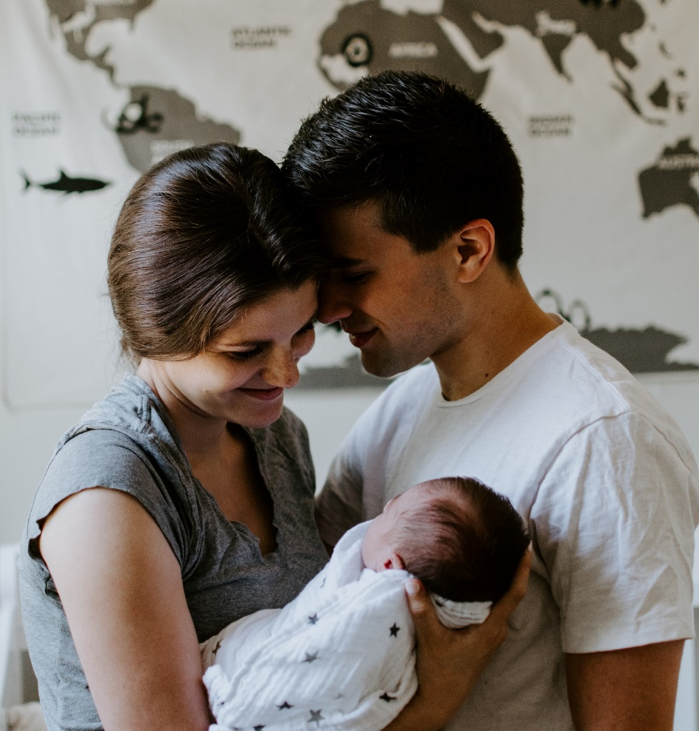
Uncharted Territory
Notes:
Prompt/Stat/Attention Grabber
Titanic vs

Slide 3
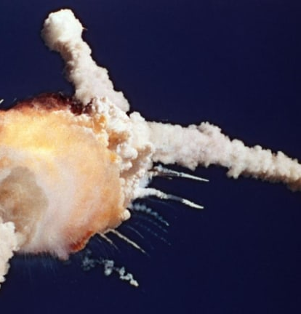
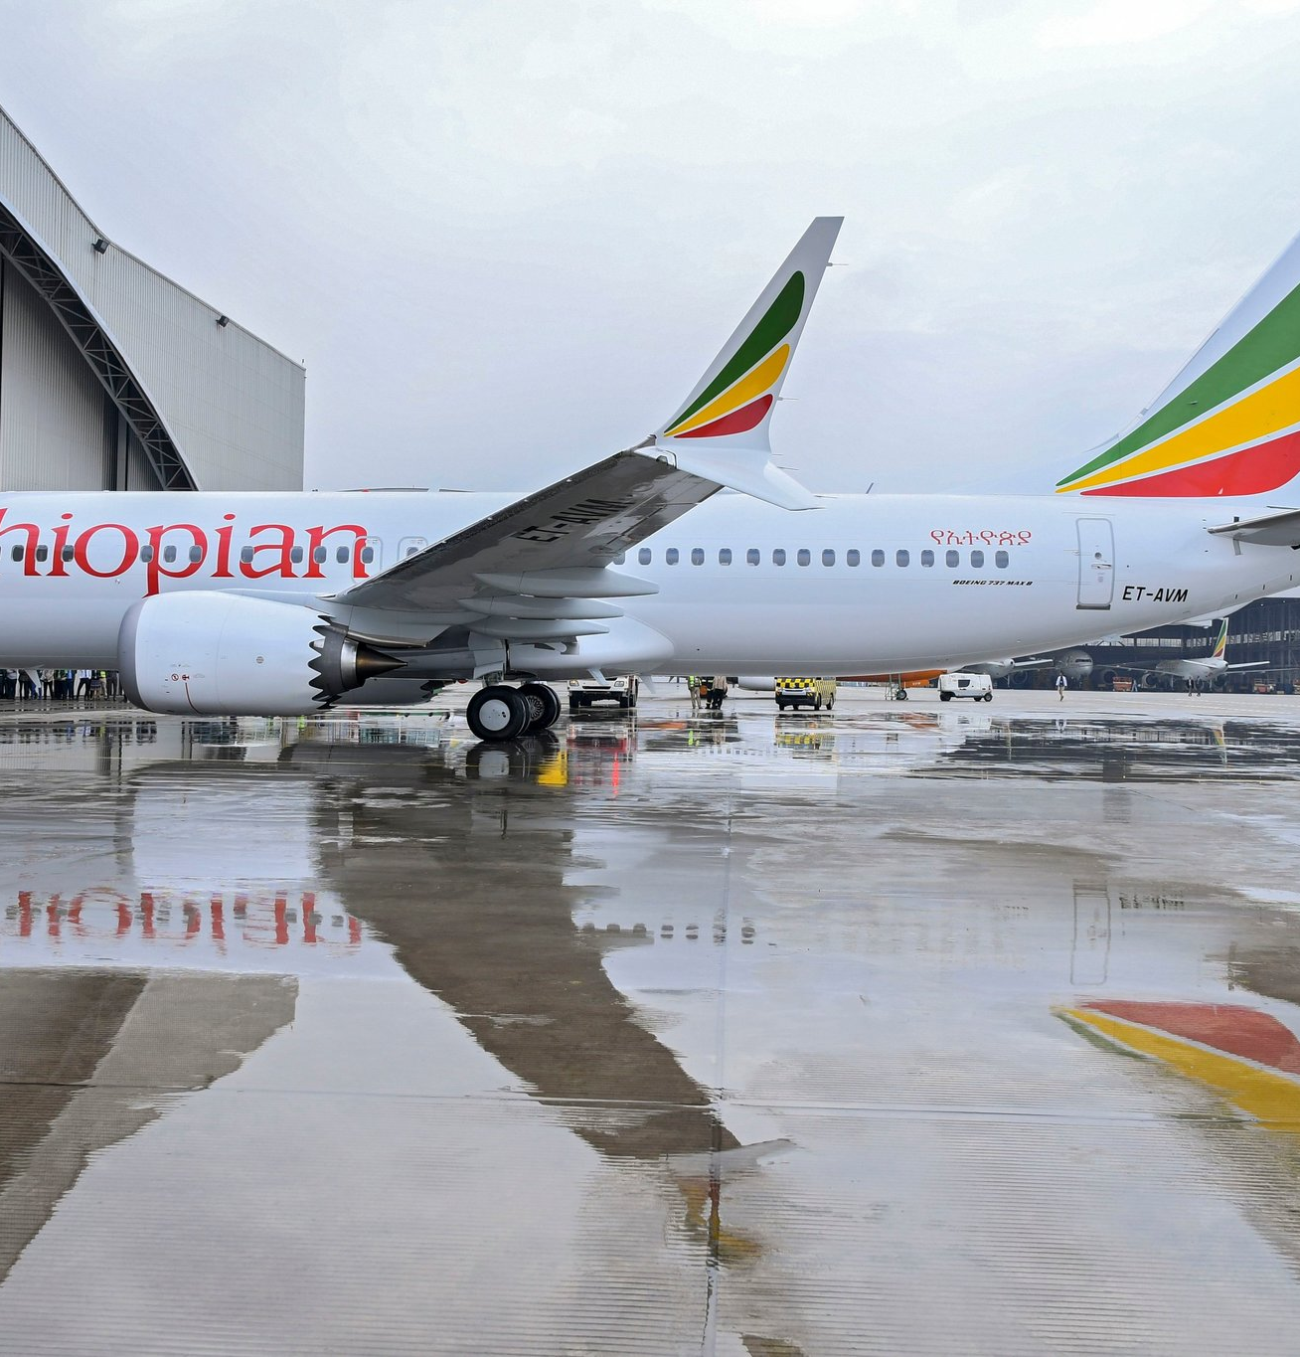
Uncharted Territory
Notes:
Prompt/Stat/Attention Grabber
Titanic vs

Slide 4
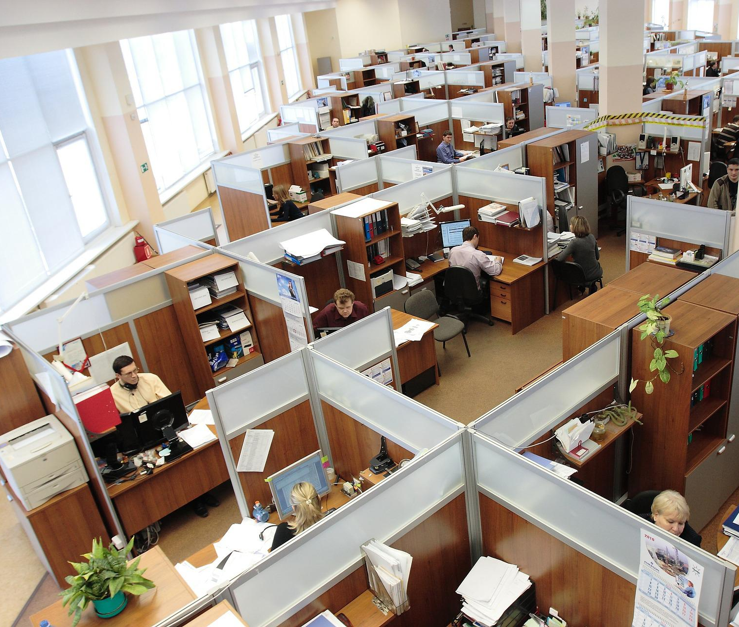
50/50
Retention
Talent acquisition
Employee Engagement
Notes:
Why Should You Care about the future of the hybrid workplace?
STATS… (Nicholas Bloom – Prof of Economics at Stanford University) (US and Northern Europe)
50% can’t work from home…. (E.G.: Essential Workers, Manufacturing, Retail, etc.…)
50% can ….. And large majority will be hybrid because :
they want to…and
they will …. AND either do it with your organization or with another organization…
Need to embrace it, make plans for it, and see that this is a reality that is not going away.)
So, when I ask you why?? why you should care…. I suggest that if your organization is facing challenges such as :
Retention,
talent acquisition,
employee engagement…. (to name just a few)….
Then, you should care.

Slide 5
Biggest Challenge
Notes:
50/50
Half is logistics --- meaning how do we do this….
- Who stays home/who doesn’t/what are the best staffing percentages/how do we schedule to meet the needs of the community members, etc.…
But Frankly ---- equal part is how do we change the mindset of a lifelong, traditional, sometimes institutionalized methodology of “this is how we’ve done it”, “the emergency is over”, “it’s time to get back to business”….. THE WAY IT WAS…. Because hybrid will not work… it’s too hard…. It won’t produce the needed results… etc..
Candidly, these thoughts often exist from varying levels of leaders in organizations. WHY? Because to lead effectively in this new hybrid workplace is nothing we’ve been asked to do before. It is a shift in awareness and skills.
This means dealing with people's experiences, opinions, and biases.
And this, THIS is the biggest challenge and the hardest work of all!

Slide 6
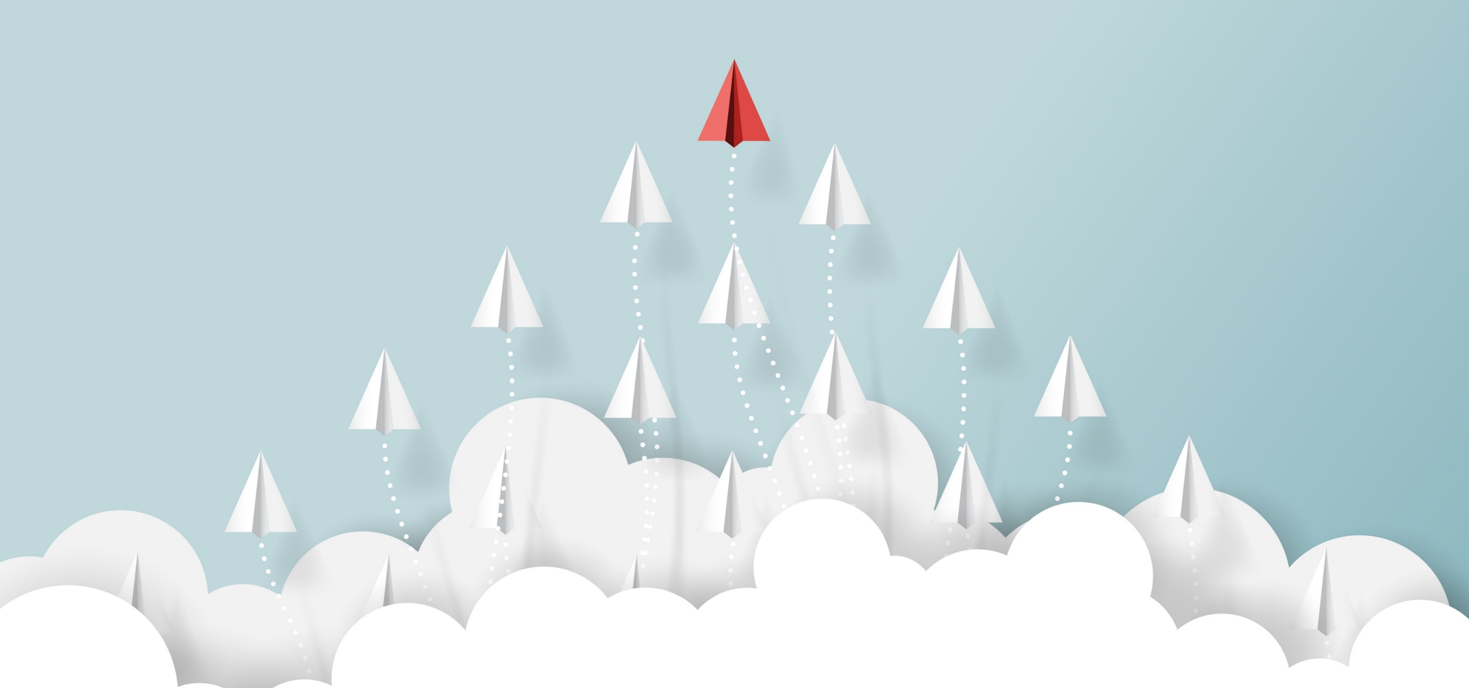
Session Objectives
The Future Hybrid Workforce
What is Needed
TEAMS
What is Still to Come
LEADERS
What We Know
RESEARCH
Notes:
We walk through this journey from the lens of
1. What we know now
.. from researchers that began looking at hybrid workplaces back in 2004 (like Nick Bloom) and others that continue to gather data from that time up through the pandemic.
2. What is needed now
.. what needs to be considered when implementing a hybrid approach including the type of team and the function being performed.
3. What is still to come
.. what do leaders need to do and understand about the office today and the purpose it should be used for – hint: it is not what it was in the past

Slide 7
Session Objectives
The Future Hybrid Workforce
What We Know
RESEARCH
Notes:
We walk through this journey from the lens of
1. What we know now
.. from researchers that began looking at hybrid workplaces back in 2004 (like Nick Bloom) and others that continue to gather data from that time up through the pandemic.
2. What is needed now
.. what needs to be considered when implementing a hybrid approach including the type of team and the function being performed.
3. What is still to come
.. what do leaders need to do and understand about the office today and the purpose it should be used for – hint: it is not what it was in the past

Slide 8
The Research
2010
- 13% more productive
March 2020
- 5000 Americans per month
More Time
- 70 minutes / day saved
- 30 more minutes working
- Increased positivity
- 80% better than expected
- Fewer and shorter breaks
- 50% less likely to quit
Notes:
WE KNOW…..
Stats :
https://siepr.stanford.edu/publications/policy-brief/how-working-home-works-out
We talked about today 50/50
2004 – Nick Bloom Stanford Economist
2010 landmark study that when individuals randomly selected to work from home --- 13% more productive / fewer and shorter breaks/ 50% less likely to quit
2020 – whole world became a research lab for Nick and others in this field. Began collecting significant data across industries, positions, and levels.
5000 pp/month throughout pandemic
Sharp rate of increase on how positive people are working from home
And 80% found it to be better than they thought it would be.
Average Amer: saved 70 min/day working from home saving time in “prepping” and commuting.
In exchange, the organization picked up an extra 30 mins/day in productive time.
RESEARCH SAYS: FUTURE IS NOW!!!! EVIDENCE IS THERE – YET Residence still happens
https://www.forbes.com/sites/jackkelly/2022/01/08/harvard-and-stanford-professors-predict-the-future-of-work/?sh=51c8a4af986a
Although we’ve been dealing with this for the last two years, it's been haphazard. Since we didn’t know the pandemic would last so long, many of the plans, policies and procedures weren’t made with permanence in mind. Our new reality—one in which we may continually be subjected to various strains of Covid-19, along with new viruses—will make business leaders set a standard for their respective companies.
https://api.includere.co/uploads/Stanford%20Research-How%20working%20from%20home%20works%20out%20-%20June%202020.pdf
Pre-Pan – 5% working days were spent working from home – with very neg connotation
https://www.apollotechnical.com/working-from-home-productivity-statistics/

Slide 9
Fairness is about meeting needs
Notes:
We run into “it’s not fair”…….
WE KNOW….
Not for everyone (we talked about this)
BANDAID EXAMPLE…. TikTok vide
What a leader may want… may not be reality right now….. They may need to reflect on what they have known and what is NOW
Same goes for employees …. Want they experienced during the pandemic and want now may not be a long-term realistic reality….
POINT – Both the organization (meaning the leaders) and the employees are influx right now. THIS WE KNOW.
- Do you have employees that are making an hour+ commute to come in to do a function that could be done remotely? Are there workers staring at a computer screen frustrated, wondering “why am I hear”? Because it needs to be “FAIR”…. We are thinking we don’t want other teams, departments to get upset, so we will make a blanket policy across the board…. When actually, you may putting other, good employees in a position they do not need to be in….

Slide 10
Silver Linings
Bottoms-up style of management has emerged
Notes:
WE KNOW….
https://www.forbes.com/sites/jackkelly/2021/10/09/ciscos-hybrid-work-model-offers-flexibility-choice-wellness-and-inclusion/?sh=5d4c56a72cb7
One of the positive aspects arising from the ashes of the devastation caused by the virus outbreak is the change in mindset of corporate leadership. A bottoms-up style of management has emerged. Companies are listening to their employees and taking bold actions and initiatives on their behalf. In a war-for-talent and “Great-Resignation” environment, businesses are offering choices, such as remote and hybrid work models, flexibility, abbreviated workweeks, actively promoting diversity and inclusion in the workplace, wellness programs and empathy.
At least those organizations that are clear of the fact that hybrid is here to stay.
It is amazing the amount of effort that an organization will put into setting up Strategic Plans, Operation Plans, etc….
But right now many are moving forward with Hybrid plans with little to no data. Meaning that some have taken the time to survey staff, had good conversations, explained the difference between fair with equal --- And, most important, understand the concept of going back to check back in, how is it working? What do we need to shift or do differently? For both the org/employee and those we serve. UNCHARTERED TERRITORY…

Slide 11
Prompt/Action Step
Is there an opportunity to connect with staff to seek input? (whether for the first time or to check-in?)
Are there areas in the organization where leaders have bias that get in the way of the hybrid approach?
What side are you on? Are you part of the solution or the problem?

Slide 12
Session Objectives
The Future Hybrid Workforce
What is Needed
TEAMS
What We Know
RESEARCH
Notes:
We walk through this journey from the lens of
1. What we know now
.. from researchers that began looking at hybrid workplaces back in 2004 (like Nick Bloom) and others that continue to gather data from that time up through the pandemic.
2. What is needed now
.. what needs to be considered when implementing a hybrid approach including the type of team and the function being performed.
3. What is still to come
.. what do leaders need to do and understand about the office today and the purpose it should be used for – hint: it is not what it was in the past

Slide 13
Hybrid Teams
Based on interdependence:
Individual
Relay
Team
Notes:
How many days should your team be working from home? Depends on how interdependent they are.
Three kinds of interdependence:
Individual “sport” --- gymnastics…. Call centers (IT)
Relay “sport” --- teams that are project related – Building and Planning, or cross functional collaboration (HR, Legal, DH… coming together)
Team “sport” --- Full time functionality – Research and Design – labs, first responders,

Slide 14
Proximity Bias
Inherent tendency of favoring the people and ideas physically closest and therefore most familiar to you.
Notes:
IT IS THE…inherent tendency of human beings to favor the people and ideas physically closest at hand and therefore most familiar to them.
While often unconscious, this is a cognitive bias which can have a strong negative effect on team morale and performance, undermining attempts to institute fairness and equality in performance management and reward. Failing to tap into the skills and competence of the full workforce is also a clear loss to the employer.
DEFINITION:
the idea that employees with close physical proximity to their team and company leaders will be perceived as better workers and ultimately find more success in the workplace than their remote counterparts.
Common examples of proximity bias include:
Evaluating the work of onsite employees more highly than remote employees regardless of objective performance metrics.
Offering the most interesting projects, assignments or development opportunities to onsite employees.
Excluding remote employees from important meetings or not encouraging them to speak up on calls.
It’s been around… pandemic exacerbated it for obvious reasons. Best way to combat – do not ignore it and do not bring everyone back into the office.
If proximity bias is ignored, businesses risk giving responsibilities, promotions and rewards to workers for being present and familiar to their managers rather than focusing on those who achieve business goals, develop high levels of competence, and have influence with clients.
Fair performance management, well-functioning collaborative working platforms, and more effective and tailored communication by managers and business leaders can all be used to boost inclusion and minimize proximity bias.
https://nhglobalpartners.com/proximity-bias-remote-work/

Slide 15
Proximity Bias
Lower staff engagement
Less robust business decisions
Less long-term vision
Less workforce competence
Less workforce diversity
Notes:
If allowed to operate unchecked in a working environment, proximity bias may have unfortunate consequences for workforce performance, business success and the bottom line of your company. For example:
Lower staff engagement
Staff who don’t feel recognized can become less engaged in their work and if you want your company to excel, staff engagement matters. Research shows that engaged teams are 21% more profitable, 17% more productive and score 10% higher on customer ratings.
Read more about employee engagement at What is Employee Engagement & Why it is the Key to Your Organization’s Success?
There is also the risk that, in order to combat proximity bias, remote employees push themselves to overwork and burnout (also known as ‘digital presenteeism‘).
Less robust business decisions
If you only involve on-site workers in important meetings and decisions, you risk of making sub-optimal business choices that fail to include the full knowledge, experience and perspectives of your wider workforce. For more robust strategy and decisions, business leaders should include all those able to add value, and ensure that IT provision and other commitments allow this to happen.
Less long-term vision
Allowing proximity bias might appear to offer short term benefit in terms of ease and speed of daily working but this can be very quickly cancelled out by the long-term risks of demoralizing remote workers and setting the business on a badly informed strategic course.
Less workforce competence
If promotion and reward processes are influenced by physical presence over objective performance metrics, this reduces the chance of getting the best people into key jobs.
You can learn about how to effectively track the performance of ‘non-proximate’ employees at How To Track Performance in Remote Teams.
Turnover is also higher when staff engagement falls, and high-performing staff are more likely to find new external opportunities. Businesses may be left with a mediocre core workforce and management promoted more for presentee-ism than achievement.
Less workforce diversity
With higher numbers of women, international workers and workers in minority ethnic groups among those who have traditionally chosen to work remotely, losing competent remote workers from a company can easily mean that you lose perspectives and experiences from these groups disproportionately. A less diverse workforce can lead to group think, poorer problem solving, and less long term business resilience.
https://nhglobalpartners.com/proximity-bias-remote-work/

Slide 16
How to avoid it?
More inclusive ways of working
Social Inclusion
Reliable IT platforms with solid collaborative softward
More objective performance management and reward
Proactive and inclusive communication
Notes:
NO one way. Each org has to consider and adjust based on the nature of their work and its starting level of promixity bias.
Options to consider include:
1. More inclusive ways of working
In companies where meetings remain an important for sharing information or making decisions, remote workers need to be included as part of business-as-usual. In some organizations this could mean making all important meetings virtual (i.e. even on-site workers log in at their desks). At a minimum, it should at least mean that the option to attend a meeting remotely is always in place.
Opening up decision-making beyond a single meeting is another inclusive working tool which tackles proximity bias. Facilitating multiple and potentially asynchronous inputs via collaborative working tools, email or phone, captures a wider range of views and expertise. This may then lead to more robust decisions which are understood and backed by more of the workforce.
2. Social inclusion
Team building and social activities should also include those not on-site during core hours. Some companies organize both virtual and real-life activities or alternate the two. Others mix real and virtual activities (e.g. quizzes with on-site or virtual participation). Asynchronous and remote workers can take part in a series of events or ongoing activities (e.g. fantasy football) with remote or locally organized sessions or teams.
3.Reliable IT platforms with functional collaborative working software
Inclusion of remote workers is highly reliant on IT infrastructure, equipment and software. Business leaders should ensure that full provision is made for whatever forms of collaborative working, remote working, asynchronous working and other models are relevant to their workforce.
4. More objective performance management and reward
Instituting a performance framework with more objective goals and metrics can help to limit the influence of proximity bias. Obtaining good quality 360 degree performance feedback on employees and inviting peer and stakeholder nominations for bonuses and awards can challenge proximity bias in the minds of leaders and managers as well as reducing its power.
5. Proactive and inclusive communication
Managers can be proactive in challenging their own proximity bias by communicating equally but differently with all staff, rather than focusing on on-site workers by default and others as an afterthought. They should plan and structure their communication to offer the same level of management oversight and support to all through the most appropriate means for each team member or group of individuals.
This might mean delivering the same message through multiple channels for on-site and remote workers, allowing time to use a collaborative working platform to engage asynchronous workers in another country, and making themselves available for any team contacts and questions at regular times or on regular channels.

Slide 17
Prompt/Action Step
How aware of proximity bias are your leaders?
What needs to be put in place to minimize the impacts of proximity bias in your organization?
What will happen if you do nothing?

Slide 18
Session Objectives
The Future Hybrid Workforce
What is Needed
TEAMS
What is Still to Come
LEADERS
What We Know
RESEARCH
Notes:
We walk through this journey from the lens of
1. What we know now
.. from researchers that began looking at hybrid workplaces back in 2004 (like Nick Bloom) and others that continue to gather data from that time up through the pandemic.
2. What is needed now
.. what needs to be considered when implementing a hybrid approach including the type of team and the function being performed.
3. What is still to come
.. what do leaders need to do and understand about the office today and the purpose it should be used for – hint: it is not what it was in the past

Slide 19
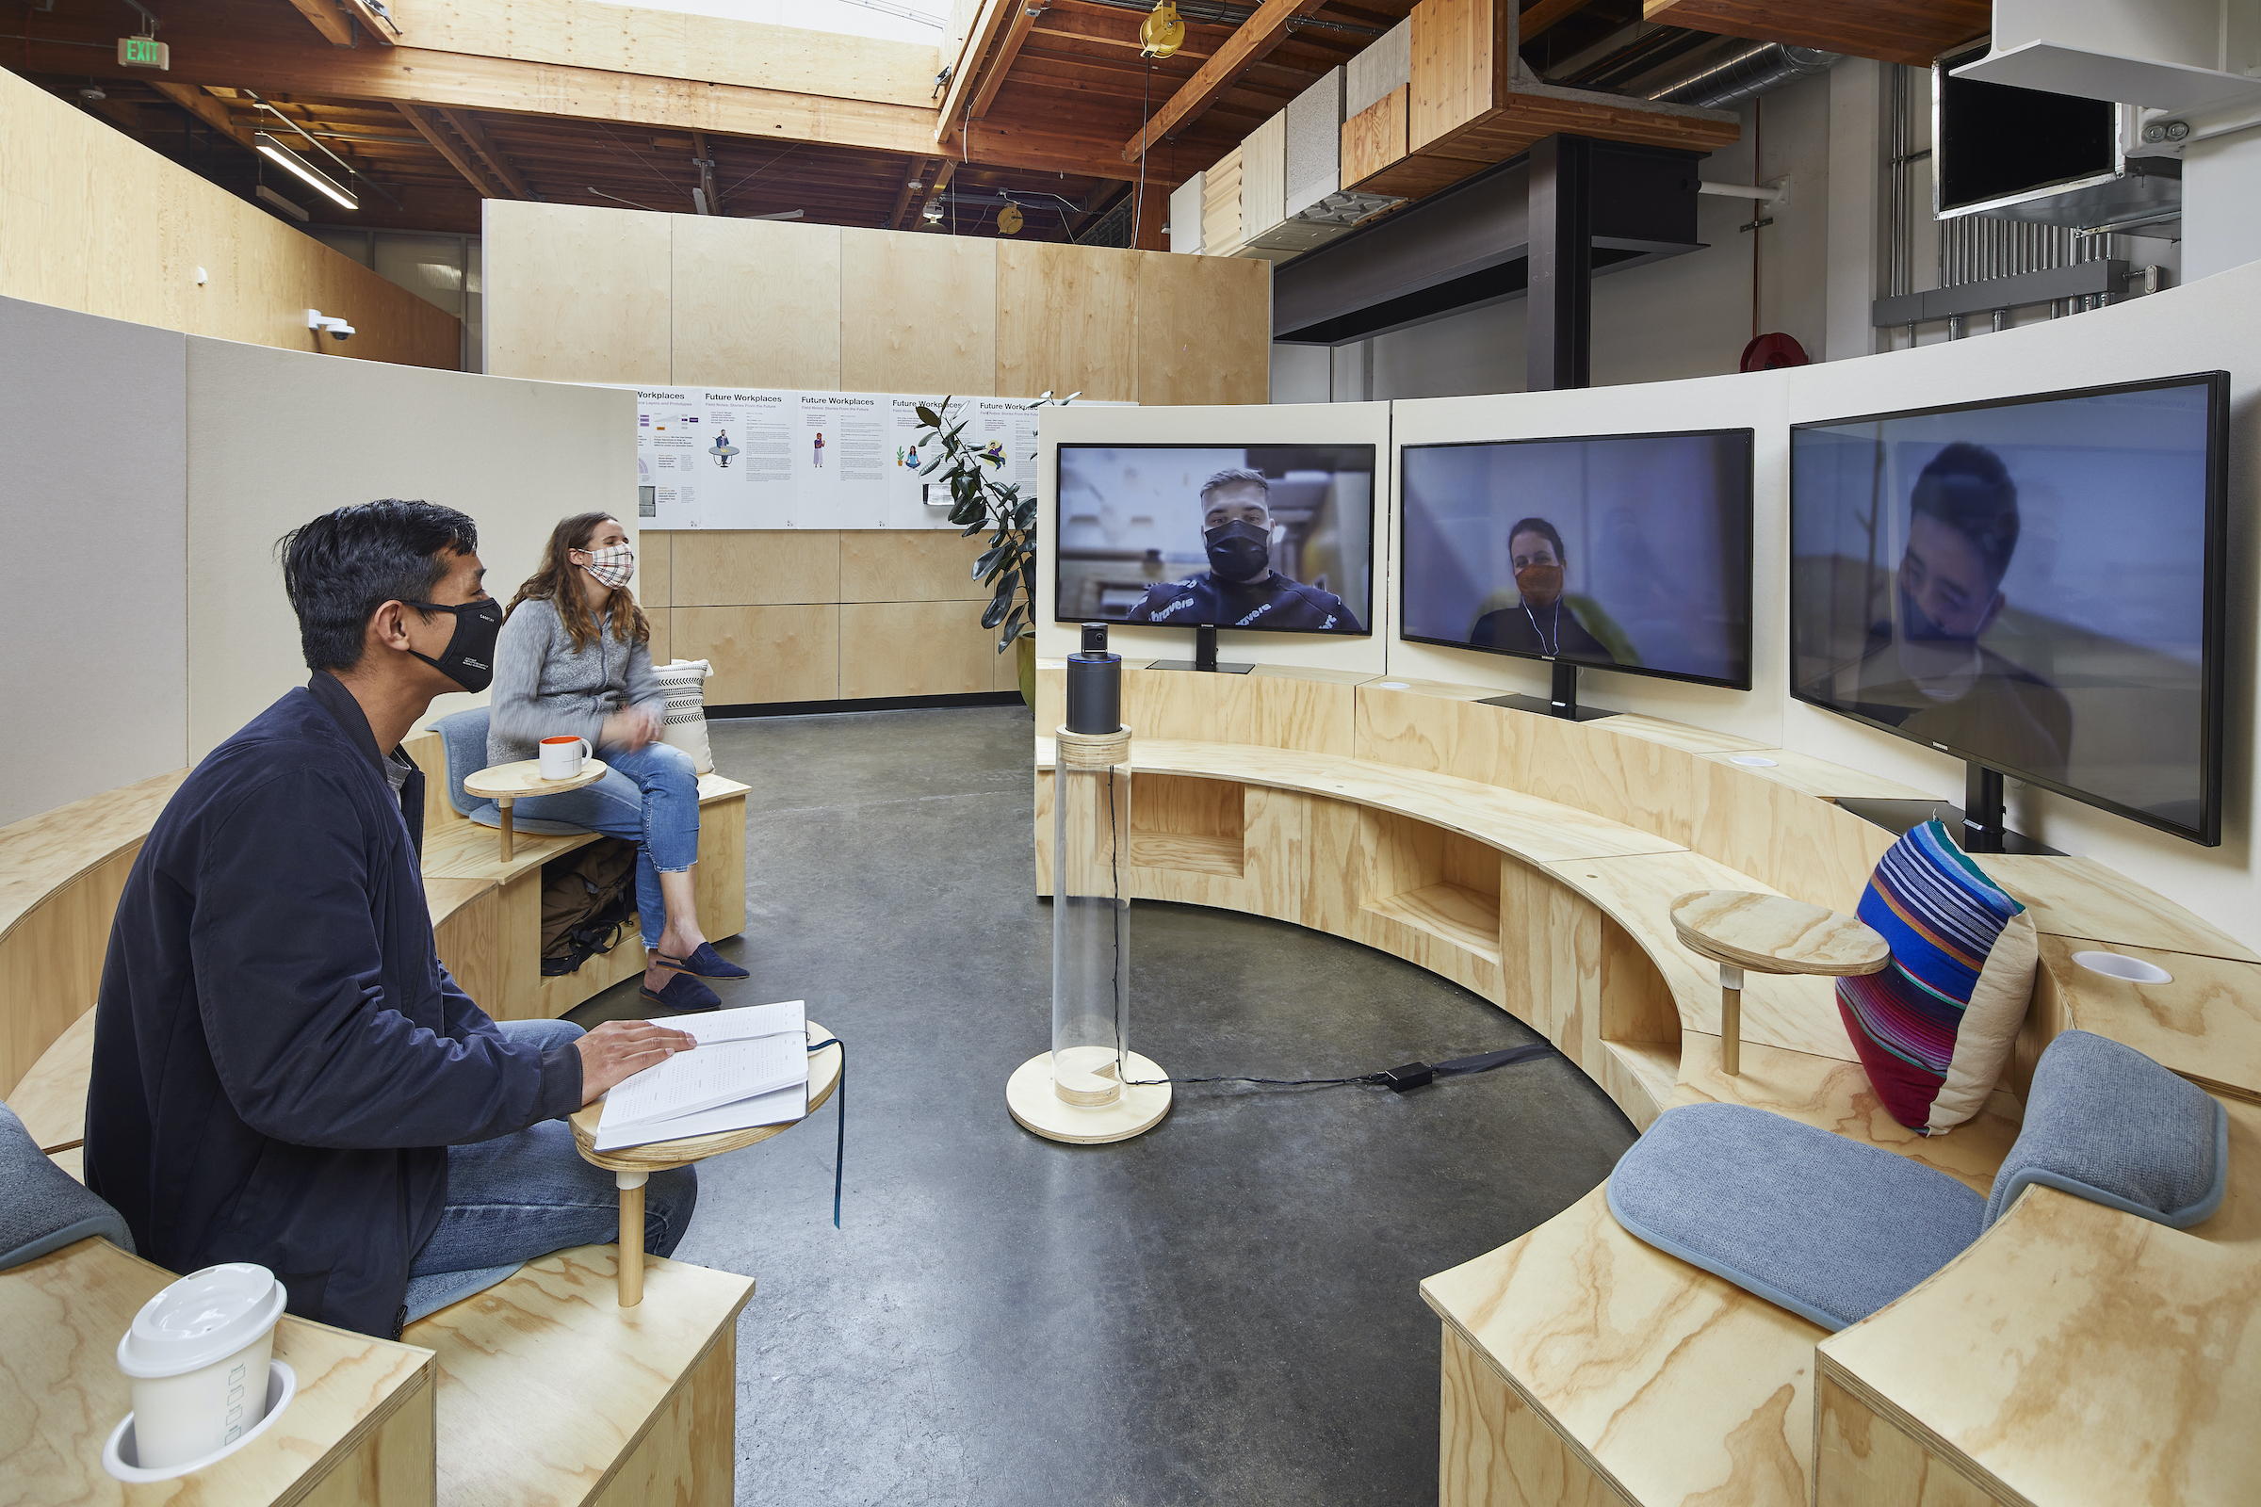
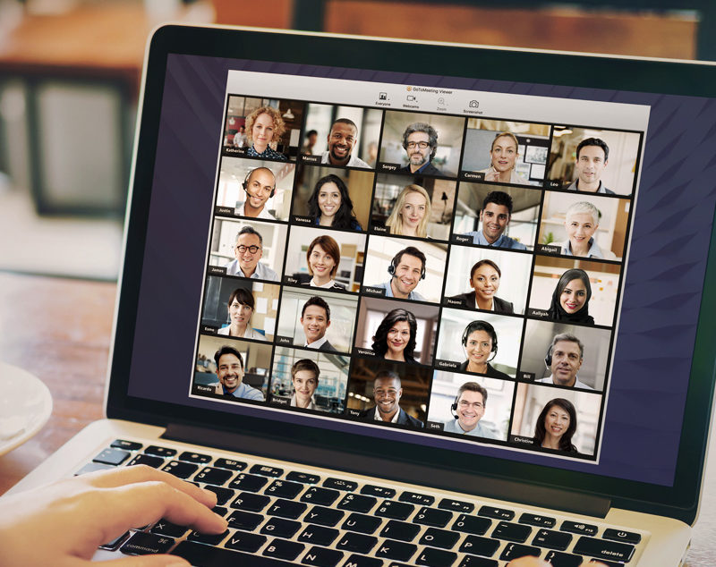
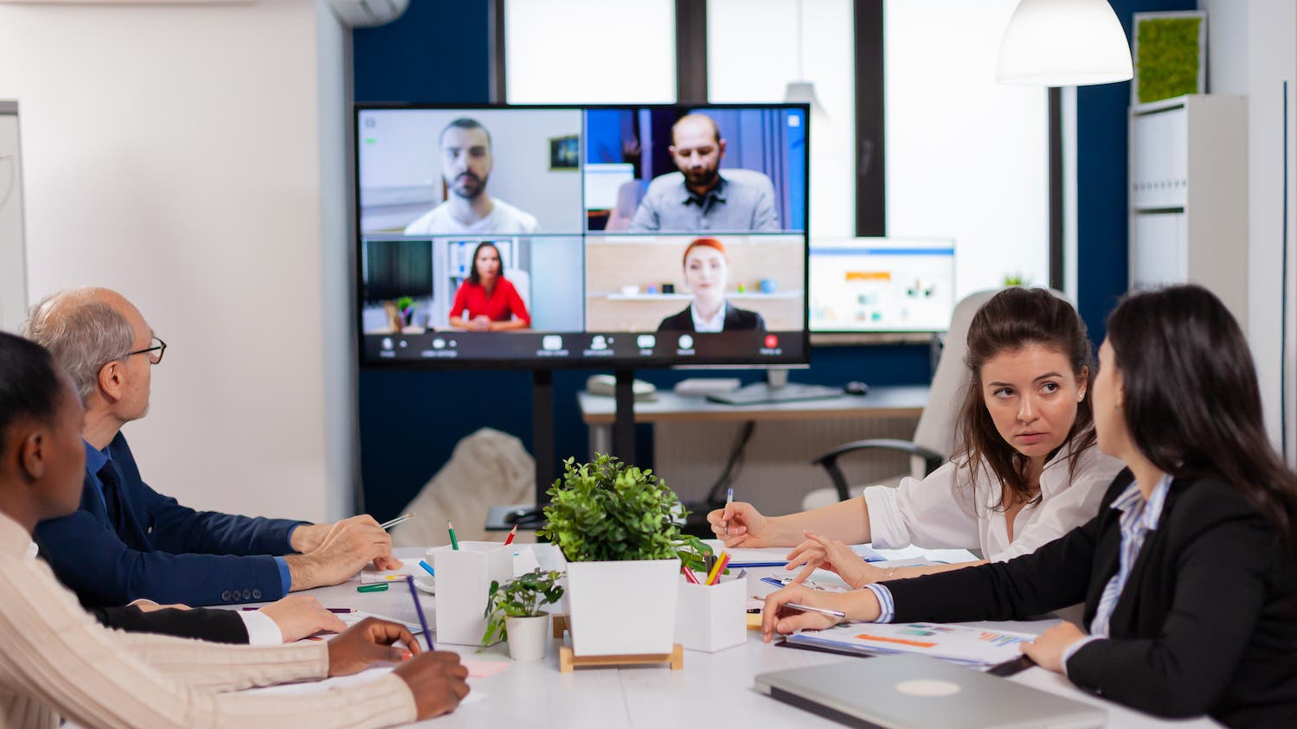
Notes:
https://www.barrons.com/articles/ive-been-studying-work-from-home-for-years-heres-whats-coming-51641330825

Slide 20
Reality…. mindset shift
Notes:
Why Care
..Good/Bad…. No (V/IP) – Just Reality… We need shift mindset – it’s a GOOD reality… A REALLY GOOD… if we learn how to use it and embrace it.

Slide 21
Digital Spaces and Places
Digital Spaces VIRTUAL
In-person Places OFFICE
Equal
Purposeful
Reflection, deep work
Teams, Webex, Zoom,
Consider them PLACES
Build community culture
No longer a destination
Consider it a TOOL
Notes:
Tsedal Neeley, Prof at Harvard Biz School…. Recognized as a Top Voice on LinkedIn in remote work and one of the 100 people transforming business who are innovating, sparking trends, and tackling global challenges by Business Insider,
No Better / No Worse
Leaders – Beware of Mix Messages:
“Oh so glad we are Together!” “so tired of being virtual!”
VIRTUAL – Digital Spaces
Teams, Webex, Zoom, etc…. ARE NOW PLACES
PLACES were …..reflection, deep work.
Gives us a second mode of communication
OFFICE –
No longer a destination…. It is a tool!!!
Just like Teams, Webex, or Zoom is a tool!
A TOOL were…..build community culture
Again, NO BETTER/NO WORSE – Equal.
The question for organizations and leaders is….

Slide 22
Leveling Up…Care
People need to feel your digital and physical presence for a leader to lead effectively
Notes:
Tsedal Neeley, Prof at Harvard Biz School…. Recognized as a Top Voice on LinkedIn in remote work and one of the 100 people transforming business who are innovating, sparking trends, and tackling global challenges by Business Insider,
We should be thinking about CARE and CONNECTION.
In order to create a culture of care – in a hybrid world, we must become intention about using unstructured time for human connection.
Starting each meeting with unstructured time designed to let the team connect. Using a conversation prompt to bring together people and increase the energy.
Conduct “OT Hangout” time. Leaders block time following the mtg to allow team members time for 1:1 quick questions or conversations,
Goal for these type of activities is over communication and building emotional trust --- for ALL staff… not just those walking down the hallway.
1- MANAGERS: Feel your digital presence and physical presence as well --- develop emotional trust – they need to feel that they Care about difficulties, preferences, career developments – through actions…. HOW? Mtgs with OT… Structuring unstructured time… (10% of a mtg – checking in) virtual norms/rules of engagement for equal contribution – turn taking (some people dial up/others down)- leader responsible to monitor and support this…. Limits on talk time, Large groups – beyond 50+ … #tag approach…(#Ques/#aha/#Fire/#debate)
2-

Slide 23
Leveling Up…Care
Opportunity to be multi – modal workers/leaders
Notes:
Tsedal Neeley, Prof at Harvard Biz School…. Recognized as a Top Voice on LinkedIn in remote work and one of the 100 people transforming business who are innovating, sparking trends, and tackling global challenges by Business Insider,
We should be thinking about CARE and CONNECTION.
In order to create a culture of care – in a hybrid world, we must become intentional about using unstructured time for human connection.
Starting each meeting with unstructured time designed to let the team connect. Using a conversation prompt to bring together people and increase the energy.
Conduct “OT Hangout” time. Leaders block time following the mtg to allow team members time for 1:1 quick questions or conversations,
Goal for these type of activities is over communication and building emotional trust --- for ALL staff… not just those walking down the hallway.
1- MANAGERS: Feel your digital presence and physical presence as well --- develop emotional trust – they need to feel that they Care about difficulties, preferences, career developments – through actions…. HOW? Mtgs with OT… Structuring unstructured time… (10% of a mtg – checking in) virtual norms/rules of engagement for equal contribution – turn taking (some people dial up/others down)- leader responsible to monitor and support this…. Limits on talk time, Large groups – beyond 50+ … #tag approach…(#Ques/#aha/#Fire/#debate)
2-Mulit- modal workers/leaders – toggle between the two mediums…. This time calls for it. The more talented and comfortable that leaders get in both of these spaces and with both tools, the more effective they will be and the organization will be.
BONUS: embracing this hybrid approach can support greater diversity and inclusion into the workplace. WHEN prox bias is in check --- how? Using virtual functions and leaning into chat exchanges, polls, etc has proven to give the extraverts in “room” equal space for contribution…. AND those with diverse experiences and views. A qtrly study of 10k employees showed that black and brown professional disproportionality preferred – at 97% - the remote / hybrid work. (Future Forum/SLACK Thinktank) WHY? No micro aggressions, no “coat switching” or pychological swifts they feel they need to make when going into the office…. Women also agree. THIS DOES NOT MEAN that we assign black or brown professional in remote/hybrid schedules or plans, but rather identify how we are managing and utilizing the input and contribution of these staff members now when in the workplace.

Slide 24
Prompt/Action Step
What blind spots currently exist in your organization?
How are these getting in the way of a healthy and supportive hybrid workplace?
What conversations or actions need to take place now?
Notes:
Is it time for a relaunch?

Slide 25
Uncharted Territory
Notes:
We opened talking about uncharted territories…. Once an experience has happened… you don’t go back to the way things were before… you learn, refine, take what did work and continue to adjust and move forward.
You will be leaving here today to go back to your organizations…. To face:
..
….
….
I know….. AND some of you will have heard something I shared today that will resonate with you… something that will say to you –
Maybe….. There are conversations to be had with our leaders…
Potential adjustments you may not have thought of that can be made with staff
So that we retain high performing employees/attract great talent
Continue to serve the community members we cherish….

Slide 26
It is like a voyage of discovery into unknown lands, seeking not for new territory but for new knowledge. It should appeal to those with a good sense of adventure.
— Frederick Sanger
Copyright © 2012 Gallup, Inc. All rights reserved.
Notes:
…was an English biochemist who twice won the Nobel Prize in Chemistry.

Slide 28
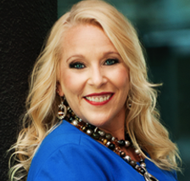
Thank You!
Deanna Potter, M.A.
Strategic Communications Manager
dpotter@tcfoe.com
Direct: 760-415-5245

