Slide 1
California Communities Environmental Health Screening Tool (Cal-EnviroScreen) Office of Environmental Health Hazard Assessment California Environmental Protection Agency
Presentation: CSAC Agriculture and Natural Resources Policy Committee Meeting. November 27, 2012

Slide 2
Program Origins in Environmental Justice
Statutory definition of EJ
“Environmental justice means the fair treatment of people of all races, cultures, and incomes with respect to the development, adoption, implementation and enforcement of environmental laws, regulations, and policies.” Gov. Code §65040.12(e), 1999
Cal/EPA’s responsibilities
Required development of interagency environmental justice strategy for Cal/EPA (completed 2004)
Required each of the Cal/EPA boards and departments to review, identify, and address program obstacles impeding the progress of environmental justice Public Resources Code §71113, 2000

Slide 3
Basis of concern for cumulative impacts
Numerous studies have shown that multiple pollution sources are disproportionately concentrated in low-income communities with high-minority populations.
Studies have reported communities with certain socioeconomic factors (i.e. low-income, low-education) have increased sensitivity to pollution.
Combination of multiple pollutants and increased sensitivity in these communities can result in higher cumulative pollution impacts.

Slide 4
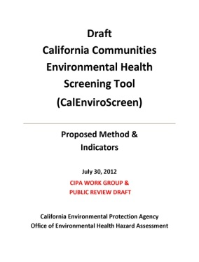
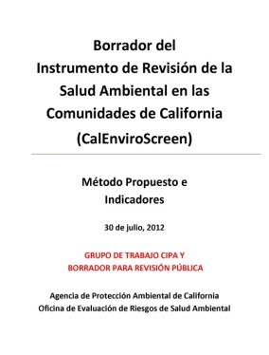
How We Got Here (Process)
California Environmental Justice Advisory Committee
Recommended cumulative impacts as an important EJ issue
Environmental Justice Action Plan (October 2004)
Called for guidance on cumulative impacts
CA Interagency Working Group on Environmental Justice
Adopted working definition for cumulative impacts
Office of Environmental Health Hazard Assessment
Designated lead on cumulative impacts guidance development
Convened a Work Group of external stakeholders to provide advice.

Slide 5
December 2010 Project Report
Described an approach to evaluating cumulative impacts across California.
Screening tool for comparing the cumulative impacts of multiple pollution sources in CA communities, while accounting for socioeconomic factors that that can increase a community’s vulnerability to pollution.
Identify communities with high cumulative impacts.
Available on the OEHHA website at:
http://oehha.ca.gov/ej

Slide 6
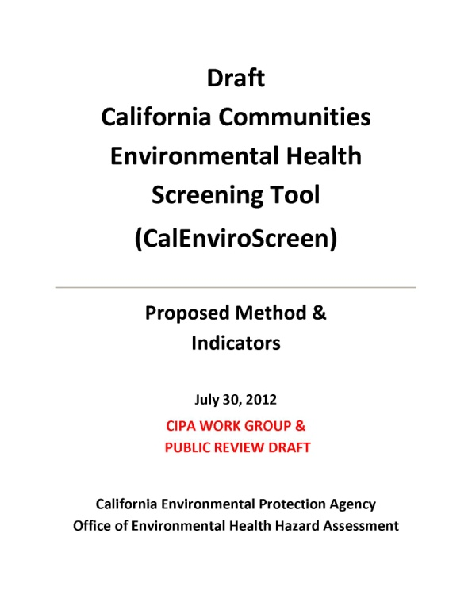
2012 Draft CalEnviroScreen Tool
Identifies 19 indicators of environmental and socioeconomic conditions.
Analyzes indicators in 1800 CA zip codes.
Presents a broad picture of the relative burdens communities face from environmental pollution.
Reflects a “work in progress”

Slide 7
Stakeholder Engagement Process for Cal-Enviroscreen
Conducted 12 public workshops
Cumulative Impacts Precautionary Approach (“CIPA”) Workgroup
7 Regions around the state
Business Communities, Local Government, Tribes
Academic workshop to receive detailed comments from experts in the field
Received numerous oral comments and questions (e.g., > 1000)
Presented to California Council for Environmental and Economic Balance, CAPCOA Board, others
Comment period ended October 16
Received 29 written submissions commenting on tool

Slide 8
Working Definition
“Cumulative impacts means exposures, public health or environmental effects from the combined emissions and discharges in a geographic area, including environmental pollution from all sources, whether single or multi-media, routinely, accidentally, or otherwise released. Impacts will take into account sensitive populations and socioeconomic factors, where applicable and to the extent data are available.”
-- Cal/EPA Interagency Working Group on Environmental Justice

Slide 9
Primary Components
Burden of Pollution
Exposures
Public Health Effects
Population Characteristics
Sensitive Populations
Socioeconomic Factors
Environmental Effects

Slide 10
Interpretation of Major Terms
Exposures
Contact with pollution
Public Health Effects
Disease and other health conditions that increases susceptibility to pollutants
Environmental Effects
Adverse environmental conditions caused by pollutants
Sensitive Populations
Populations with biological traits that may magnify the effects of pollutant exposures
Socioeconomic Factors
Community characteristics that result in increased vulnerability to pollutants

Slide 11
Proposed Geographical Unit: ZIP Code¹
Familiar scale
Publicly established
Public recognition
Not too large to discern differences
Not too small
To lose relevant data (e.g., certain health data)

Slide 12
Components are Characterized by Indicators
Pollution Burden |  |  | Population Characteristics
Exposures | Public Health Effects | Environmental Effects | Sensitive Populations | Socio- economic Factors
Ozone concentrations PM 2.5 concentrations Traffic density Pesticide use Toxic releases from facilities Drinking water quality* | Low birth weight rate Asthma ER visit rate Heart disease mortality rate* Cancer Mortality rate* * under development or revision | Clean-up sites (brownfields) Leaking under-ground storage tanks and cleanups Solid waste sites and facilities and hazardous waste facilities Impaired water bodies | Prevalence of children Prevalence of elderly | Educational attainment Household income Poverty Percent non-white

Slide 13
Criteria for indicator selection
Provide a good measure of the contribution to the component
Pollution burden indicators should relate to issues that may be actionable by Cal/EPA
Population characteristic indicators should relate to demographic factors that may influence vulnerability to disease
Publicly available
Statewide and location-based information
Good quality data (e.g., covers the state, accurate, current)

Slide 14
Proposed model for aggregating components
Cumulative Impact
Exposures + Public Health Effects + Environmental Effects
Sensitive Populations + Socioeconomic Factors

Slide 15
Range of Scores for Components
Component | Range of Possible Scores
Exposures | 1-10
Environmental effects | 1-5
Public health effects | 1-5
Sensitive populations | 1-3
Socioeconomic factors | 1-3
Cumulative impact | 6-120
Considering revised scoring based on comments.

Slide 16
Indicator: Ozone
Air Resources Board’s Air Monitoring Network
Indicator: Daily maximum 8-hour ozone concentrations for the summer season
Interpolated from nearest monitors to geographic center of the ZIP code by ARB
Three year (2007-2009) average
Assign a percentile (>0 – 100) to all California ZIP codes

Slide 17
Preliminary Statewide Map: Ozone

Slide 18
Preliminary Component Score: Exposures Indicators

Slide 19
Preliminary Component Score: Public Health Indicators

Slide 20
Preliminary Component Score: Environmental Effects Indicators

Slide 21
Preliminary Component Score: Sensitive Populations

Slide 22
Preliminary Component Score: Socioeconomic Factors

Slide 23
Some Potential Uses of Tool
To aid ongoing planning and decision-making within Cal/EPA
To provide a baseline of information
The tool is not
intended to be used as the sole determining factor in decision-making
to replace a formal risk assessment

Slide 24
SB 535 (De Leon, 2012)
Cal/EPA shall identify disadvantaged communities for investment opportunities based on geographic, socioeconomic, public health and environmental hazard criteria.
Department of Finance triennial investment plan for Greenhouse Gas Reduction Fund must allocate at least 25 percent to projects that benefit these communities, and at least 10 percent to projects located in these communities.

Slide 25
Examples of Comments Received on the Methodology
Geographical unit: Consider using census tracts instead of ZIP codes
Components should be weighted differently
Consider different method than percentiles for scoring individual indicators
Consider additive rather than multiplicative model (to aggregate pollution burden and population characteristics)

Slide 26
Next Steps
Review Comments from the Public and Making Revisions
Revise indicators and analysis
Release a revised CalEnviroScreen for public comment early 2013
CIPA workgroup meeting
Consider comments
Finalize CalEnviroScreen early 2013

Slide 27
How to learn more…
Project reports, meetings, and archive of public materials:
Website
http://www.oehha.ca.gov/ej/index.html
E-mails when new information is available or when meeting are announced:
OEHHA’s listserv, select “Cumulative Impacts”
http://www.oehha.ca.gov/Listservs/default.asp

