Slide 1
Complying with Electric Vehicle Charging Station Permit Streamlining Law Webinar
California State Association of Counties
League of California Cities
California Governor’s Office of Business and Economic Development
February 19, 2020

Slide 2
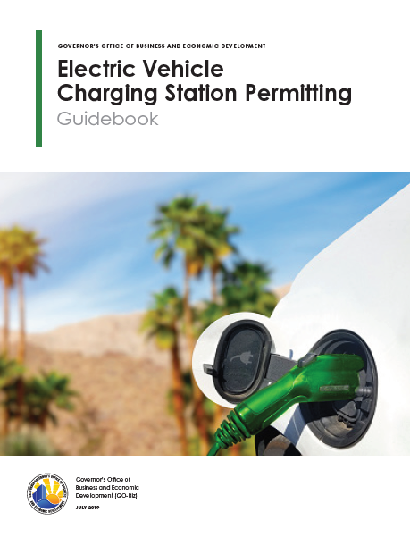
Electric Vehicle Charging Station Permit Streamlining
CSAC/League of Cities Webinar
- February 19th, 2019 -

Slide 3
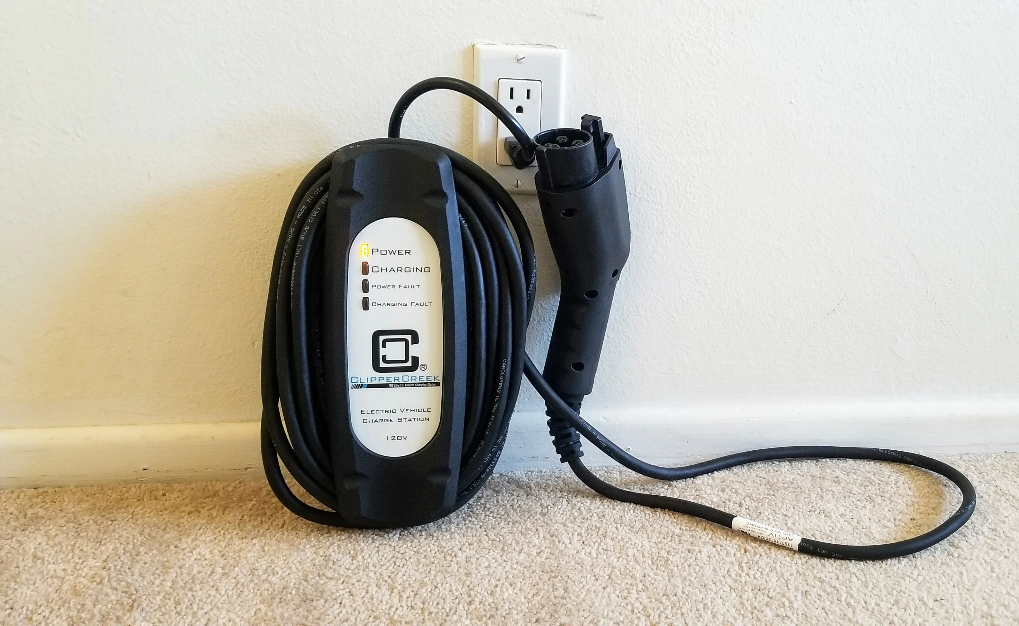
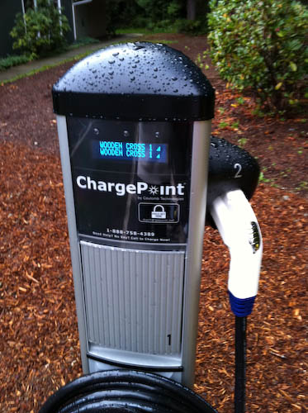
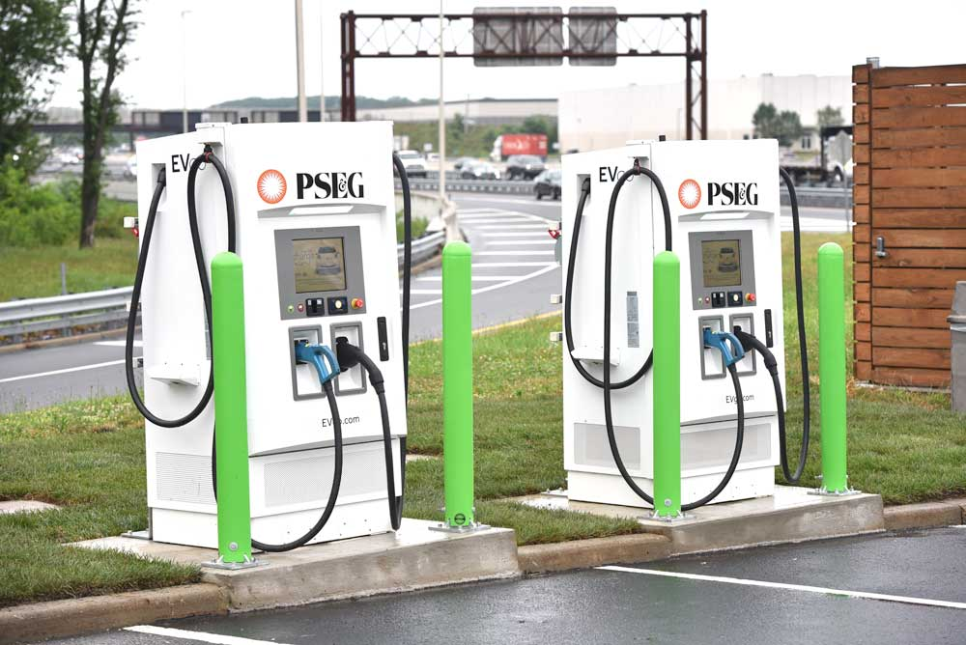
Intro: What are Electric Vehicle Charging Stations (EVCS)
Level 1
(Up to 1.9 kW)
- 4-5 miles per hour -
Level 2
(Up to19.2 kW)
- 12-70 miles per hour -
Level 3 / Direct Current Fast Chargers / DCFC
(50-350 kW)
- 3-20 miles per minute -

Slide 4
Guidebook Key Sections
1. Planning and Site Selection
2. Permitting
AB 1236 Streamlining Map
3. Accessibility
4. Connecting to the Grid
5. Construction, Commissioning, and Operation

Slide 5
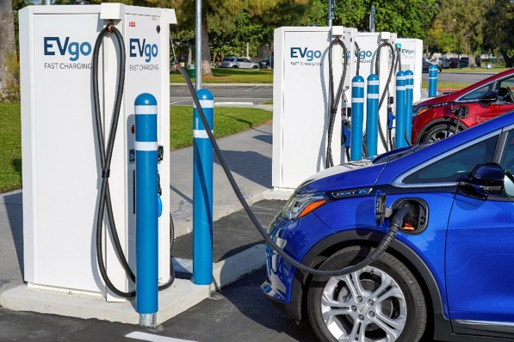
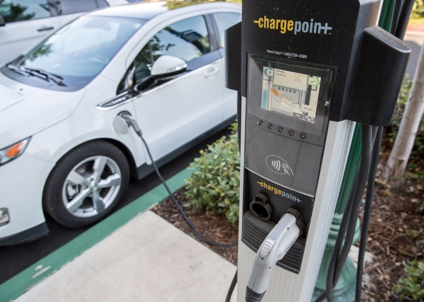
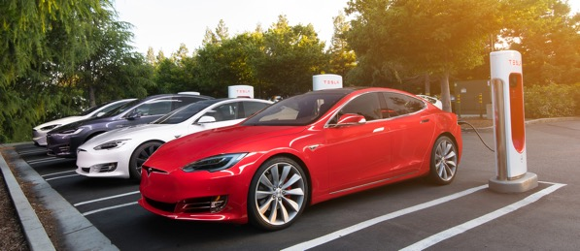
Planning and Site Selection
Voluntary Building Codes
Parking/Charging Clarification
AB 1100 (Kamlager-Dove, 2019)
Climate Action Plans
Authority Having Jurisdiction (AHJ) | Policy
Sacramento County | EVCS spaces count as two spaces
Los Angeles County | EVCS spaces count as one space
City of Pleasanton | EVCS spaces count as one space
City of Santa Barbara | EVCS spaces count as one space
City of West Hollywood | EVCS spaces count as one space
City of Stockton | EVCS spaces count as two spaces, for up to 10% reduction of parking requirements
Notes:
AB 1100, effective Jan. 1, 2020 requires an EVCS parking space to be counted as at least one standard automobile parking space, and an accessible EVCS parking space with an access aisle to be counted as at least 2 standard parking spaces, for the purpose of complying with any applicable minimum parking requirements established by a local jurisdiction.

Slide 6
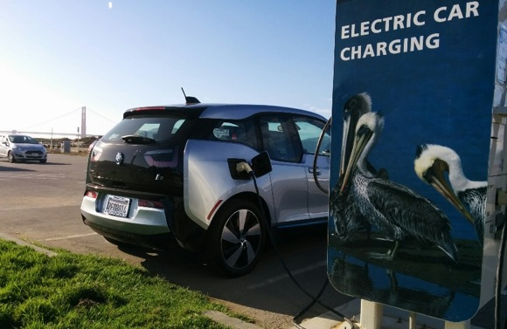
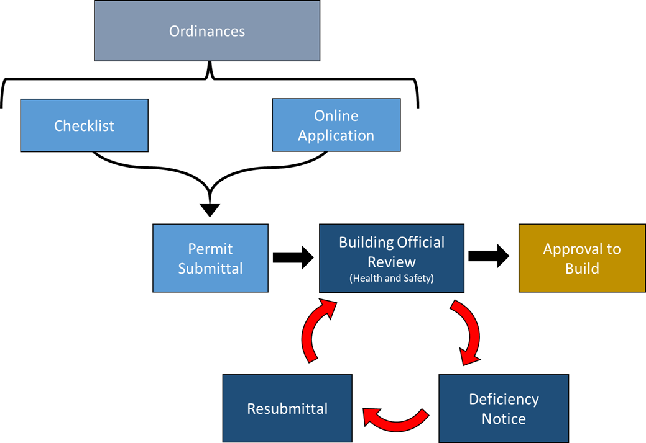
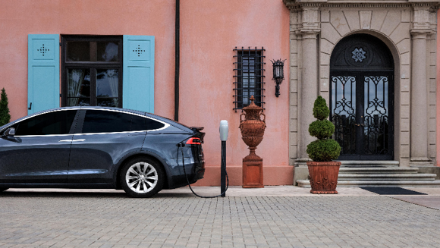
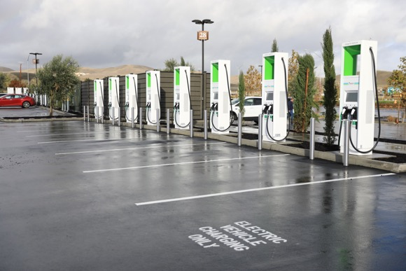
Permitting
Assembly Bill 1236 Permit Streamlining Law

Slide 7
Best Practice Permitting Timelines

Slide 8
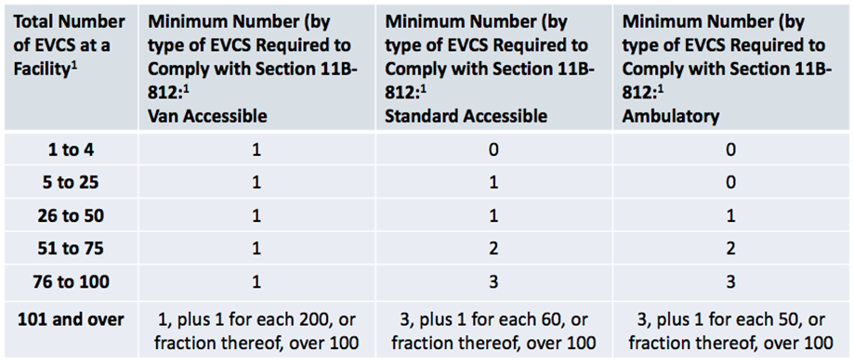
Accessibility
California is first in the nation to provide ADA compliance specificity

Slide 9
Connecting to the Grid
Working with Utilities
Communicate early with utilities
Working with designated interconnection teams

Slide 10
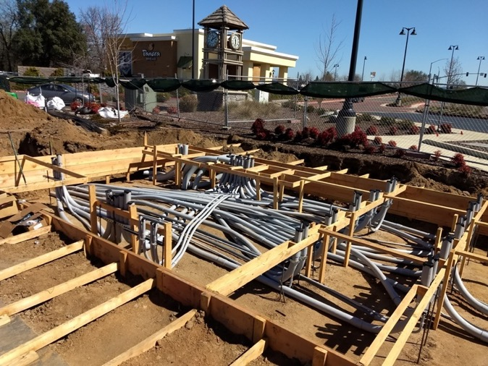
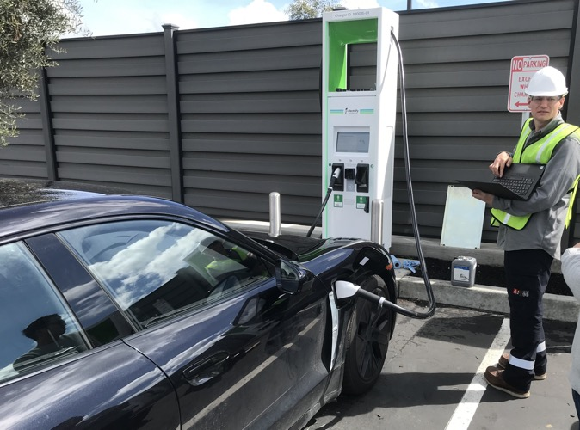
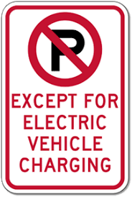
Construction, Commissioning, and Operation
Weight and Measures Certification
Signage

Slide 11
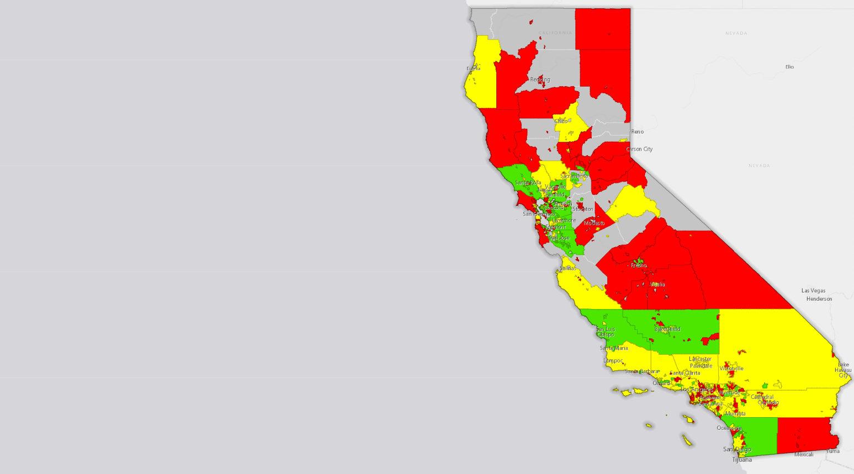
CA Electric Vehicle Charging Station Permit Streamlining Map
*Interactive map available here
EVCS Permit Ready Score:
Green – City or County is EVCS Permit Ready, charging infrastructure permitting is streamlined
Yellow – City or County EVCS permit streamlining is in progress, or partially complete
Red – City or County is not streamlined for EVCS permitting
Grey – Not yet evaluated (or in process)

Slide 12
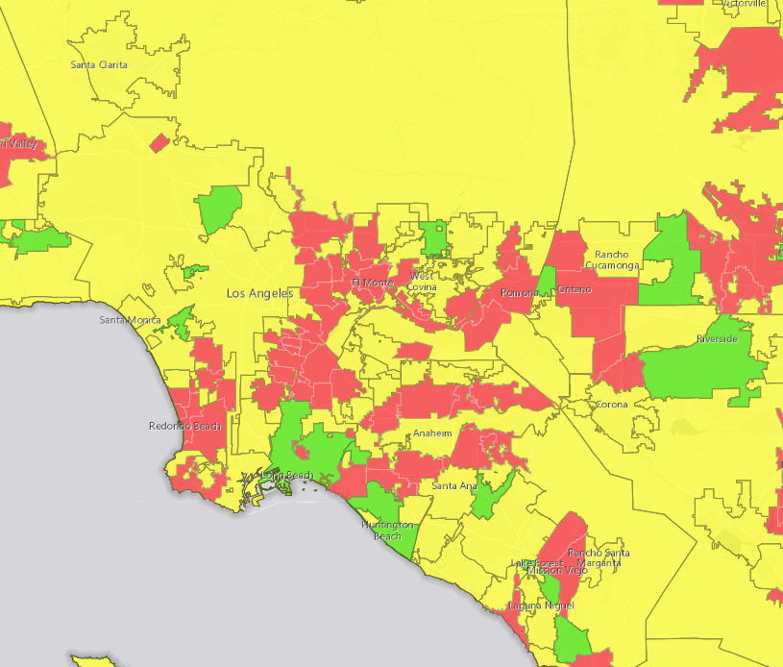
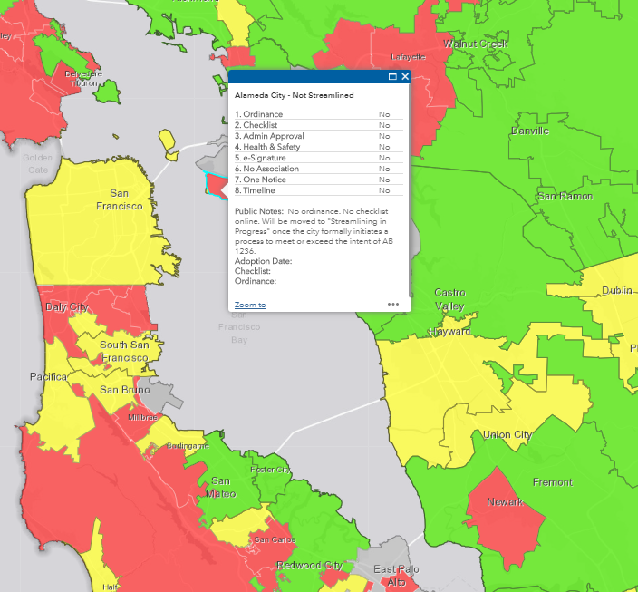
*See http://business.ca.gov/zevreadiness for updated map

Slide 13
Status of the State as of 2/12/20 - Cities and counties
Streamlined - 73
Streaming in Progress - 165
Not Streamlined - 257
Only 14.7% of California has streamlined its EVCS permitting

Slide 14
Why is Permit Streamlining Important?
Installing a charging station is 3 to 5 the cost of charger itself (more expensive than other countries)1
Soft Costs (i.e. permitting) have the greatest possibility for cost reduction with installing charging stations
Electrify America data across states:
Average permitting time in California exceeds the national average by more than 70%
Stations must be redesigned in California 30% more frequently
Cost 22% more to build in California
New jobs, economic development and cleaner air
1. From Reducing EV Charging Infrastructure Costs, Rocky Mountain Institute.

Slide 15
 | Scoring Criteria: | Complete if:
□ | 1. Streamlining Ordinance Ordinance creating an expedited, streamlined permitting process for electric vehicle charging stations (EVCS) including level 2 and direct current fast chargers (DCFC) has been adopted. | Streamlining ordinance has been adopted
□ | 2. Permitting checklists covering Level 2 and DCFC Checklist of all requirements needed for expedited review posted on city or county website. | Permitting checklist is available and easily found on city or county website
□ | 3. Administrative approval of EVCS EVCS projects that meet expedited checklist are administratively approved through building or similar non-discretionary permit. | The streamlining ordinance states that permit applications that meet checklist requirements will be approved through non-discretionary permit (or similar)
□ | 4. Approval limited to health and safety review EVCS project review limited to health and safety requirements found under local, state, and federal law. | The streamlining ordinance states that no discretionary use permit is required and permit approval will be limited to health and safety review

Slide 16
□ | 5. Electric signatures accepted AHJ accepts electronic signatures on permit applications.* | Electronic signatures accepted on City or County website (usually specified in the ordinance)
□ | 6. EVCS not subject to association approval EVCS permit approval not subject to approval of an association (as defined in Section 4080 of the Civil Code). | The streamlining ordinance states that EVCS permits do not require association approval
□ | 7. One complete deficiency notice AHJ commits to issuing one complete written correction notice detailing all deficiencies in an incomplete application and any additional information needed to be eligible for expedited permit issuance. | The streamlining ordinance dictates that a written correction notice must detail all deficiencies
□ | 8. Bonus: Expedited timeline for approval Consistent with the intent of AB 1236, AHJ establishes expedited timelines for EVCS permit approval compared to standard project approval procedures. | The streamlining ordinance (or other policy mechanism) outlines expedited approval timelines for EVCS permits

Slide 17
Common Problems
Aesthetics – Requiring additional landscaping, colored bollards, public art etc.
Zoning Concerns
Parking Counts
No Electronic Signature
Different ADA Interpretations
Lack of Awareness of AB 1236

Slide 18
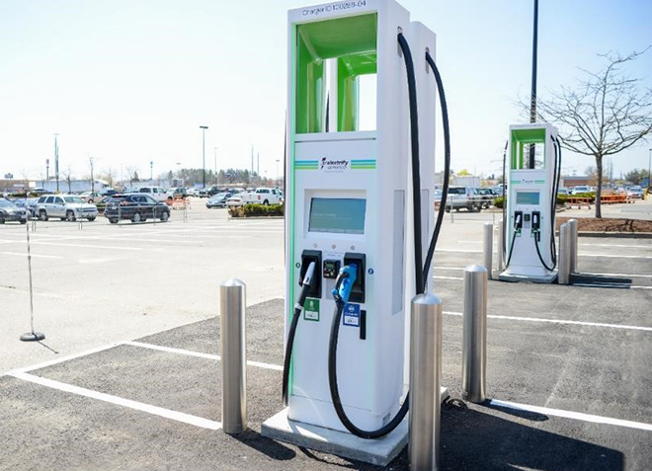
Common Problem: Multiple Rounds of Deficiency Comments
ADA Compliance
Second, Third, Forth Round of Comments
Building Review Comments
Planning Review Comments
Parking Count Issues

Slide 19
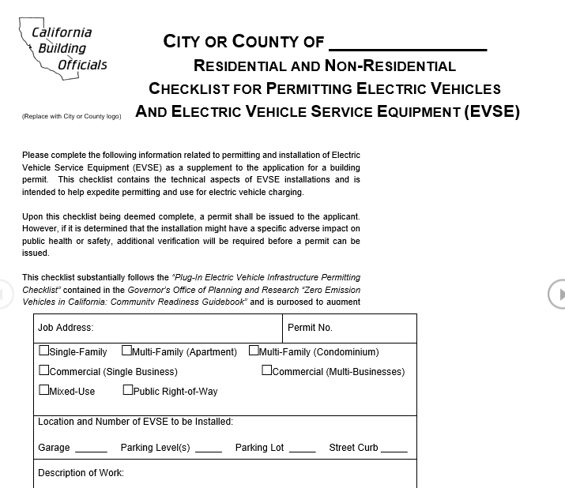
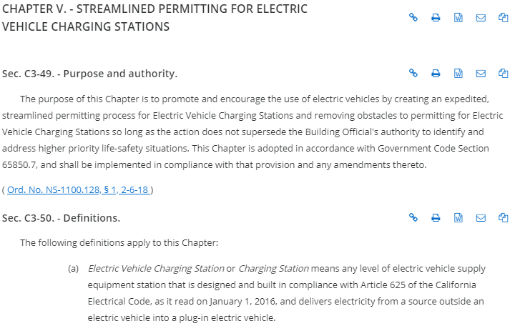
How to become “Green” on the AB 1236 Map
Pass an Ordinance
Create EVCS permitting checklist
Based on the ordinance and checklist, develop permitting process that (in practice) streamlines the permitting process
Removing Planning Department decisions from the process as much as possible

Slide 20
Learn More About Permit Streamlining in LA on March 10th
Online and in-person attendance (free lunch provided)
Register to attend here: bit.ly/ZeroEmissionWorkshop

Slide 21
Contact us with your questions:
Kielan Rathjen
kielan.rathjen@gobiz.ca.gov
(916) 447-7936
Tyson Eckerle
tyson.eckerle@gobiz.ca.gov
(916) 322-0563
Subscribe to our Newsletter: The Plug and the Nozzle

Slide 22
Questions?

