Slide 1
Evidence Based Practices in Napa County Probation
By Mary Butler

Slide 2
Evidence Based Practices
Definition:
A progressive, organizational use of direct, current scientific evidence to guide and inform efficient and effective correctional services.

Slide 3
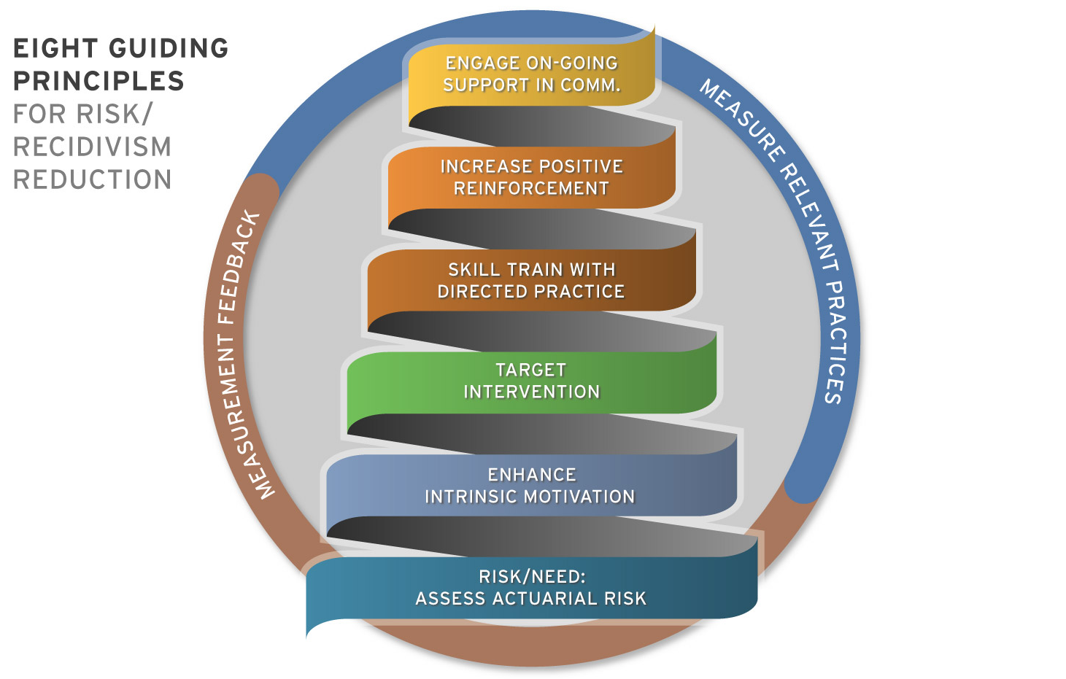
CASE PLAN

Slide 4
Evidence Based Practices
Links between treatment and recidivism:
Criminal sanctions 7% increase
Inappropriate treatment 6% increase
Intensive supervision 7% increase
Appropriate treatment 30% reduction

Slide 5
Evidence Based Practices
Criminogenic Needs:
TOP FOUR
Anti-social cognition
Anti-social companions
Anti-social personality
Family and/or marital status

Slide 6
Evidence Based Practices
Criminogenic Needs:
THE NEXT FOUR
Substance abuse
Education
Employment
Leisure time/recreation

Slide 7
Evidence Based Practices
WHAT WORKS:
Target criminogenic needs
Cognitive behavioral treatment
Incorporate social learning practices
Balanced approach to sanctions and interventions
Therapeutic integrity
Four to one principle

Slide 8
Napa County Probation
Implemented risk/needs assessment in 2005
Trained entire criminal justice system in evidence based practices
Developed cognitive behavioral facilitators
Opened Community Corrections Service Center in 2009

Slide 9
Community Corrections Service Center
Day Reporting Center
Assessments
Cognitive Behavioral Programs
Life Skills
Anger Management
Substance Abuse
Moral Reconation Therapy
Domestic Violence

Slide 10
Community Corrections Service Center
Intensive Program
Moves at offender’s own pace
Includes prosocial activities
Includes giving back to the community
Most intensive program for high risk offenders
Over 150 graduates
24% recidivism rate

Slide 11
Dosage Probation
Pilot program with the National Institute of Corrections
Three sites in the US
Premise is to deliver the appropriate amount of programs for the appropriate length of time to achieve maximum results and then release offender from supervision
Started in April 2016

Slide 12
Dosage Probation
High risk offenders receive 300 hours
Medium risk offenders receive 200 hours
Must be supervised for minimum of one year
Violent crimes, gang and sex offenders are excluded from the program
Currently have 40 offenders in the program. Goal is to have 200.

Slide 13
Dosage Probation
Seven probation officers
Received additional training in delivering cognitive programming
Program is voluntary to clients
Incentive based
Accountability crucial to success of program
Additional support to staff with coaching and monitoring of client contact

