Slide 1

California’s Infrastructure Crisis

Slide 2

Statewide Transportation System
Needs Assessment 2011
“California’s transportation system is in jeopardy. Underfunding – decade after decade – has led to the decay of one of the State’s greatest assets.”
- California Transportation Commission .
Notes:
“California’s transportation system is in jeopardy. Underfunding – decade after decade – has led to the decay of one of the State’s greatest assets.” – California Transportation Commission

Slide 3

Neglected Improvements Are Staggering
California’s unfunded needs are
through 2021.
$295B
- California Transportation Commission .
Statewide Transportation Needs Assessment 2011
Notes:
California’s unfunded transportation needs are $295 billion through 2021.
- California Transportation Commission Statewide Transportation Needs Assessment 2011

Slide 4

California Infrastructure Report Card
Pavement
58%
of California Roadways Require
Rehabilitation or Pavement Maintenance
87%
of California’s Counties have an Average Pavement Rating of “At Risk” or “Poor”
25%
of Local Streets and Roads will be in “Failed” Condition by 2022 under our Current Funding Levels
6
of the Nation’s 10 Worst Urban Area Pavement Conditions
- California Transportation Commission .
Statewide Transportation Needs Assessment 2011
Notes:
Infrastructure Report Card
CALIFORNIA
Pavement:
58% of California’s Roadways Require Rehabilitation or Pavement Maintenance
6 of the Nation’s 10 Worst Urban Area Pavement Conditions
Bridges:
20% Require Major Maintenance or Preventative Work
6% Require Complete Replacement
- Statewide Transportation Needs Assessment 2011

Slide 5
California Infrastructure Report Card
Transit
46%
of Vehicles in California’s Bus Fleet are at or beyond the 12-year Replacement Age Recommended by the Federal Transit Administration
$37.2B
- Projected Level of Investment Needed to Bring all Existing Transit Capital Assets to a “State of Good Repair” over the Next 10 Years.
Notes:
Infrastructure Report Card
CALIFORNIA
6 of the Nation’s 10 Worst Urban Area Pavement Conditions
14 of the Nation’s 20 Most Congested Transportation Corridors
66% of California’s Major Urban Highways are Congested
- Texas Transportation Institute

Slide 6
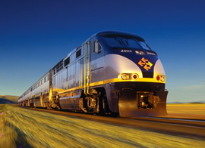
There Are State Rail Challenges, Too!
Caltrans Rail
$3+ B
- 10-year Capital Shortfall
$1.4B
- 10-year Operation and Maintenance Need
- CTA Needs Assessment
Notes:
Infrastructure Report Card
CALIFORNIA
14 of the Nation’s 20 Most Congested Transportation Corridors
66% of California’s Major Urban Highways are Congested
- Texas Transportation Institute

Slide 7
Jobs & Unemployment
Each $1B Invested in Transportation Creates Approximately
30,000 Jobs
- 15,000 Direct and Indirect Transportation Jobs
- 15,000 Induced Jobs
The Construction Industry is Reporting
20-40% Unemployment
- Federal Highway Administration
Notes:
Jobs and Unemployment
Each $1 billion invested in transportation creates approximately 30,000 jobs
15,000 direct and indirect transportation jobs
15,000 induced jobs
The construction industry is reporting 20-40% unemployment (Federal Highway Administration)

Slide 8
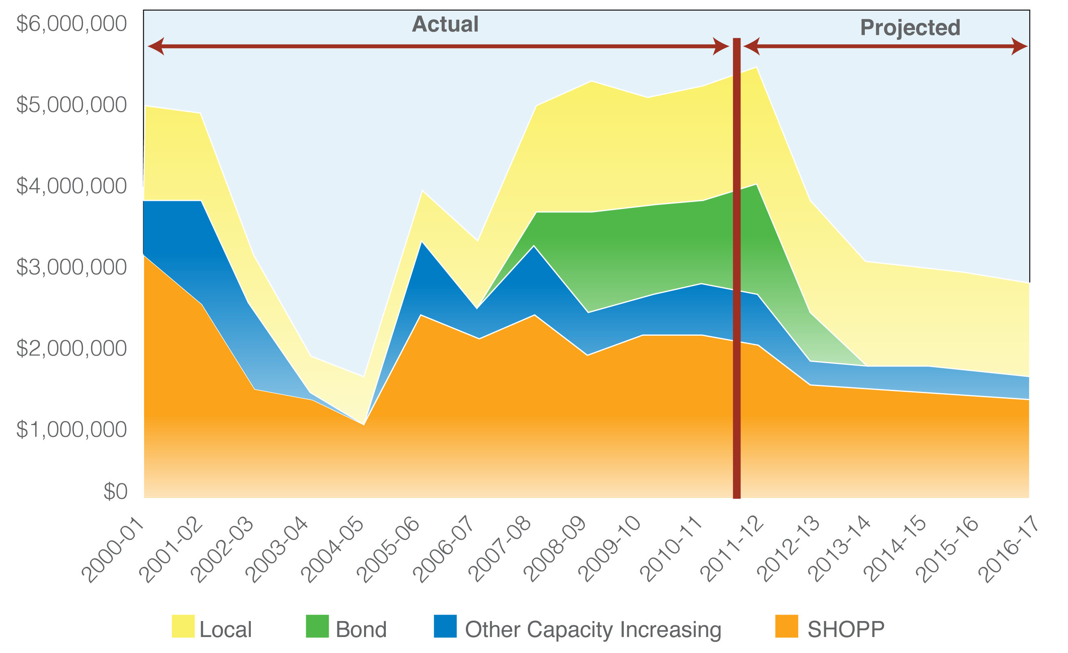
Funding Will Collapse in 2013-14
Source: Transportation Weekly. Vol. 11, Issue 34
Notes:
Transportation funding Will Collapse in 2013

Slide 9

Our Current Challenges
Decline of Gas Tax Revenues and Purchasing Power
Diversion of Transportation
Revenues (GO debt service)
Lack of State and Federal Solutions
Notes:
Changes in technology have caused fuel taxes to grow slower than the amount of vehicle miles traveled and population growth.
Two factors are prominent in this dilemma:
Increasing fuel economy of newer cars is causing less fuel to be consumed per mile of travel and, hence, less fuel tax collected per mile.
Increasing use of alternative fuels, such as methanol and compressed natural gas, which are not taxed as much as gasoline or diesel fuel. Increasing use of hybrid and electric vehicles will have the same effect.
Additionally, with state budget issues, transportation revenues are being diverted to backfill other areas.

Slide 10

2013: Critical Year to Address the State’s Transportation Funding Challenges
Prop 1B Coming to an End
Gas Tax Revenue Continues to Decline
Needs are Critical
State’s Economy and Quality of Life on the Line
Need to Take Action NOW
Notes:
2013: Critical year to address the State’s transportation funding challenges
Prop 1B coming to an end
Gas tax revenue continue to decline
Needs are critical
State’s economy and quality of life on the line
Need to take action NOW

Slide 11

The Plan
Capitalize on our Unique Opportunity
  High Unemployment
  Prop 1B Sunsetting
  New Transportation Secretary

Slide 12
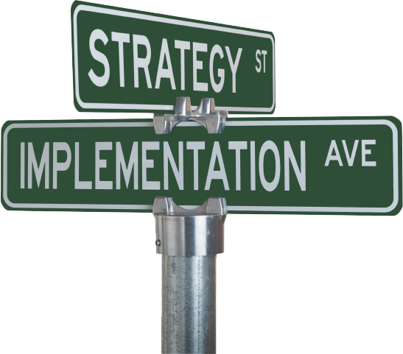
The Plan
Energize our Effort
Educate Our Industry
Educate the Public
Educate Legislators
Influence Funding Choices

Slide 13

The Best Opportunities
Cap & Trade
Self-Help Voter Threshold (55%)
Vehicle User Fee (VF)
Diesel User Fee

Slide 14
Early Polling Data, January 2013
Funding for Roads and Safety:
VF (1%) 52% Y 45%N
VF(1 ½%) 42%Y 54%N
GO Bond ($10B) 35%Y 54%N
GO Bond ($20B) 24%Y 66%N

Slide 15
Early Polling Data, January 2013
Head-to-head, GO bond and VF (1%)
Bond 16%
VF 62%
Neither 16%

Slide 16
Early Polling Data, January 2013
VF (1%), after “push” questions, moved from:
52% to 55%

