Slide 1
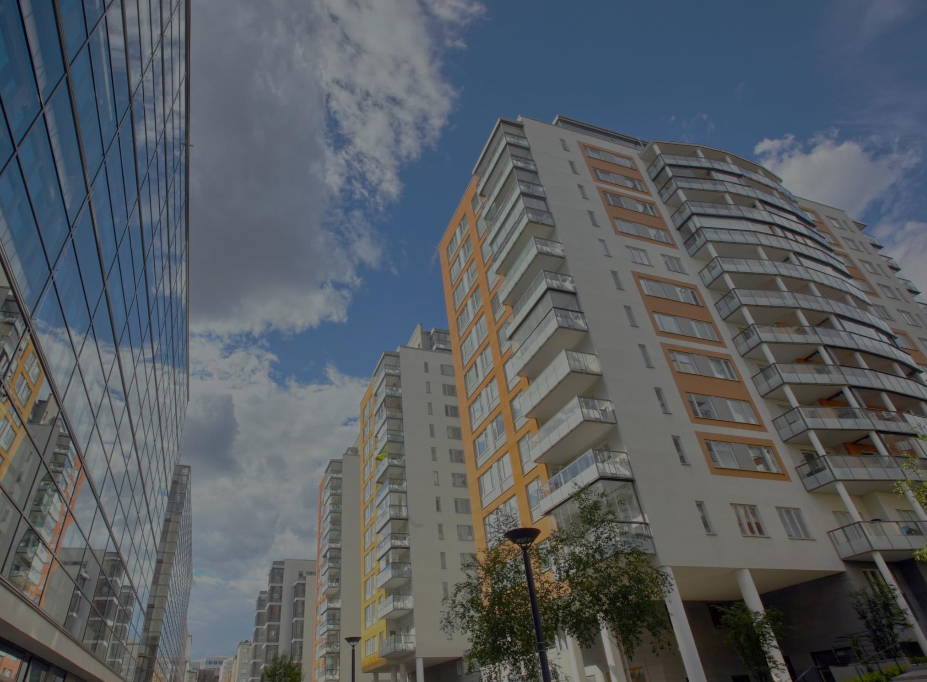
LOS ANGELES COUNTY DEPARTMENT OF HEALTH SERVICES
CHERI TODOROFF, DEPUTY DIRECTOR
ctodoroff@dhs.lacounty.gov

Slide 2
goals
Create 10,000 units of housing quickly
End homelessness in LA County
Reduce inappropriate use of expensive health care resources
Improve health outcomes for vulnerable populations.

Slide 3
Why housing matters to DHS
Chronically homeless individuals are our most vulnerable residents – studies have shown that living on the streets can take up to 25 years off an individual’s life
A chronically homeless person can use over $8,000 in public services each month
Homeless patients stay in the hospital an average of 4 days longer (10.6 vs. 6.4 days)

Slide 4
Permanent supportive Housing
Decent, safe, and affordable community based housing linked to a flexible array of support services that provides homeless people with housing stability, improved health status, and greater levels of independence and economic security.
Housing for Health has provided 500 people with housing since November 2012

Slide 5
population
Homeless DHS patients with
Complex physical and
Behavioral health conditions

Slide 6
Clients housed
N=282
Majority of clients housed are MALE AND OVER AGE 50.

Slide 7
Health of clients
MOST COMMON CONDITIONS:
Hypertension
Diabetes
Asthma
Heart disease
Congestive heart failure
Cancer
HIV/AIDS
Hepatitis
Depression
Bipolar disorder
PTSD
Most HFH clients have MULTIPLE CHRONIC HEALTH CONDITIONS

Slide 8
Homeless status
The average length of time that patients experienced homelessness was 3 years and 7 months and the median length of time was 2 years
The majority of clients were chronically homeless (83%), which means they were homeless for more than one year or experienced four or more episodes of homelessness in the last three years

Slide 9
Hfh client process
PATIENT IDENTIFICATION
by DHS Hospitals and other clinical partners
REVIEW/EVALUATE/ROUTE REFERRALS
by HFH Administrative/Clinical Team
INTERIM HOUSING
PERMANENT HOUSING
RECUPERATIVE CARE
PERMANENT HOUSING
STABILIZATION HOUSING

Slide 10
Rental subsidies
Tenant Based Section 8
Project Based Vouchers
Flexible Housing Subsidy Pool

Slide 11
Housing types
County-wide
Single family homes to 100+ unit apartment complexes
Non-profit supportive housing, affordable housing, and private market housing
Scattered site and project based

Slide 12
Intensive case management
Every client connected to services.
Individualized service planning; linkages to health, mental health, and substance use disorder services; benefits establishment
Help clients retain housing and reach health and wellbeing goals.
Services provided by on-site staff or mobile teams.

Slide 13

Flexible housing subsidy pool

Slide 14
new rental subsidy program
Launched: January 2014 by Housing for Health
Mission: Quickly and effectively house homeless
Initial Funding: $18 million (w/ $4 million from
Conrad N. Hilton Foundation)
Housing Types: Supportive; Affordable; Private market housing
Product Types: SFHs; single apt. unit; blocks of units; entire building

Slide 15
Rental subsidy operator
BRILLIANT CORNERS Operates FHSP:
Identifies/secures inventory of decent, safe, and affordable housing countywide
Agreements to lease/procure housing
24/7 response to property owners and landlords
Housing retention services
Monthly rental subsidy payments to owners/operators

Slide 16
rental subsidies goals
2017:
2400 rental
subsidies
2016:
1200 rental subsidies
2015:
600 rental subsidies
2014:
300 rental subsidies
GOALS (Cumulative)

Slide 17

selected HFH projects

Slide 18
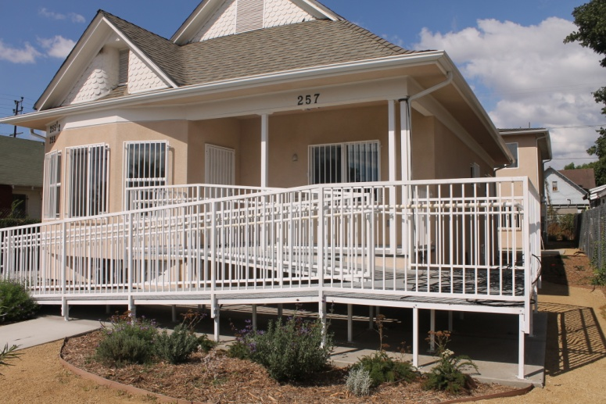
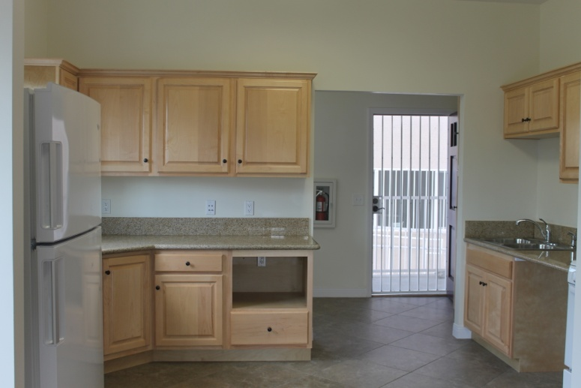
Neighborhood stabilization Project
South Los Angeles
Scattered site program
  15 newly renovated properties
  56 total units
Acquired/renovated w/ NSP funding in partnership with City of LA Housing Agencies
Support Services provided by Housing Works

Slide 19
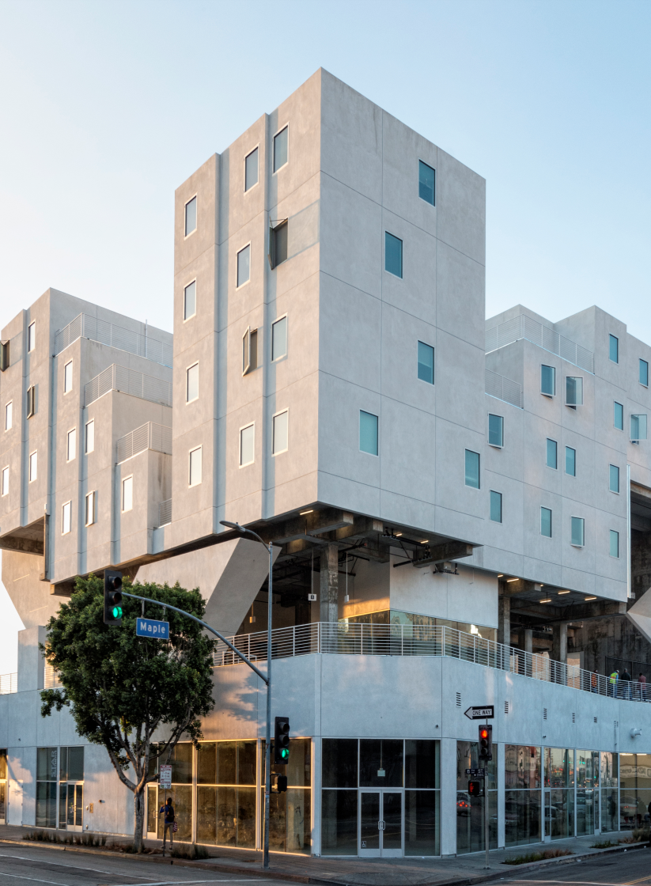
The star apartments
Downtown Los Angeles
100-unit innovative housing complex w/ modular pre-fabricated units
Owned by Skid Row Housing Trust with onsite support services
15,000 sq. ft. of outdoor
community space (track, basketball, garden, kitchen, wellness center)
Home of Star Clinic specializing in integrated primary care for homeless DHS patients

Slide 20
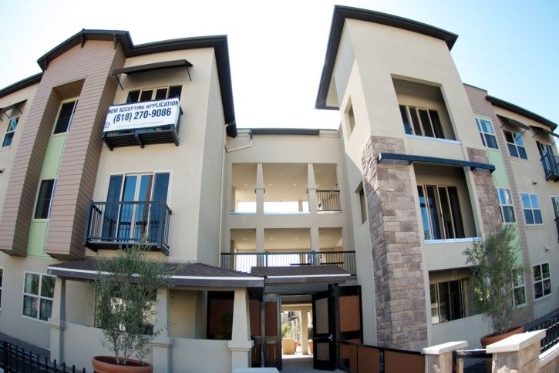
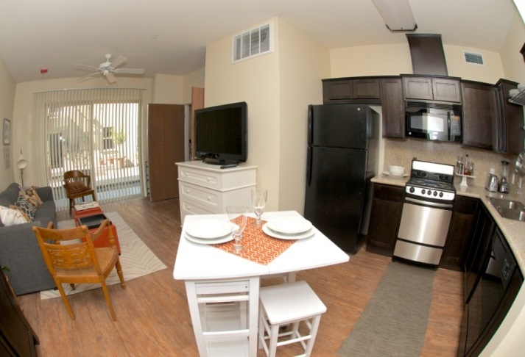
Parkview place
City of San Fernando
Senior complex (62+) with 20 units set aside for DHS homeless high utilizers
Across from park with senior center and aquatic park
Support services provided by LA Family Housing

Slide 21
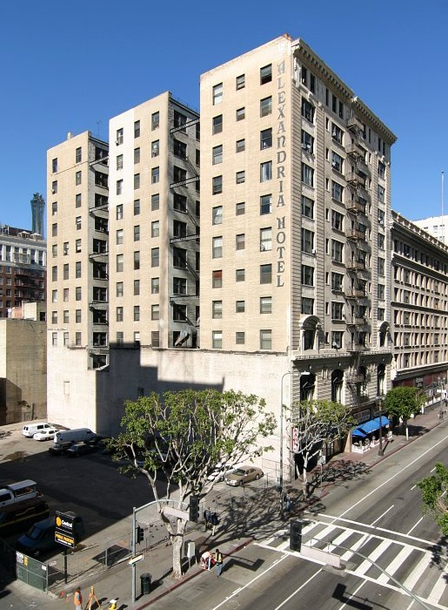
The Alexandria
Downtown Los Angeles
Studio / Micro‐Loft Apartments
110 units for DHS patients through FHSP
Support services provided onsite by LAMP Community

Slide 22
outcomes
90% retention rate in housing after 12 months
$32,000 year-over-year health care savings following housing a DHS client
Reduction in hospital utilization by homeless before and after housing:
  77% reduction in emergency room visits
  77% reduction in inpatient admissions
  85% reduction in inpatient days

