Slide 1
Homelessness and Housing
New Opportunities

Slide 2
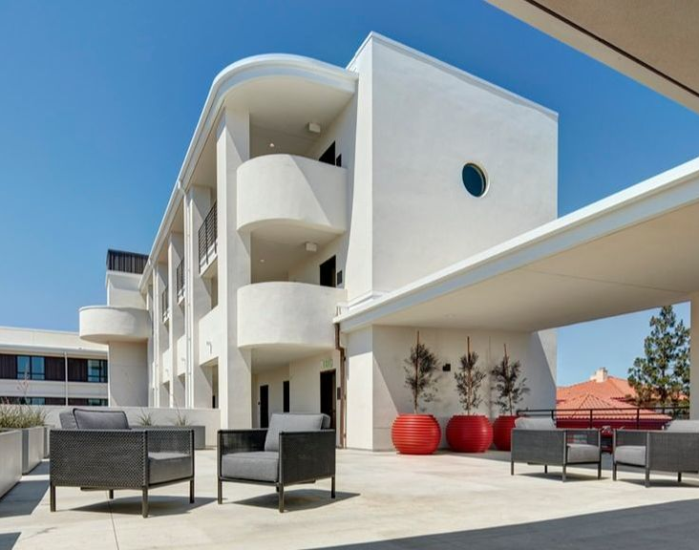
ABOUT US
Nonprofit Developer, Owner and Operator of Affordable Housing
Established in 1998
Created more than 6,700 affordable homes in 44 properties

Slide 3
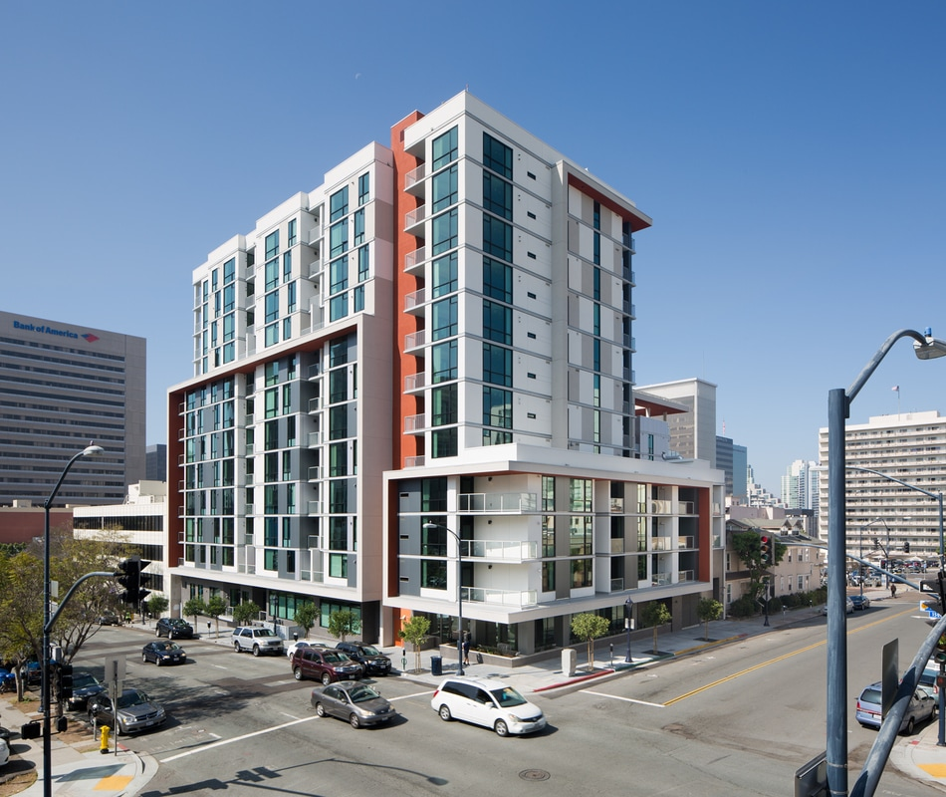
Atmosphere Apartments
205 Units
Downtown San Diego
51 units for formerly homeless individuals
  31 units for MHSA special needs
County Services
Operating Budget Services
51 Project Based Vouchers

Slide 4
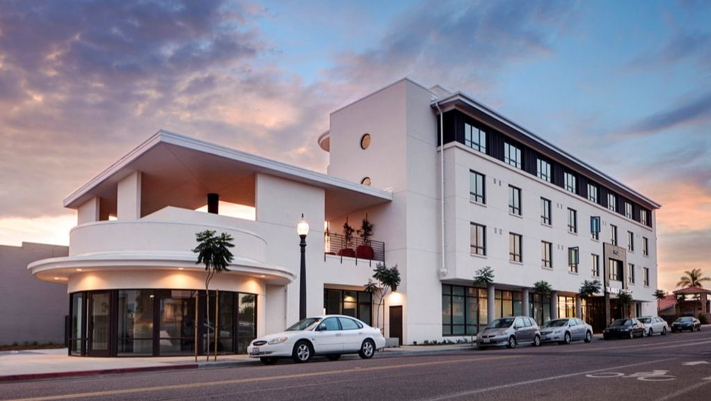
Talmadge Gateway
60-Units
Mid-City San Diego
100% for seniors with chronic health conditions
St. Paul’s PACE program
Father Joe’s Services
100% Project Based Vouchers
Services Reserve

Slide 5
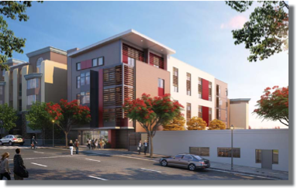
Beacon Apartments
44 Homes
Downtown San Diego
100% for Formerly Homeless
Father Joe’s Services
County Services
100% Project Based Vouchers
Services Reserve

Slide 6
Pico Boulevard Apartments
50 Homes
Mid-City Los Angeles
100% for Formerly Homeless
County Services – Prop H
City HHH Funds
100% Project Based Vouchers

