Slide 2
WELCOME AND INTRODUCTIONS

Slide 3
MICHAEL UDO
STUDENT BODY PRESIDENT,
KING-DREW MAGNET HIGH SCHOOL OF MEDICINE AND SCIENCE

Slide 4
MARK RIDLEY-THOMAS
SUPERVISOR, LOS ANGELES COUNTY
CO-CHAIR, COUNCIL OF REGIONAL HOMELESS ADVISORS

Slide 5
DARRELL STEINBERG
MAYOR, CITY OF SACRAMENTO
CO-CHAIR, COUNCIL OF REGIONAL HOMELESS ADVISORS

Slide 6
ERIC GARCETTI
MAYOR, CITY OF LOS ANGELES

Slide 7
FRAMING THE
LOS ANGELES RESPONSE

Slide 8
VIDEO

Slide 9
HEIDI MARSTON
CHIEF PROGRAM OFFICER,
LOS ANGELES HOMELESS SERVICES AUTHORITY

Slide 10
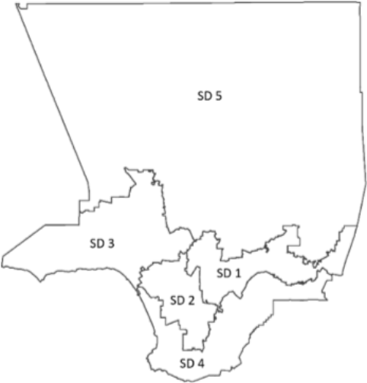
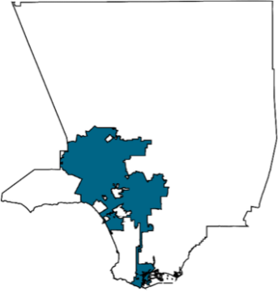
58,936
People experiencing homelessness at point-in-time count
CITY OF LOS ANGELES
16% Increase
36,300
COUNTY OF LOS ANGELES
12% Increase
The LA CoC total number was 56,257 a 11.7% increase from 2018. The LA CoC
is Los Angeles County excluding Glendale, Pasadena, & Long Beach CoCs.

Slide 11
LA housed more people than ever, yet our housing affordability crisis drove a net rise in homelessness.
721,000
Severely rent-burdened LA households
5,643 people prevented from entering homelessness
54,882
Estimated inflow over 2018
52,765
58,936
2018 Point-in-time count
2019 Point-in-time count
21,631
27,080
People placed in homes
Estimated other exits to housing

Slide 12
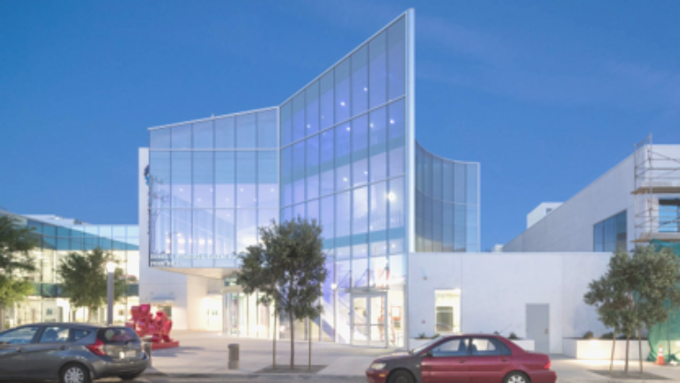
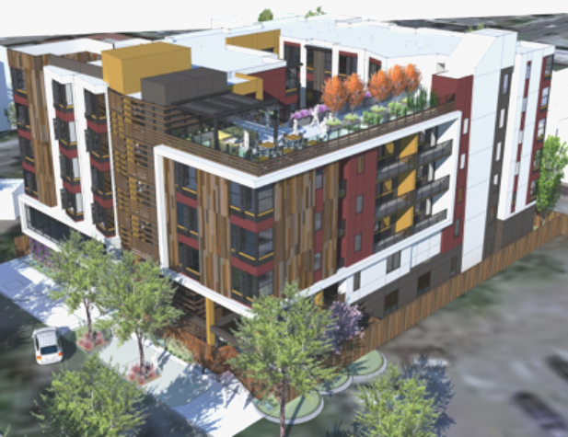
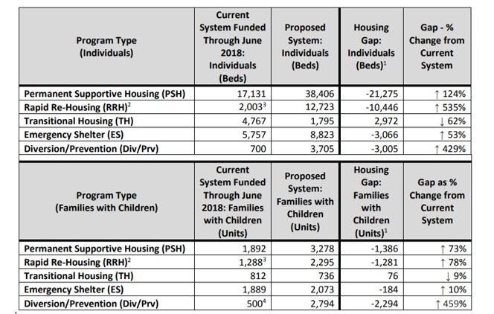
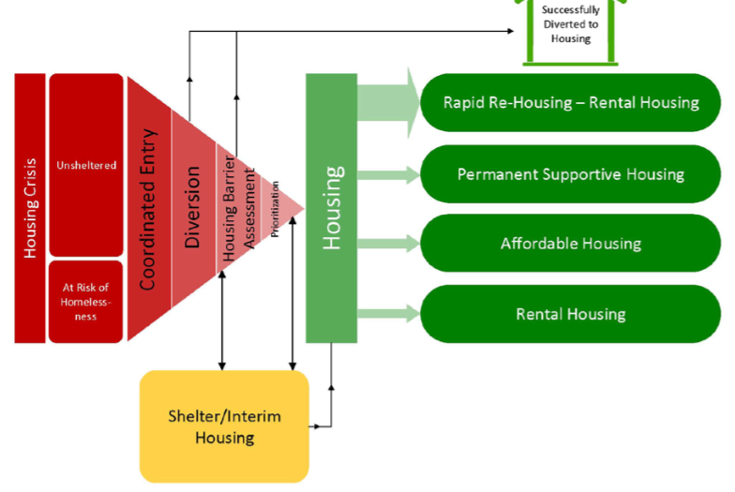
2019 Gaps Analysis
A Resource Map to Achieve Functional Zero
The gap model estimates how many people experience homelessness over the course of the year, incorporates compiled and analyzed data on the current system resources and how they are being used, and proposes a system with the recommended number and proportion of resources to functionally end homelessness
Sample results from previous gaps analysis report
Methodology
Right-sizing resources and defining system flow to resolve our clients’ homelessness crisis:
Analyze - Data from the prior year on which service pathways are most effective;
Understand - Differences between subpopulations, household types, chronic/not-chronic populations;
Incorporate - National best practices, feedback from community collaborators and key stakeholders, cost estimates
Release Date: October 2019

Slide 13
INTEGRATED SERVICES AND HOUSING:
LESSONS LEARNED

Slide 14
BEHAVIORAL HEALTH

Slide 15
DR. JONATHAN SHERIN
DIRECTOR,
LA COUNTY DEPARTMENT OF MENTAL HEALTH

Slide 16
Integrated Care: MLK BHC
Community (collective)
Prevention
Social Determinants
System of Care
Crisis Response Network
“Real-time” Svc
UCC/Sobering/ED
Treatment Beds
Re-Entry Programs
Homeless Outreach
Justice In-reach
Involuntary Care
BHC
Notes:
Move right and up.

Slide 17
Integrated Care: MLK BHC
Multiple Agencies
3 Health Depts
Probation
Workforce Dev
Full Continuum
Residential (x4)
IOP/OP/Detox
Training/Jobs
Diversion 101
Streets
Jail
Isolation
BHC
Notes:
Move right and up.

Slide 18
HOUSING FOR PEOPLE EXPERIENCING HOMELESSNESS

Slide 19
LIBBY BOYCE
DIRECTOR, HOUSING FOR HEALTH DIVISION,
LA COUNTY DEPARTMENT OF HEALTH SERVICES

Slide 23
EMILIO SALAS
DEPUTY EXECUTIVE DIRECTOR,
LOS ANGELES COUNTY DEVELOPMENT AUTHORITY
RUSHMORE CERVANTES
GENERAL MANAGER,
LOS ANGELES HOUSING + COMMUNITY INVESTMENT DEPARTMENT

Slide 24
PHAs located in the County of Los Angeles:
Los Angeles County
Los Angeles City
Baldwin Park
Burbank
Compton
Culver City
Glendale
Hawaiian Gardens
Hawthorne
Inglewood
Long Beach
12. Norwalk
13. Pasadena
14. Pico Rivera
15. Pomona
16. Redondo Beach
17. Santa Monica
18. South Gate
19. Torrance

Slide 25
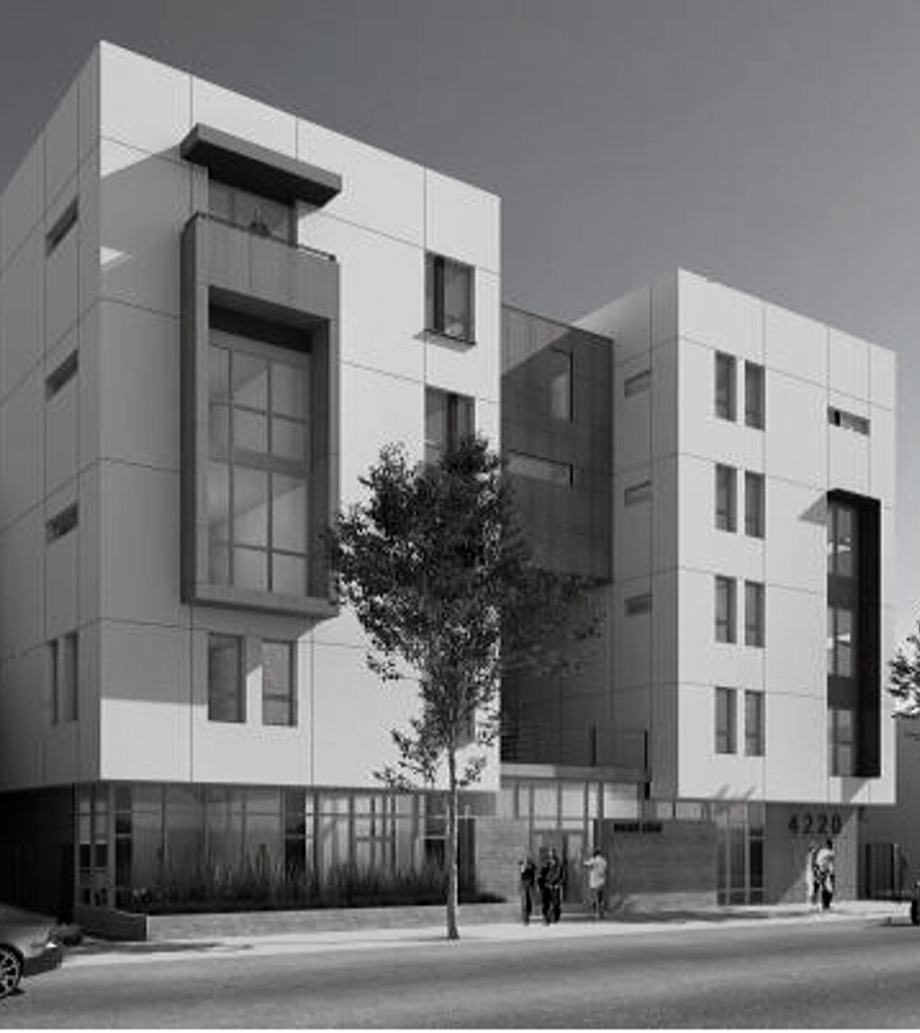
COLLABORATION
CITY & COUNTY
SUCCESS
Measure H and Proposition HHH
MEMORANDUM
City - 10,000 supportive housing units
County - provide wrap-around services
HACLA - 1,000 project-based vouchers per year
STREAMLINING
Unified online application
for developers (capital, vouchers, services)
Coordinated application review / underwriting process

Slide 26
Incentive-Based
Funding match
REQUESTS OF THE STATE
Rental Subsidy
Dedicated source
CEQA (AB 1197)
Supportive housing exemptions
TCAC / CDLAC
Geographic equity
Medi-Cal Flexibility
Work with local health and housing officials
Reduce Parking Requirements
Increase density near transit
Ballot Initiative Threshold
Lower local 2/3 requirements for local bond measures for supportive housing and services

Slide 27
HOMELESS HOUSING, ASSISTANCE, AND PREVENTION PROGRAM

Slide 28
LAHELA MATTOX
DIRECTOR OF LOCAL PARTNERSHIP PROGRAMS,
HOMELESS COORDINATING AND FINANCING COUNCIL

Slide 29
GOVERNANCE AND REGIONAL COORDINATION

Slide 30
JACQUELINE WAGGONER
COMMISSIONER,
LOS ANGELES HOMELESS SERVICES AUTHORITY
WENDY GREUEL
COMMISSIONER,
LOS ANGELES HOMELESS SERVICES AUTHORITY

