Slide 1
COUNTY OF SAN BERNARDINO
Presented by: Mary Jane Olhasso
Executive Assistant Officer, Finance and Administration
Presented to: California State Association of Counties (CSAC)
www.SBCounty.gov

Slide 2
San Bernardino County
The Vision
We envision a complete county that capitalizes on the diversity of its people, its geography, and its economy to create a broad range of choices for its residents in how they live, work, and play.
We envision a vibrant economy with a skilled workforce that attracts employers who seize the opportunities presented by the county’s unique advantages and provide the jobs that create countywide prosperity.
We envision a sustainable system of high‐quality education, community health, public safety, housing, retail, recreation, arts and culture, and infrastructure, in which development complements our natural resources and environment.
We envision a model community which is governed in an open and ethical manner, where great ideas are replicated and brought to scale, and all sectors work collaboratively to reach shared goals.
From our valleys, across our mountains, and into our deserts, we envision a county that is a destination for visitors and a home for anyone seeking a sense of community and the best life has to offer.
www.SBCounty.gov

Slide 3
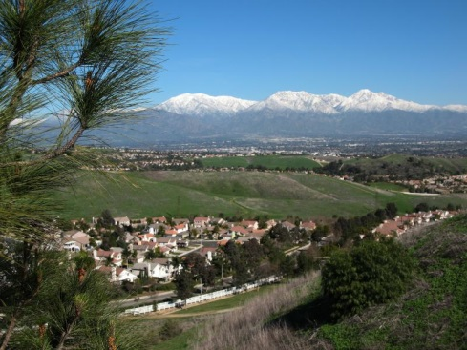
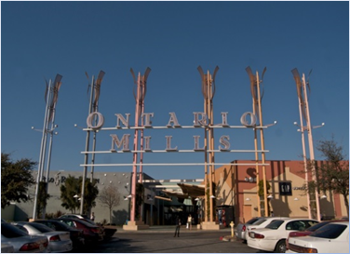
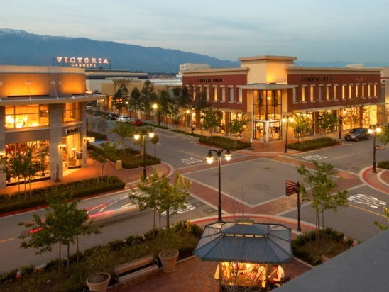
San Bernardino County – Fast Facts
The largest county in the U.S. at 20,160 sq. mi.
Population of 2.1 million residents
$76.6 billion GDP
Local access to more than 20 colleges and universities
Access to 900,000 person workforce
Regional labor force population of 1.5 million
Median age 32.3
Median commute 30 minutes
Avg. household size 3.28
Avg. household income $71,226
2015 total taxable retail sales (incl. food/drink) $24.8 billion
www.SBCounty.gov

Slide 4
Median, Average & Per Capita Income
Source: ESRI

Slide 5
Financial Forecast
The Financial Forecast (July 2016 – June 2021) includes moderate growth of major revenue streams. Not included in the forecast are the impacts of a potential recession or the unknown economic impacts of the coming statewide $15 minimum wage.
The County continues to adopt structurally balanced budgets wherein ongoing revenue pay for ongoing expenses.
The realignment of many state services has made counties increasingly dependent on sales tax revenue. While sales taxes are projected to experience a modest increase in 2016-17, they tend to be much more volatile and quicker to react to changes in the economy, resulting in a higher risk of funding losses during times of economic stress.
We are now over seven years into what has been a slow recovery. For perspective the longest expansion in U.S. History is 10 years.
The County fiscal plan is conservative in projecting anticipated costs and revenues while focusing on ensuring that the County is positioned to attract and retain a competitive workforce and is committed to making the most of its funding to provide necessary public services in an effective and efficient manner and fulfilling its role in the achievement of the Countywide Vision.
www.SBCounty.gov

Slide 6
The Countywide Plan
The Countywide Plan will be a comprehensive web-based system to document land use planning and organizational governance policies.
Composed of three basic components:
Policy Plan (a comprehensive general plan)
County Business Plan (a system that will define and guide how the County government operates and manages itself)
Regional Issues Forum (a web-based resource center containing information regarding shared Countywide issues)
Additionally, the County is updating and expanding the community plans. When completed, there will be 27 web-based community plans involving 49 communities
www.SBCounty.gov

Slide 7
Inland Region Housing Market
San Bernardino County Housing Market
79 new home developments selling in SB Co. at the end of 2015.
Avg. price of new homes sold in SB Co. during Q4 2015: $460,940 (a 4.8% increase over the avg. price of new homes sold during Q4 2014: $439,875)
Avg. rate of absorption among actively selling new home developments: 2.9 sales per month.
Only 508 released and unsold units in SB Co. at the end of 2015 (approx. 2.2 month(s) supply) of which approx. 89% are Single Family Detached homes.
2,434 new home sales in SB Co. in 2015.
2015 Single Family Detached home sales: 2,142 – 88%
2015 Single Family Attached home sales: 292 – 12%
6% resale appreciation in 2015.
Forecasted new homes market activity in SB Co. 5% (based on inflation in direct construction costs per sq. ft. due to labor.)
(Source: www.marketinsiteadvisors.com and Doug Jorritsma – Land Advisors)
www.SBCounty.gov

Slide 8
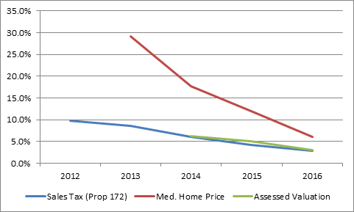
Indicators
*Three indicators showing (data is recent peak growth rate through 2015-16 growth rate)
www.SBCounty.gov

Slide 9
Inland Region Housing Market
According to Futurist, Joel Kotkin -
“The shortage of new housing everywhere else in Southern California suggests that the Inland region will continue to be price competitive with the coastal counties. Although median prices have risen from a low of $142,000 in 2010, the present price of $254,000 is well below the bubble high of $373,000 seen in 2007. The area remains far more in the range of potential homebuyers; although affordability has dropped from a high of 70 percent in 2010 to 50 percent. This is much better than in Los Angeles and Orange counties, where affordability is roughly half as high.”
“Overall, San Bernardino County has experienced a stronger rise in millennial population than the coastal counties between 2000 and 2010. Arguably the strongest lure for millennials, particularly as they age, will be finding affordable housing. Despite much writings to the contrary, millennials, according to various surveys, actually prefer single family houses and suburbs by a wide margin when they consider the “ideal” places to settle down. Overall, they remain as committed to home ownership as previous generations. “
www.SBCounty.gov

Slide 10
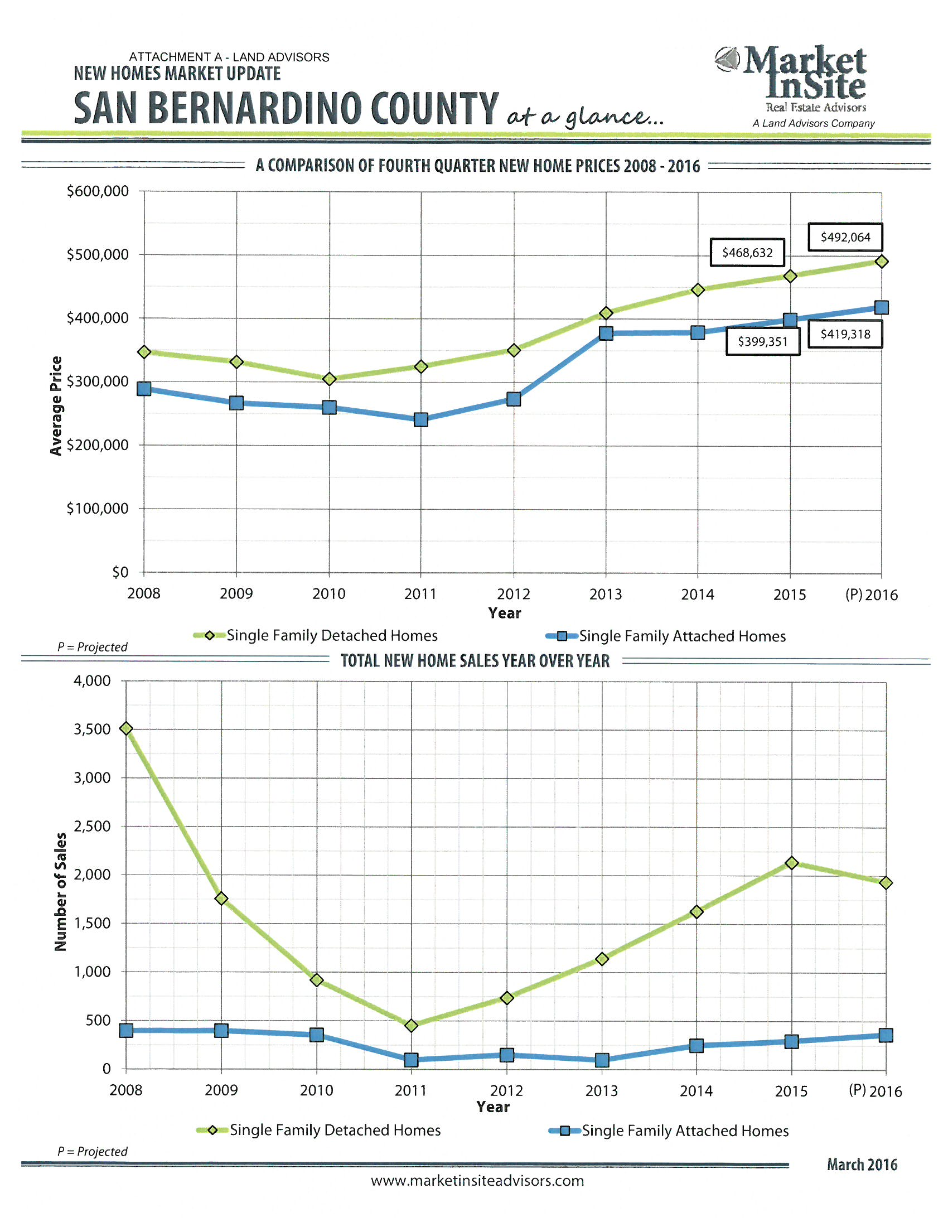

Slide 11
Inland Region Office Market
Broad based absorption continues through the first half of 2016
Vacancy rate 14.1%
Net absorption 64,332 SF
Lease rate $1.87 FSG
No Construction
Overall vacancy rates are still too high at this point to call it a true landlord’s market – need to fall about 3-4%
Existing supply should continue to be absorbed – causing rental rates to trend in a positive direction
(Source: CBRE Market Report – Q2 2016)
www.SBCounty.gov

Slide 12
Inland Region Retail Market
Strong leasing and active tenants drive retail in Q2
The vacancy rate decreased from Q1 – currently at 9.6%
Notable amount of positive net absorption totaling $442,559 sq. ft.
Lease rate $1.89 NNN
Discount department stores and fitness tenants among most active users for 2016 thus far
Overall progress in the region
Declined vacancy
Strong positive absorption
Continued job growth
(Source: CBRE Market Report – Q2 2016)
www.SBCounty.gov

Slide 13
Inland Region Industrial Market
Industrial market continues to soar through its second renaissance
Vacancy rate closed Q2 at 3.7%
Gross activity and net absorption rose to 12.2 million sq. ft. and 6.2 million sq. ft. respectively
Lease rate $0.50 NNN
Year-to-date gross activity has outpaced levels from one year ago by 4.8%
Consumer goods and 3PLs involved in e-commerce related activities continue to drive gross activity and net absorption.
Construction activity expected to remain strong throughout 2016 and well into 2017
(Source: CBRE Market Report – Q2 2016)
www.SBCounty.gov

Slide 14
Employment – Riverside-San Bernardino-Ontario MSA
The unemployment rate in the Riverside-San Bernardino-Ontario MSA was 6.9% in July 2016, up from a revised 6.6% in June 2016, and below the year-ago estimate of 7.2%. This compares with an unadjusted unemployment rate of 5.9% for California and 5.1% for the nation during the same time period. The unemployment rate was 6.7% in San Bernardino County.
Between July 2015 and July 2016, total nonfarm employment increased by 31,500 jobs or 2.4%. Agricultural employment increased by 900 jobs, or 6.3%.
Trade, transportation, and utilities outdid all other industry sectors by adding 10,700 jobs to the region.
Notable job growth was also reported in government, educational and health services, manufacturing, leisure & hospitality, and construction.
Professional and business services and mining and logging reported a decrease of 400 and 200 jobs respectively.
(Source: Employment Development Department – Labor Market Information Division 08/19/16)
www.SBCounty.gov

Slide 15
Contact Information
For additional information please contact:
Mary Jane Olhasso, Executive Assistant Officer
County Administrative Office
Finance and Administration
Maryjane.Olhasso@CAO.SBCounty.Gov
www.SBCounty.gov

Slide 16
BOARD OF SUPERVISORS
James C. Ramos, Chairman, Third District Supervisor
Robert A. Lovingood, Vice Chairman, First District Supervisor
Janice Rutherford, Second District Supervisor
Curt Hagman, Fourth District Supervisor
Josie Gonzales, Fifth District Supervisor
Gregory C. Devereaux, CEO
www.SBCounty.gov

