Slide 1
The 2019-20 Budget: California’s Fiscal Outlook
California State Association of Counties
November 29, 2018

Slide 2
Near-Term Outlook

Slide 3
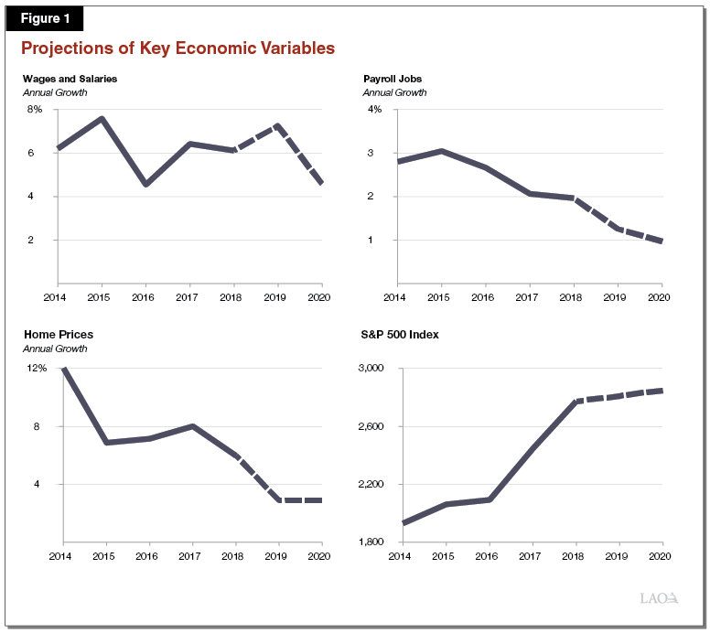
Projections of Key Economic Variables

Slide 4
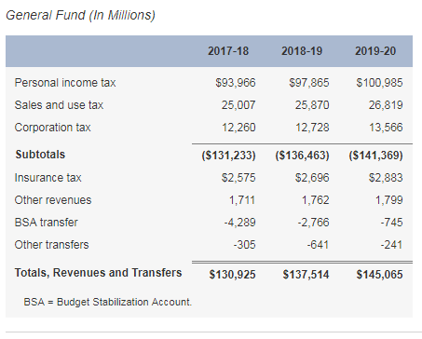
LAO Revenue Outlook
The Budget Is in Remarkably Good Shape

Slide 5
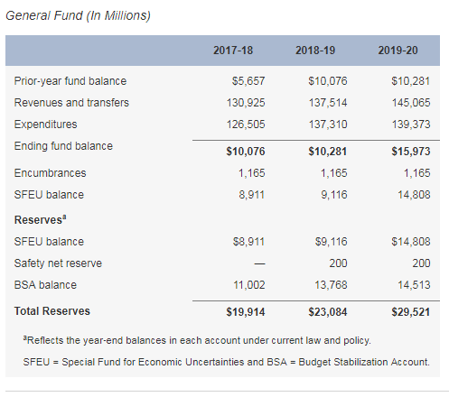
LAO General Fund Condition
The Budget Is in Remarkably Good Shape

Slide 6
Longer-Term Outlook

Slide 7
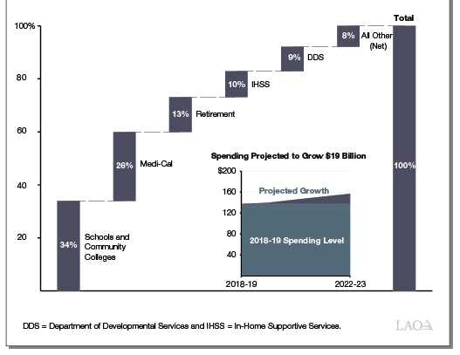
Spending in Growth Scenario
Schools, Community Colleges, and Medi-Cal Drive $19 Billion in Projected Spending

Slide 8
General Fund Surpluses and Deficits Under Different Scenarios
Long-Term Outlook Is Positive

Slide 9
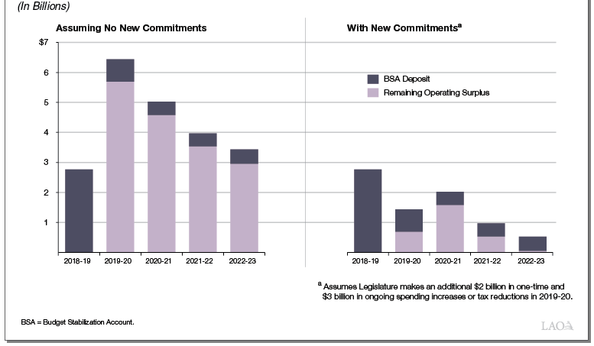
General Fund Surpluses Under Economic Growth Scenario
General Fund Operating Surpluses Decline With New Commitments

Slide 10
General Fund Condition Under Recession Scenario
With More Commitments, Reserves Might Not Fully Cover the Budget Problem

Slide 11
LAO Comments
The State’s Budget Condition Can Change Quickly
Legislatures Has Unique Opportunity to Prepare for Coming Challenges

Slide 12
Demographic Changes

Slide 13
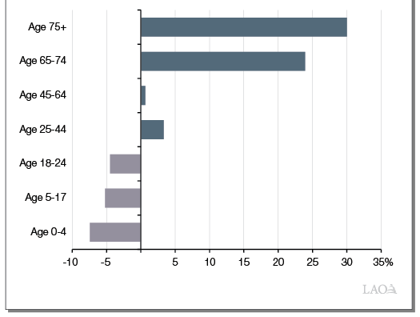
Expected Growth by Age Cohort, 2017-2023
On Net, Demographic Trends Likely Resulting In Lower General Fund Spending Growth

