Slide 1
Closing Considerations
Presented by:
Webster J. Guillory, Orange County Assessor

Slide 2
Consider Shared Services
Shared services is a model for the use of some computer systems and applications
System development, enhancement, administration and maintenance are centralized
Larger user groups create economies of scale for development and use
Users share the costs, based on the level of service

Slide 3
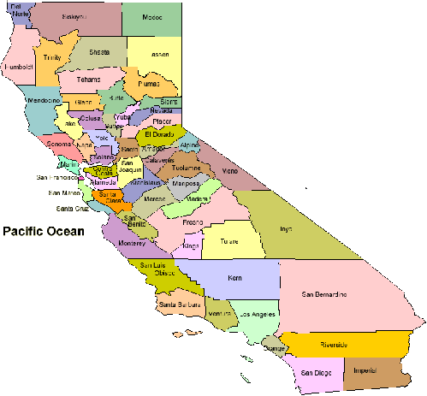
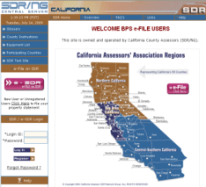
CA Assessors’ SDR/e-SDR Shared Service
40 California Counties Use The System To Receive Business Property Statements e-Filed Worldwide
One county provides the network
Software and annual updates
Hardware servers/storage/security
All user counties share in the costs
Over 500,000 users (industry & county)

Slide 4
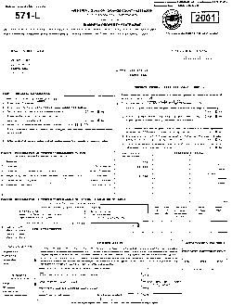
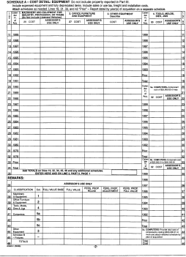
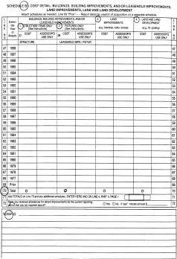
SDR Services Diverse User Groups
COUNTY USERS
43 of California’s 58 Counties
Population: 12 Million to 30K
Urban, Rural & Agricultural
Total Start-up Cost: $350,000
Shared Cost: $40,000 to $100
BUSINESS USERS
International Corporate Filers
Mom & Pop Shops
1 to 2,500 Statements Each
My Company Name

Slide 5
Some Top SDR Filers
99 Cents Only
American Airlines
Bank of America
Big 5
Big Lots
Chick-Fil-A
Footlocker
In-N-Out
Longs Drugs
Panda Express
Rite Aid
Safeway/Vons
Starbucks
Supercuts
Target
United Airline
US Bank
Walgreen

Slide 6
CA Assessors’ e-FORMs Shared Service
County assessors use about 100 forms standardized and controlled by the State Board of Equalization (BOE)
15 to 20 forms are changed annually
Each county assessor makes the form revisions to post on their website
This will become a shared service among 58 county assessors and the BOE
Will allow on-line filing with e-Signatures that will work with all touch devices

Slide 7
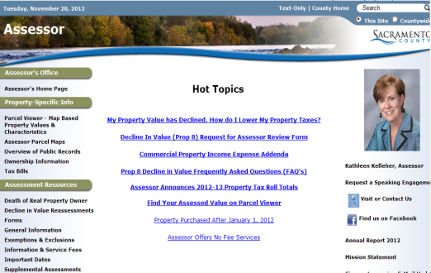
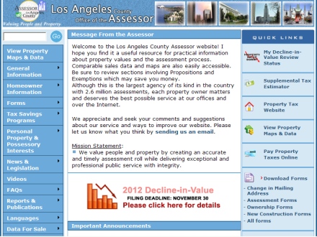
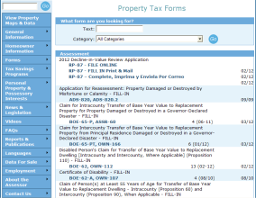
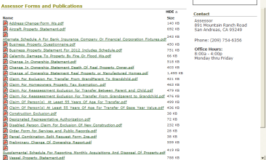
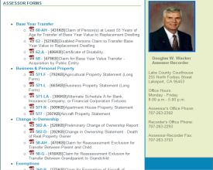
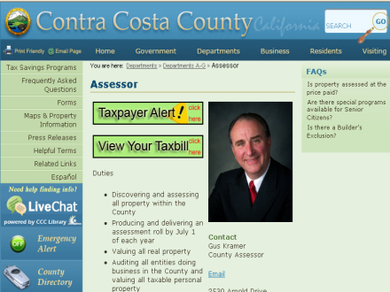
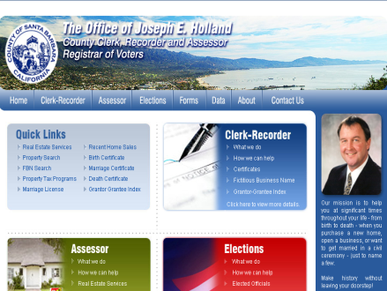
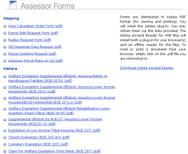
Forms Are Updated & Maintained By 58 County Assessors & Posted on 58 Websites

Slide 8
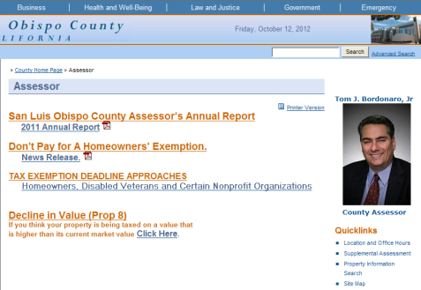
e-FORMs Centralizes This Process
Forms Will Be Posted and Updated on One Central Server
Statewide
e-FORMs Site
Taxpayers Will Access Forms Through Each Assessor’s Website

Slide 9
Why We Considered a Shared Solution
High Volume With Repeated Use Millions of forms are filed with assessors annually in CA
Standardized Uniform Requirements Assessors are required to use the same BOE forms statewide
Win-Win Solution
Added convenience for taxpayers
Centralized updates and data collection for assessors

Slide 10
Why Consider an Online Solution?
Enhanced Customer/Public Service
Reduced Waiting/Processing Time
Improved Access to Information and Services
Efficiency & Productivity Gains

Slide 11
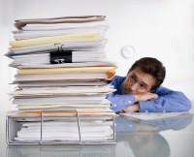
Cost Of Time Wasted Searching . . .
$5.25 Billion Annually For Employers With 1,000 Information Workers
As much as 10% of a company’s salary costs are wasted on ineffective searches
Assumptions
$60,000 annual salary plus benefits
9 to 10 hours a week, on average, looking for information
SOURCE: NETWORKWORLD, JANUARY 23, 2007

Slide 12
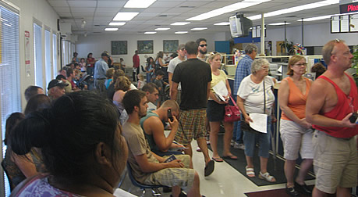
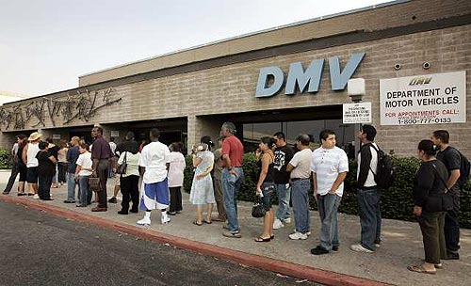
California e-File Statistics
Department of Motor Vehicles - FY 2011-12
Driver’s License Renewal: 433,593 or 30%
Vehicle Registration Renewal: 7,267,000 or 25%
Renew Online or Wait in Line?

Slide 13
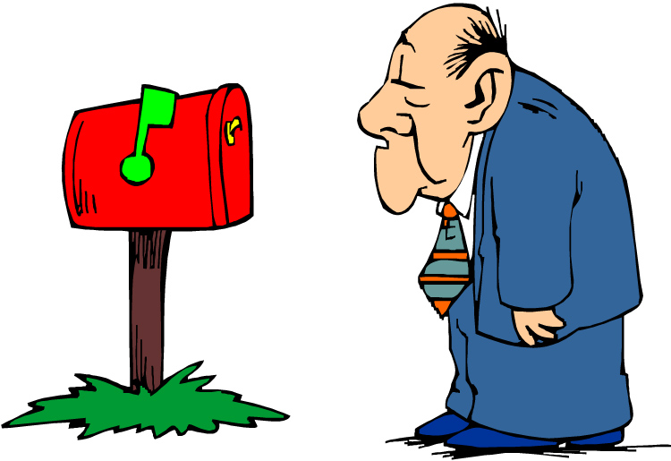
California e-File Statistics
Franchise Tax Board – 2011 Filing Season
Individual Income Tax Returns: 11,122,500 or 85%
(Avg. Processing Time: 5-10 days vs. 1 month for paper)
How Fast Do You Want a Refund?

Slide 14
What Makes Good $ense
What are the long-term benefits?
What are the costs (initial & ongoing)?
What entities could become a partner?
What are the options and risks?
What support is needed?
Who will be responsible?

Slide 15
How Can We Do More With Less . . .
Share your ideas and expertise
Offer input – don’t just let it happen
Your insight may make the difference
Learn something new
You may be required to do a new task
Work together to get things done
Assist others when possible
Remember . . . technology is your friend

Slide 16
Did You Know . . .
The NSA is building the country’s biggest spy center in Utah
The $2 billion facility will encompass 1 million square feet, have storage capacity of 1 YOTTABYTE
(Wired Magazine, March 15, 2012)

Slide 17
So What’s a Yottabyte?

Slide 18
So Really, What’s a Yottabyte?
1 Yottabyte
.
Library of Congress Collection (2005)
10 Petabytes or (10 x 10¹⁵)
All Human Knowledge Created Through 2003 (250,000 years)
5 Exabytes or (5 x 10¹⁸)
All Digital Data That Existed in June 2011
1.8 Zettabytes or (1.8 x 10²¹) and equal to:
Every person in the U.S. tweeting 3 tweets/minute nonstop for 26,976 years, or
57.5 billion iPads - enough to build a wall around South America 20 feet high

