Slide 1
THE CLUB AT JUVENILE HALL
A Partnership between Sonoma County Probation, the Boys and Girls Club of Central Sonoma County, and the City of Santa Rosa

Slide 2
Changes in Juvenile Hall Populations
Low risk youth diverted from juvenile system
Limited eligibility to send youth to the Department of Juvenile Justice
Increase in gang affiliated youth
Increase in mentally disordered youth

Slide 3
The Club –Core Tenets
Make it fun
Make it a privilege
Teach, Role Model & Build Character
Make Club services available to all Juvenile Hall residents
Think toward release
Make it part of your institutional culture

Slide 4
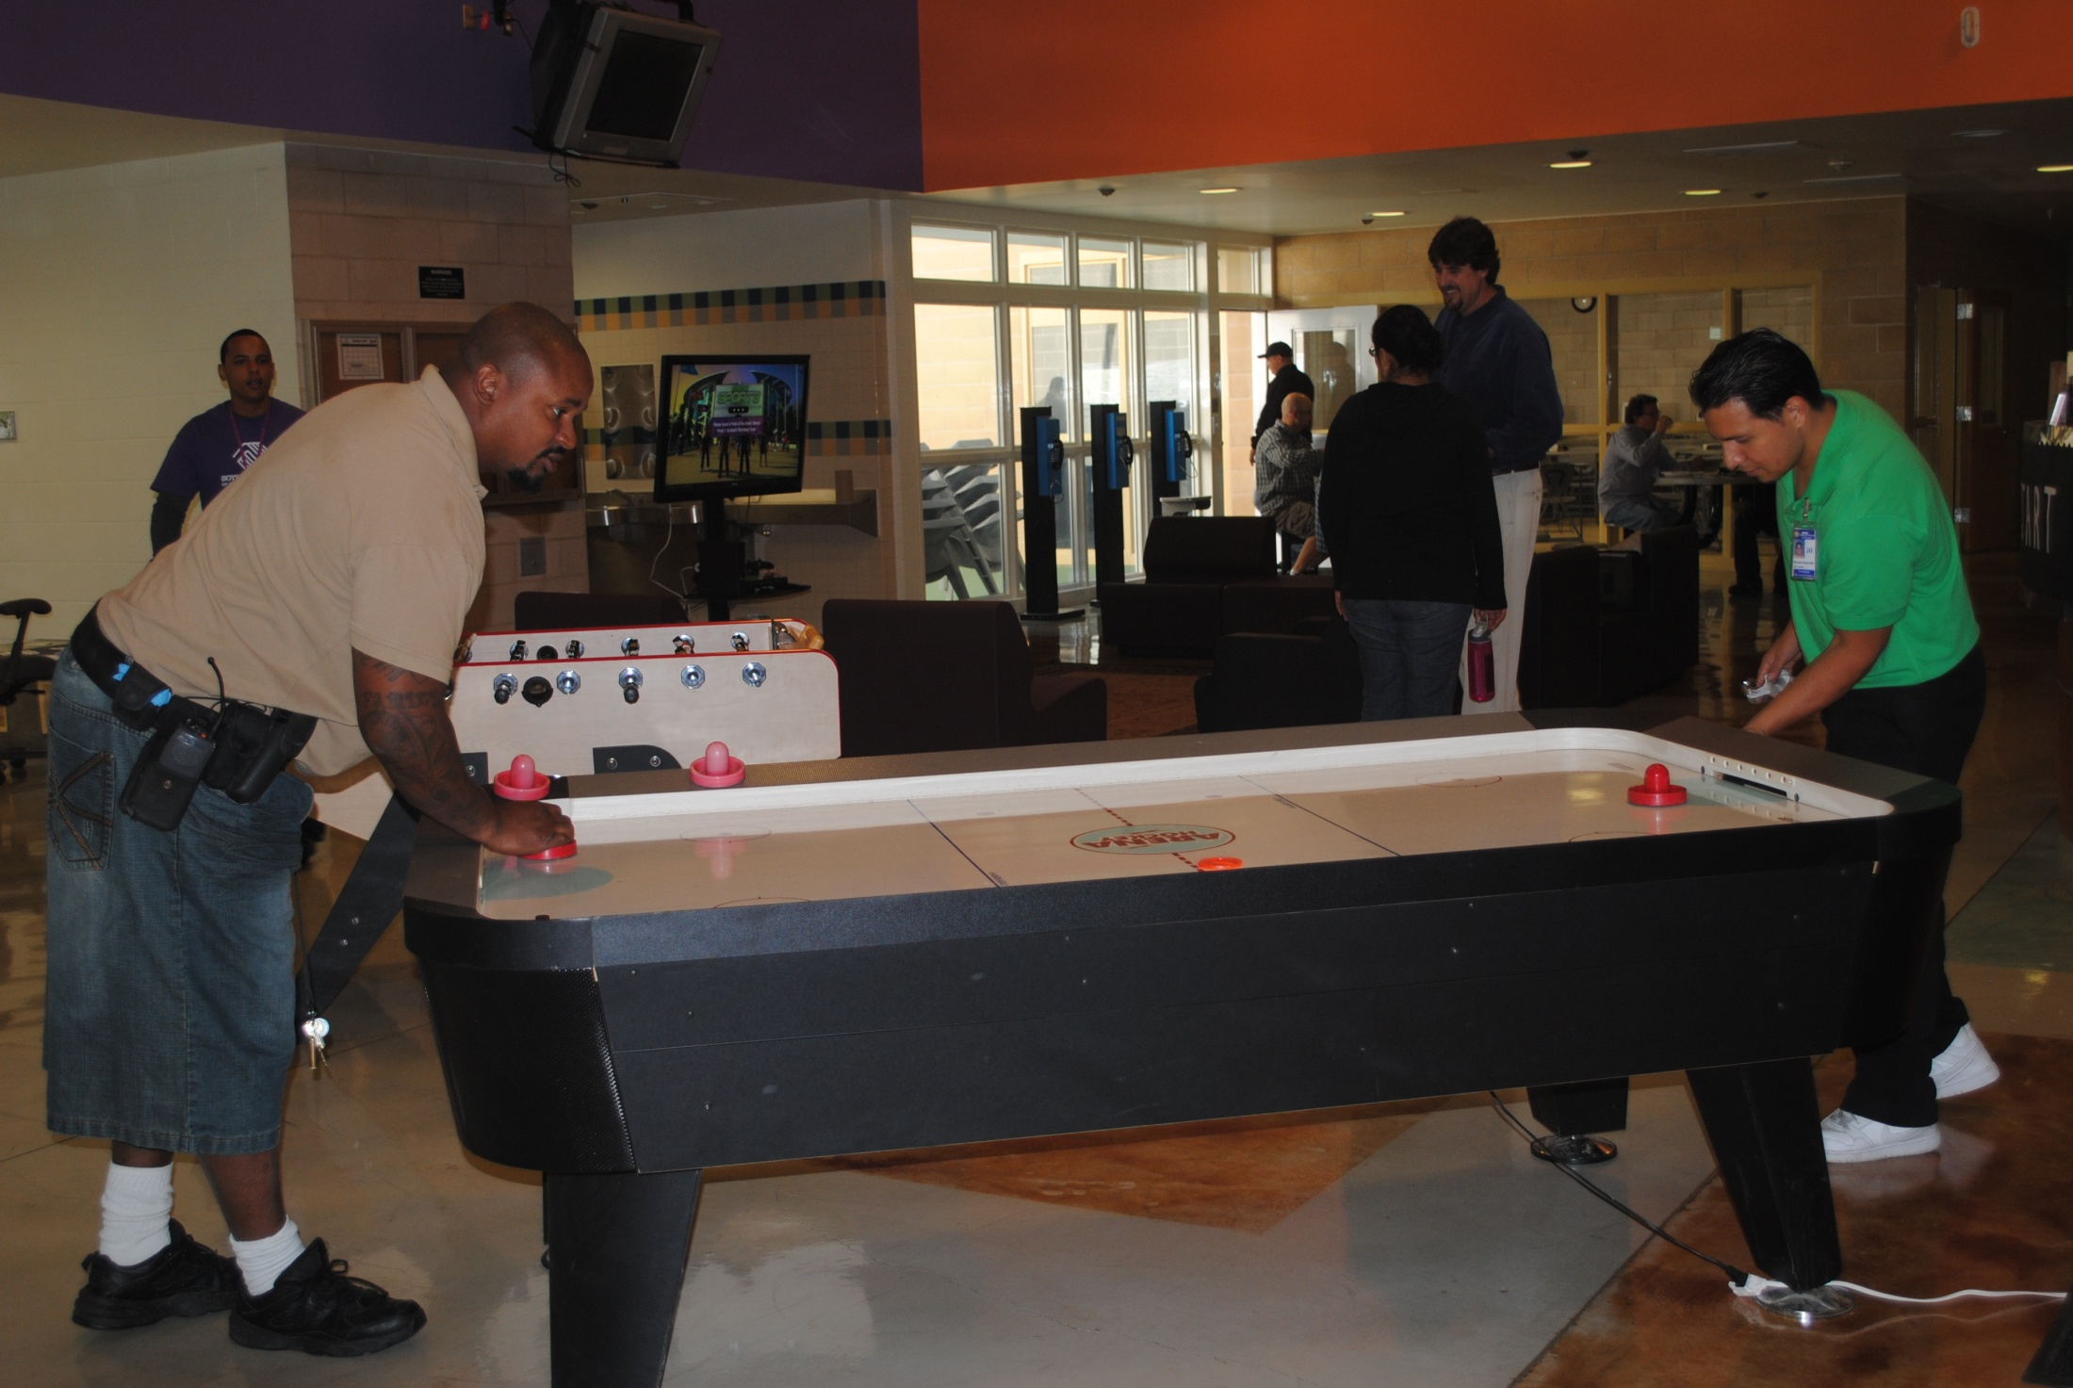

Slide 5
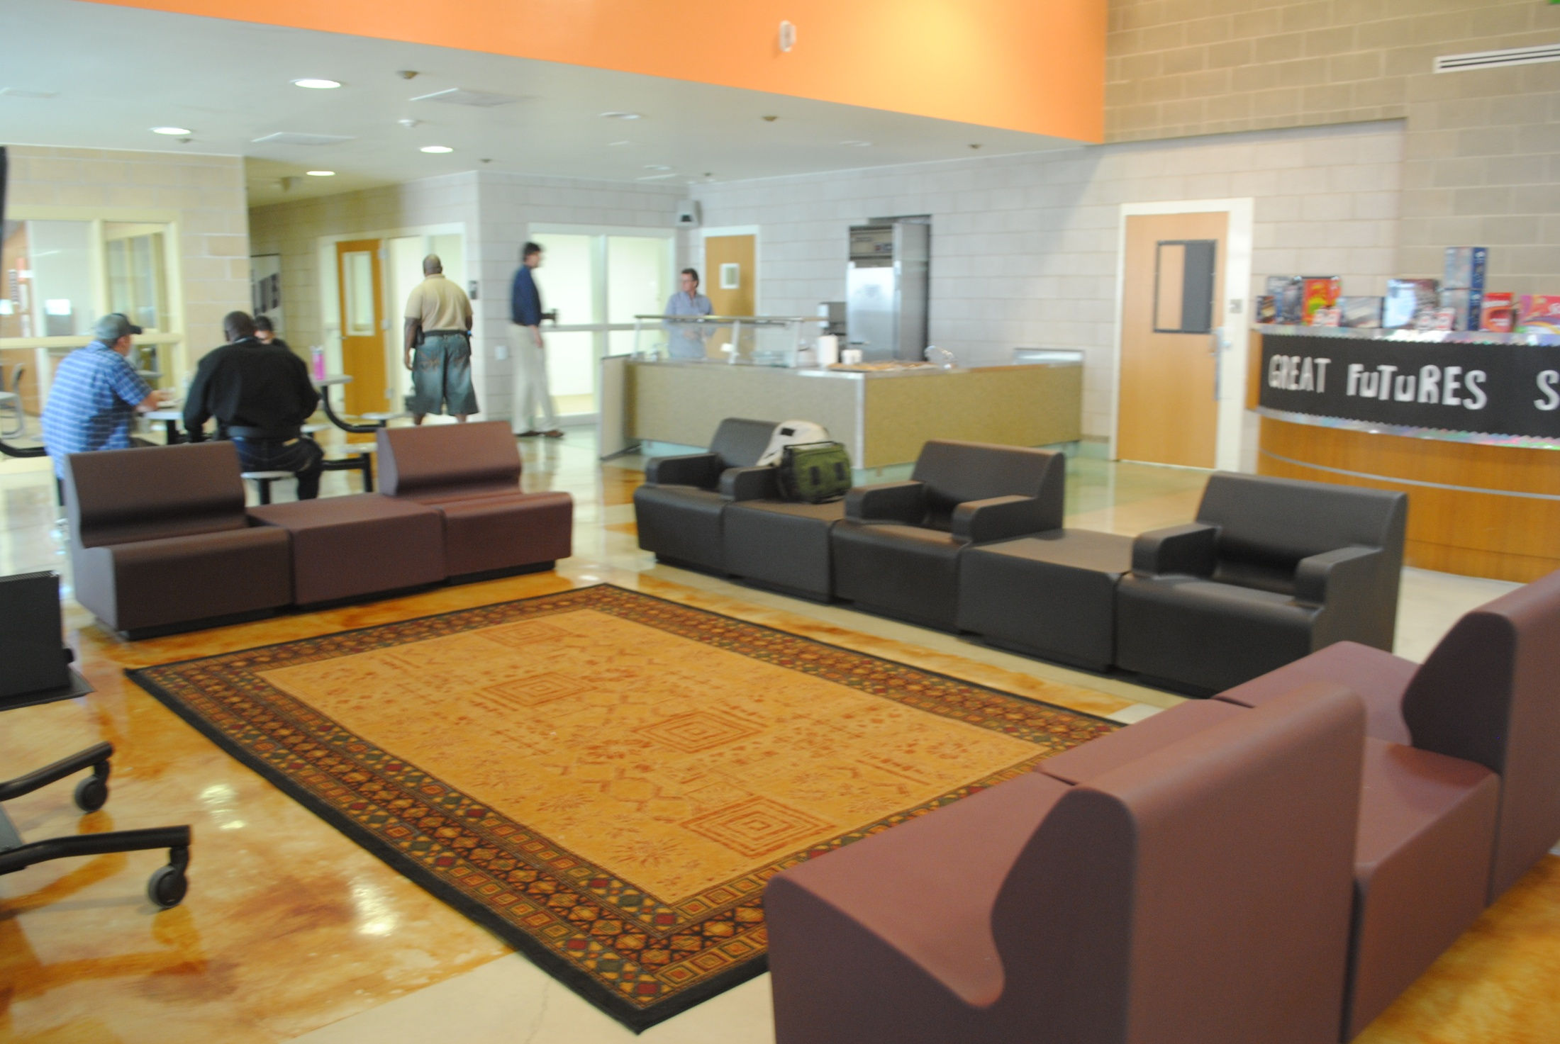

Slide 6
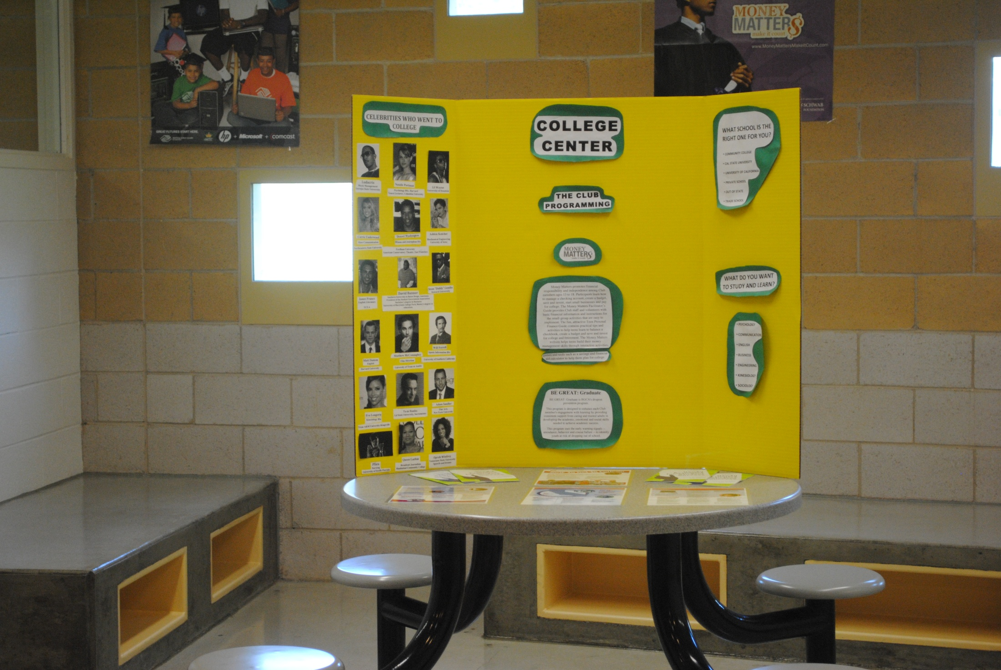
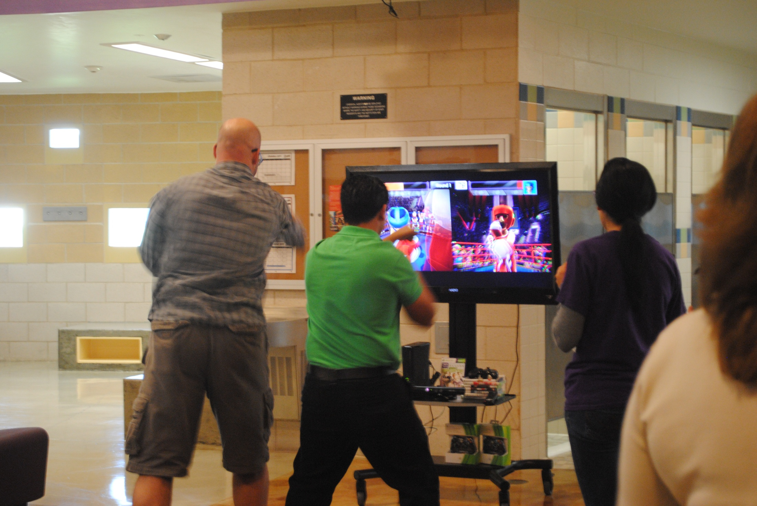

Slide 7
Programming Offered
Character & Leadership Development
Health & Life Skills
The Arts
Sports/Fitness /Recreation
Academic Success & Career Development

Slide 8
Targeted Re-Entry
Case Management
Mentoring
Life Navigation
Emotional Support
Educational enrollment

