Slide 1
The Road to Census 2020
Tim McMonagle
Geographic Coordinator
US Census Bureau
Los Angeles Region

Slide 2
Why We Do a Census
Article 1, Section 2 of the US Constitution
  The actual Enumeration shall be made within three Years after the first Meeting of the Congress of the United States, and within every subsequent Term of ten Years, in such Manner as they shall by Law direct.
Key Purpose is Apportioning the US House of Representatives

Slide 3
Also About Fairness…
Fundamental element of Federal legislation
Some examples:
  Voting Rights (Voting Rights Act)
  Civil Rights
    Title VI
    Title IX
    ADA
    Age Discrimination Act
  Fair Housing Act
Notes:
While the Decennial Census population count is about the apportionment of the congressional seats to the States, the count is also the basis Federal Legislation, including the Voting Rights Act, Civil Rights and Fair Housing Act.

Slide 4
And About Funding
Source: “Counting for Dollars: The Role of the Decennial Census in the Distribution of Federal Funds - Andrew Reamer and Rachel Blanchard Carpenter, Brookings Institution (3/2010)
Notes:
The Decennial count is also the basis for the distribution of over 400B dollars annually to the states. This graph shows the ten largest programs, include the Department of Housing and Urban Development, the Department of Education, the Department of Transportation and other Assistance programs.

Slide 5
Additional Uses
Drawing Congressional, state, and local legislative districts
Basis for population projections
Informing the decisions of governments, business, and non-profits regarding numerous topics such as community and regional development, education, agriculture, energy, etc.

Slide 6
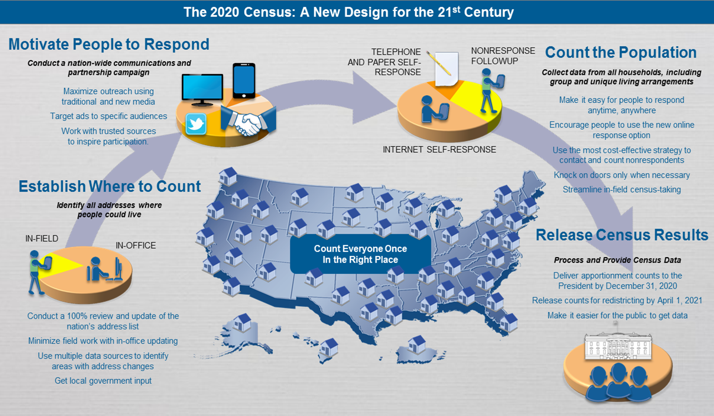
2020 Census Design

Slide 7
Three Main Reasons We Miss People
We don’t have an address
  We can’t send a form
  If we get a response, we can’t “match” them to the ground
We can’t get a response
  We have an address, but we can’t determine occupancy
We get a partial response
  Children
  Multiple Families
  Unrelated individuals

Slide 8
2020 Census Local Update of Census Addresses (LUCA)
Voluntary geographic partnership operation
Once a decade opportunity to review and update the Census Bureau’s Address List for residential addresses
Authorized by the Census Address List Improvement Act of 1994 (Public Law 103-430)
Notes:
LUCA is a voluntary operation, and is the only opportunity prior to the 2020 Census to review and update the Census Bureau’s residential address list for their jurisdiction. The Census Bureau relies on a complete and accurate address list to reach every living quarters and associated population for inclusion in the Census. If an address is not on the list, then the housing unit and it’s associated population will not be visited or sent a questionnaire.
LUCA is authorized by the Census Address List Improvement Act of 1994 – Public Law 103-430.

Slide 9
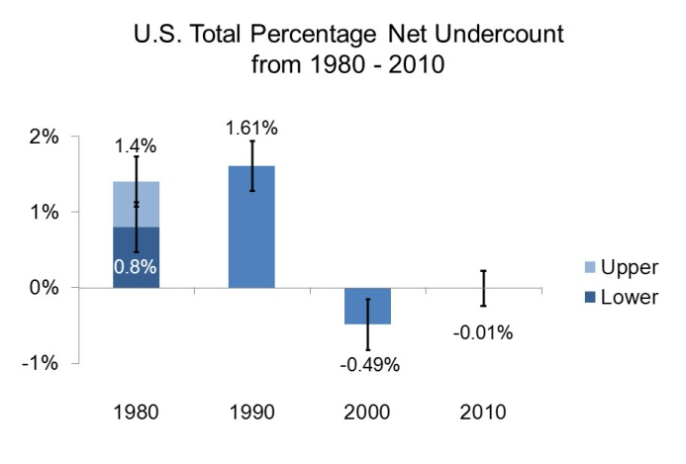
The 2010 Census
A Very Good “Net” Census
Notes:
So in 2010, the “Net” results were very good when you compare them to prior censuses. I’ll go over the “Net” results for Alaska a little later. To produce the Net results, we run and independent operation to measure the outcome are compare the results. Above the 0% line are the Net undercount, as is in the case of the 1980 and 1990 Census. In 2000, there was a half of percentage over count, and the 2010 Census results were very good 0.01% over count – so from the “data quality perspective, the 2010 results were very good.

Slide 10
Who Can Participate in LUCA
  States
  Counties
  Incorporated places (Cities, towns)
  Federally recognized tribes with a reservation or off-reservation trust land
Notes:
States.
Counties
Cities.
Federally recognized tribes with a reservation and/or off reservation trust lands.
And Alaska Native Regional Corporations
Are eligible to participate in LUCA
If your government lacks the resources to participate in LUCA, you can arrange for a higher level of government, such as a Borough; or an organization, such as a regional planning agency or council of governments, to conduct your address review.

Slide 11
Confidentiality and Security
The information provided to/from LUCA is covered under Title 13 of the United States Code which:
  Requires the Census Bureau to ensure confidential treatment of census-related information, including individual addresses and map structure points
  Requires that all liaisons, reviewers, and anyone with access to Title 13 materials abide by Confidentiality and Security Guidelines
  Requires the Census Bureau maintain the confidentiality of all information it collects
Notes:
The information provided to/from LUCA is covered under Title 13 of the United States Code, which:
Requires the Census Bureau to ensure confidential treatment of census-related information, including individual addresses and map structure points. Structure points identify the location of living quarters.
Each participating government will designate a LUCA liaison who accepts the responsibility for protecting and safeguarding Title 13 materials. The LUCA liaison, reviewers, and anyone with access to Title 13 materials must read, understand, and agree to abide by the confidentiality and security guidelines by signing the Confidentiality Agreement form.
It also requires the Census Bureau maintain the confidentiality of all information it collects

Slide 13
2020 LUCA schedule
Timeframe | Activity
January 2017 | Advance Notice mailing mailed to Highest Elected Officials (HEOs), Tribal Chairs (TCs), Governors and other potential 2020 LUCA contacts.
March 2017 | 2020 LUCA Promotional presentations began.
July 2017 | 2020 LUCA invitation and registration materials mailed to HEOs, TCs and Governors.
October 2017 | 2020 LUCA Training workshops began.
December 15, 2017 | 2020 LUCA registration deadline.
February - April 2018 | Participants receive their 2020 LUCA materials.
March - September 2018 | Census Bureau processes 2020 LUCA submissions.
April 2018 - May 2019 | Census Bureau validates 2020 LUCA addresses.
Summer 2019 | Census Bureau delivers 2020 LUCA feedback.
April 1, 2020 | CENSUS DAY.
✓
✓
✓
✓
Notes:
It is important to discuss the LUCA schedule as a preparation aspect of 2020 LUCA. Keeping the schedule in mind prepares you for upcoming tasks and actions.
January 2017 – Advance Notice mailing conducted.
The purpose of the Advance Notice mailing was to bring awareness to 2020 LUCA and its schedule so governments could begin preparing to participate. The Census Bureau asked contacts to review the LUCA Information Guide and to confirm/correct their contact information. The Census Bureau sent a large number of Advance Notice materials in order to build a solid courtesy copy base for the invitation mailing that occurred in July 2017. Nearly 83,000 contacts were shipped the Advance Notice mailing which covered just over 40,000 governments and organizations.
March 2017 – LUCA promotional presentations began.
The six regional offices manage the scheduling of these presentations. Direct questions regarding the LUCA training presentations to the GEO 2020 LUCA e-mail and/or toll-free number provided on the next slide.
July 2017 – LUCA invitation mailing (which includes registration materials) conducted.
The invitation mailing included a letter, four forms necessary for LUCA registration, a document with instructions for registration, and a copy of the Confidentiality and Security Guidelines.
October 2017 – LUCA training workshops began.
December 15, 2017, is the 2020 LUCA registration deadline.
February - April 2018 – 2020 LUCA materials begin to ship to participants. Participants begin their review and have 120 calendar days to complete.
March - September 2018 – Census Bureau processes 2020 LUCA submissions.
April 2018 – May 2019 – Census Bureau validates 2020 LUCA addresses.
Summer 2019 – Census Bureau delivers LUCA feedback to participants (the Appeals process is still under development, but has a very short review timeframe).
April 1, 2020 is CENSUS DAY!

Slide 14
Questions about 2020 LUCA?
Visit the 2020 LUCA Web site:
<https://www.census.gov/geo/partnerships/luca.html>
  Frequently Asked Questions document
Contact us:
  Geographic Programs Support Desk toll-free telephone number: 1-844-344-0169
  E-mail: <GEO.2020.LUCA@census.gov>

Slide 15
Contact Information
Tim McMonagle
Timothy.William.mcmonagle@census.gov
818-267-1730
LUCA Program
los.angeles.geography@census.gov
818.267.1724

