Slide 1


Sharing information on our shared clients: Is the juice worth the squeeze?
SF Department of Public Health Coordinated Care Management System
Maria X Martinez

Slide 2
Situation
Overwhelming need in Managed Care to identify, understand, and find high-risk individuals
Silo systems are linear. People come in, get served one at a time, get diagnosed, data stored
Need to coordinate and track high-risk individuals, measure their system usage and system’s effectiveness, have markers
Providers unaware of others working with patients and duplicate, miss, confuse care
Money spent on homeless system of care is reported, but unduplicated homeless individuals unknown

Slide 3
MIS Challenges
Data segregated by specialty silos, funding silos, vendor silos
IT priorities are to implement large systems to maximize revenue, serve as clinical chart, & meet meaningful use criteria
Getting systems to talk to each other is expensive
Manual integration of datasets for analyses is very time-consuming and one-shot…not sustainable
Jumping on and off of multiple systems requires too much time, too complicated in the provider setting

Slide 4
Approach to Solution
Integrate datasets and create composite picture of each unique patient.
Develop design team (Clinical, Epidemiology, IT, and Management) to determine what data are relevant.
Set-up transfer of data to warehouse server; once there, program system to match and merges
Identify transactional datasets that collect bio-psycho-social information about high-risk patients

Slide 5
Purpose of Data Integration
Aim is not to replace source databases, to bill, or serve as an EMR
Goal is to tell the patient’s story, identify the Care Coordinating Team, facilitate timely communication, and offer “actionable” information

Slide 6
Coordinated Case Management System
Begun in 2005, CCMS has grown to include bio-psycho-social histories of over 600,000 adult high-risk / high-cost patients.

Slide 7
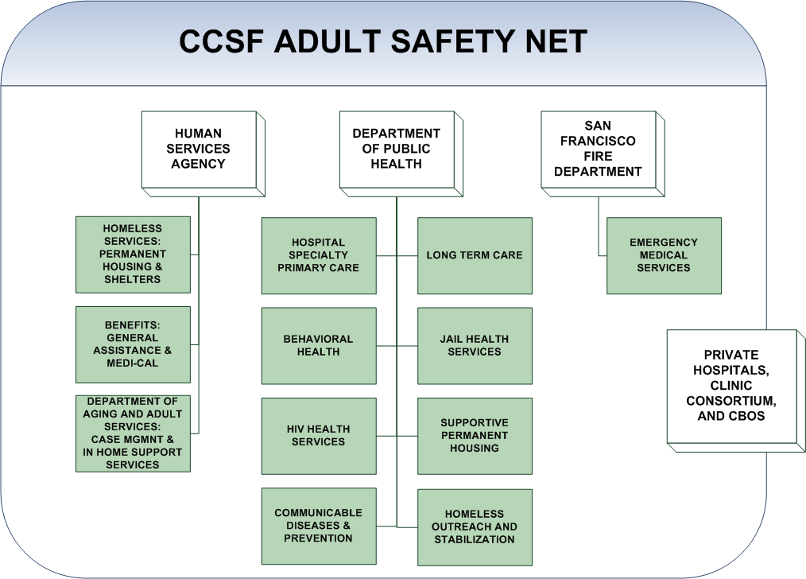

Slide 8
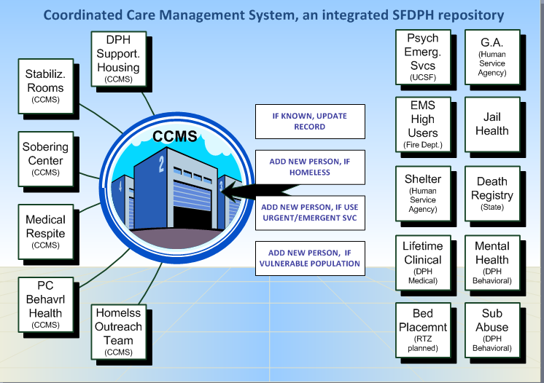

Slide 9
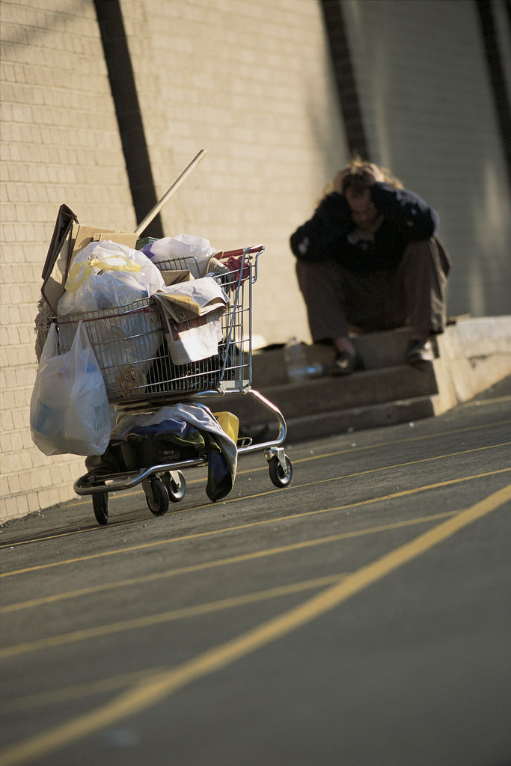
How data from CCMS are being used to understand and improve clinical care and systems of care.

Slide 10

CCMS by Domains
Physical Health | Mental Health | Substance Use | Living Situation | Finances
Legal | Safety | Skills | Support | Meaning-ful Role

Slide 11
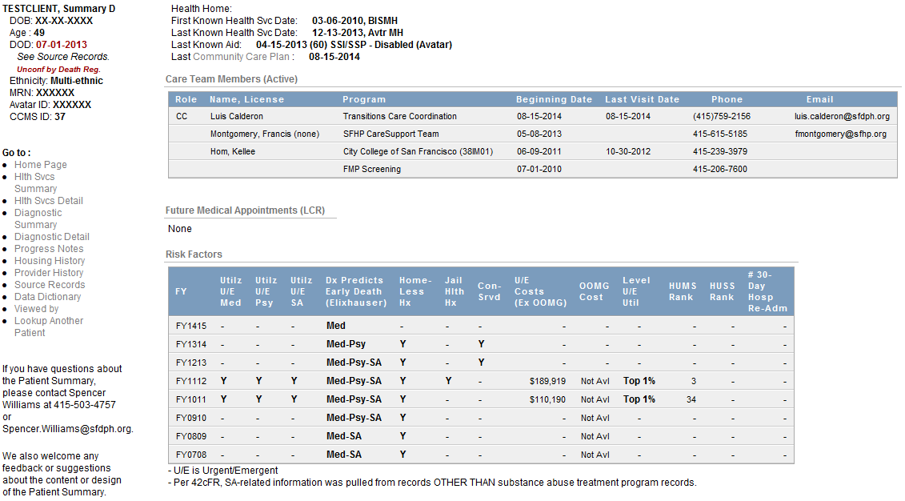
Home Page

Slide 12
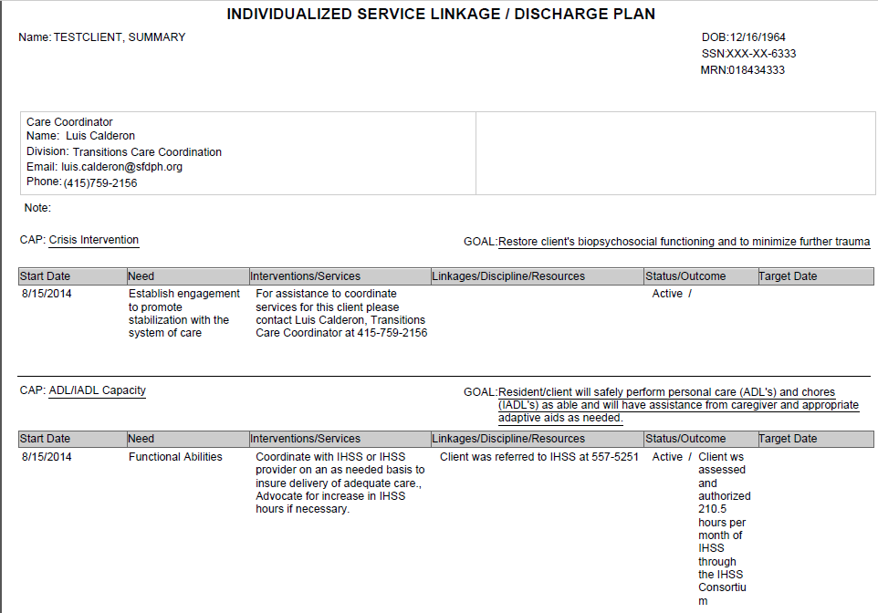
Community Care Plan

Slide 13
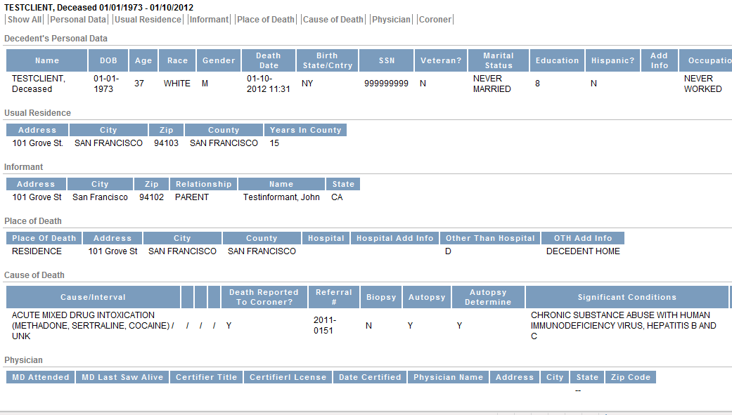
Death Registry (State of California)

Slide 14
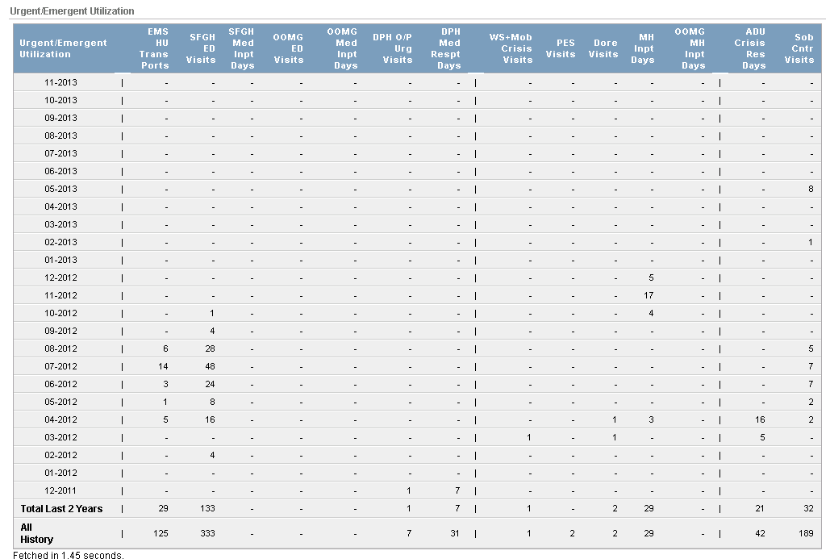
Health Service Summary

Slide 15
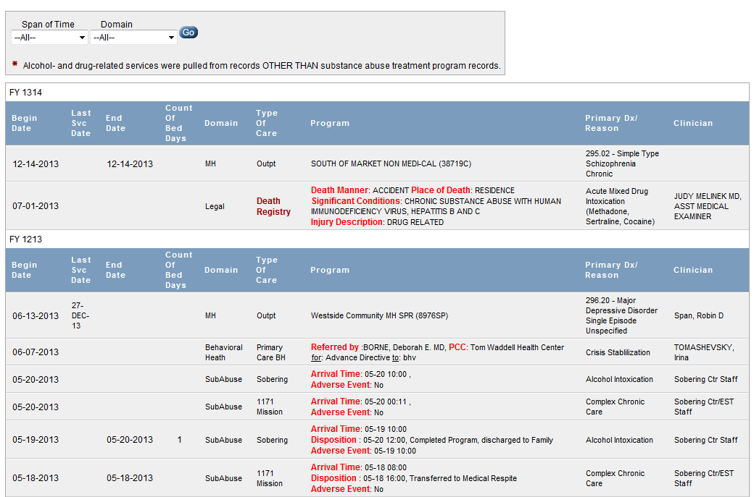
Health Services Detail

Slide 16
Understanding Populations Served
Identify risk factors and acuity based upon all health and human service systems
Profile utilization of urgent/emergent services
Determine span of time with homeless history
Compare programs, clinics, panels, populations
Determine overlapping/shared populations

Slide 17
EMS High Users
EMS High Users are defined as anyone transported four or more times in any one month. Two-thirds appear acutely, one-third are chronic.
Misuse of crisis services results in fragmented care for high-risk patients and cost overruns for an already over-taxed system; as well as delayed response times for others in need of ambulance and emergency department services.

Slide 18
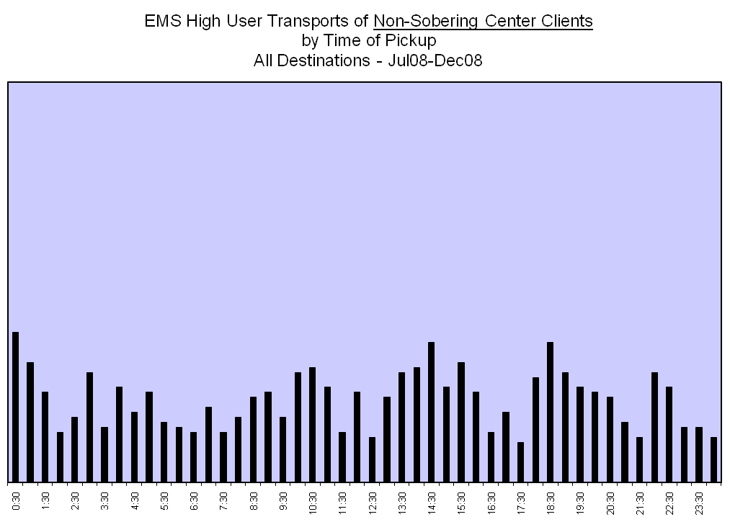

Slide 19
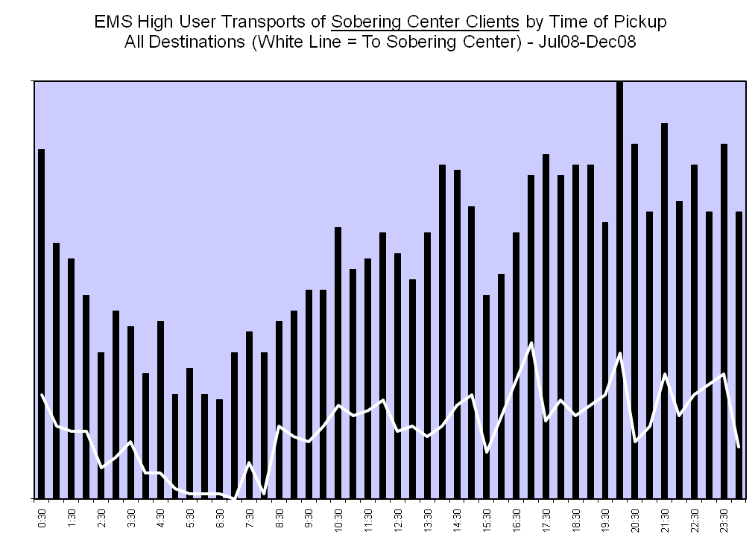

Slide 21
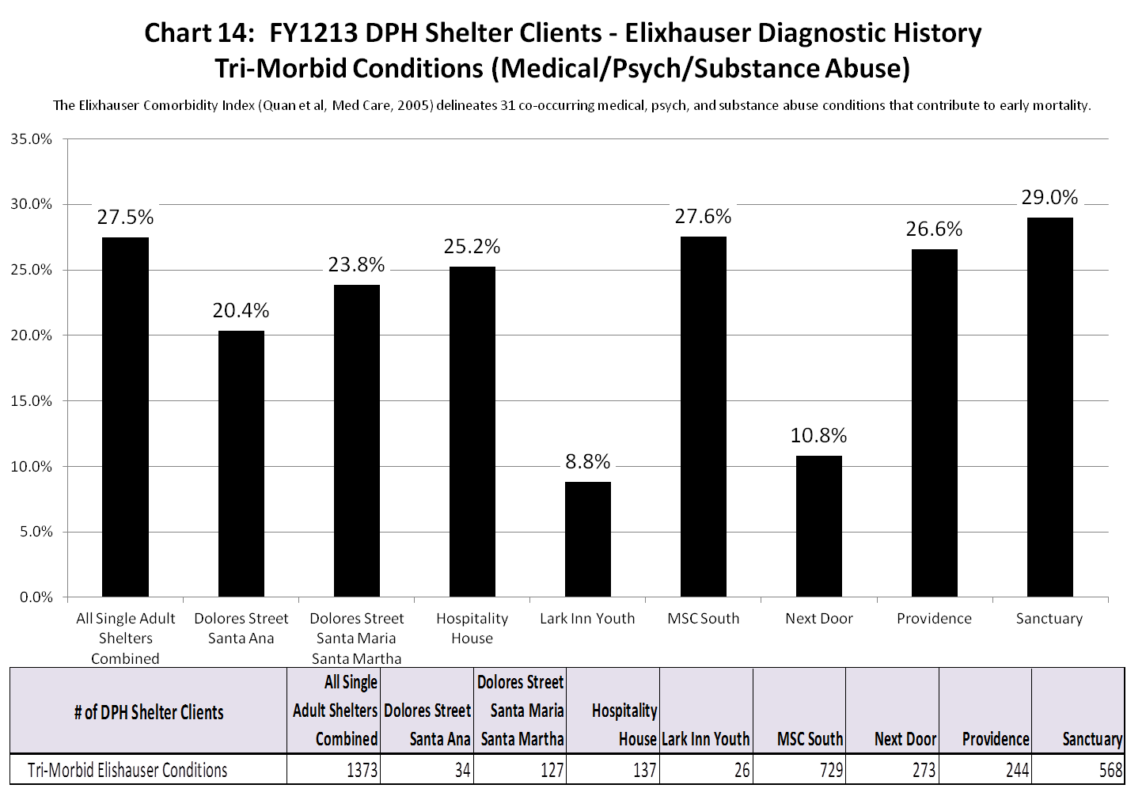

Slide 22
High Users of Multiple Systems (HUMS)
A small percentage of clients, despite assertive case management and repeated efforts at stabilization in the community, are failing to recover.
Present with transitory cognitive impairments and lengthy histories of self-neglect and assaults, necessitating higher levels of care in multiple systems. In lieu of routine community care, they repeatedly use urgent / emergent services.
Their confluence of co-morbid disorders results in extremely high rates of premature mortality &high costs to the system.

Slide 23
Urgent/Emergent Care in SFDPH
Medical System
EMS transports
ED medical
Inpatient – 24hr
Medical Respite (hospital offset)
Urgent care clinics at TWHC, hospital
*Programs in red are the only ones studied
in other communities.
Psychiatric Sytem
PES, Dore St (PES offset)
Psych Inpatient – 24hr
Acute Diversion Units (hospital offset) – 24hr
Crisis clinics at Westside, Mobile Crisis
Substance Abuse System
Sobering Center
Res Medical Detox – 24hr
Res Social Detox – 24hr

Slide 25

Generate shared vision and leadership …this is going to take time.
Iron-out privacy and security issues for sharing data.
Assure you have IT bandwidth.
Engage the provider community…what do they need at the moment of truth to improve the patient experience? What do they need to manage their panels or caseloads better?
Engage the epidemiology community…what data do they need to evaluate outcomes?
Develop protocols for how providers are expected to use integrated data.
Keys

Slide 26

Thoughts? Questions?

Slide 27
San Francisco Department of Public Health
Maria X Martinez
Office of the Director of Health
415-554-2877 maria.x.martinez@sfdph.org

