Slide 1
University of California, Davis Department of Land, Air and Water Resources
Long Term Impacts of the Drought
California State Association of Counties
Nov/2015
Samuel Sandoval, PhD
Assistant Professor
C.E. Specialist in Water Resources

Slide 2
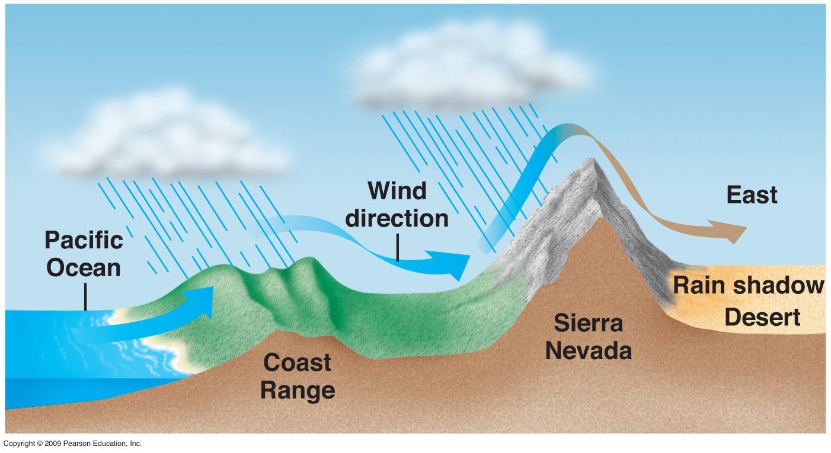
California Climate: Full of extremes
Mediterranean Climate
Dry Summers
Wet Winters
Atmospheric Rivers
Notes:
In modern California, cities, and agriculture are an important part of this hydrologic cycle – they both use groundwater and recharge back into groundwater. Groundwater is intrinsically linked to surface water, with all of its ecosystem functions.

Slide 3
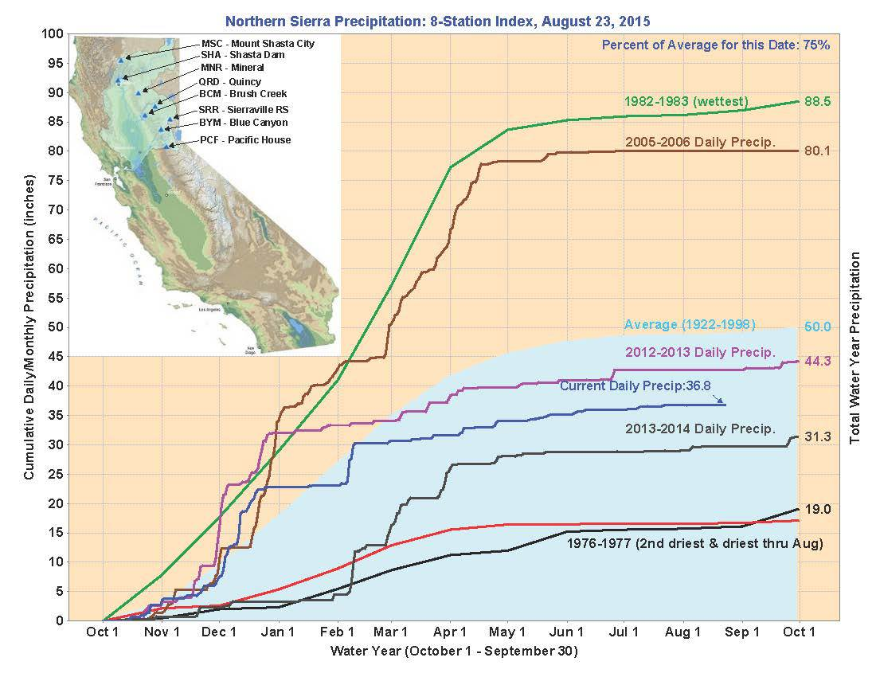
California Climate: Full of extremes
Cumulative Precipitation (inches)
Normal
3-years ago
Last year
2-years ago
Driest Years
(23-24, 76-77)
Notes:
In modern California, cities, and agriculture are an important part of this hydrologic cycle – they both use groundwater and recharge back into groundwater. Groundwater is intrinsically linked to surface water, with all of its ecosystem functions.

Slide 4
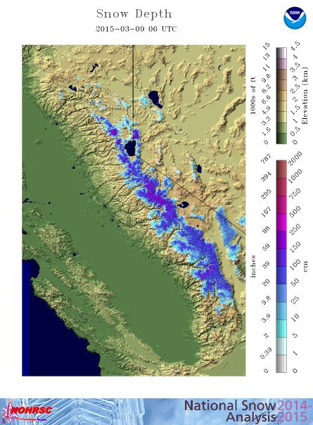
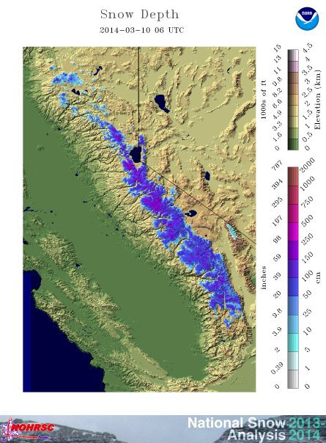
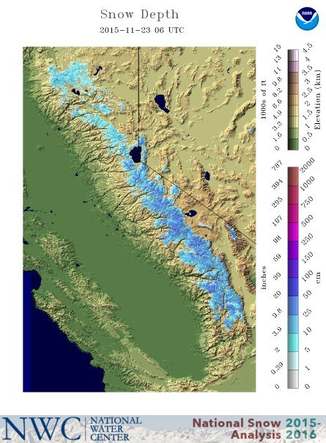
Last Year
2 Years ago
This year

Slide 5
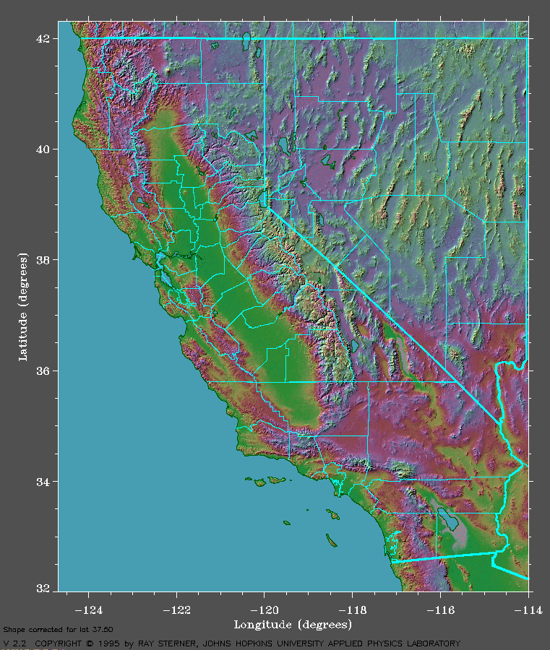
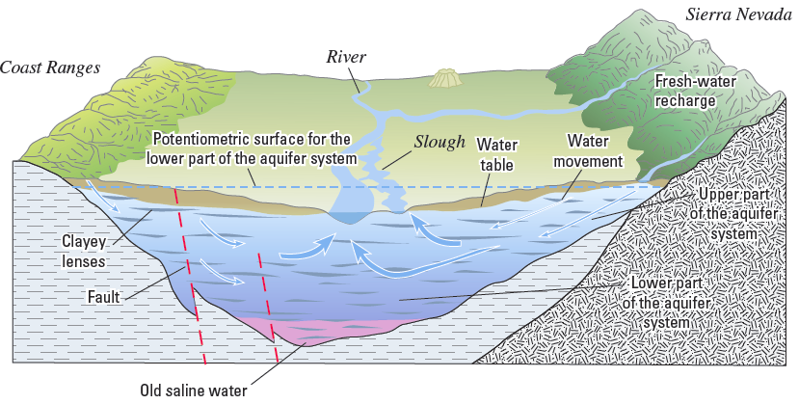
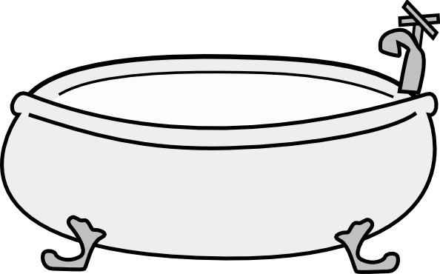
California Physiography
Figure: Faunt, 2009, p. 22
Notes:
In modern California, cities, and agriculture are an important part of this hydrologic cycle – they both use groundwater and recharge back into groundwater. Groundwater is intrinsically linked to surface water, with all of its ecosystem functions.

Slide 6
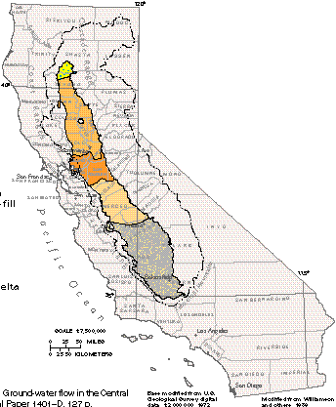
Groundwater Challenges
State GW source
Problems
Depletion
Seawater intrusion
Subsidence
Management strategies?
Notes:
In modern California, cities, and agriculture are an important part of this hydrologic cycle – they both use groundwater and recharge back into groundwater. Groundwater is intrinsically linked to surface water, with all of its ecosystem functions.

Slide 7
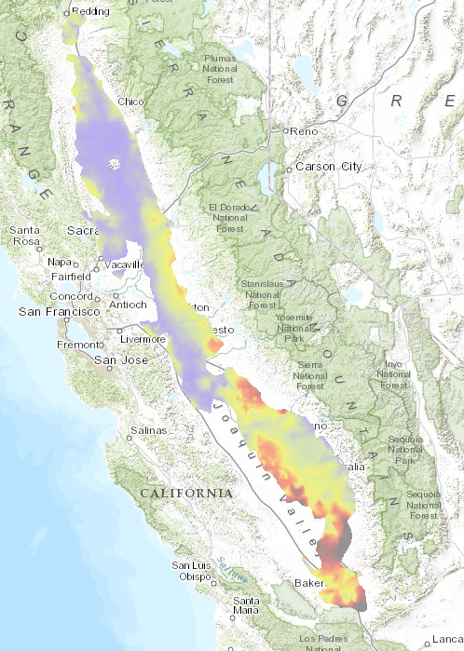
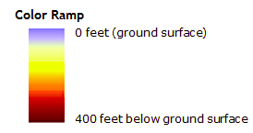
Groundwater Depletion
http://gis.water.ca.gov/app/groundwater

Slide 8
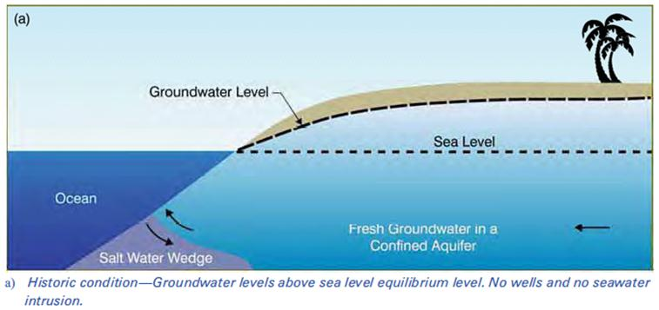
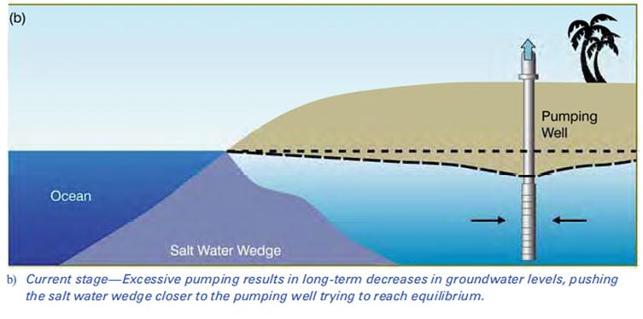
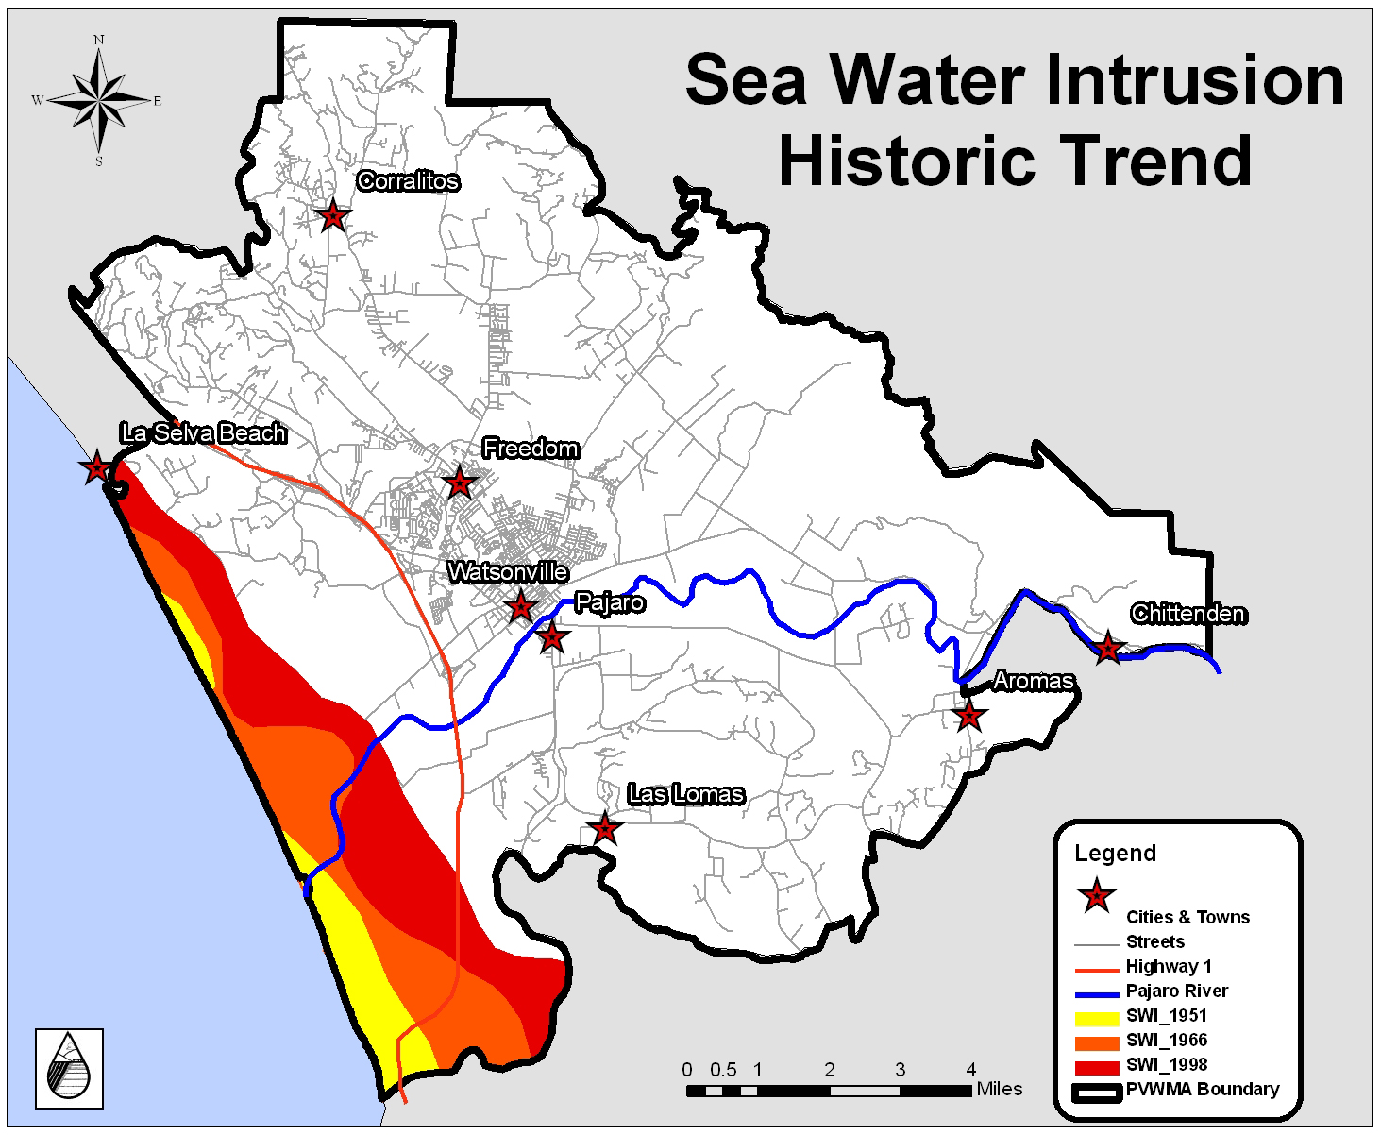
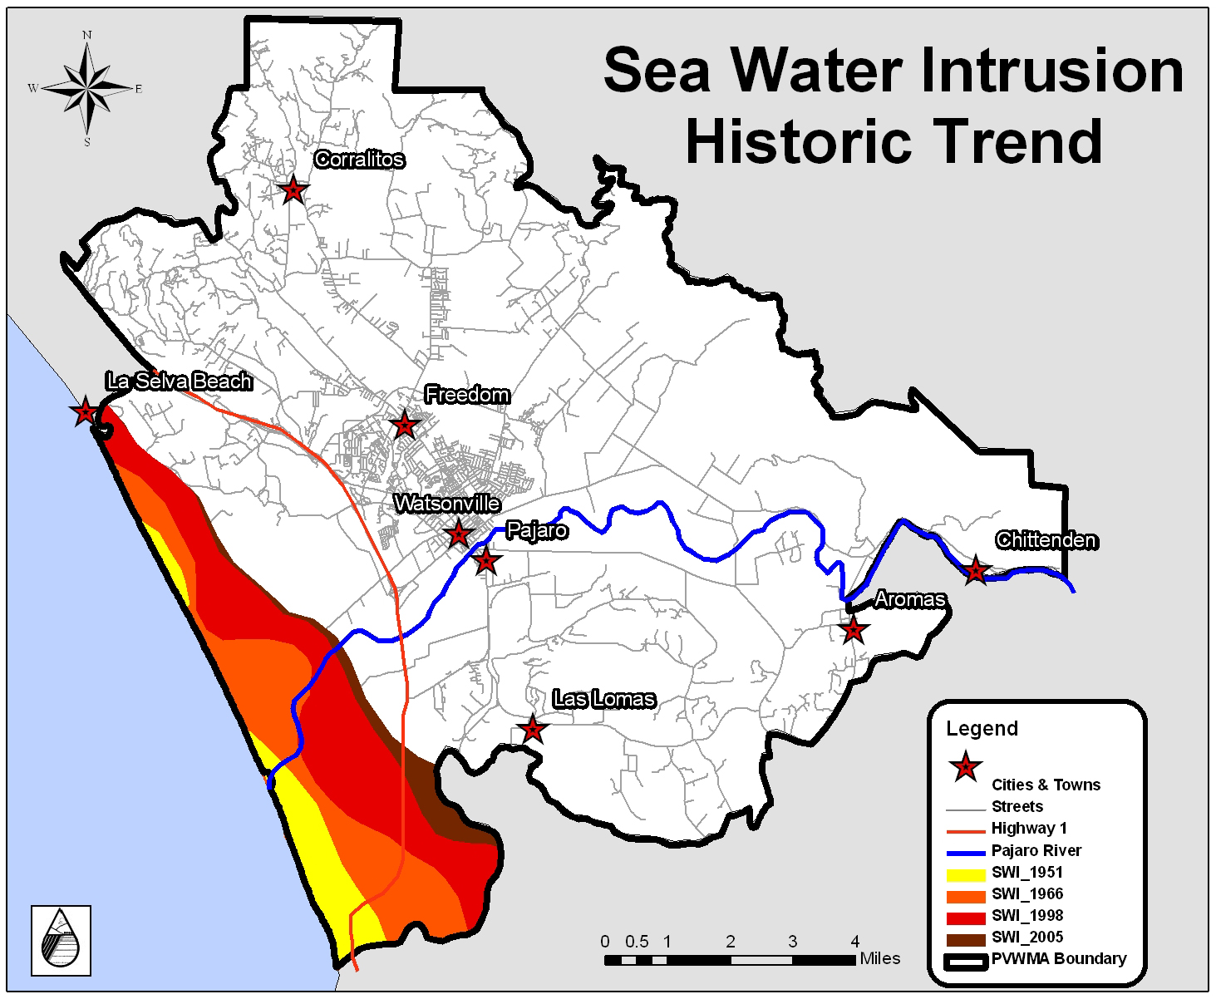
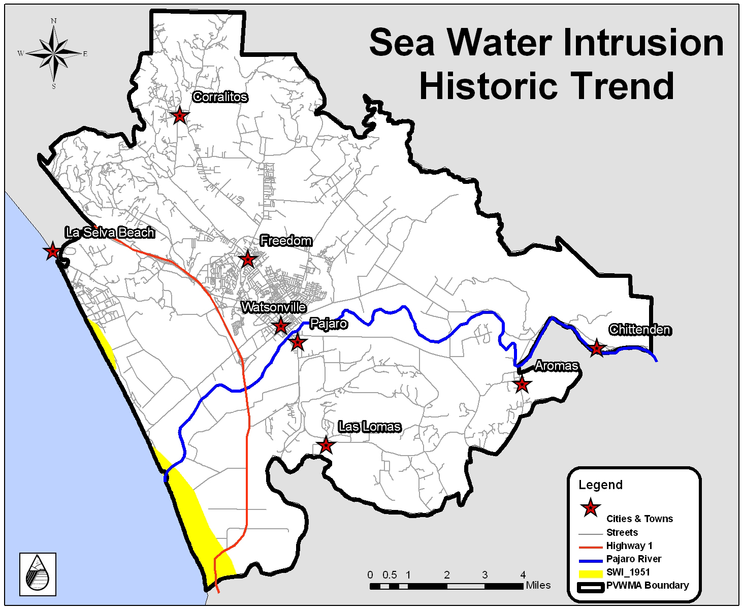
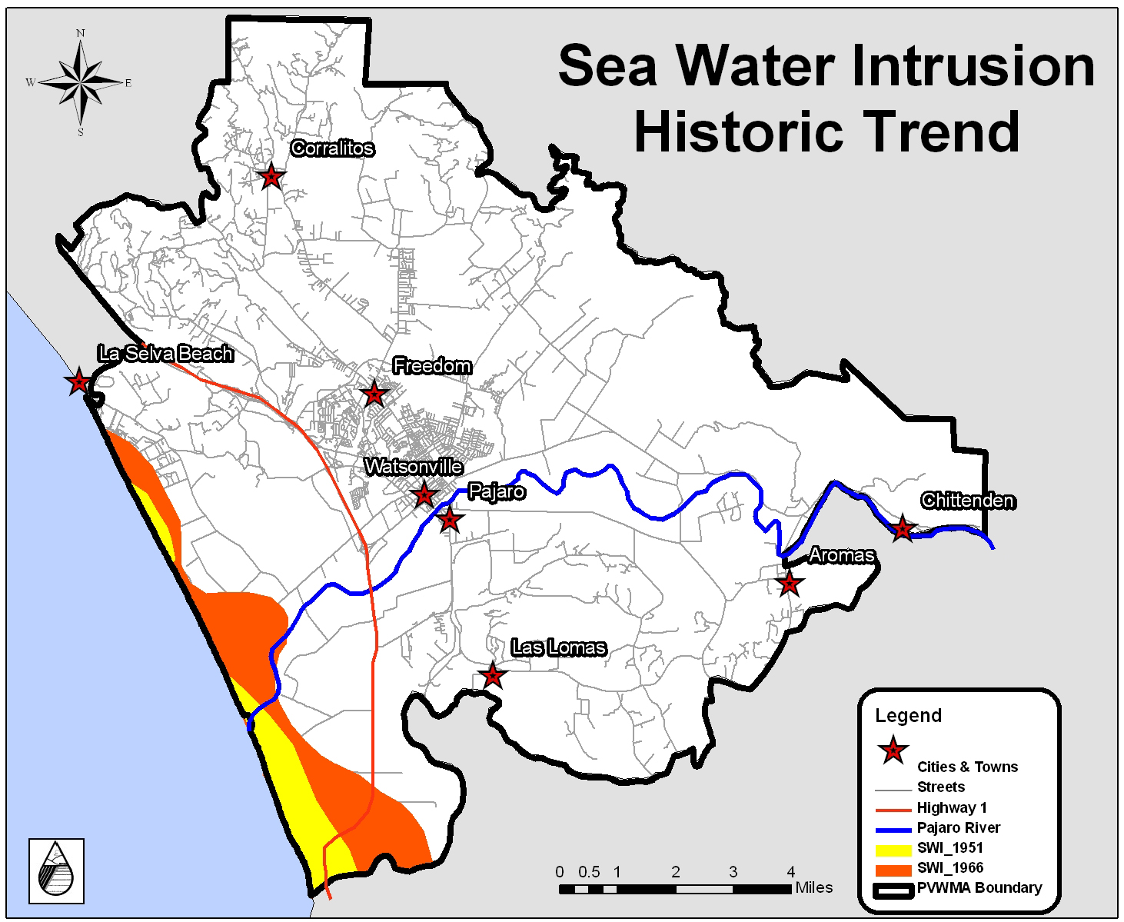
Seawater Intrusion

Slide 9
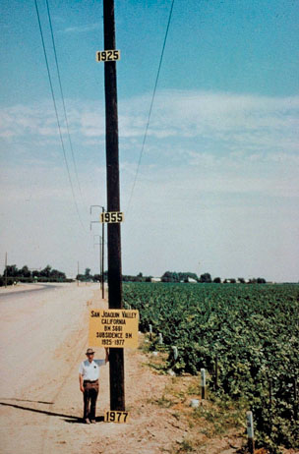
Subsidence
What’s going on here?
A dropping of the land surface as a result of ground water being pumped.
Cracks and fissures can appear in the land. Subsidence can be an irreversible process.

Slide 10
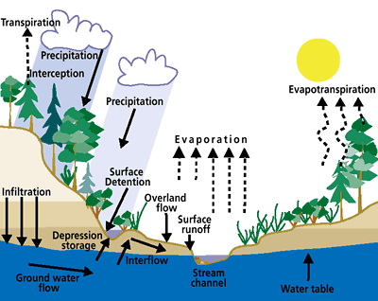
Solutions: Water Budget
Water Balance!
ΔS = P – R – G – ET
S: Storage
P: Precipitation
R: Runoff
G: Ground infiltration
ET: Evapotranspiration

Slide 11
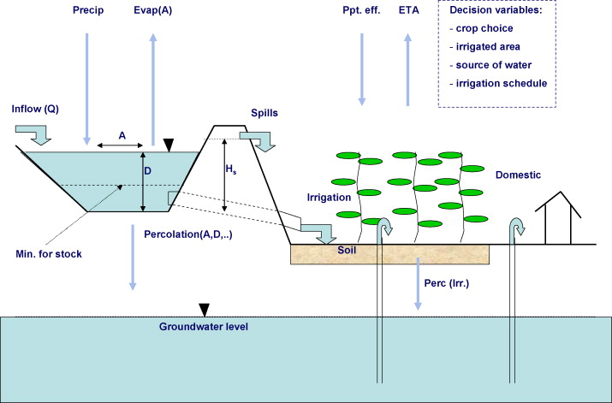
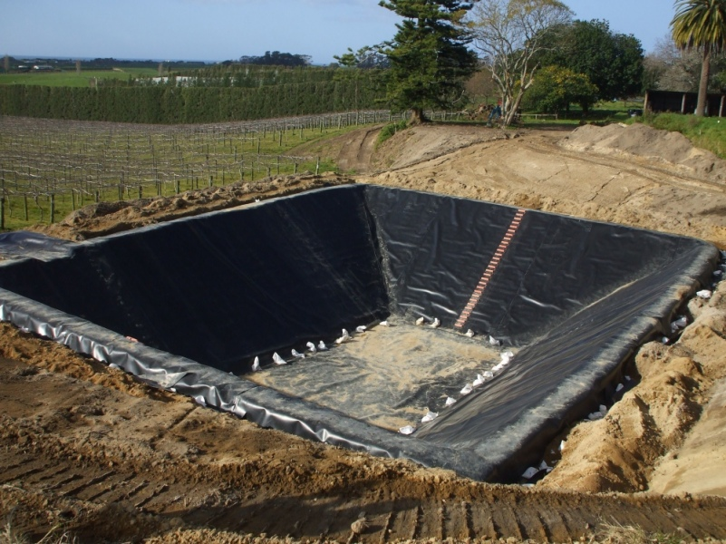
Solutions: Conjunctive Use
Coordinated use of surface water and groundwater to meet crop demand
Active: artificial recharge; SW intentionally percolated or injected into aquifers for later use
Passive (“In Lieu”): rely on SW in wet years, use GW in dry years

Slide 12
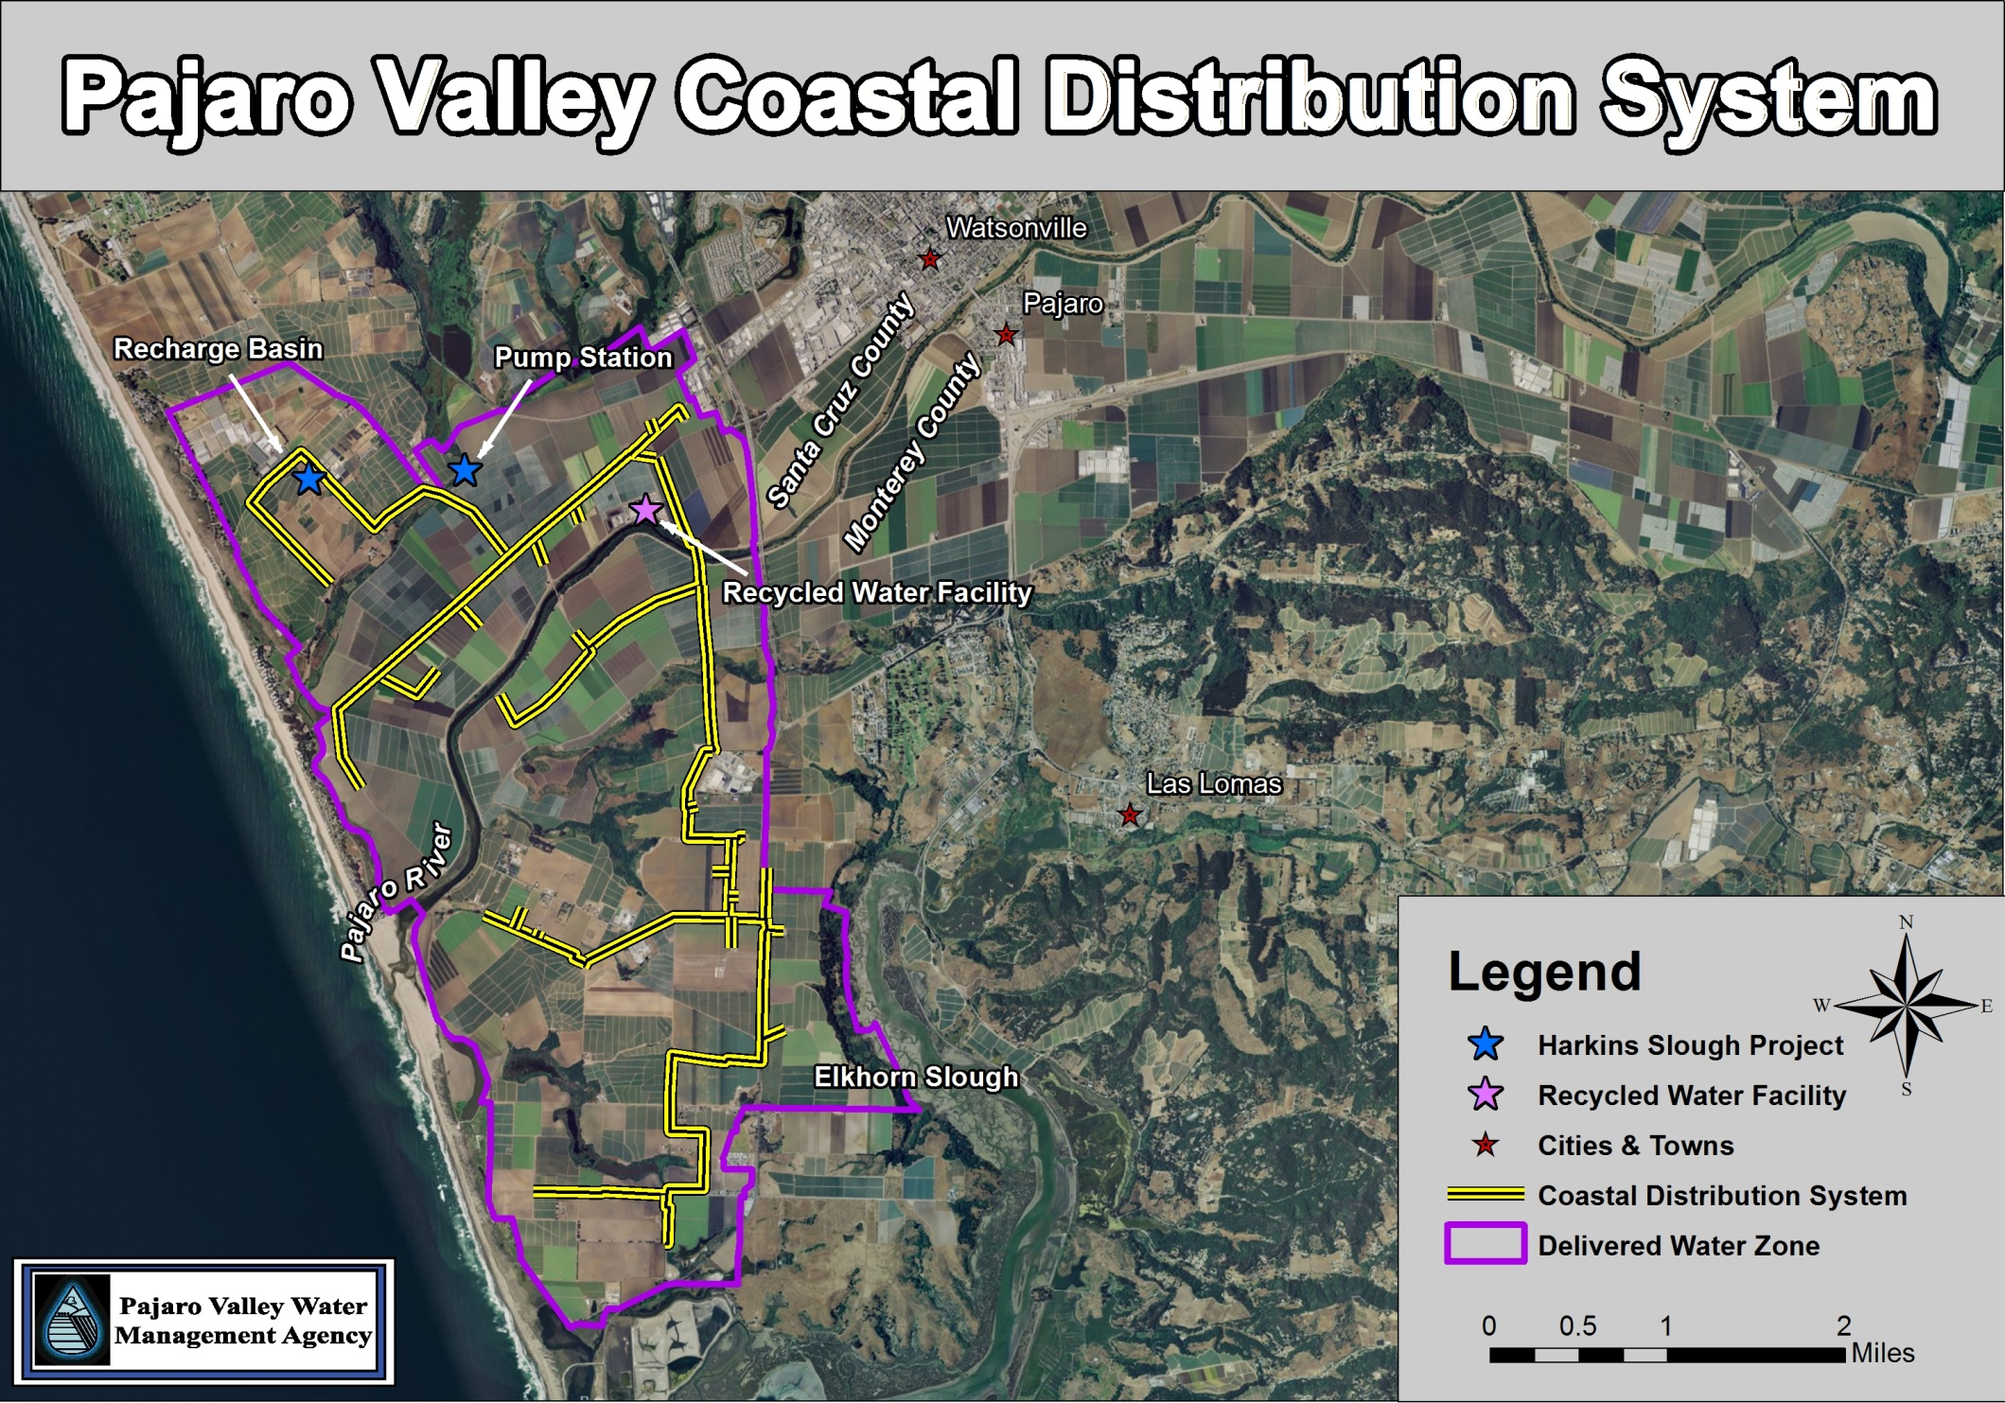
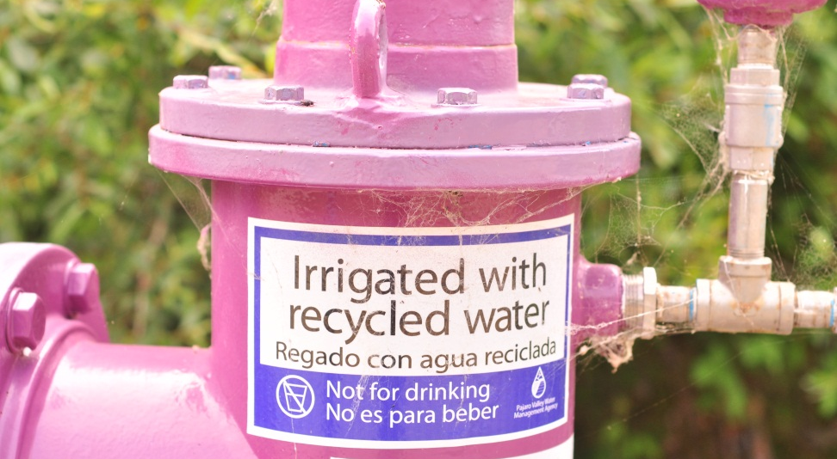
Solutions: Recycled Water

Slide 13
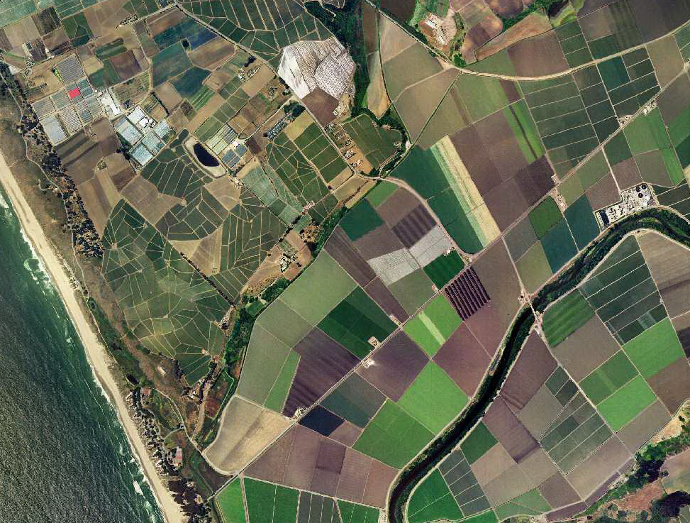
Solutions: Management of Artificial recharge (MAR)
Groundwater management: artificial recharge to store excess water + improving water quality
Water traps
Drainholes
Cutwaters
Infiltration basins

Slide 14
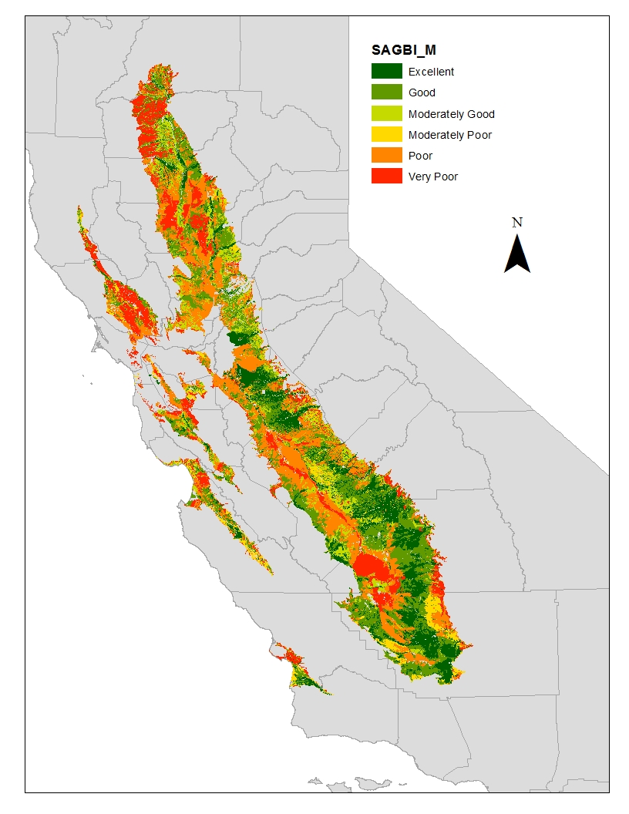
Solutions: gW banking in Agricultural Land (ag-GB)
Soil Agricultural GW Banking Index
Deep percolation
Root zone residence
Topography
Salinity & Nutrient
Surface condition
2.3 million hectares of good soils for Ag-GB

Slide 15
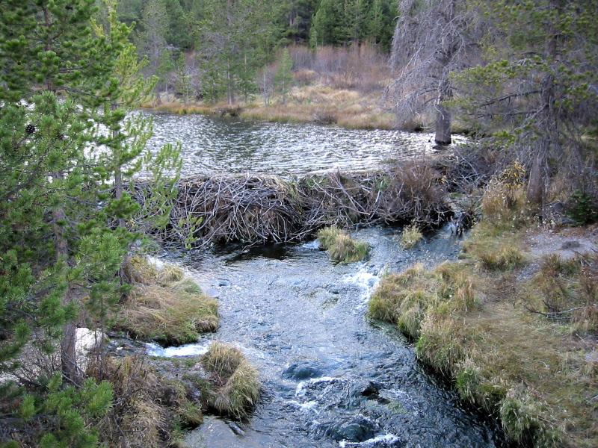
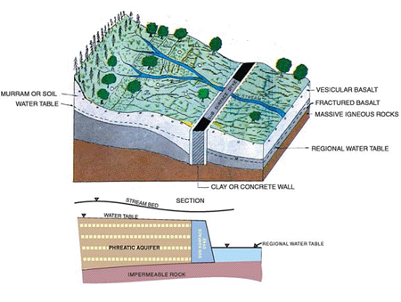
Solutions: Other Recharge methods
Water traps: increase infiltration in streambeds. The traps are earthen dams of variable height
Cutwaters: excavations of variable dimensions, used as reservoirs, built in low-lying areas

Slide 16
“Use the water that you need, but not a drop more”
“Usa el agua que necesites, pero ni una gota mas”
Thanks
samsandoval@ucdavis.edu
http://watermanagement.ucdavis.edu/cooperative-extension/

