Slide 1
Achieving Groundwater Sustainability CSAC Legislative Conference
May 15, 2014 • Timothy Quinn, ACWA Executive Director

Slide 2
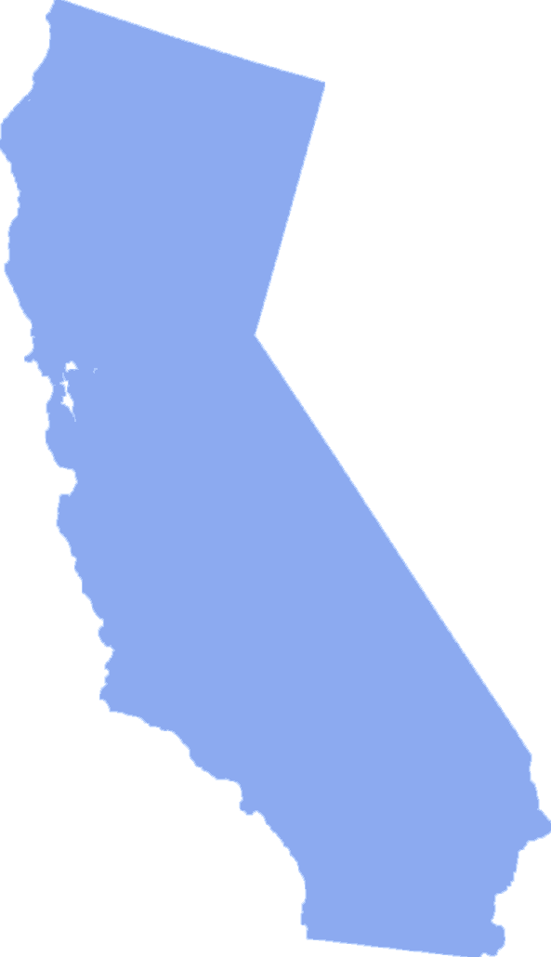
About ACWA
Who We Represent . . .
ACWA members responsible for 90% of the state’s distributed water
Water Sources & Services
federal, state and local projects
surface and groundwater
agricultural, urban, industrial customers
Wholesale, retail

Slide 3
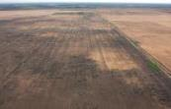
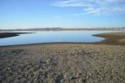
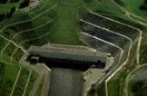
California Water in 2014
Acute Drought Crisis
Chronic System Failure
2014 is clearly a year of crisis and opportunity!

Slide 4
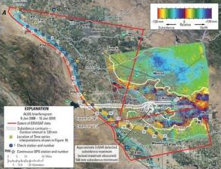
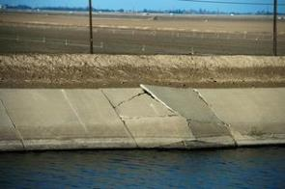
Groundwater Crisis
Unprecedented strain on groundwater today
Groundwater declines becoming unsustainable in some areas
Local subsidence, degraded water quality a concern
Implications for other users, key infrastructure

Slide 5
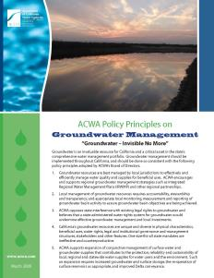
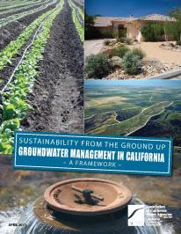
ACWA Groundwater Sustainability Task Force
The groundwater crisis will be with us long after the drought ends
March 2009 Groundwater Management Policy Principles adopted by ACWA Board
April 2011 Groundwater Framework adopted by ACWA Board

Slide 6
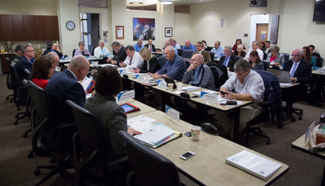
ACWA Groundwater Sustainability Task Force
ACWA Board-Level Task Force created November 2013
Core Instincts
Respect property rights
Protect local control
Promote sustainable outcomes
Take bold action

Slide 7
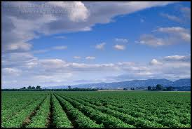
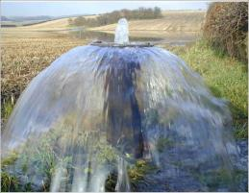
ACWA Groundwater Sustainability Recommendations
Define the problem
Sustainable outcomes for economy / ecosystem
Create management entities
Local flexibility
Interagency cooperation
Provide the tools they need
Quantified goals
Data collection
Limits on demands
Funding, Including local fees
Establish a “backstop”
Make sure it’s part of a comprehensive program

Slide 8
ACWA Groundwater Sustainability Recommendations
ACWA position = “Game Changer”
Historic legislation likely this year
Two bills in progress
AB 1739 (Dickinson)
SB 1168 (Pavley)
“The game-changer today is that the Association of California Water Agencies …put forward a set of recommendations…” Sacramento Bee editorial

Slide 9
Contact & More Information
Timothy Quinn
ACWA Executive Director
timq@acwa.com
916.441.4545 • www.acwa.com

