Slide 1
Sustainable Groundwater Management
May, 2014

Slide 2
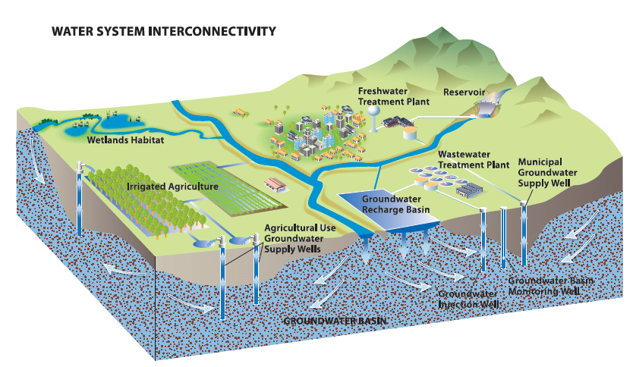
Integrated Water Management

Slide 3
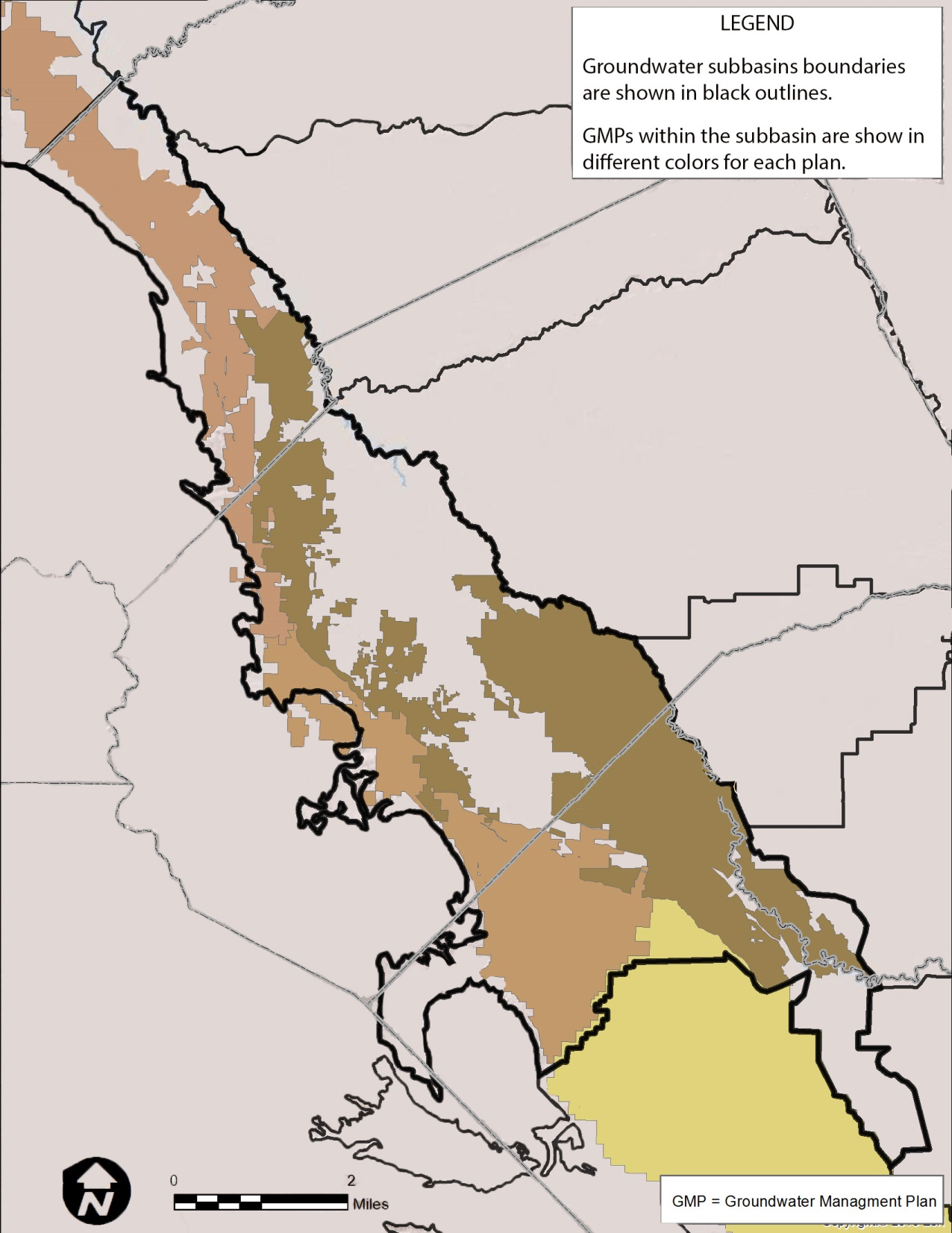
LGME Jurisdiction Formation
County A
County B
Water District GMP
County C
Water District GMP
Water District GMP

Slide 4
Draft Recommendation 4:
Groundwater Management Authorities
Measuring and reporting on groundwater conditions
Allocating groundwater and managing pumping consistent with property rights
Assessing fees
Allowing and approving groundwater transfers
Land use coordination with counties
Ability to enforce requirements

Slide 5
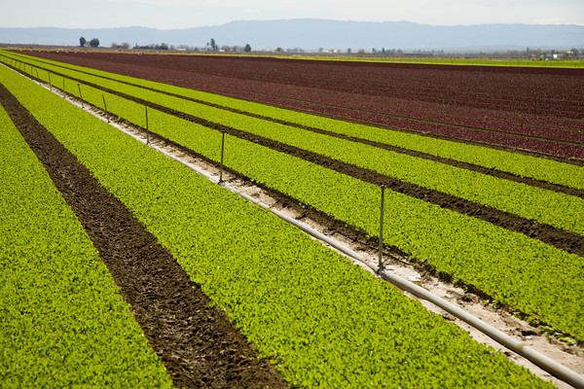
Challenging Issues
Protection of property rights
Groundwater management and water quality
Inclusiveness and transparency
Land use coordination and collaboration
Prevention vs. reaction (tipping point)

Slide 6
Moving Forward
100 years to get here
Critical issue for everyone
Must avoid the slow moving disaster
Now is the time

