Slide 1
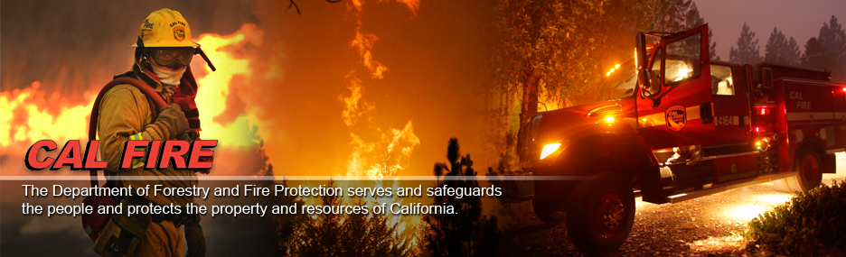
CAL FIRE
CSAC 5/30/13

Slide 2
Direct Protection Area
Of California’s 100 million acres:
1/3 is CAL FIRE protection
1/3 is federal protection
1/3 is local protection

Slide 3
Fire Season Outlook
Northern California

Slide 4
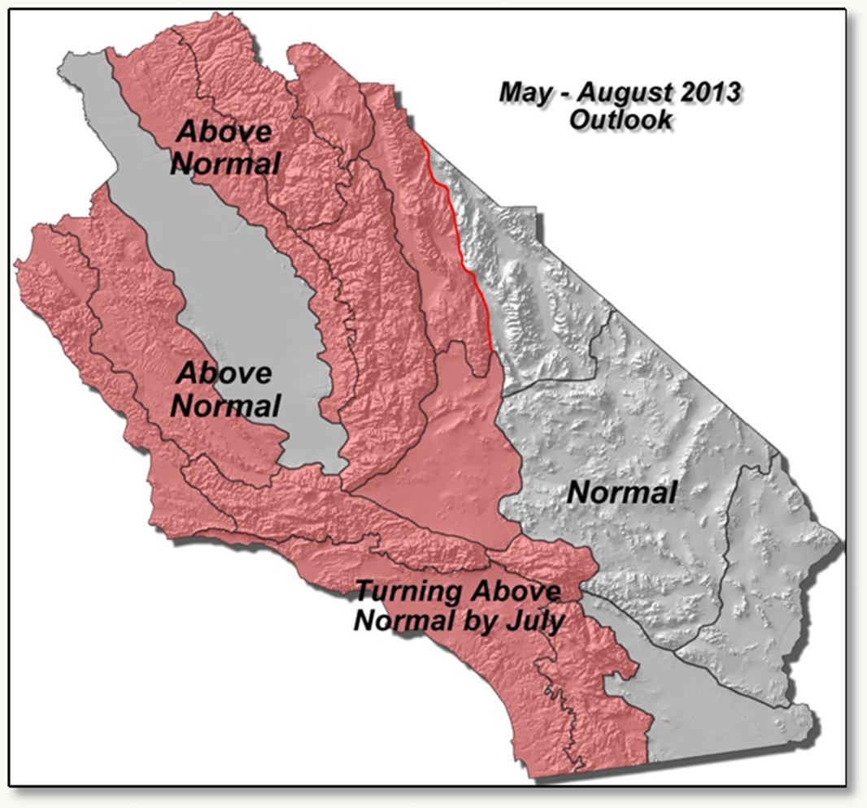
Fire Season Outlook
Southern California

Slide 5
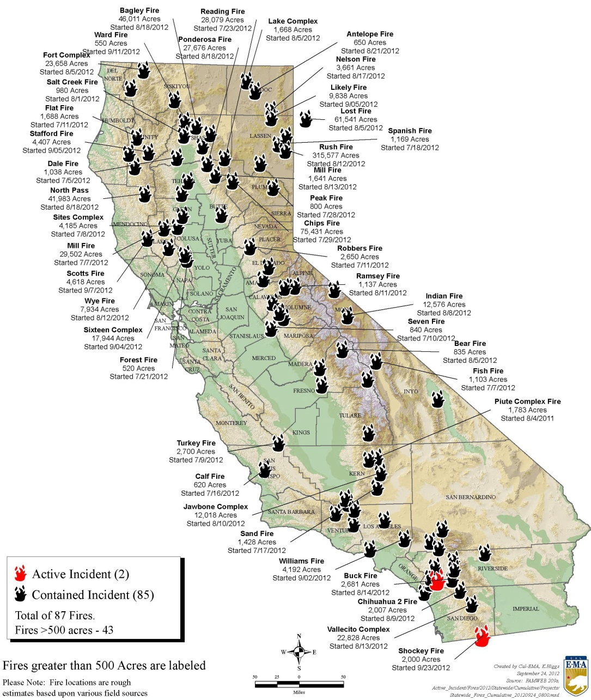
Significant Fires

Slide 6
