Slide 1
Results First Clearinghouse Database 101
Amalia Mejia, CSAC
Karyn Milligan, Santa Barbara County
Holly Child, Santa Clara County
Sara Jamison, Santa Cruz County
November 29, 2017

Slide 3
CSAC-Results First Partnership
CSAC Hub
Program Inventory & Benefit-Cost Model
Program Inventory Technical Assistance
Expand County Partnerships
Evidence-based Programming Help Desk

Slide 4
Bringing research into local government
What do you know about the adult criminal justice programs in your county?
As a Board of Supervisor or staff member how do you ensure the programs have some level of evidence?
How do you track the program’s effectiveness? Is there fidelity?
How can the clearinghouse be used as menu approach of programs?

Slide 5
What are programs?
Programs are systematic activities that engage participants in order to achieve desired outcomes.
In Adult Criminal Justice, this includes programs that address recidivism, life skills, substance abuse, parenting skills, etc.
For example:
Cognitive behavioral therapy
Postsecondary correctional education
InsideOut Dad

Slide 6
Evidence-based programs and practices
Promising programs and practices
Evidence-based ≠ Effective

Slide 7
What are clearinghouses?
Purpose is to identify “what works”
Review and summarize rigorous evaluations of different interventions
Assign ratings to interventions based on the evidence (e.g., model, promising, mixed effects)
Use slightly different methodologies, criteria and terminology
Policy area specific
What Works Clearinghouse = Education
CrimeSolutions.gov = Criminal Justice

Slide 8
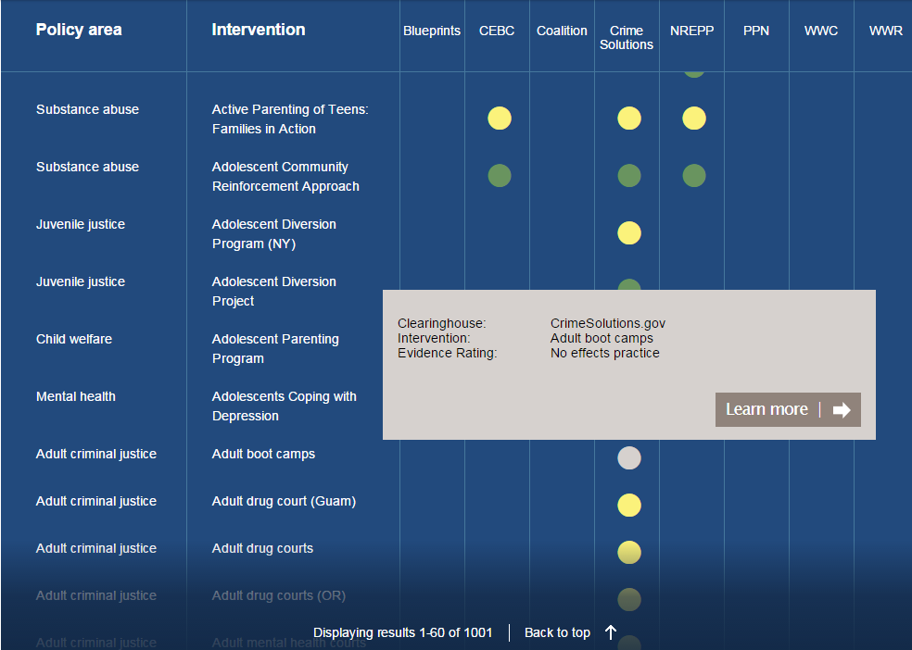
Source: The Pew-MacArthur Results First Initiative, Results First Clearing House Database, http://www.pewtrusts.org/en/multimedia/data-visualizations/2015/results-first-clearinghouse-database
Notes:
Results First composed

Slide 9
Source: The Pew-MacArthur Results First Initiative, Results First Clearing House Database, http://www.pewtrusts.org/en/multimedia/data-visualizations/2015/results-first-clearinghouse-database

Slide 10
Search by Policy Area
Adult Criminal Justice
Juvenile Justice
Child welfare
Health
Substance Abuse
Mental Health

Slide 11
Search capabilities:
Name
Policy Area
Intervention type
Rating Color
Results First Clearinghouse Database

Slide 13
County examples

Slide 14
Q & A
amejia@counties.org

