Slide 1
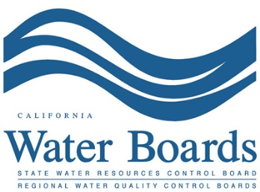
Cannabis Cultivation & the Environment CSAC November 19, 2014
Cris Carrigan, Director
State Water Board
Office of Enforcement

Slide 2
Scope of the Problem
Marijuana cultivation operations on private and public lands cause enormous harm.
Marijuana cultivation site preparation activities can cause erosion and stream habitat degradation.
Unlawful water diversions by those cultivating marijuana can severely limit the amount of water available to the public and wildlife.
Fertilizers and pesticides used in these sites are often mixed in the water source contaminating streams.

Slide 3
Damage caused by Cannabis Cultivation
Cannabis Cultivation operations often generate garbage which can end up in our water.
Photo By Stormer Feiler,
North Coast Regional Board©

Slide 4
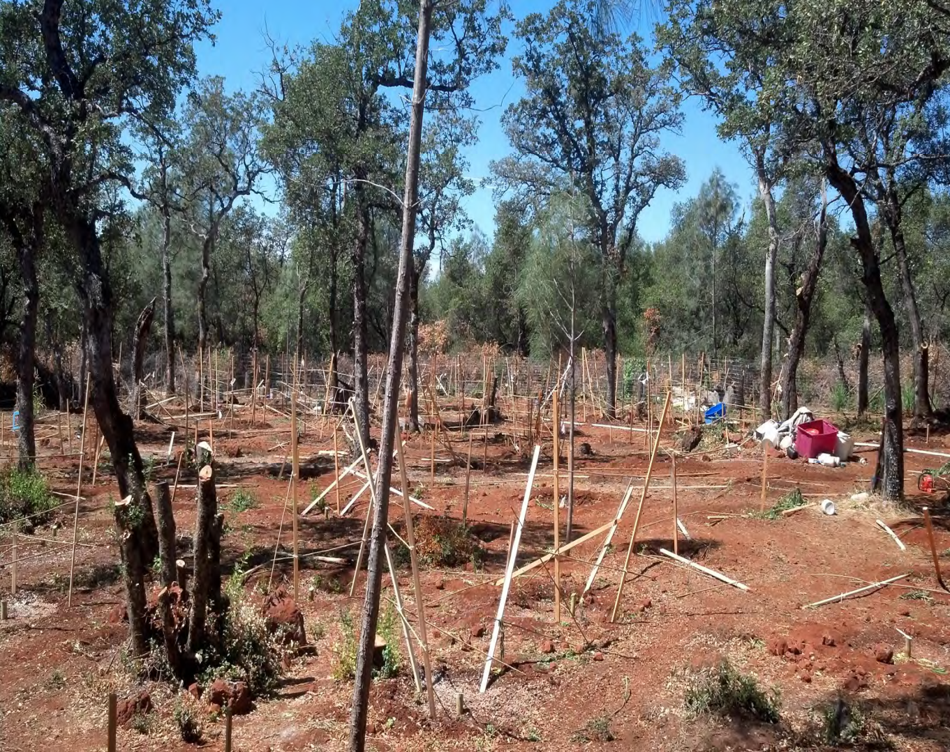
Damage caused by Cannabis Cultivation
Large Scale Cannabis Cultivation operations often generate runoff containing sediments, pesticides and nutrients which can end up in our water bodies.
Photo By California Department of Fish & Wildlife©

Slide 5
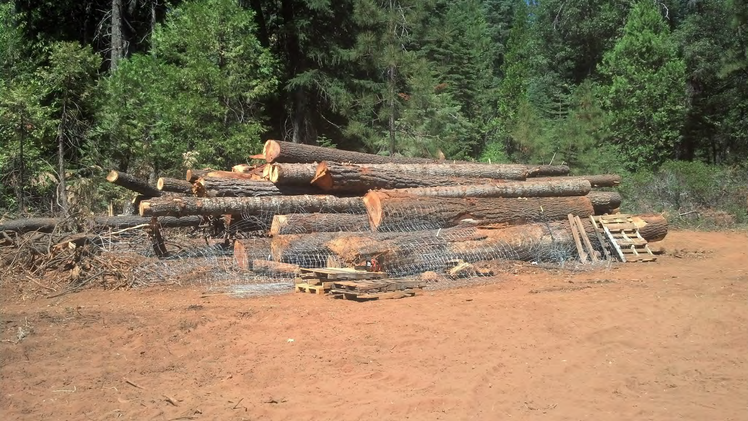
Damage caused by Cannabis Cultivation: Unpermitted Timber Conversion

Slide 6
Sedimentation Caused by Grows
Development of roads and the diversion of streams for irrigation can cause mass sedimentation.
Photo By Stormer Feiler, North Coast Regional Board©

Slide 7
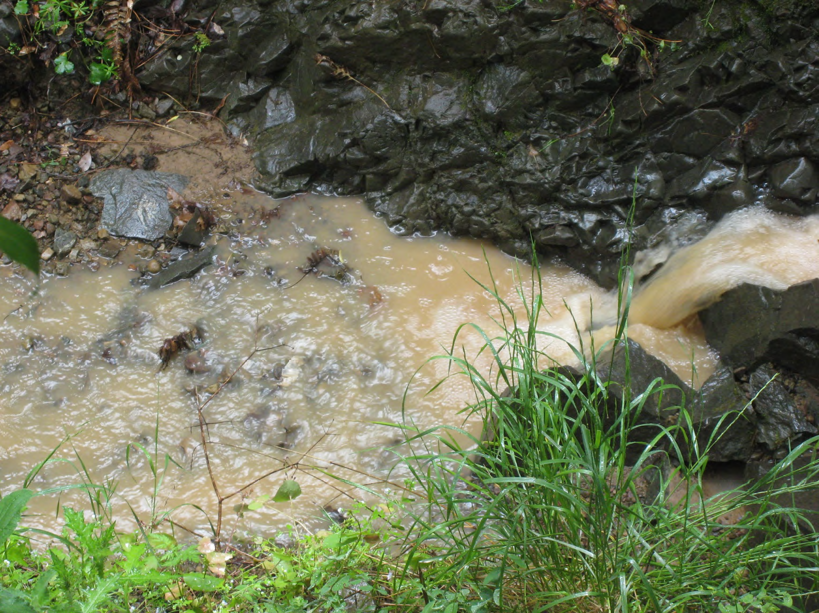
Erosion Caused By Cannibis Cultivation

Slide 8
Erosion Caused By Marijuana Grows
Photo By Stormer Feiler,
North Coast Regional Board©
Notes:
Erosion above water body

Slide 9
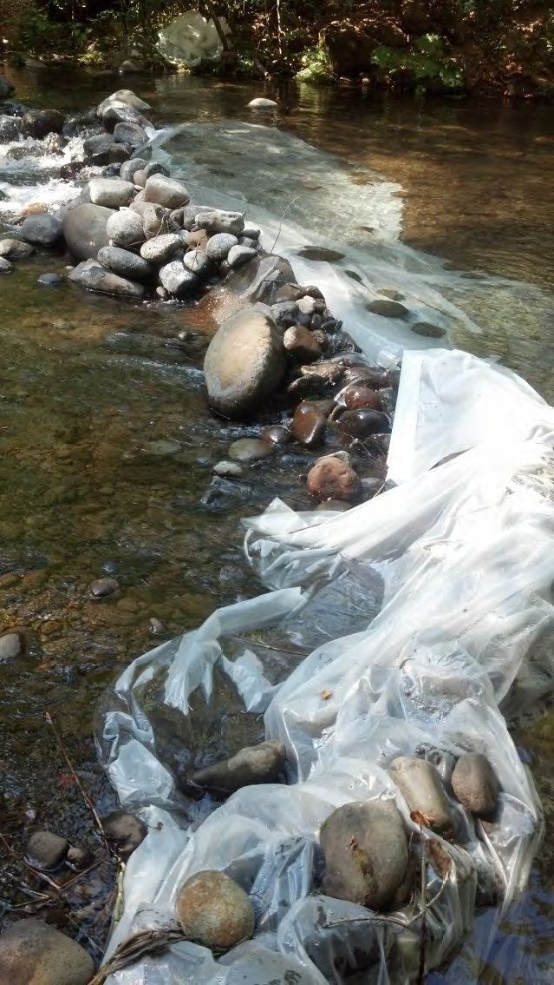
Illegal Diversions

Slide 10
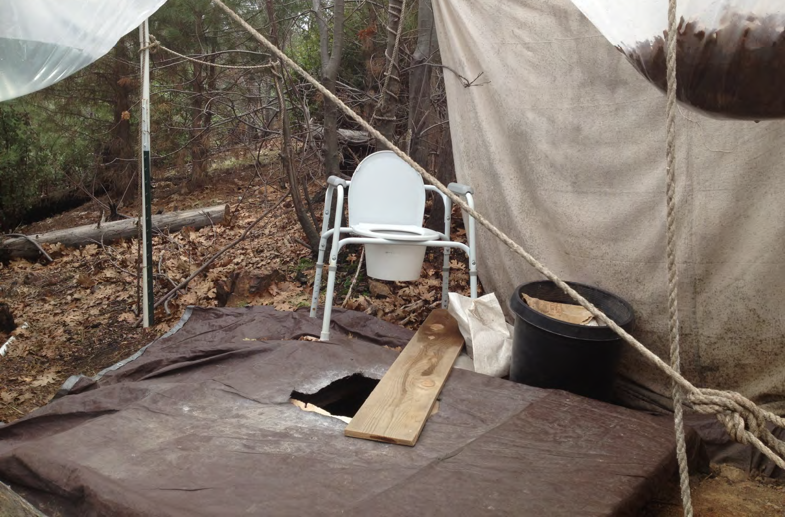
Human Waste Near Water

Slide 11
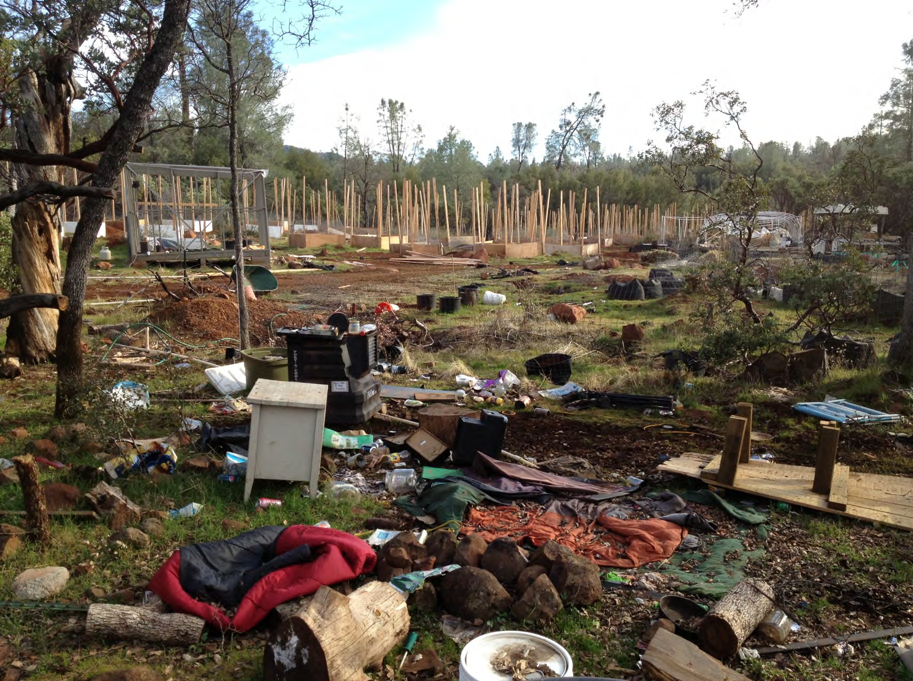

Slide 12
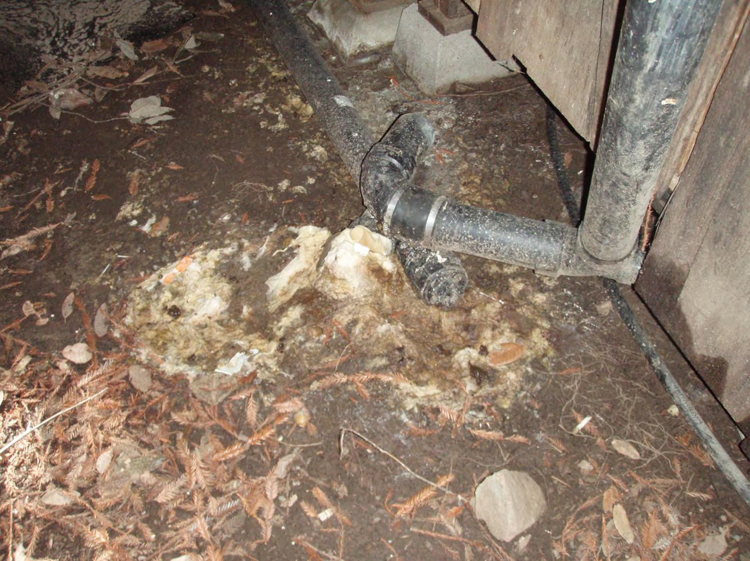
Septic Directly to Stream

Slide 13
State Water Boards’ Jurisdiction

Slide 14
Four Keys of Outreach & Compliance
Engage in Targeted Enforcement
Develop a Regulatory Program
Educate the Regulated Public
Coordinate with State and Local Agencies

Slide 15
Regulatory Tools
Storm Water Toolbox: To address Grading Violations but inadequate to effectively regulate marijuana grows
Basin Plan Prohibitions: Not Financially Viable Approach to Regulatory Program
Waste Discharge Requirements & Conditional Waivers

Slide 16
Legal Remedies
Water Code section 13304: Cleanup and Abatement Order CAOs -Administrative Civil Liability Complaint (ACLC)
Public Lands: Water Boards Play a Support Role Only- Expertise on Impacts to Water Quality, Supply and Remediation – Per Se Illegal
Private Lands: All the Familiar Water Code Tools – Compassionate Use Act Compliant
Notes:
Not all marijuana inspections would result in the Water Board as the lead for administrative penalties. It is anticipated that in many cases, staff would serve to support the relevant County Counsel or District Attorney’s office, or Attorney General’s office in prosecution. In this role, County Counsel, the DA or AG might use staff inspection reports, written professional opinion, or expert testimony. The Water Board Office of Enforcement and CDFW’s LED and Staff Counsel will assist staff in the event assistance is requested by a local prosecutor or the AG.
--------------------------------------------------------------------------------------------------------
Health and Safety Code Section 11362.5
Ensures seriously ill have right to obtain and use marijuana
Patients and their caregivers who use marijuana for medical purposes are not subject to criminal prosecution
Shall not supersede legislation prohibiting persons from engaging in conduct that endangers others, or to condone the marijuana for nonmedical purposes
Provides protections for certain individuals who possess or cultivate marijuana for “the personal medical purposes of the patient.”

Slide 17
Clean Water Act vs. Water Code
Waters of the United States vs. State Waters
Discharges vs. Diversions

Slide 18
Enforcement Challenges
Owner/Operator claim of legality under Compassionate Use Act
Viable business entity operator with intent to continue in business, or
Viable landowner with desire to preserve property value

Slide 19
Considerations for New Program
Hazardous Waste/Chemical Removal and Disposal Costs, Liability
Enforcing Illegal Water Diversions (Regulatory tools, Staffing, Statute, Penalties are insufficient)
Migratory Nature of Growers & Sites
Program sustainability & fee mechanisms

Slide 20
Questions?
Cris.Carrigan@waterboards.ca.gov
1001 I Street
Sacramento, CA 95814
(916) 341-5272

