Slide 1
Housing Outlook: Boom or bust?
November 2017
Ben Ayers, Senior Economist

Slide 2
Job gains remain supportive of ongoing economic growth
and housing demand
Job growth, 3-month moving average
October 2017
Jobs (thousands)
Sources: BLS/Haver Analytics
Notes:
The labor market is quite strong – with +200,000 monthly job gains and an unemployment rate that is approaching full employment. These trends are supporting consumer spending and wider economic growth.

Slide 3
Strong homebuyer demand is pushing sales higher
Total home sales (new + existing), 3-month moving average
September 2017
Millions
Current value
Sources: Census Bureau; NAR; Haver Analytics
Notes:
Overall inflation remains held down by lower energy prices. Core inflation is stable and below the Fed’s 2.0 percent goal – but there are signs of a pick-up in recent months.

Slide 4
…but tight inventories are holding back some sales while pushing up home prices
Total existing homes on the market
September 2017
Millions
Source: National Association of Realtors/Haver Analytics

Slide 5
No signs of a national housing bubble, though
House prices versus incomes
August 2017
Index, Jan. 1990 = 100
CoreLogic House Price Index
Disposable income per capita
Sources: BEA/CoreLogic/Haver Analytics
Notes:
The labor market is quite strong – with +200,000 monthly job gains and an unemployment rate that is approaching full employment. These trends are supporting consumer spending and wider economic growth.

Slide 6
While housing affordability remains elevated
Composite Housing Affordability Index
August 2017
Index value
Sources: National Association of Realtors/Haver Analytics
Notes:
Overall inflation remains held down by lower energy prices. Core inflation is stable and below the Fed’s 2.0 percent goal – but there are signs of a pick-up in recent months.

Slide 7
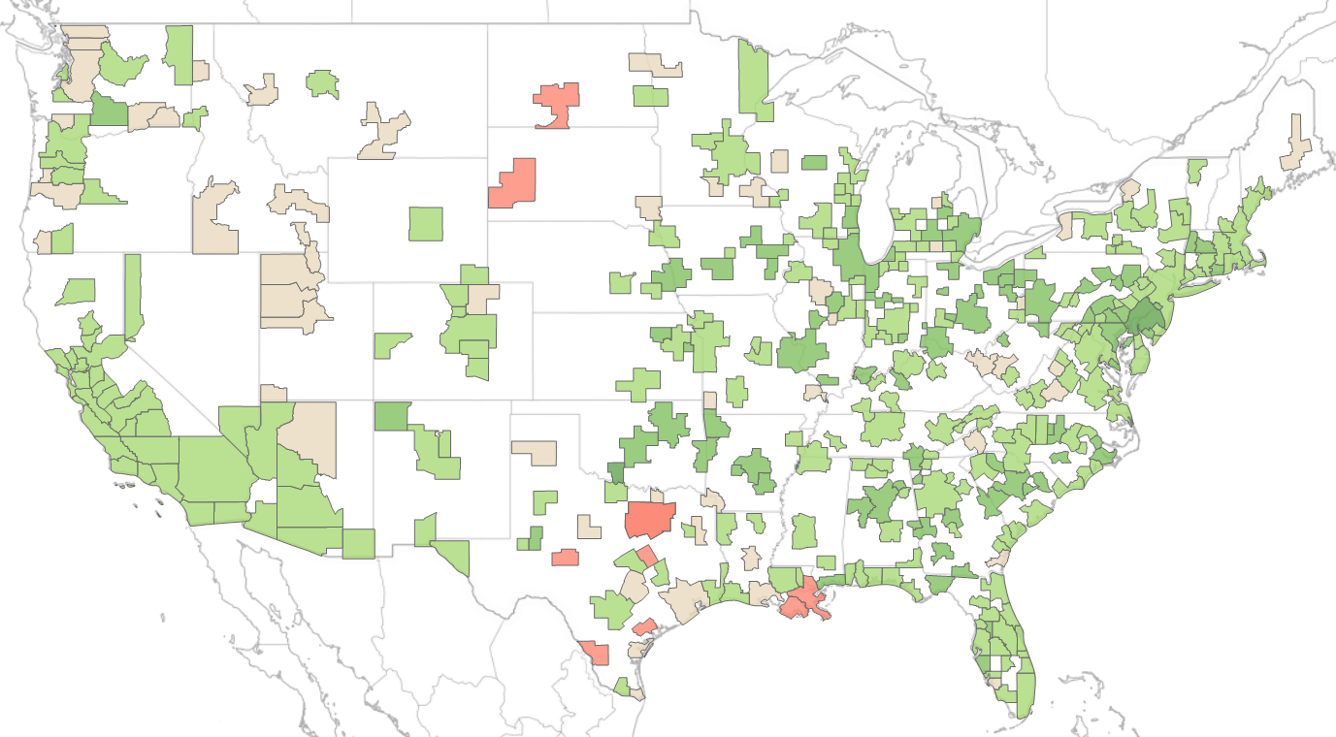
LIHHM Rankings: Positive outlook across most cities
Nationwide’s Leading Index of Healthy Housing Markets (LIHHM)
2017Q2
Performance Rankings:
+4
POSITIVE
0
NEUTRAL
- 4
NEGATIVE
See more at: https://blog.nationwide.com/housing/

Slide 8
California housing markets have positive rankings
Historical LIHHM Rankings – California MSAs
Performance Rankings:
+4
POSITIVE
0
NEUTRAL
- 4
NEGATIVE
See more at: https://blog.nationwide.com/housing/

Slide 9
California job growth is near the national average
Job growth by region
September 2017
Percent, year-to-year change
National
Southern California
Northern California
Sources: BLS/Haver Analytics
Notes:
The labor market is quite strong – with +200,000 monthly job gains and an unemployment rate that is approaching full employment. These trends are supporting consumer spending and wider economic growth.

Slide 10
Construction employment is leading the way
California job growth by sector
September 2017
Index value
Sources: BLS/Haver Analytics
Notes:
Overall inflation remains held down by lower energy prices. Core inflation is stable and below the Fed’s 2.0 percent goal – but there are signs of a pick-up in recent months.

Slide 11
Affordable housing is a growing concern in many markets
Relative Affordability: House prices versus incomes
MORE
PAR
LESS
Sources: CoreLogic/Haver Analytics

Slide 12
Important disclosures
The information in this report is provided by Nationwide Economics and is general in nature and not intended as investment or economic advice, or a recommendation to buy or sell any security or adopt any investment strategy. Additionally, it does not take into account any specific investment objectives, tax and financial condition or particular needs of any specific person.
The economic and market forecasts reflect our opinion as of the date of this report and are subject to change without notice. These forecasts show a broad range of possible outcomes. Because they are subject to high levels of uncertainty, they will not reflect actual performance. We obtained certain information from sources deemed reliable, but we do not guarantee its accuracy, completeness or fairness.
Nationwide, the Nationwide N and Eagle and Nationwide is on your side are service marks of Nationwide Mutual Insurance Company. © 2016 Nationwide.

