Slide 1
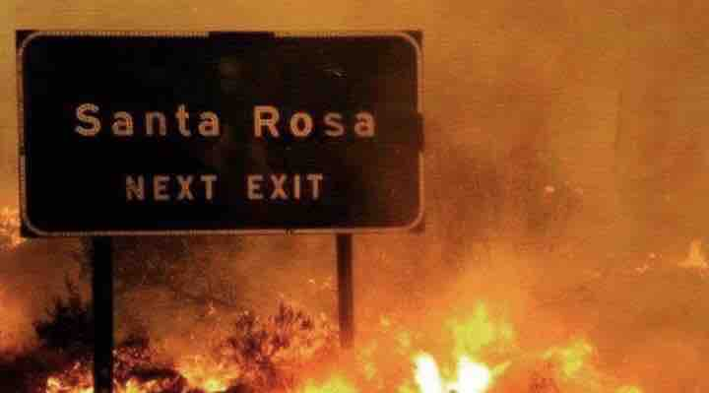
2 Years On:
Sonoma County Efforts
CSAC Resilience
October 2019
Notes:
Fire experiences

Slide 2

Preface

Slide 3
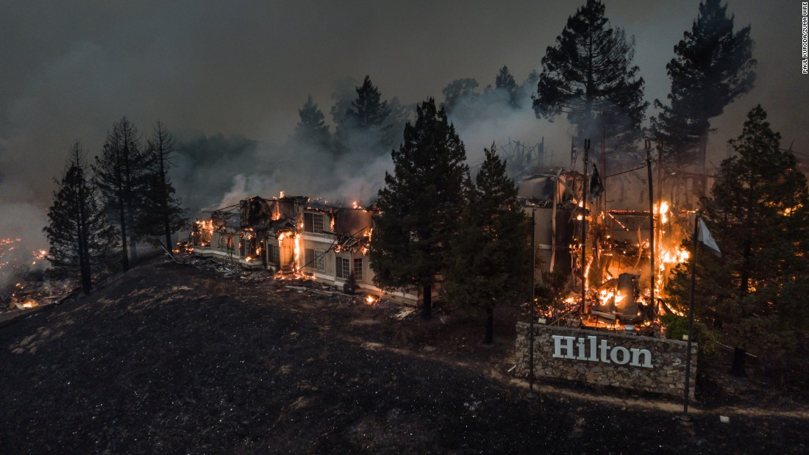

Slide 4
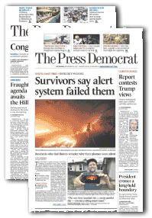
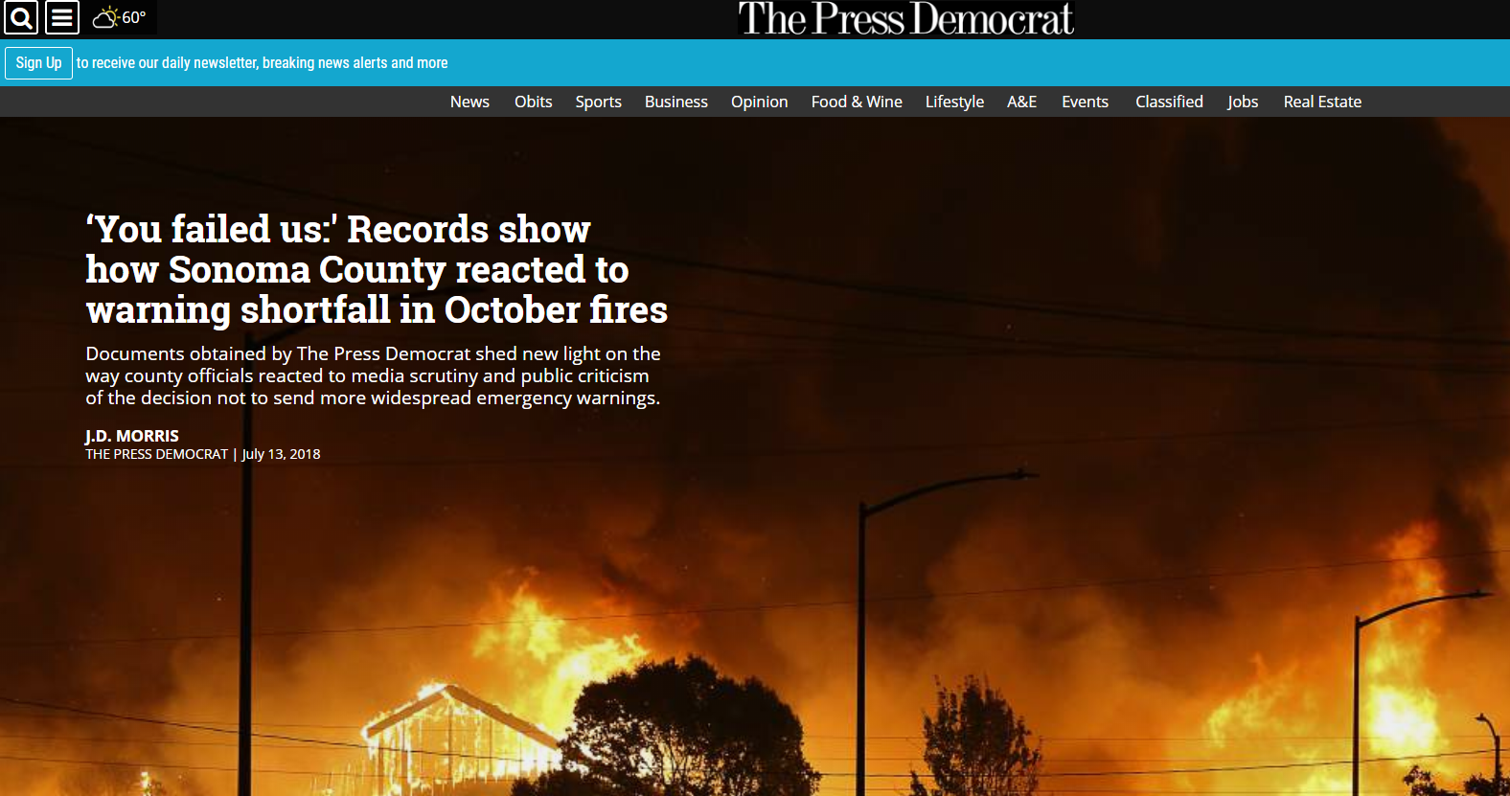
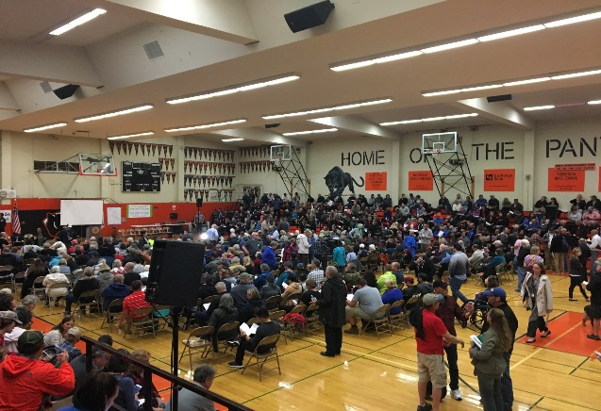
Notes:
First analysis was from the media and the public.
Questions from media about not using EAS started within 24 hours. OES staff was tasked with defending the decision – initially cited concern about WEA over warning and creating traffic congestion impacting evacuations.
The fallout from not using WEA/EAS was intense. Emotional at community meetings, Board of Supervisors meetings. Massive local and even national media coverage.

Slide 5
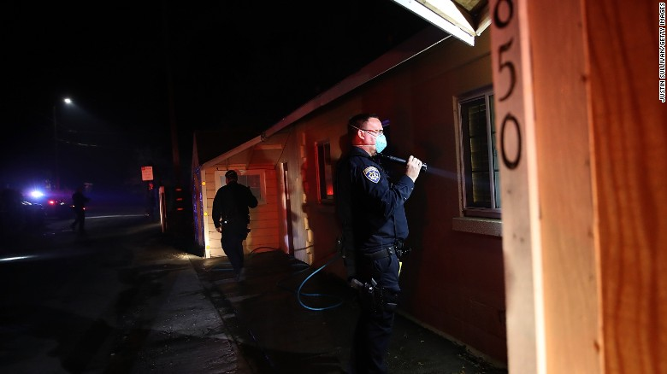
Alert & Warning
Notes:
Poor Situational Awareness
Used SoCoAlert (subscription or opt in system)
Did not use WEA or EAS
Fire moved too fast – finally stepped back and evacuated all of northern and portions of east Santa Rosa

Slide 6
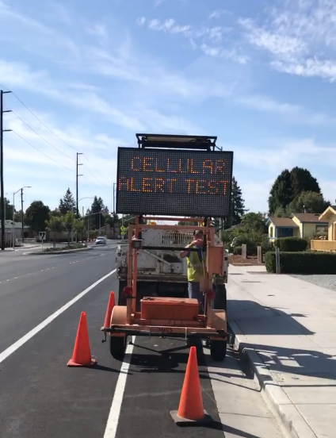
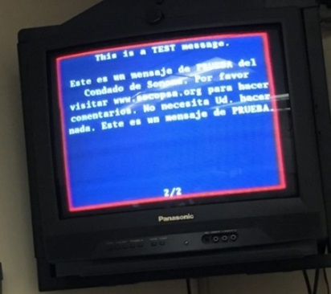
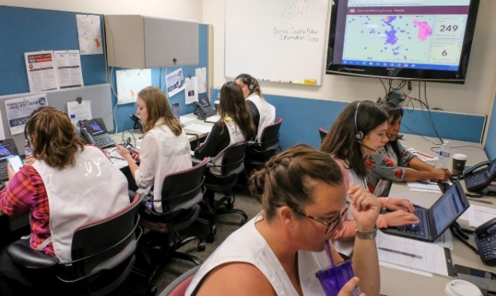

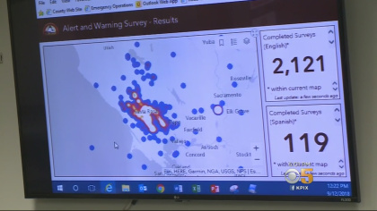
Exercises

Slide 7



Slide 8
Notes:
Respondent Counts
AT&T on the left, Verizon on the right

Slide 9
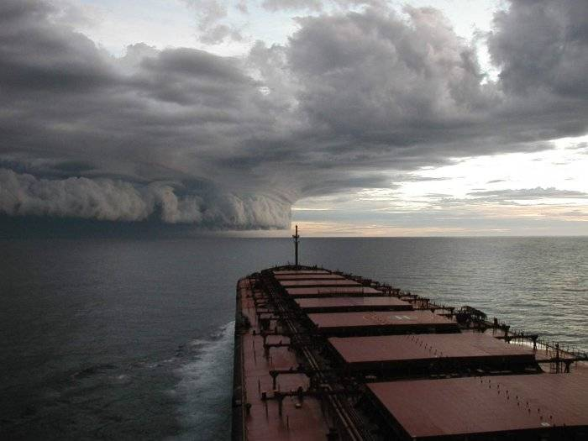
Charting a New Course

Slide 10
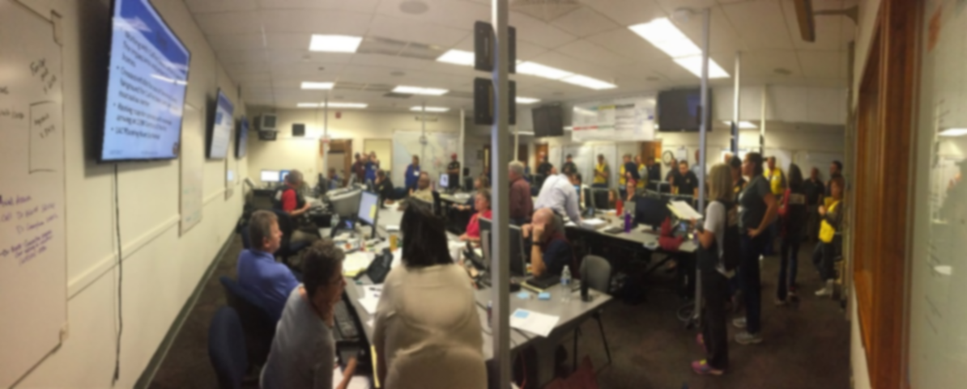
EM Program
Commitment
$ = Expanded Department

Slide 12
Notes:
3.5 staff to 8.5

Slide 13
EM Program
Commitment
$ = Expanded Department
Staff Development Program = 1%
COOP
Evacuation Planning
Community Preparedness
Emergency Manager Director

Slide 14

Takeaways
Notes:
So, key suggested takeaways for EMs

Slide 15

Game has changed – so must we
A&W System ≠ A&W Program
Public expects more
Notes:
The EM game has changed – new threats, evolving hazards, expanding lines of service, more complex recovery efforts
9/11 is not the future
The County currently manages a public warning system capability on par with most counties in California. However, this level of capability may no longer be sufficient.
Alert & warning technology has been transformed in the last 10 years in both capability and complexity.
A system does not equal a program. Need additional capabilities to make the system truly effective
Public expectations for local government alert and warning services have escalated significantly beyond current industry practices.

Slide 16
Thank You
Christopher Godley, CEM
Director of Emergency Management
County of Sonoma
christopher.godley@Sonoma-county.org
858-775-6132

