Slide 1
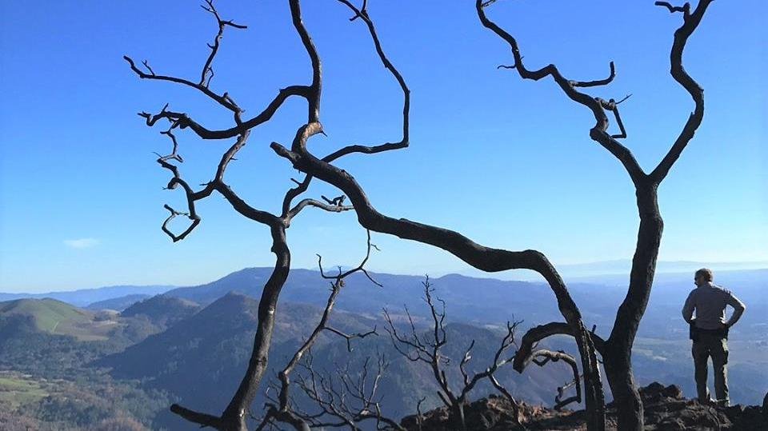
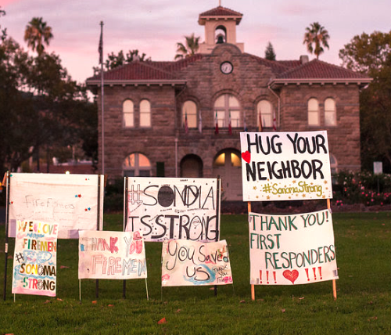
Michael Gossman
Deputy County Administrator
Notes:
Good afternoon everyone. I’m Michael Gossman and I’m pleased to be here today to tell you a bit about the Office of Recovery & Resiliency and the work we have been doing since the 2017 Fires.

Slide 2
Resilience:
The ability to recover from setbacks, adapt well to change, and emerge better and stronger than before.
Notes:
Knowing that recovery from a devastating disaster like the North Bay Wildfires wasn’t going to happen over night, our Board of Supervisors created the Office of Recovery and Resiliency just a month after the fires were extinguished. The Board diverted funding from other CAO project areas and infused additional dollars to support what are still some of the most critical needs in our community. I was hired as the Director and quickly brought on a team of analysts and support staff to focus on areas of recovery and most importantly on components of resiliency.
Early on we set the goal that we didn’t want to get back to where we were on the night of October 8, 2017. We wanted our recovery to be defined by resilience, or “The ability to recover from setbacks, adapt well to change, and emerge better and stronger than before.”
We know we will face future disasters again – but we absolutely will be better prepared when we do. And here is why:

Slide 3
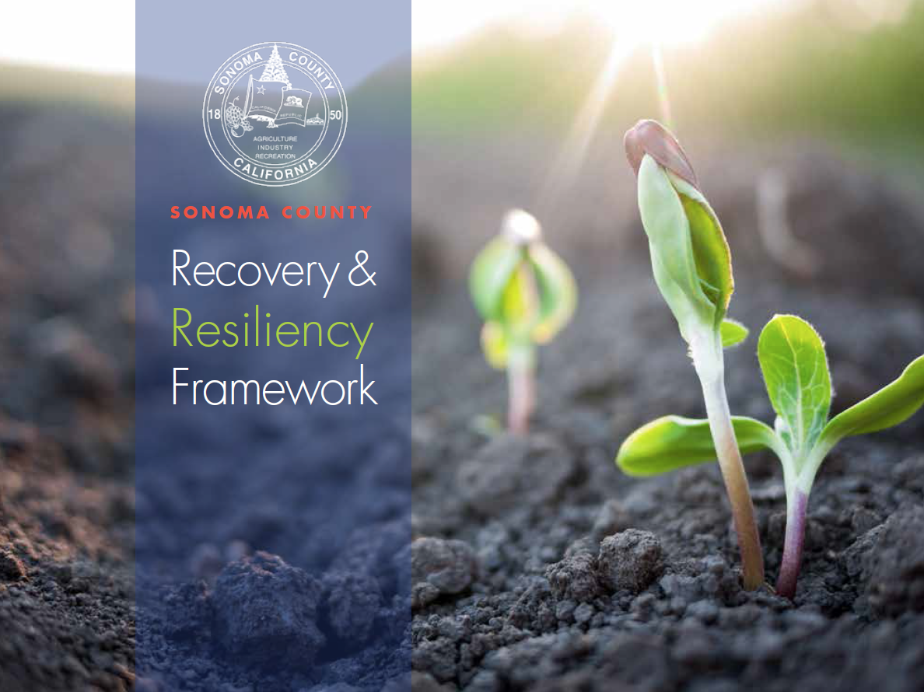

Recovery & Resiliency Framework
Notes:
We have a Framework.
Our initial Office of Recovery and Resiliency mandate was to create a plan, a blue print for how to recover from what was at the time the most destructive fire in California’s history.
To develop this Framework, we worked quickly to create a skeleton. What was most powerful, however, is that we took that outline to our community and we genuinely engaged with them, and our end product is so much better because of this engagement. I’ve come to believe that the community always knows what they need most.

Slide 4
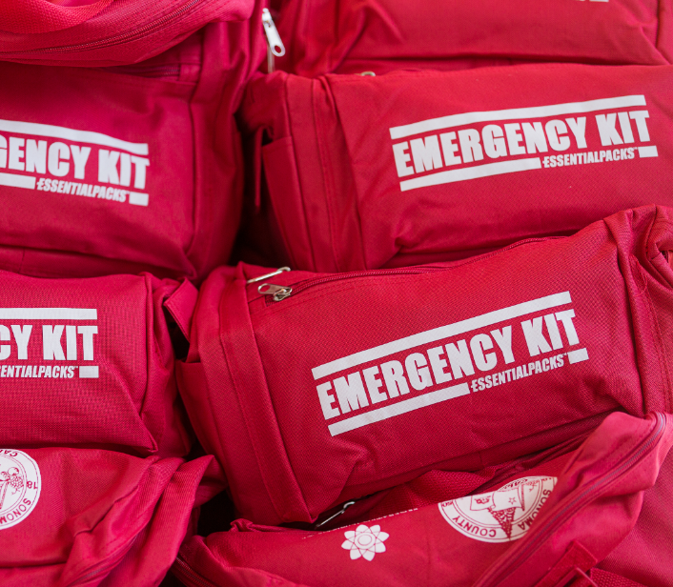
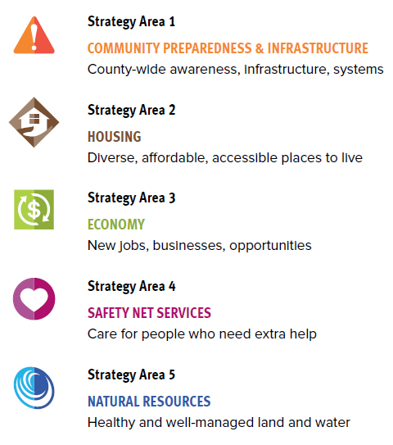

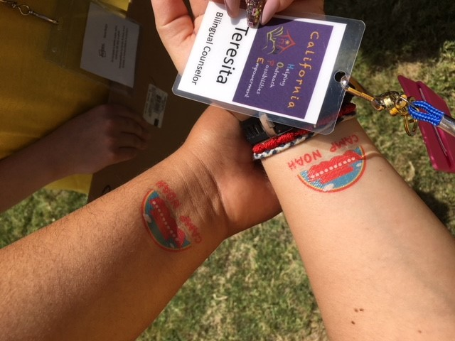
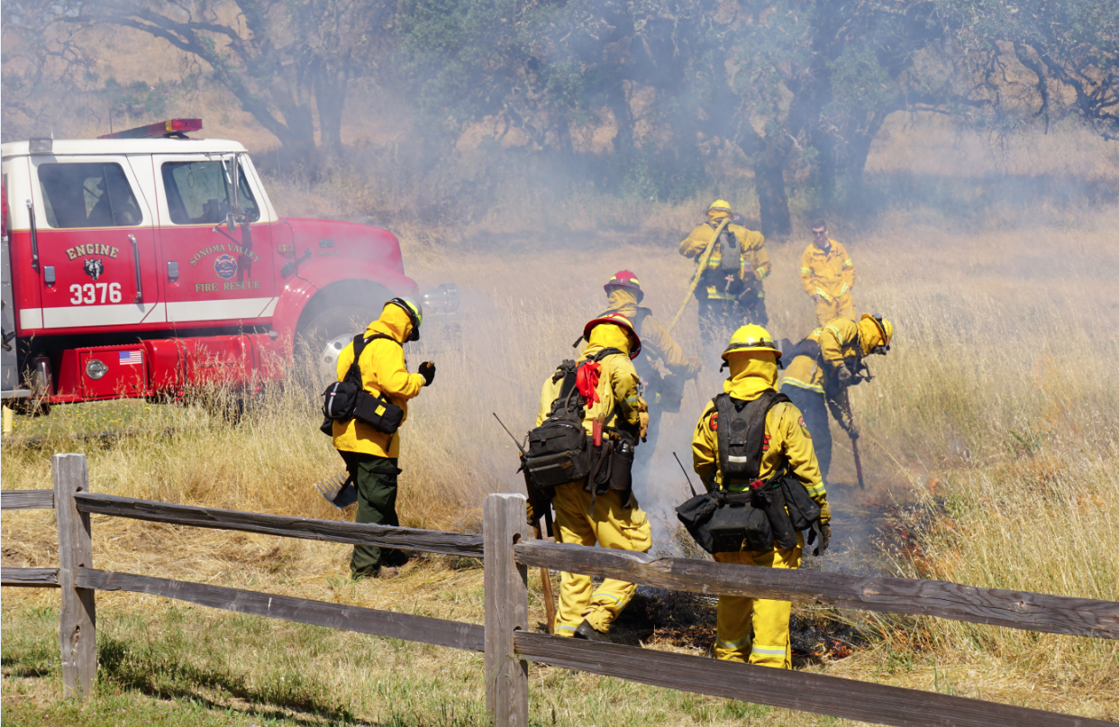
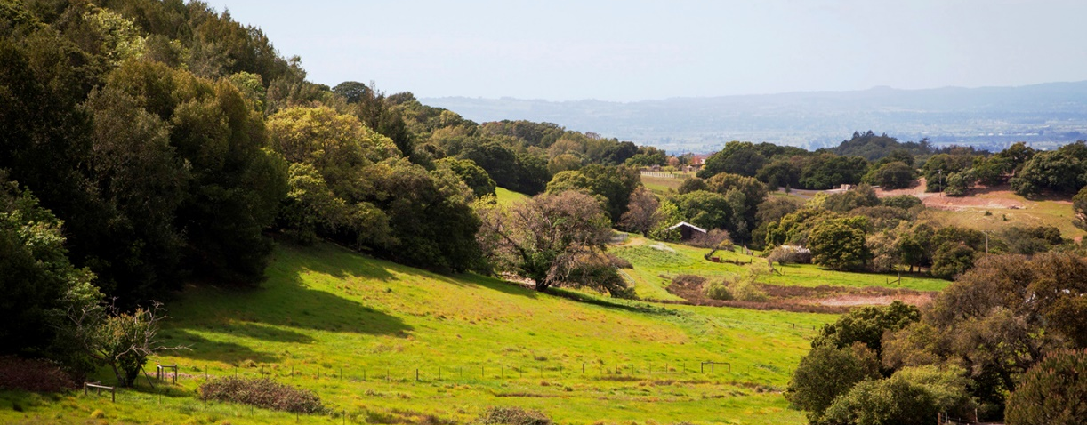
5 Strategy Areas
Notes:
We started with a structure drawing from FEMA’s National Disaster Recovery Framework. A focus of the Framework is on planning and preparedness before a disaster occurs. Planning includes coordination with partners, risk mitigation, continuity planning, identifying resources and developing capacity to manage the recovery process.
The Framework is structured around recovery efforts in five critical functional areas, each with its own vision statement, goals, and actions.
Community Preparedness and Infrastructure - includes goals to increase county-wide awareness and preparedness, improvements in our alert and warning systems and a restructuring in how our County responds to emergencies – Director Chris Godley will dive deeper into these efforts - they have been substantial and critical for our community.
Housing – like every jurisdiction in California, we have a housing crisis here in Sonoma County, one that was intensified dramatically when we lost 5,300 homes. As we rebuild, we continue to infuse equity, affordability, and accessibility whenever possible. We have put enormous effort into easing the incredible stress and work that goes into rebuilding a house – we have expedited permits, eased ordinances, and have been innovative. For example, we have reduced fees and made it much easier for property owners to build Accessory Dwelling Units to increase housing stock on land already available.
Economy – Supporting our local impacted business and helping employees who lost work was an initial priority. While our economy rebounded well, we have also used this opportunity to again be innovative in seizing resilient opportunities. For example, using grant funding to expand career technical education and retraining our workforce to expand the trade industry, especially construction workers.
Safety Net Services – this area of the Framework is focused on caring for people in our community – and following a major disaster, people need a lot of care. One essential step we took organize and provide an incredible amount of emotional support through FEMA funded California HOPE counselors. Over a year and a half, counselors provided over 70,000 FREE services and counseling sessions to community members.
Natural Resources – how we help the 100,000 acres of land that burned recover and even more importantly, how do we manage our forests and land to prevent future explosive wildfires. This is another area our Board has invested deeply in. For example, earlier this year, we expanded the Fuels Reduction and Landscape Resiliency Campaign to reduce wildfire risk through vegetation management, including controlled burns, property inspections, and grazing projects.
These are just a few of the goals within the Framework. Most importantly, they are a result of a comprehensive community engagement effort.

Slide 5
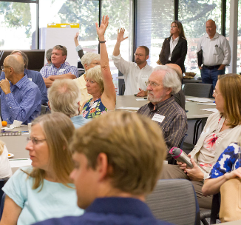
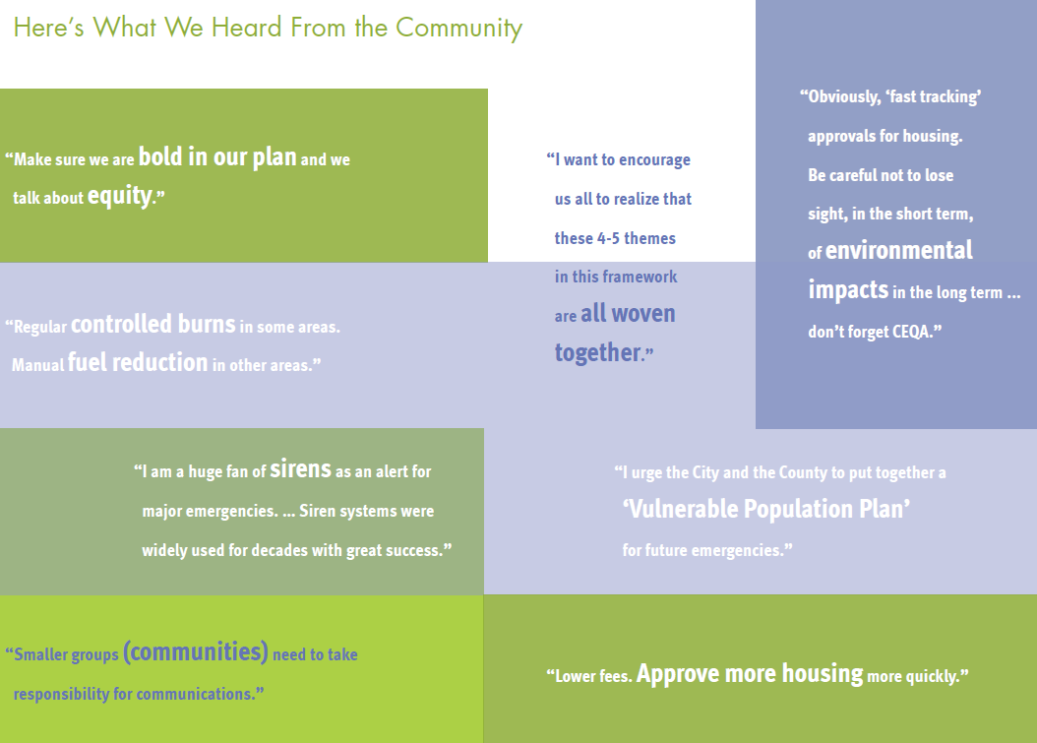
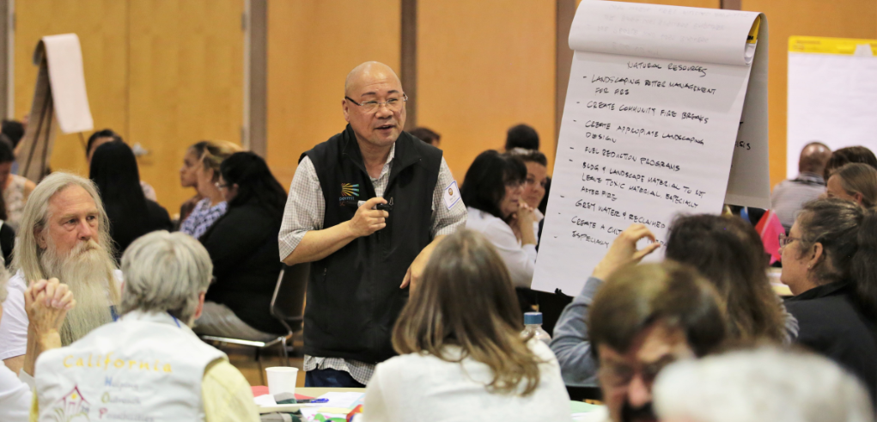
Community Engagement
Notes:
Over 3 months, we held 7 Recovery Planning Community Meetings throughout Sonoma County. Over 300 people attended to share their thoughts and ideas. We started each meeting with a mental health counselor teaching attendees about a helpful to manage the stress and anxiety in everyday, post-fire life. In a community who lost as much as we did, this was such an effective way to start a dialogue. We provided a brief introduction and information at each meeting, but spent the majority of the time in small group discussions. County employees from across our 27 departments volunteered to facilitate table discussions – we came together as a county family for these community meetings.
In addition, we met with over 80 community groups and stakeholders and we conducted sought input through an online survey. Our Board also held Workshops on each of the 5 strategic areas of recovery.

Slide 6
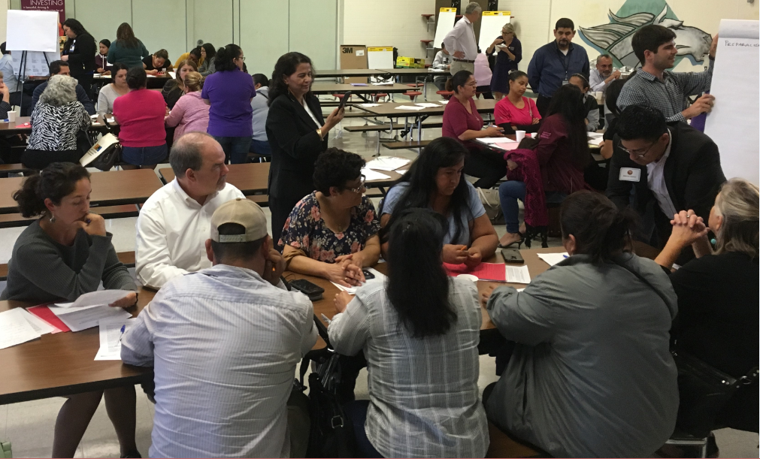
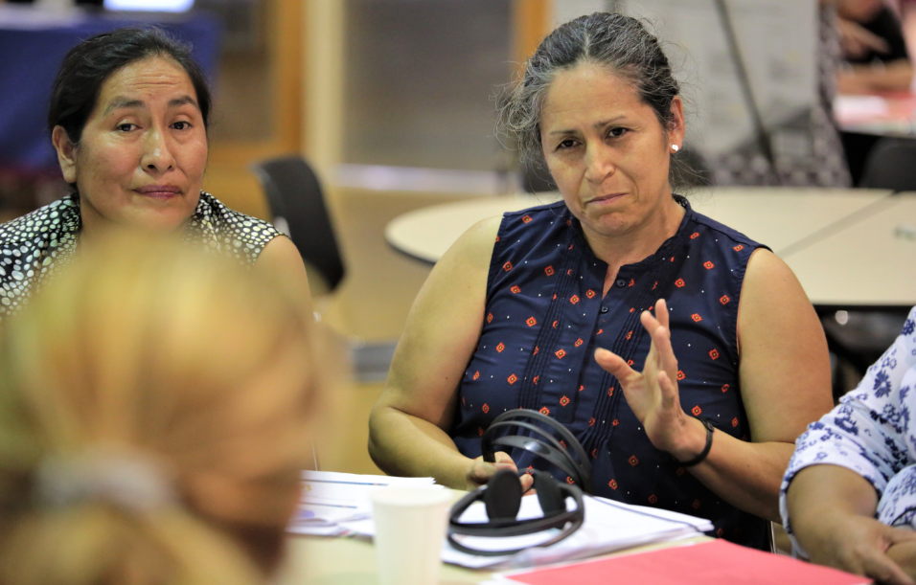

Community Engagement
Notes:
One part of our community engagement that I’m particularly proud of was our outreach to the Latinx community in Sonoma County. Two of the community meetings we conducted were held in all Spanish. Again, we utilized bilingual county employees to engage in dialogue and hear from this community. We are fortunate to have a Board member, Supervisor James Gore, who is fully bilingual and also helped out with these efforts.
All of the documents we used were translated into Spanish, and we had interpreters available at all the English meetings as well. The full Framework from translated into Spanish as well.

Slide 7
2019 Top 10 Priority Projects
Establish a comprehensive Alert and Warning System.
Work with community to identify hazards, risks, mitigation strategies, including evacuation routes.
Facilitate construction hardening techniques appropriate for wildfire urban interfaces and seismic retrofits for rebuilding and for existing homes through education and grant programs.
Work with private utility providers on solutions related to hardening infrastructure and on coping with destroyed utilities in a disaster, including undergrounding where appropriate and necessary.
Help property owners navigate vegetation management opportunities through partnership with Fire Safe Sonoma and similar programs.
Notes:
While the Framework is filled with hundreds of action items, we are focusing in on 10 major priority projects this calendar year. They include:
Establish a comprehensive Alert and Warning System.
Work with community to identify hazards, risks, mitigation strategies, including evacuation routes.
Facilitate construction hardening techniques appropriate for wildfire urban interfaces and seismic retrofits for rebuilding and for existing homes through education and grant programs.
Work with private utility providers on solutions related to hardening infrastructure and on coping with destroyed utilities in a disaster, including undergrounding where appropriate and necessary.
Help property owners navigate vegetation management opportunities through partnership with Fire Safe Sonoma and similar programs.

Slide 8
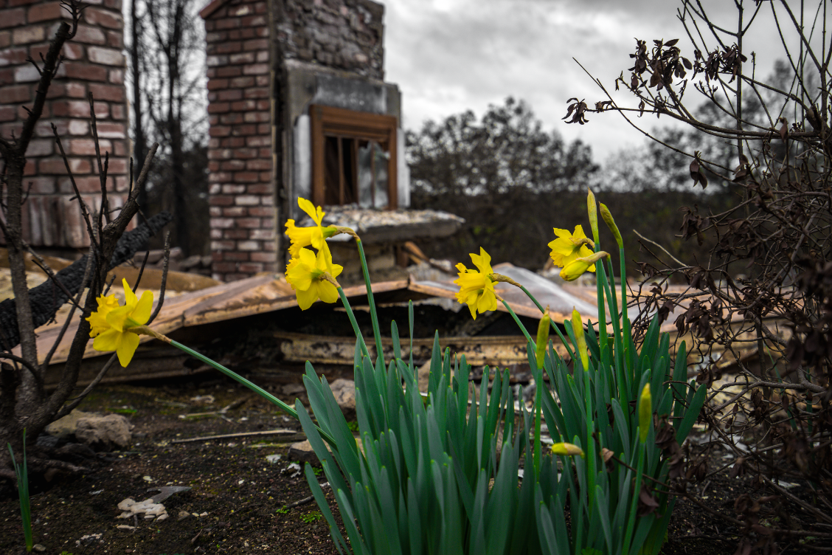
2019 Top 10 Priority Projects
Continue to advocate for substantive changes to insurance regulations.
Engage the Community to raise Awareness about how to prepare and plan ahead for disasters.
Expedited Permitting for homeowners who are rebuilding.
Enhance the 2-1-1 System
Develop a One-Stop Shop Resource Center
Notes:
Continue to advocate for substantive changes to insurance regulations.
Engage the Community to raise Awareness about how to prepare and plan ahead for disasters.
Expedited Permitting for homeowners who are rebuilding.
Enhance the 2-1-1 System
Develop a One-Stop Shop Resource Center

Slide 9
Accomplishments
We are improving our disaster alert and warning systems to reach everyone
We are managing our environment and homes for wildfire.
    Fuels Reduction and Landscape Resiliency Campaign
    Home hardening education through Sonoma County Energy Independence Program (SCEIP)
We have new early detection tools
    Fire cameras
    Stream and rain gauges
Expedited permits and amended ordinances to help property owners
    18% of rebuilds are complete; 68% are somewhere in the process of rebuilding
Applying for external grants and funding
Notes:
We still have a long road ahead, but we have made tremendous progress to recover and be more prepared than ever before. To highlight a few:
1. We are improving our disaster alert and warning systems to reach everyone
Chris Godley will talk more about this as well as some of the other internal measures we have put into place to improve the way we respond to emergencies.
2. We are managing our environment and homes for wildfire.
- For example, Through the Fuels Reduction and Landscape Resiliency Campaign, we are reducing wildfire risk through vegetation management, including controlled burns, property inspections, and grazing projects.
Another example is the Sonoma County Energy Independence Program (SCEIP) offers education and advice on home hardening, such as fire resistant materials like roofing and siding. The Program also offers financing opportunities for these types of home improvements.
3. We have new early detection tools
In August 2018, the Sonoma County Board of Supervisors approved funding for eight fire cameras to provide early detection of wildfires in the Lake Sonoma Watershed. The network of fire cameras is growing throughout the North Bay, with PG&E committed to funding an additional 9 cameras throughout Sonoma, Napa and Marin counties. The cameras are invaluable in detecting fires and provide firefighters with greater awareness of a fire’s severity, where it is spreading and how quickly it is growing.
Additionally, a system of stream and rain gauges installed throughout burn areas to monitor potential dangers and risks of debris flows and flash floods.
4. We have expedited permits and amended ordinances to help property owners
- 18% of rebuilds are complete; 68% are somewhere in the process of rebuilding
5. And, we are we are leveraging every possible funding opportunity to help our community, including the potential to receive $32.6 million from the FEMA Hazard Mitigation Grant Program to fund projects to reduce or eliminate long-term risk to people and property from future disasters. We have successfully been awarded 5 HMGP Grants for over $5 million to fund projects like: an update to the existing Sonoma County Local Hazard Mitigation Plan, updates to the current Sonoma County Community Wildfire Protection Plan (CWPP) that will become part of the County General Plan Safety Element, and funds for Sonoma Agency for a Booster Station Structural Retrofit and for a Sanitation District Secondary Treatment Clarifiers Seismic Rehabilitation and Retrofit project.

Slide 10
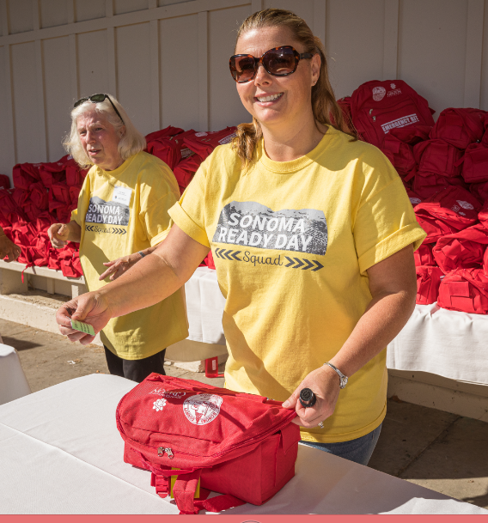
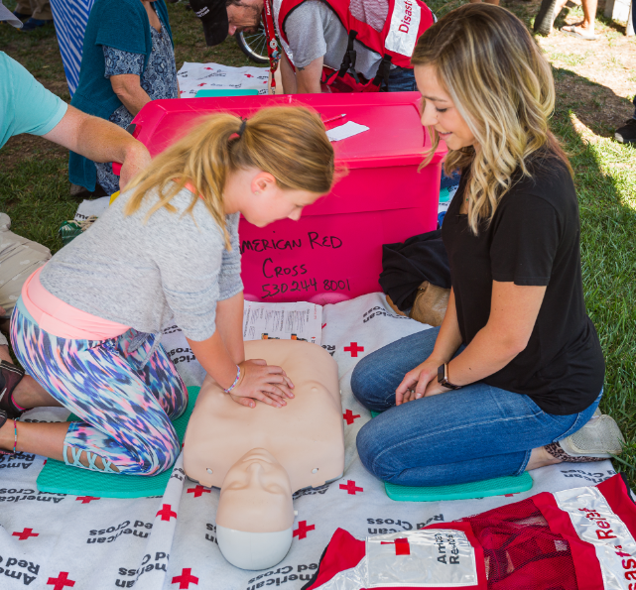
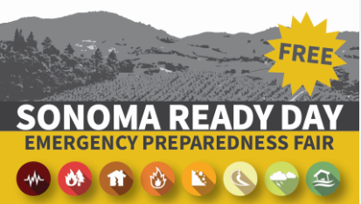
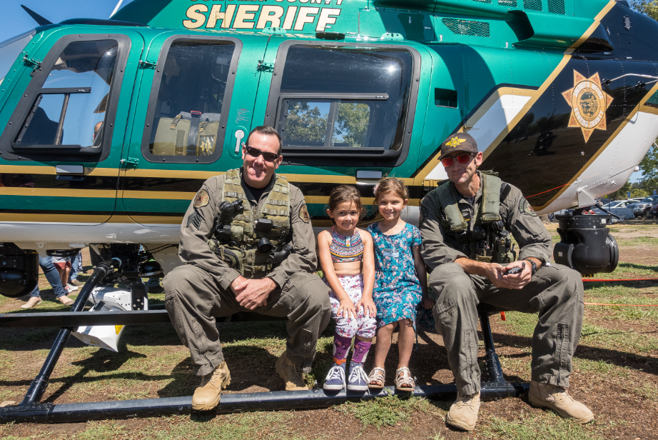
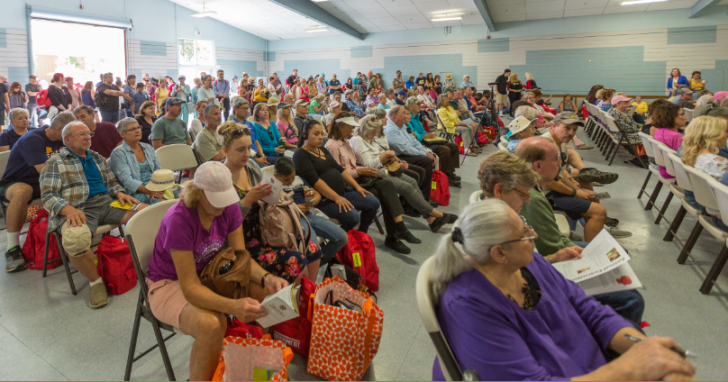
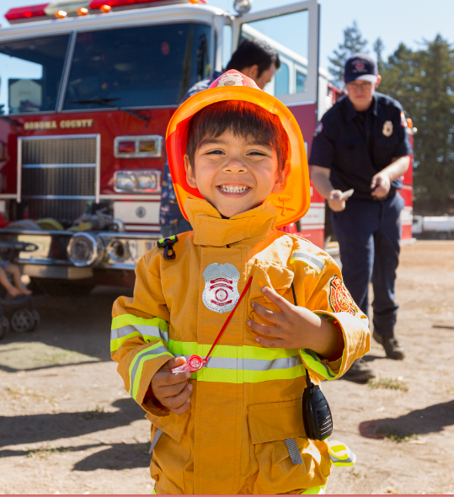
Notes:
And just a few weeks ago, we put on Sonoma County’s first county-wide emergency preparedness fair, Sonoma Ready Day. We never would have thought that 5,000 people would show up on a Sunday to get prepared for an emergency, but we did. It was an incredible event and showed the eagerness of the community to learn more.

Slide 11
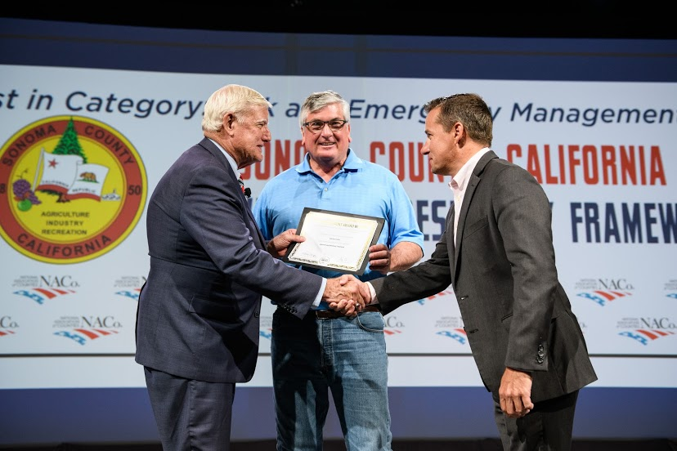
Notes:
And I’m proud to share that NACo awarded our Framework Best in Category for Risk and Emergency Management.

Slide 12
Next Steps
Continue implementation of Framework Actions
Quarterly Progress Monitoring and Reporting
Ongoing Engagement of the Community and Partners
Legislative Advocacy
Grants Coordination
Notes:
Our next steps are to:
- Continue implementation of Framework Actions
- Quarterly Progress Monitoring and Reporting
- Ongoing Engagement of the Community and Partners
- Legislative Advocacy – just last week, Governor Newsom passed 22 bills into law to help California with wildfire preparation.
- Grants Coordination

Slide 13
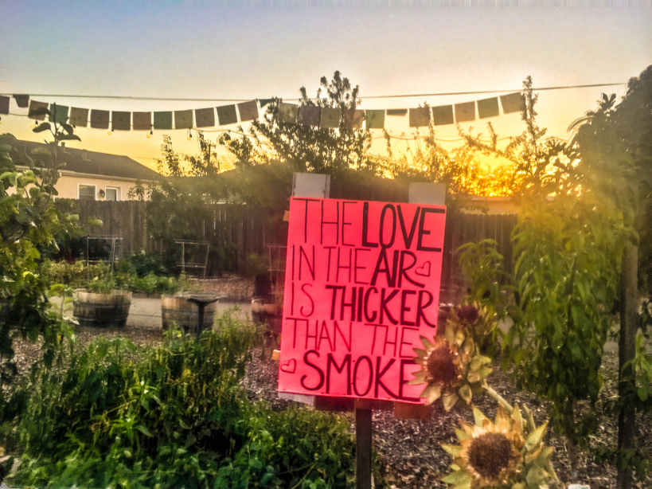
Office of Recovery & Resiliency Contact Info
ORR Website: www.sonomacounty.ca.gov/ORR
Sonoma County Recovers:
http://SonomaCountyRecovers.org
Email:
recoveryinfo@Sonoma-county.org
Notes:
Here is our contact information.
Thank you for having me here with you all today.

