Slide 1
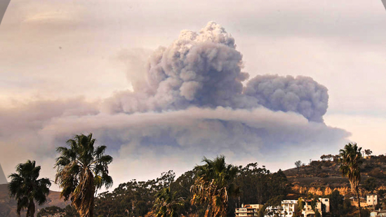
2-1-1 VENTURA & DISASTER
ASSISTANCE
ERIK STERNAD, EXECUTIVE DIRECTOR - INTERFACE CHILDREN & FAMILY SERVICES

Slide 2
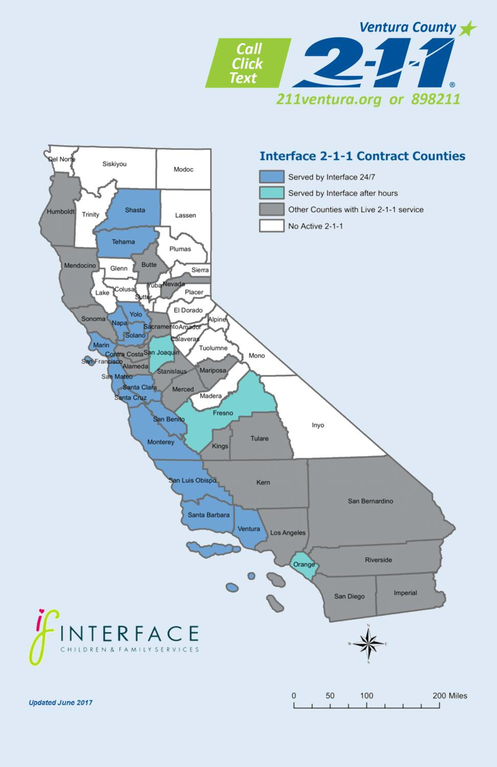
Interface 2-1-1 Coverage Map

Slide 3
2-1-1 VENTURA 2017 DISASTER RESPONSE AREAS
(27K DISASTER CALLS & TEXTS)
January 12th Pajaro River flooding in
July 7th Whittier Fire starts in Santa
Santa Cruz and Monterey Counties
Barbara County
August 25th Hurricane Harvey hits Texas
January 20th San Joaquin County
Levee Breach near Manteca
January 22nd Orange County Severe
September 4th Hurricane Irma becomes a
category 4
October 1st A gunman opens fire on 22k
Weather
Feburary 12th Oroville Dam
at the Harvest 91 Festival in Las Vegas.
October 8th The North Bay fires begin in
Evacuations
the Bay Area
Feburary 17th Fresno County evacuates • October 9th The Canyon Fire starts in
Anaheim, Orange County.
December 4th The Thomas Fire begins in
residents in the city of Tranquility due to threat from a levee breach
February 20th Monterey Wind Storm
Ventura County
January 9th Montecito is devastated by a
and Flooding
mudslide in Santa Barbara County

Slide 4
HOW CAN 2-1-1RESPOND TO YOUR DISASTER?
PREPARE
2-1-1 Disaster Assistance MOU
Submit CPUC Application for 2-1-1 dialing code
RECOVER
Transform Texting Campaigns from Active Disaster to Recovery
RESPOND
Ask for Assistance
Activate 2-1-1 lines and update appropriate IVR messages
Follow-up Quickly
Track Successes and persistent Unmet Needs
Tell the Story
Seek Reimbursement
Program 2-1-1 inContact Phone System Disaster Campaign
Populate Website and Texting
Campaign
Fill State & National Database with Local Disaster Resources
Use Push-texts to Give Proactive Information
Build Disaster Form in State & National Database
Update and Activate Text Keyword campaigns: English & Spanish
Designate Active Disaster Information Sources
Activate 2-Way texting
Drive calls to Text and Web
Ask for help!
Support Staff
Build 2-1-1 Disaster & Recovery
Website
Build Disaster Keyword Campaign
Mock Disaster Training & Simulations

Slide 5
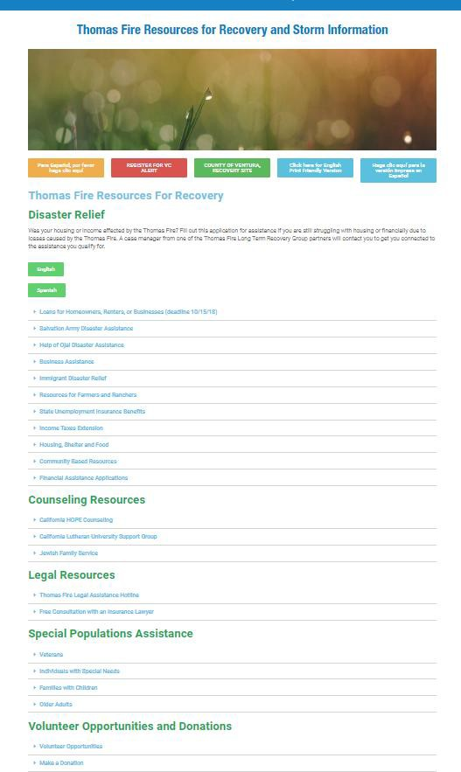
PREPARE
2-1-1 DISASTER & RECOVERY
WEBSITE
Create a link from regular 2-1-1 page to 2-1-1 Disaster and Recovery page
Keep all disaster and Recovery information in one location
Employees, Volunteers, Partners, and the Public can view
Be known for updated, verified information
Include links to other verified resource sites
Provide translation as needed
Provide print ready versions
Do a media blast

Slide 6
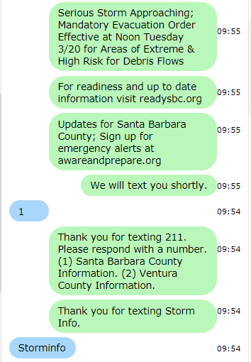
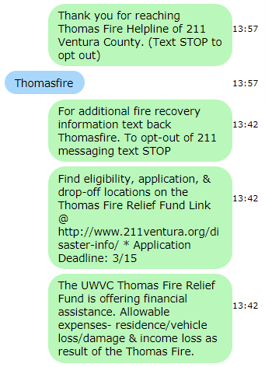
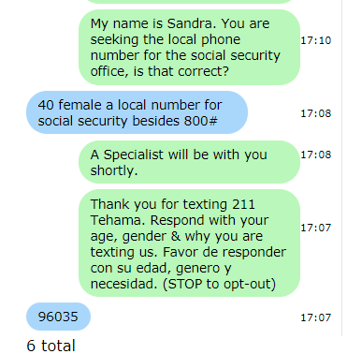
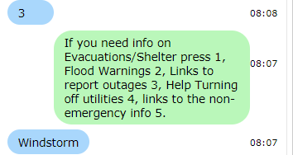
898211 TEXT MESSAGING BY TYPE
RESPOND
KEYWORD CAMPAIGNS
PUSH TEXT
2-WAY-TEXTS

Slide 7
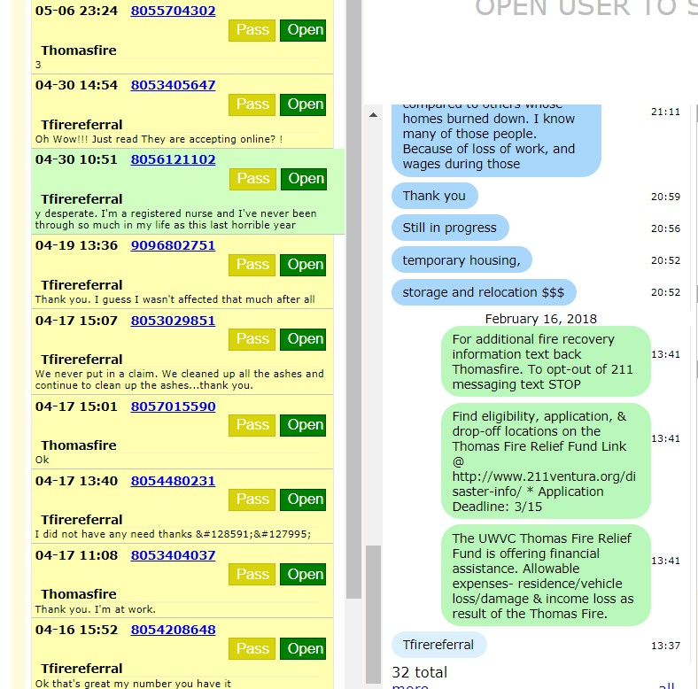
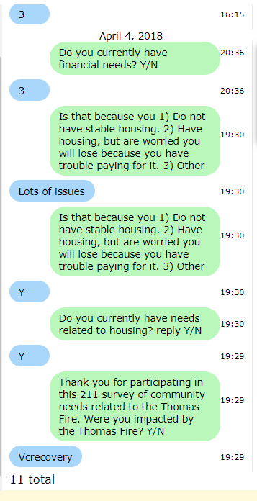
RECOVER
Transform texting campaigns, and webpages from active disaster to recovery
Follow-up quickly

Slide 8
THANK YOU!

