Slide 1
Legislative Update
Mark Neuburger, Legislative Advocate Kristina Gallagher, Legislative Analyst
Housing, Land Use and Transportation (HLT)
April 12, 2023

Slide 2
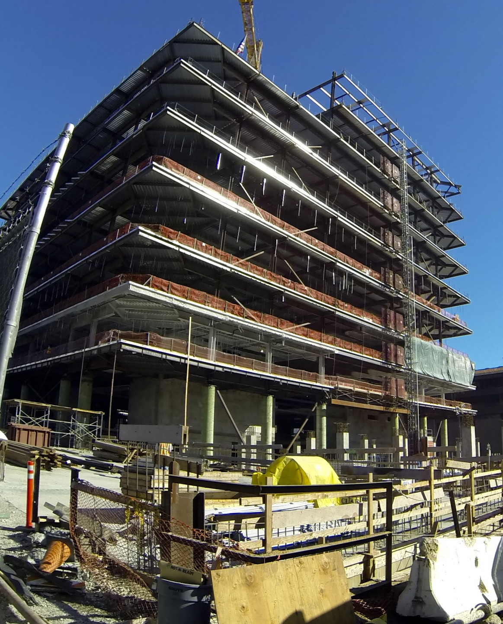
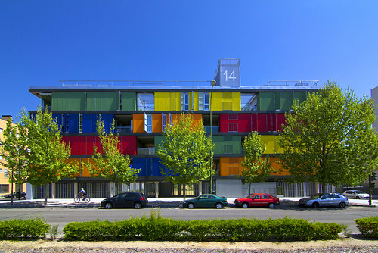
Legislation
AB 7 (Friedman)
Attempting to address climate impact of transportation system.
AB 309 (Lee)
Authorizes local govs to create social housing developments.
AB 400 (Rubio)
CSAC sponsored, makes local gov design-build authority permanent
This Photo by Unknown Author is licensed under CC BY-NC

Slide 3
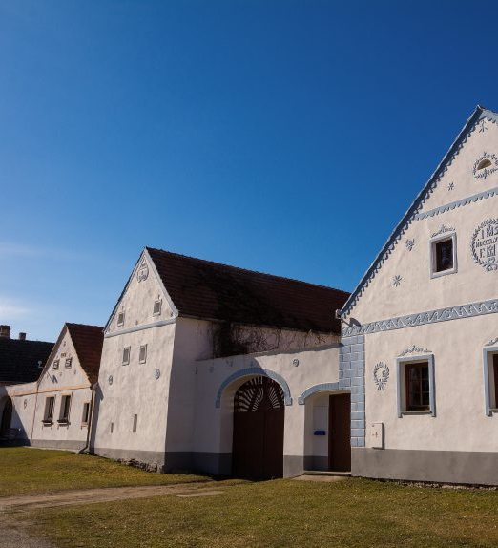
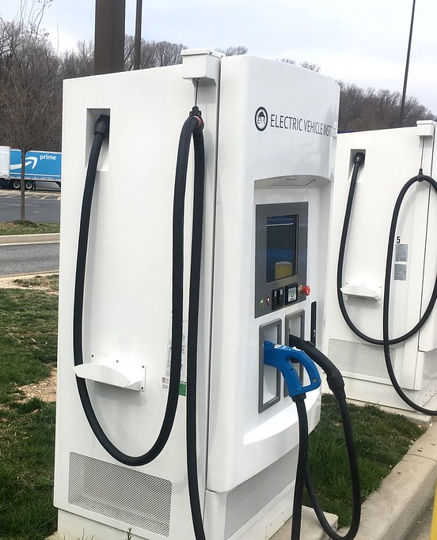
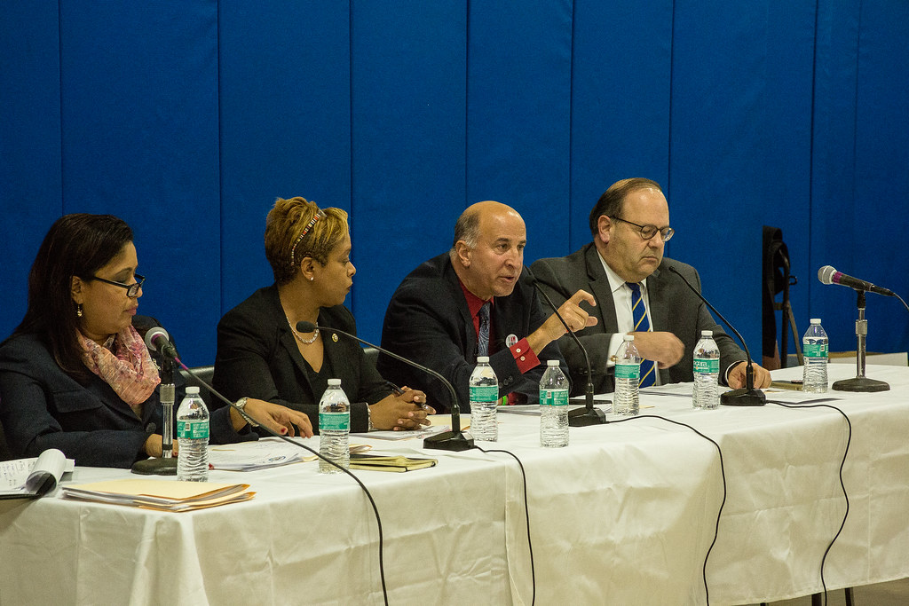
Legislation
AB 68 (Ward)
Limits housing, transfers development authority to state
AB 1504 (McCarty)
Changes approval process for EV charging stations in public right of way (i.e. streets & roads)
SB 406 (Cortese)
Fixes duplicative CEQA findings for counties involving local financing sources.
This Photo by Unknown Author is licensed under CC BY-NC
This Photo by Unknown Author is licensed under CC BY-SA
Notes:
AB 68: Currently not set for a hearing, likely will not be acted on this year

Slide 4
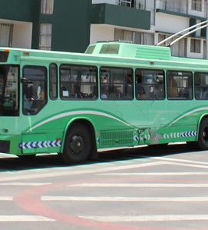
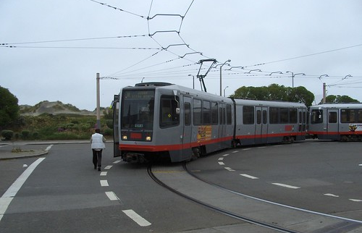
Transit Fiscal Cliff
Basics
Pre-Pandemic Declines
Pandemic Declines
Federal Assistance Ends
Challenges
Operations vs. Capital
Funding Support Source (State v. Local)
This Photo by Unknown Author is licensed under CC BY-SA
This Photo by Unknown Author is licensed under CC BY-NC-ND
This Photo by Unknown Author is licensed under CC BY-SA-NC

Slide 5
Questions

