Slide 1
Jail Diversion Treatment & Resource Center
711 G Street
April 12th, 2023

Slide 2
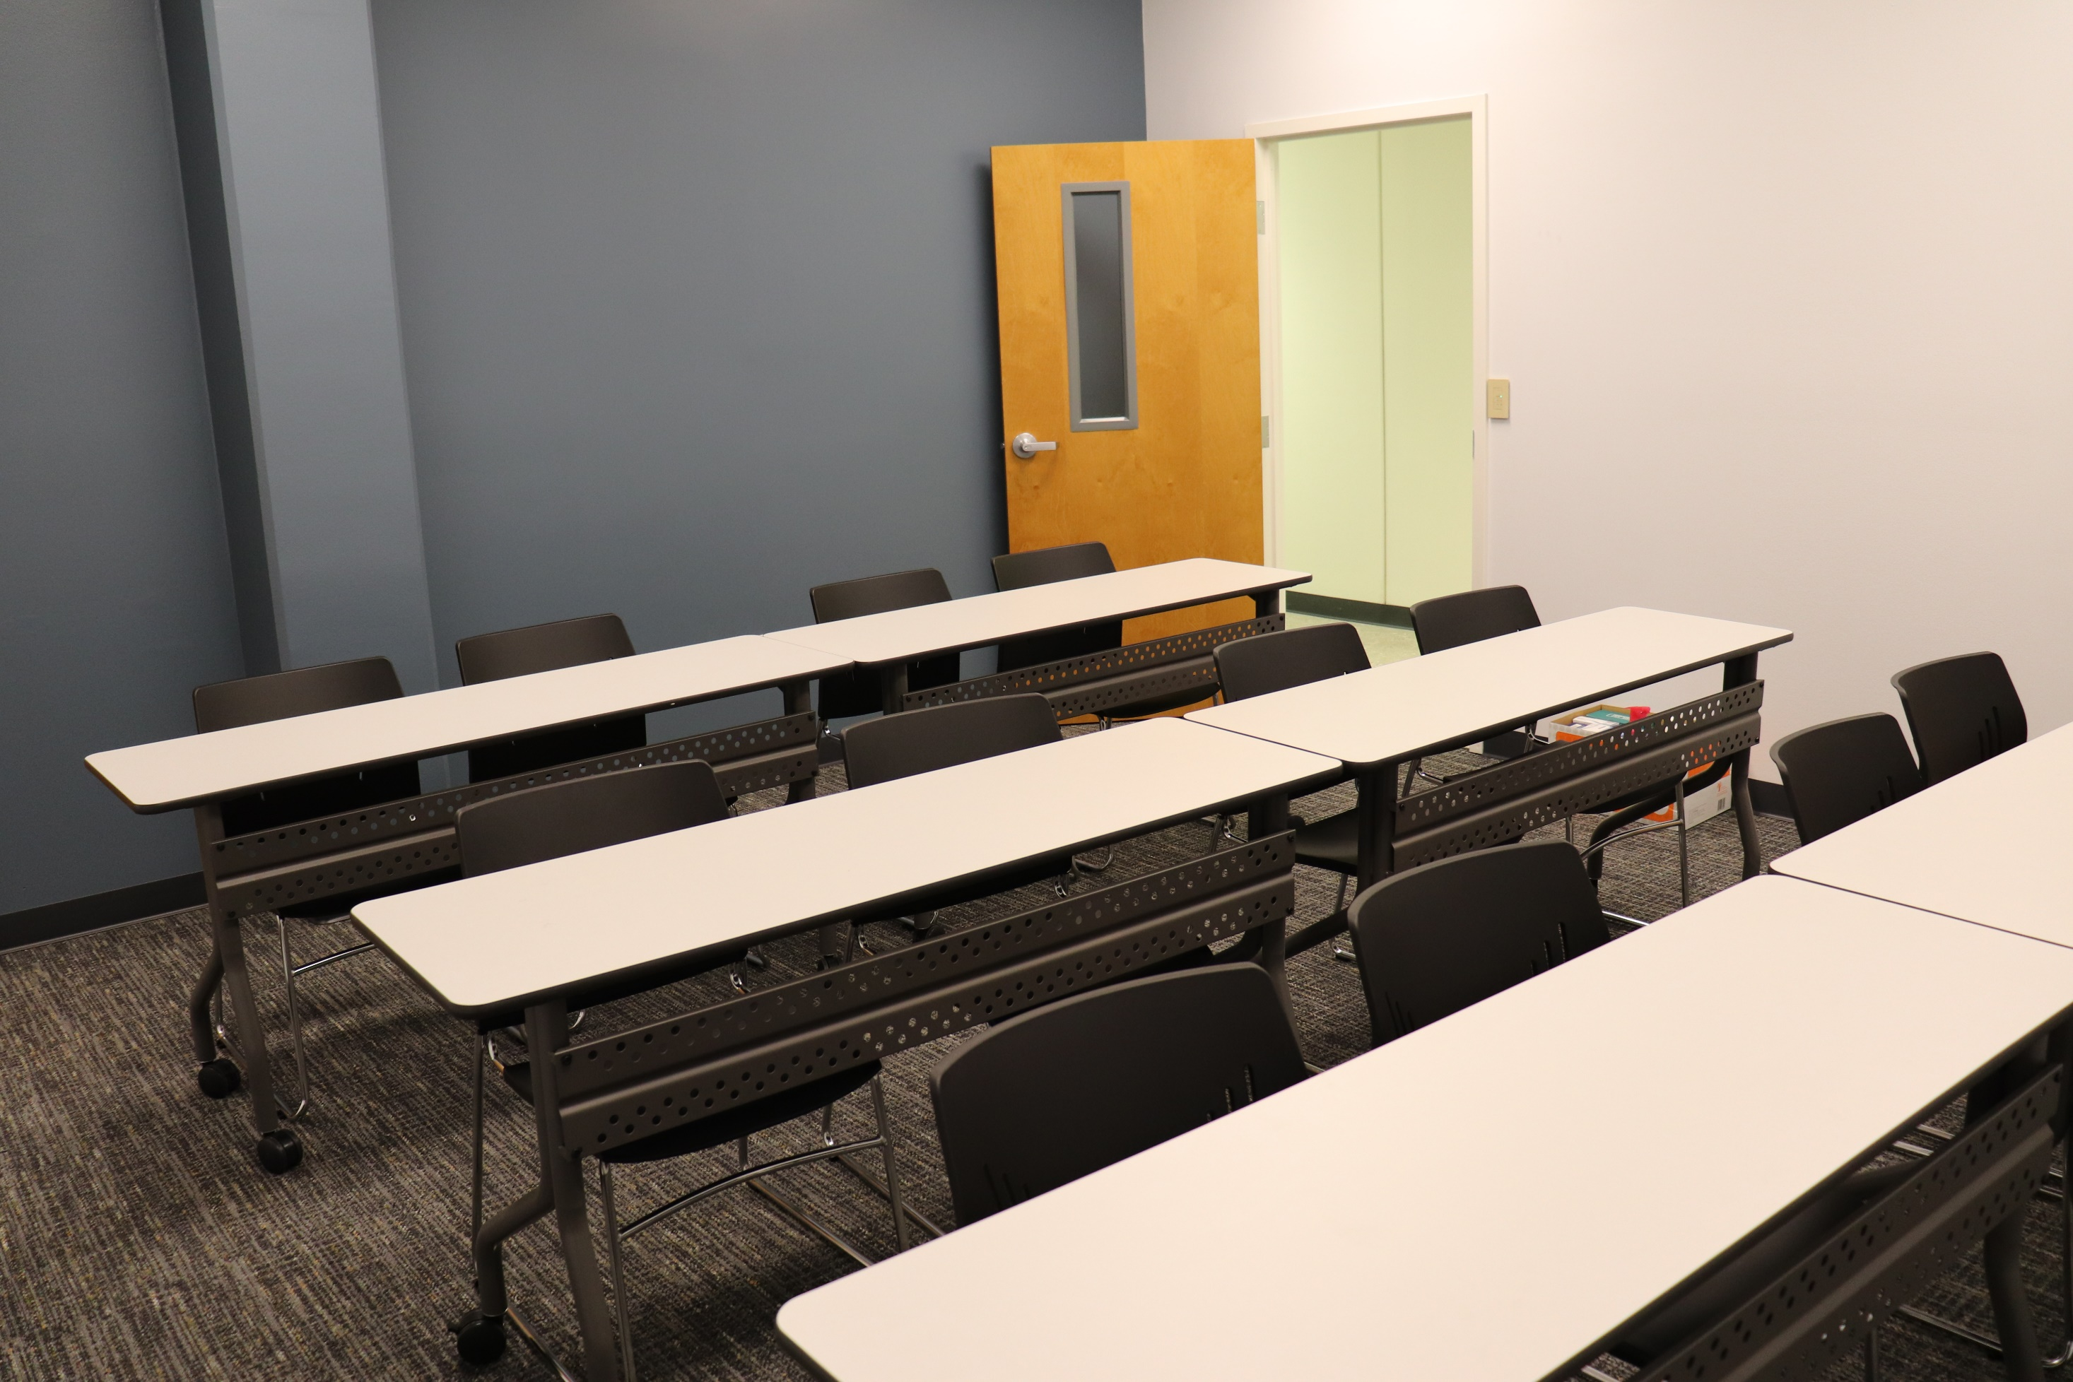
Human resources slide 3
California
Health
Financing
Fitness
Authority
Community Service Infrastructure
COUNTY COSTS ARE SPLIT BETWEEN PROBATION AND BEHAVIORAL HEALTH
SERVICES
PROJECT BUDGET:
Renovation Costs
$1,451,258
OTHER ADDITIONAL COUNTY SERVICES ARE PROVIDED IN-KIND
Furnishing & Training Costs
$239,285
TARGET POPULATION
Misdemeanor Mental Health Diversion Clients
COVERED COSTS INCLUDE:
Property Acquisition & Renovation
Furniture & Equipment
Some Start-up Costs
Applied for grant: 12/2019
Awarded granted: 3/2020
Notes:
One Stop Shop: County Partners to provide in person legal aide , assessments . Probation overseeing grant reporting, creation of all access Reports, monitoring of Fiscal , spending at JDTRC.

Slide 3
“ONE STOP SHOP”
Mental Health Assessments
MediCal
& CalFresh
JDTRC
SUDs
Assessments
Food & Drink
Legal Help
Clothing

Slide 4
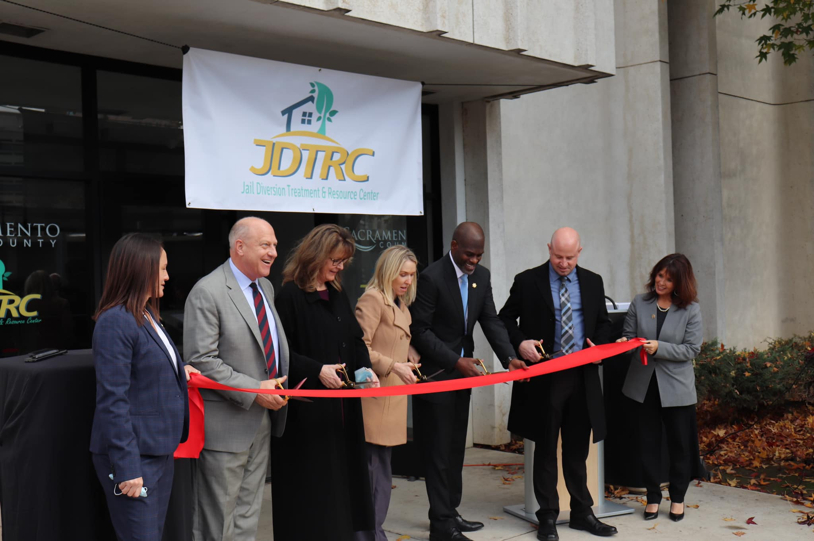
Sacramento County Probation Department
Applied and received Infrastructure grant money to build JDTRC
Fiscal Team oversees spending as outlined in the MOU
Data requirements back to CHFFA
Created a web based report, accessible by all partners.
Day to day operational over sight, DGS (county maintenance) and Security needs

Slide 5
Dept. Of Behavioral Health Services
On Site MH clinicians to meet with clients to conduct in person assessments.
In person and or Zoom therapeutic classes for clients enrolled at The JDTRC
Mental Health / SUD Assessments, direct referral to Sacramento County Access Team for Mental Health and or Substance Use linkage

Slide 6
Human resources slide 3
Mental Health Assessments
Mental Health Process
SMHC completes a mental health assessment
Outcome determines County Mental Health Plan eligibility & service level
Public Defender Office is provided assessment outcome
Service Request is submitted to the Sac County Access Team to link to mental health services

Slide 7
Substance Use Treatment Services Process
Substance Use Disorder Assessments
SMHC completes a substance use disorder assessment
Outcome determines substance use treatment level
Residential Treatment
Intensive Outpatient Treatment
Outpatient Treatment
Medically Assisted Treatment
All involved parties are provided assessment outcomes
If the client is in agreement, a Service Request is submitted to the appropriate substance use provider

Slide 8
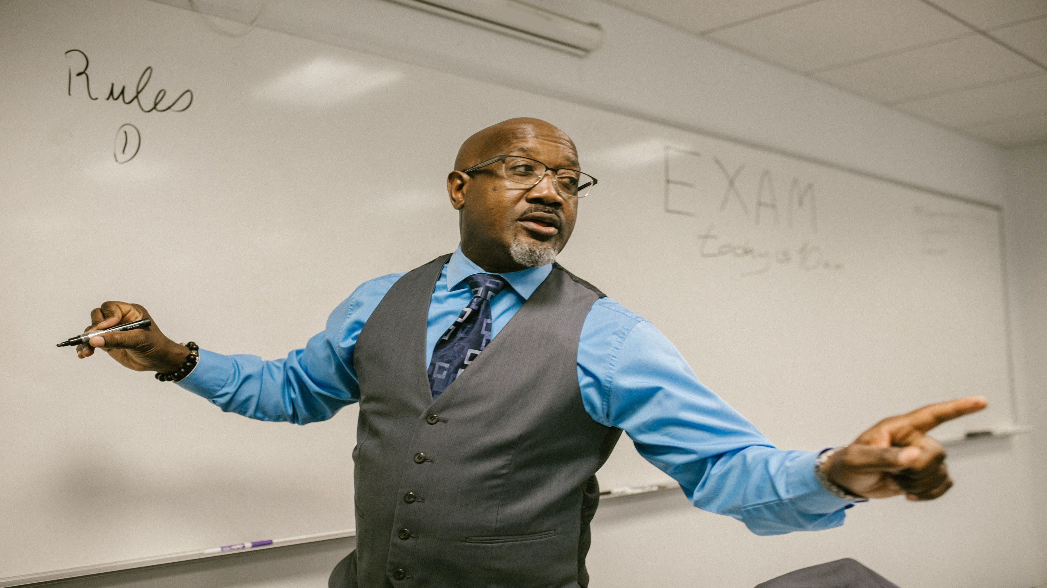
Behavioral Health Groups
MH/ SUP-T clinicians will rotate to facilitate weekly behavioral health groups for MHD participants
Groups will support participants with improving emotion regulation, interpersonal effectiveness, relapse prevention, substance use education, and mindfulness
Goal: To improve quality of life, improve relationships, and decrease incarcerations
Notes:
Classes: Grief and loss, Seeking Safety, Relapse Prevention, Social Support, Managing Anxiety..

Slide 9
Office of the Public Defender / Social Workers
On site Legal Aide, Attorneys and Student Interns
What is Misd. Mental Health Diversion?
Charged w / a Misdemeanor
Meets Requirements of PC 1001.36
Court Grants MH Diversion pursuant to PC 1001.36
On Site Social Workers:
PTSP Assessments to determine needs/ Linkage to Community Based Organizations

Slide 10
Pre-Granting of MHD
2
5
Client is offered mental health and substance use disorder classes pending outcome of MHD
4
3
Client meets with Public Defender Pretrial Support Project for a need assessment including; mental health, substance use, housing, trauma, employment, veterans status, education, and financial stability
Client meets with Department of Behavioral Health and Substance Use Prevention Treatment Team for assessment and linkage to county services.
Public Defender gathers all assessments and creates a supportive plan to help connect client to new services and obtain treatment plan for court
Client is also offered record clearing services, support to linkage of Medi-Cal Services, and Cal Works, Cal Fresh, and GA
1
Client walks over to JDTRC with Public Defender Staff (Pre-Covid 19/in-custody)
Assess
Link to Services
Develop Supportive Plan

Slide 11
Challenges
COVID
Grant Conditions
JDTRC
Construction
Clinician Hiring Shortage
Existing Space

Slide 12
What's next for the JDTRC? Expansion?
Outcome of Growth Requests
On-going County Level JDTRC Work Group to discuss expansion with current or future resources .
How JDTRC expansion could support The Mays Consent Decree/ Jail population reduction plan.

Slide 13
Questions?
JDTRC
Nina Acosta
Human Services Division Manager B
916-938-1613
LeeAnn McCluskey
Chief Deputy
916-875-0018
Joe Cress
Chief Assistant Public Defender
916-874-6411
Thank you!
Notes:
Add all names

