Slide 1
CSAC Cannabis Workshop
Karen L. Smith, M.D., M.P.H.
Director and State Public Health Officer
California Department of Public Health

Slide 2
Licensing Authorities
Cultivators
Track and Trace
Environmental Impact Report
Microbusinesses
Distributors
Testing Labs
Retailers
Manufacturers

Slide 3
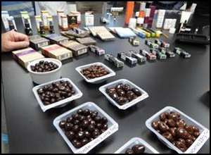
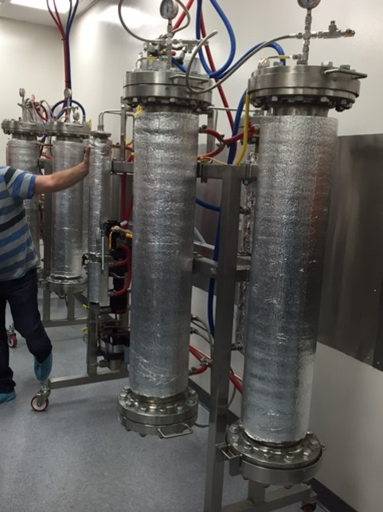
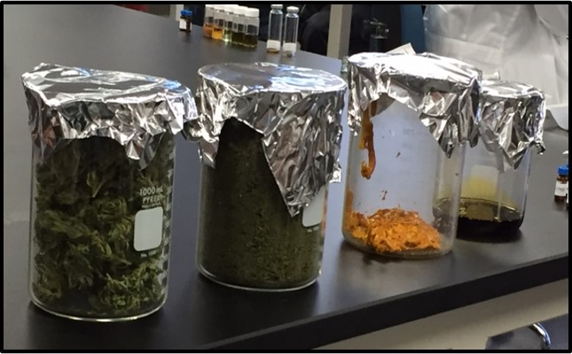
Manufactured Cannabis Regulation

Slide 4
Product Standards
No alcohol, nicotine or added caffeine
No perishable products, except beverages processed in accordance with the regulations
No dairy, except butter purchased from a licensed entity
No seafood
No low-acid canned products
Product cannot be in the shape of a human being, animal, insect, or fruit.

Slide 5
THC Limits
Edibles
10 milligrams per serving
Other Products
1000 milligrams per package (adult-use)
2000 milligrams per package (medicinal)
100 milligrams per package

Slide 6
Packaging
Cannot resemble traditional food packaging
Opaque packaging (Edibles)
Must be packaged before release to distributor
Cannot be attractive to children
Must be tamper evident and child resistant
Must be re-sealable, if there are multiple servings

Slide 7
Labeling
Contain ingredient list and basic nutritional facts
May not refer to product as candy
Cannot be attractive to individuals under age 21
Must list THC content
Must contain universal symbol and government warning statement

Slide 8
Public Health Issues
Youth, young adults (18-25), pregnant & breastfeeding
Social normalization
Edibles, concentration, dosing
Variety of products/methods
Driving/Co-use
Long term effects/lack of research
Clean Indoor Air laws

Slide 9
Public Information Campaign

