Slide 1
Building California’s Future
Notes:
Thank you for having me here today.
I’m about to tell you a story. So grab your milk and cookies, and sit back and relax.

Slide 2
Notes:
I’d like to introduce you to a family you probably know … or know someone very much like them. The Martinez family. Mom and dad spend so much time commuting to and from work, there’s no one around to help the kids with their homework, and dinners together are a thing of the past. By the time the parents do get home, they’re stressed and exhausted and have little patience to deal with even minor issues before the kids’ bedtime.

Slide 3
Notes:
Rent gobbles up more than half of their income, leaving little left over for even the most basic family necessities.

Slide 4
180,000 new homes needed annually
Annual New Housing Permits 1955-2016
1955-1989
Average 205,000
2000-2016
Average 80,000
Source: Construction Industry Research Board/California Homebuilding Foundation Reports 2005, 2013, 2015; Graphic by HCD
Notes:
But what brought us here in the first place and just how common is this story?
For years CA has been underbuilding homes—especially multifamily housing. This lack of supply and skyrocketing rents and home prices have created heavy, overwhelming cost burdens on families.
And because of all this, it’s become really bad here in CA:
We have a very low supply of new homes compared to our need. We only averaged 80,000 new homes annually over the last 25 years, less than half of our projected need, just to keep up with population growth. And less than half of what we were building in most of the 20th century, when our base population was much lower.

Slide 5
Rent vs. Renter Income
2000
2005
2010
2015
Source: California Housing Partnership analysis of 2000 Decennial Census and 2005-2014 American Community Survey 1 year data. 2001-2004 and 2015-2016 are an estimated trend. Median rent and renter income are inflation adjusted to 2014 dollars. Graphic recreated by HCD.
Notes:
Rent and renter incomes are going in opposite directions, creating a big gap between what a household like the Martinez’s earns and what they can afford to pay each month just to keep a roof over their heads. Since 2000 rents have increased nearly 30%, while renter income has struggled and has still almost 5 percent below 2000 levels.

Slide 6
1.5 MILLION Worst Case Housing Needs Households
Notes:
More than 1.5 million renter households are paying more than half their income in rent and what is really concerning is that number is trending up – up almost a third from just a decade ago. (for UCLA, list median housing sales price for LA County and how much it’s gone up over the last 5 years)

Slide 7
California has: 22% of nation’s homeless 12% of nation’s overall population
Notes:
We also have the largest homeless population in the country. California accounts for a disproportionate 22% of the nation’s homeless population, but only 12% of the overall population. Clearly, relief is desperately needed.

Slide 8
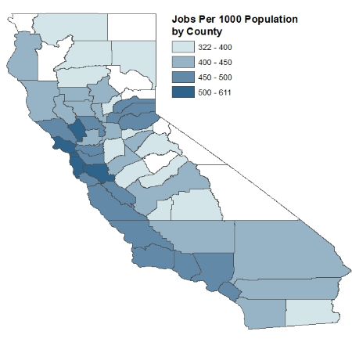
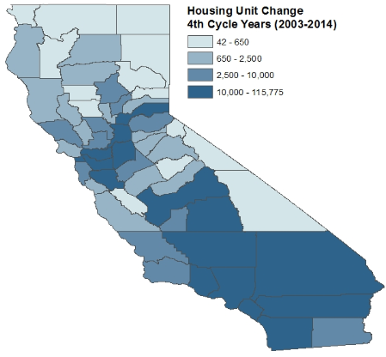
Job Availability
Housing Availability
Sources: Population: U.S. Census Bureau, Population Division, 2015 Population Estimates. Labor Force Estimates: State of California Employment Development Department 2015 Labor Force by County, note counties with labor forces under 10,000 were excluded from the map. Housing Unit Change: DOF E5 Population and Housing Estimates for Cities, Counties, and the State; E8 Historical Population and Housing Estimates for Cities, Counties, and the State.
Notes:
Megan thought you might want to talk about the TCAC Opportunity work here—reference partnership.. We are not seeing housing growth where it’s most needed either. Homes are located far from job centers and lack affordable transportation options, where the barriers to development are lower. This continued dependence on cars diminishes quality of life for all of us, with lost productivity, quality of life and strains on childcare and parenting, and sets us back on our climate change goals, given VMT comprise the single largest contributor of GHGs.
And this is not just fueling migration patterns from denser coastal communities to more sprawl-oriented inland communities. In fact recent out-migration from CA in the past year is estimated to be a net 110,000. Losses in the Los Angeles-Orange County area have gone from 42,000 in 2011 to 88,000 this year, with Texas and its less than perfect land use patterns, being the largest recipient of our out migrants.

Slide 9
2017 Legislative Package Enacted September 29, 2017
Permanent funding
Streamlined approvals
Greater enforcement
Preservation
Notes:
Fortunately, there is new hope for housing; Legislative leaders designed and delivered 15 new laws addressing principles set forth by the Governor earlier this year.
These bills bring most notably, a permanent funding source for housing, streamlined local approval processes, greater enforcement of existing housing obligations and preservation of current affordable housing stock; these were bundled up and approved and signed by Governor Brown.
So let’s fast-forward to the Martinez family in 2022. This package of housing bills has been in the works for 5 years now – and things are really looking up.

Slide 10
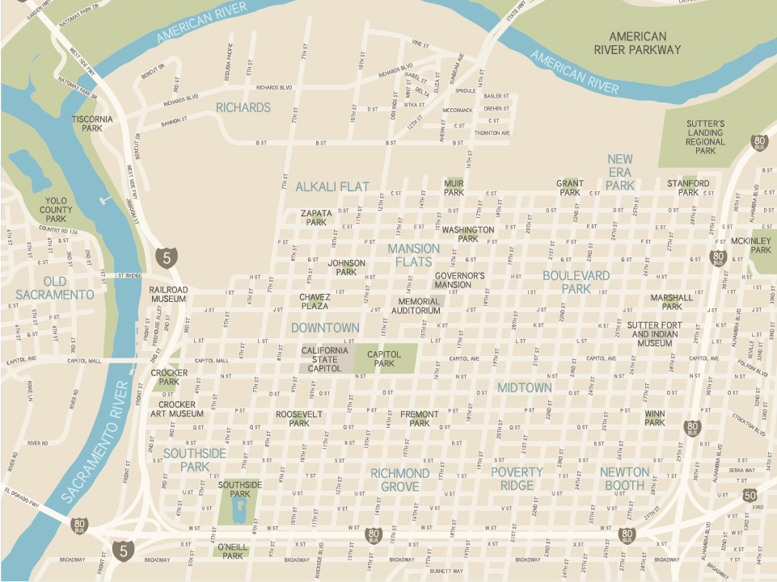
Additional Zoned Land
AB 1397
Land zoned for housing can accommodate new development.
Stronger justification needed when non-vacant sites used to meet housing needs.
Notes:
The Martinez’s are living in a new, fantastic community. And it’s affordable; they no longer spend half their income on rent and are able to make ends meet.
This all actually started with new land use authority that came along with bills like SB 1397 which ensures that there are enough sites zoned for housing.

Slide 11
Effective:
Jan 2018
TA Memo:
Spring 2018
AB 1397
Land zoned for housing can accommodate new development.
Stronger justification needed when non-vacant sites used to meet housing needs.
Notes:
We expect to put out the technical assistance memo on 1397 around Spring 2018.

Slide 12
SB 35
Streamlined approval process
Development must be on infill site and comply with existing zoning
Development must provide at least 10% of units for lower-income families and pay construction workers prevailing wage.
Only applies in jurisdictions that have fallen behind in RHNA progress
Notes:
SB 35 advances streamlined approvals.
Ensures that the development is infill and that it fits with local zoning laws.
Plus, the development needs to include at least 10% of the units for lower-income families.

Slide 13
SB 35
Effective:
Jan 2018
Guidelines:
Summer 2018
Preliminary Eligibility:
Winter 2017/18
Notes:
SB 35 goes into effect in January. We’re looking at preliminary list eligibility as early as this winter, and guidelines should be coming around the summer of 2018.

Slide 14
New Amendments to Housing Accountability Act
AB 678/167
Notes:
Several bills strengthen our Housing Accountability Act or “anti-NIMBY” law and others switch the judicial standard for the state’s housing accountability act – to a reasonable person standard.
And two identical laws - AB 678 and 167– create fines and require lawyers fees when a city loses in court - at least $10,000 per unit, that goes back to new affordable housing, if they don’t comply.

Slide 15
Effective:
Jan 2018
TA Memo:
Fall 2018
AB 678/167
Notes:
These also go into effect Jan 1. For these bills, the tech assistance memo is expected around the fall of next year.

Slide 16
Increased Enforcement For State Housing Laws – AB 72
Authorizes enforcement of Housing Element Law
Enables HCD to refer any violations to Attorney General
Notes:
And here’s another reason why cities will comply: there’s a new sheriff in town with AB 72, which provides new enforcement authority of state housing law. Will encourage implementation of local housing policies and will allow HCD to monitor implementation of housing element programs and hold negligent local governments accountable.

Slide 17
AB 72
Effective: Jan 2018
Notes:
AB 72 will be launched Jan 1 as well.
(Melinda said there isn’t really a launch date here– we’re just going to start doing it)

Slide 18
New Funding: SB 2 and SB 3
Notes:
The big deals in this package are SB 2 and SB 3. SB 2 creates a dedicated funding source for affordable housing by placing a fee on the recording of real estate documents. Most of these funds go to local governments including cities that some of you are affiliated with. These funds will also serve as “seed” money to leverage other state and federal sources.

Slide 19
SB 2
Year 1 | 50% Planning Grants | 50% Homeless Programs
Year 2 and beyond | 70% Local Governments | 30% State-Administered
Notes:
Funding will be divided equally during the first year with half going to planning grants and the other half to homeless programs.
15% of these funds will be directed to the “missing middle” by our sister agency, CA Housing Finance Agency
5% for production incentive programs
10% farmworker housing
This is the first time we’ve had any level of guaranteed, ongoing funding for housing.

Slide 20
SB 2
Guidelines:
Summer 2018
NOFA:
Fall/Winter 2018
Fees Collected: Jan 2018
Awards:
Spring 2019
Notes:
Fees will start to get collected in January of 2018.
Guideline development should start around the summer of 2018.
NOFA we hope to put out in the winter of next year.
And make awards in the spring of 2019.

Slide 21
SB 3
$1.5 billion Multifamily housing
$500 million Transit-oriented development and infill infrastructure
$400 million CalHome
$300 million Joe Serna Farmworker Housing
$300 Million Local Housing Trust Fund Matching Grant
$1 billion CalVet
Notes:
SB 3, was also part of the package; this bill put a $4 billion general obligation bond on the November ballot—and allocates $3 billion in bond proceeds for tried and true programs that assist affordable multifamily developments, transit-oriented development like the Martinez’s, and infrastructure for infill development.
$1.5 billion for Multifamily Housing • $500 million for Transit-Oriented Development & Infill Infrastructure • $400 million for CalHome • $300 million for Joe Serna Farmworker Housing • $300 million for Local Housing Trust Fund Matching Grant
$1 billion will be going to CalVet for home and farm purchases for veterans.

Slide 22
SB 3
Ballot:
Nov 2018
Initial Awards:
Summer 2019
Initial NOFA:
Spring 2019
Notes:
Of course SB 3 will be up to the voters in November of next year. For the initial NOFA of SB 3, we’re looking at winter of 2018/19 and initial awards sometime around the summer of 2019.

Slide 23
Notes:
So this set of bills is big! It’s a life-changer for families like the Martinez’s. They can feel confident that they can continue to pay their rent, and pay their utility bills, and buy school supplies. And living in a transit-rich community means their commute is so much more reasonable, those family dinners are back on the table and the kids are getting better grades in the classroom.
These bills will make the Martinez’s story more common.

Slide 24
Notes:
The benefits will extend to families all over CA as well as to young people just starting out -- seniors who are moving into homes more suited to their needs, working individuals who were struggling to find affordable homes, vets returning from service, people who were experiencing homelessness, people with disabilities who want to live independently, cities that want to plan for changing demographics in their community, and on and on.
So we’re not only talking about the 50,000 plus households who will live in SB 3-funded homes, or the estimated 1,000 households a year from SB 2.
We can also include all those who benefit from more housing opportunities and more production.
This is exciting. But the impact depends on implementation and we can’t do that without you.
We’ll need your partnership to know what’s going on on the ground. And where barriers remain. We’ll hoping you’ll share that information with us and be good partners.

Slide 25
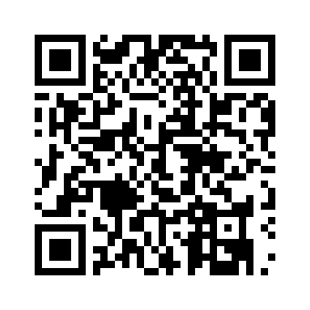
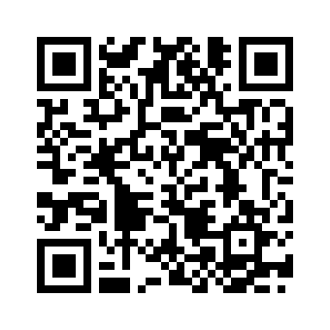
Statewide Housing Assessment
hcd.ca.gov
Email announcements
Come join our team
California Department of Housing and Community Development
2020 West El Camino Avenue, Sacramento, California 95833
916.263.7400
Follow us on Twitter: @California_HCD
Follow us on Facebook: www.facebook.com/CaliforniaHCD
Notes:
Please check out our legislative housing package page on our website, where you’ll find summaries of the package, contact information and more. We’ll continue to grow this page and add FAQS and implementation plans as they come into focus.
We also have our statewide housing assessment posted for your review.
And how will you stay on top of all of this news? Just sign up for our email announcements and we’ll keep you posted on just about any topic you choose.
And last but not least --- we’re hiring! There are huge opportunities coming to HCD in the form of new jobs. So please tell your friends, your family members, and think about it yourself! We’re looking for new talent.
Thank you.

