Slide 1
LOS ANGELES COUNTY HOMELESS INITIATIVE
CSAC Southern CA Counties Regional Meeting
September 22, 2016

Slide 2
Greater Los Angeles Homeless Count
Total Homeless Population
(includes Glendale, Long Beach and Pasadena)
Total Homeless Population -
Sheltered and Unsheltered
6% increase in 2016
2015
2016
Data provided by Los Angeles Homeless Services Authority

Slide 3
Homeless Housing Gap
Housing Type
Total Gap (units)*
Description
Permanent Supportive Housing
15,341
Provides intensive support services to chronically homeless persons
Rapid Re-Housing
8,376
Provides short-term housing assistance. Each unit can potentially house 2 households per year
Emergency Shelter
2,279
Provides crisis housing to unsheltered persons on the path to permanent housing
Homeless Prevention
2,555
Provides stabilizing housing assistance that keeps people and families from falling out of housing and into the homeless system
$450 million per year* needed to fill the homeless housing gap (not counting construction costs)
*Homeless Housing Gaps in the County of Los Angeles, Los Angeles Homeless Services Authority, January 2016

Slide 4
Homeless Initiative
Launched in August 2015
Seizing the moment: Historic opportunity to combat homelessness throughout Los Angeles County
Initial Goal: Develop a comprehensive set of recommended County strategies to combat homelessness, including strategies in which cities can participate
Inclusive and collaborative planning process – 25 County departments, 30 cities, over 100 community organizations

Slide 5
Approved Strategies
(Approved by the Board on 2/9/2016)
47 strategies divided into six areas:
Prevent Homelessness
Subsidize Housing
Increase Income
Provide Case Management and Services
Create a Coordinated System
Increase Affordable/Homeless Housing
Phase I Strategies: 12 Strategies with greatest impact in the short and medium-term.
Key Principles: Collaboration; investing in proven strategies; leveraging mainstream systems; and, seamless, client-centered services.

Slide 6
County Expenditures
Current County Expenditures
In FY 2014-15, six County departments spent an estimated $965 million to serve single homeless adults.
40% of $965 million spent on just 5% of homeless single adults.
Targeting housing/services to this 5% could generate significant savings to reinvest in combating homelessness.

Slide 7
Funding
New one-time commitment: $99.7 million
General Fund - $55.7 million (in addition to $50 million in base FY15-16 budget).
Departmental funding - $44 million.
Potential ongoing funding
The Homeless Initiative, in collaboration with the Board, is exploring potential sources of ongoing revenue.

Slide 8
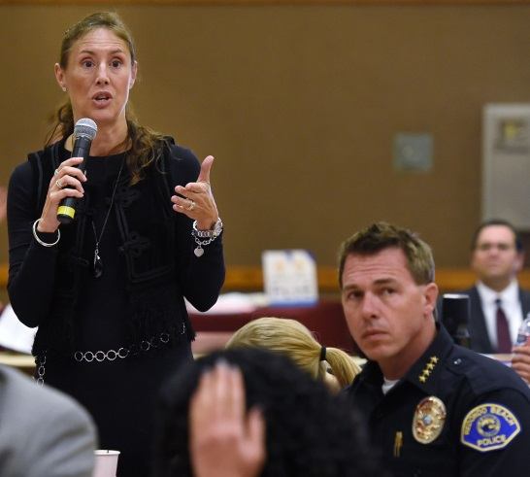
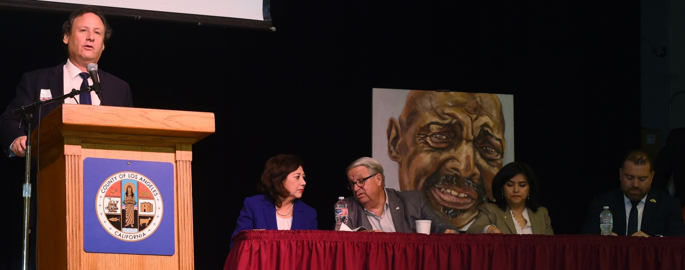
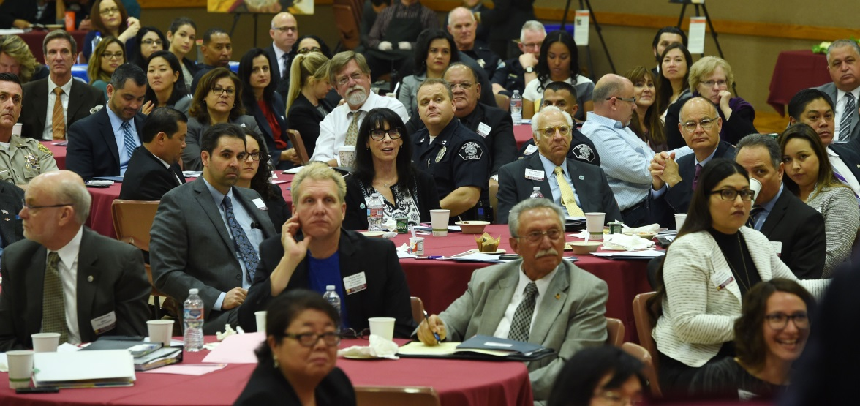
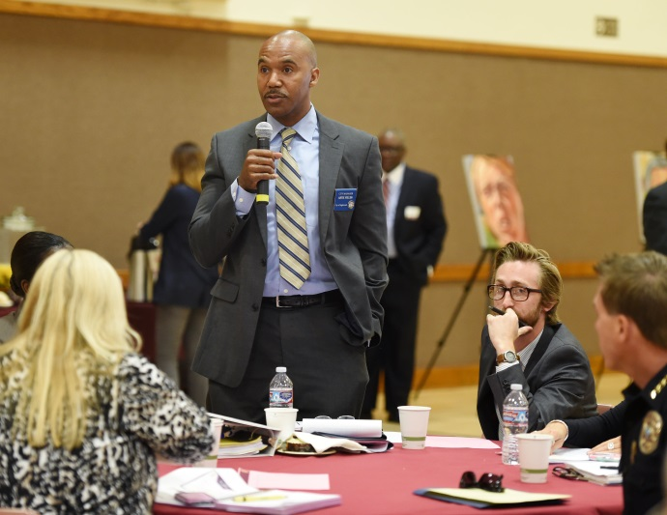
Mayors’ Regional Summit to Combat Homelessness (3/31/16)
200 attendees representing 56 cities and unincorporated areas (95% of the countywide homeless population)

Slide 9
Opportunities for Cities
Unprecedented partnership opportunities by:
Contributing city funding toward rapid rehousing (Strategy B3)
Dedicating federal housing subsidies to permanent supportive housing for the chronically homeless (Strategy B8)
Ensuring law enforcement and first responders effectively engage homeless families/individuals (Strategy E4 and E5)
Using land use policy to maximize the availability of homeless/affordable housing (Strategies F1, F2, F4 and F5)

Slide 10
http://priorities.lacounty.gov/homeless
Office of Homeless Initiative Kenneth Hahn Hall of Administration County of Los Angeles
500 West Temple Street, Room 493 Los Angeles, CA 90012
(213) 974-2326 homelessinitiative@lacounty.gov
FOR UP TO DATE INFORMATION VISIT US AT:

