Slide 1
Putting the Pieces Together the Value of Housing Choice Project Based Vouchers

Slide 2
California Housing Authorities Impact
Housing Authorities administer 348,523 Housing Choice Vouchers to low-income families.
30% of the U.S. homeless population lives in California.
67% of assisted households include persons who are disabled and/or seniors or with children.
Over 75% of California renters are at extremely low-income.
$2.97 billion in rental subsidy payments to private owners.

Slide 3
What is the Housing Choice Voucher
( HCV) Program
The Housing Choice Voucher (HCV) Program, formerly known as “Section 8”, provides rental assistance to individuals and families through a Housing Assistance Payment (HAP) to private owners.
The voucher participant is responsible for finding a suitable housing unit of the family's choice where the owner agrees to rent under the program and is not limited to units located in subsidized housing areas.
The unit selected by the voucher participant must meet program requirements including a Housing Quality Standards inspection and rent burden evaluation.
The voucher holder will pay approximately 30 percent of their household income to the rent portion and the voucher HAP will cover the remaining 70 percent paid by the Housing Authority.

Slide 4
Responsibilities & Roles for the Housing Choice Voucher Program
Housing Authority: Responsible for enforcing Housing Choice Voucher program eligibility. The voucher with the tenant and the HAP contract with the owner.
Tenant: Responsible for meeting voucher program requirements and following the Lease Agreement.
Owner: Responsible for enforcing the Lease Agreement with the Tenant and abiding by the HAP contract.

Slide 5
If an individual or family is selected from the waiting list, the following documentation is required to determine eligibility, including but not limited to:
Household Composition – Photo IDs, Birth Certificates, Social Security Cards, Verification of Citizenship
Determining Eligibility
Income – wages, social security, cash aid/CalFresh, unemployment child support, pension, self-business
Assets – bank statements, cash surrender value of policies (life insurance), certificates of deposit, annuity, real estate
Other documentation to support application – verification of residency, disability, veteran, government displaced
Note: Individual or family that fails to provide the needed documentation to determine eligibility may be removed from the waiting list.

Slide 6
determining Eligibility
In addition to meeting basic program requirements, individuals and families will need to meet income targeting.
At least 75 percent of the individuals and families admitted to the HCV program each year must be extremely-low income.
HUD establishes income limits for all areas of the country and publishes them annually in the Federal Register. They are based upon estimates of median family income with adjustments for family size. The income limits are used to determine income targeting for eligibility for the HCV program.

Slide 7
is the Rent Reasonable?
Based on the RTA, the unit rent must pass the reasonableness test. HACSJ will perform this test by using a third-party rent reasonableness software
to locate comparable units to justify the owner’s contract rent amount.
If the rent requested is more than the Payment Standard (driven by HUD Fair Market Rents), it may not be affordable for the family and the Housing Authority cannot approve the unit.
Rent may not be approvable even at the Payment Standard because:
A deduction must be made if the family will be responsible for any of the utilities (i.e., PG&E, water, sewer, garbage, etc.)
The owner is asking more for this unit, than for other similar units.
Your share of the rent plus the utility allowance may not exceed 40% of your family monthly adjusted gross income at move-in.

Slide 8
housing Assistance Payment Contract
Upon passing HQS inspection, the Housing Authority will enter a Housing Assistance Payment (HAP) Contract with the owner.
The HAP Contract will identify tenant’s responsible rent portion and the amount to be paid by the Housing Authority on the tenant’s behalf, along with the owner program requirement.
When the HAP Contract is executed by the owner and the Housing Authority, payments will be made directly to the owner.
Direct deposit is the most preferred method for HAP and payment will be released on a monthly basis as long as the tenant and owner are in compliance with the program.

Slide 9
project Based Voucher
vs. Tenant Based Voucher
Project-based voucher program: a Housing Authority enters an assistance contract with the owner for specified units and for a specified term. The Housing Authority refers families from its waiting list to the project owner to fill vacancies. Housing assistance is tied to the unit, not the family. A family who moves from the project-based unit does not take the housing assistance with them. However, they may be eligible for a tenant-based voucher if available.
Under the tenant-based housing choice voucher program, the PHA issues an eligible family a voucher and the family selects a unit of its choice. If the family moves out of the unit, the contract with the owner ends and the family can move with continued assistance to another unit.

Slide 10
project Based Voucher (PBV) Program
24 Code of Federal Regulations (CFR) 983 covers the Project Based Voucher Program.
PBV program allows affordable housing for even the lowest income families.
Vouchers are committed affordable properties through the PBV program ensures those units will be available exclusively to PBV voucher households.
PBVs helps facilitate production of housing for vulnerable populations including veterans, persons with disabilities, seniors, and persons experiencing homelessness who often are the most challenged when attempting to access housing in the open market. Analysis may be conducted by local agency to address most vulnerable population within their community.
For unit(s) to be considered PBV, owners must undergo a competitive selection process for available PBV and meet all PBV program requirements.
Local Housing Authority’s Administrative Plan outline the process for PBV proposals and selection process. A Housing Authority is limited and is subject to a cap on the number of units a Housing Authority may utilize for PBV.
Initial term of the HAP contract for any PBV unit may not be less than one (1) year, nor more than twenty (20) years. Extensions may be applicable if the HAP contact is less than twenty (20) years.
Contact local Housing Authority for PBV opportunities.

Slide 11
Cottage Village Senior Apartments
Developed by the Housing Authority County of San Joaquin (HACSJ) through its nonprofit subsidiary and development arm Delta Community Developers Corp. (DCDC)
48 Units of Affordable Housing for Seniors
40 One-Bedroom Units
8 Two-Bedroom Units
Funding included:
City of Manteca
San Joaquin County
4% Low Income Housing Tax Credits
Permanent Financing
Annual LIHTC Base Rent Revenue $393,270
Annual PBV Rental Subsidy (Over LIHTC Rents) $639,195
Additional Revenue Available for Debt Service $245,925
15 Year Loan at 7.45% Interest | PBV Rents Debt Service | LIHTC Rents Only Debt Service | Increased Leverage with PBV Rents
Principal | $ 4,803,054 | $ 2,955,199 | $ 1,847,855
Interest | $ 3,186,884 | $ 1,960,921 | $ 1,225,963
Total Principal & Interest | $ 7,989,938 | $ 4,916,120 | $ 3,073,818

Slide 12
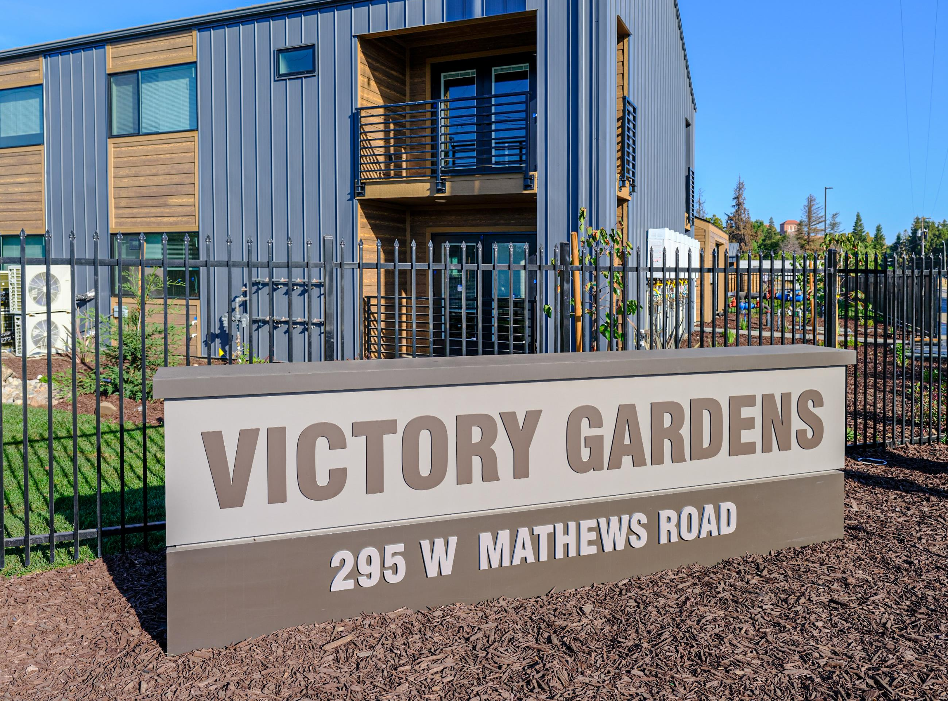
Victory Gardens
Developed by the Housing Authority County of San Joaquin (HACSJ) through its nonprofit subsidiary and development arm Delta Community Developers Corp. (DCDC)
48 Units of Permanent Supportive Housing for Homeless Veterans
41 One-Bedroom Units
7 Two-Bedroom Units
Funding included:
San Joaquin County Ground Lease and HOME funds
9% Low Income Housing Tax Credits
Veteran Housing and Homeless Prevention (VHHP) funds
California Emergency Solutions and Housing (CESH) funds
Annual LIHTC Base Rent Revenue $254,076
Annual PBV Rental Subsidy (Over LIHTC Rents) $519,528
Additional Revenue Available for Debt Service $265,452
As a permanent supportive housing project, Victory Gardens does not have permanent debt. The extensive services require capitalized operating reserves to cover the cost of the services not supported by cash flow.
Without Project-Based Vouchers, Victory Gardens would need an additional $5,309,040 in reserves

Slide 13
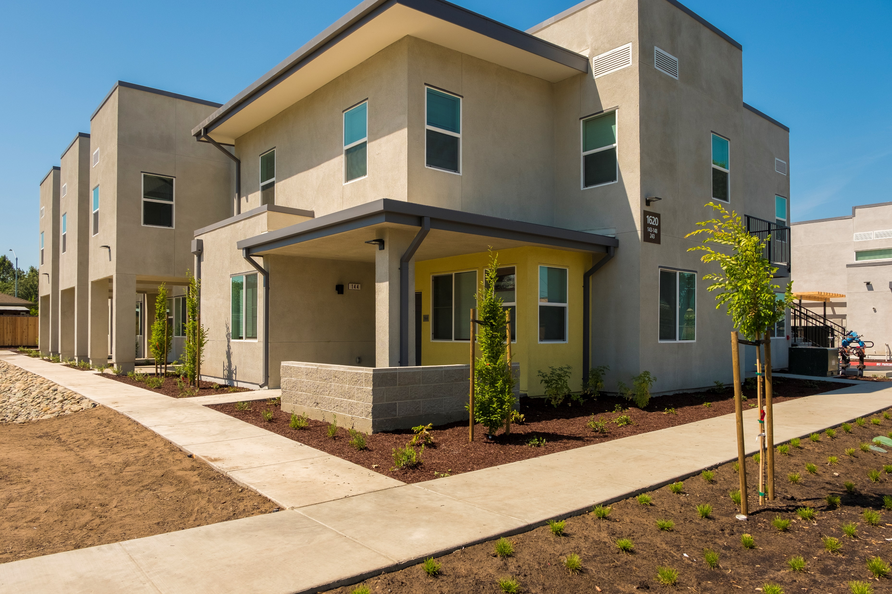
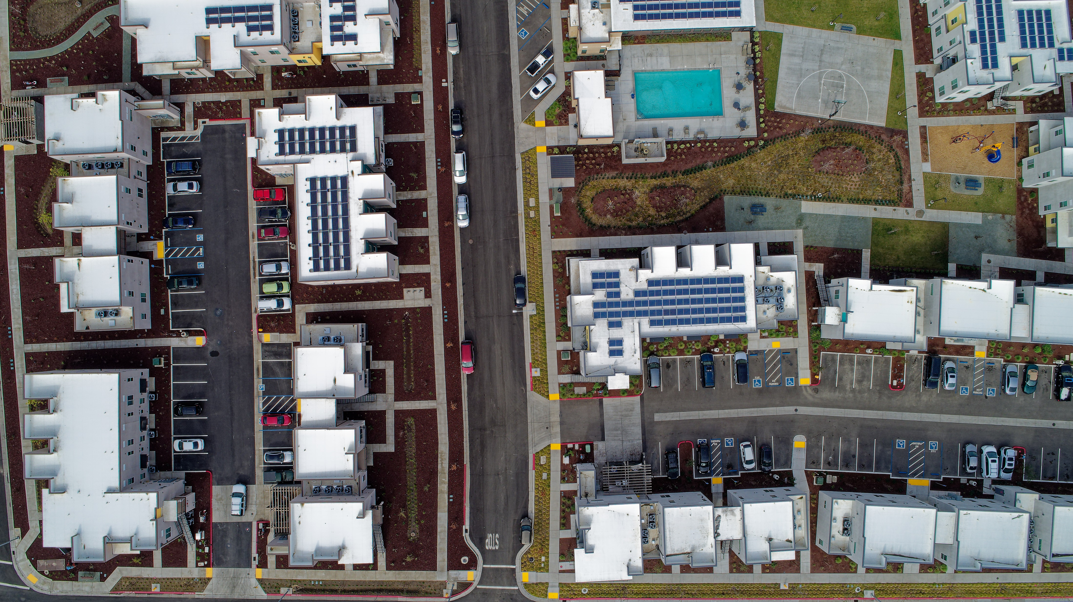
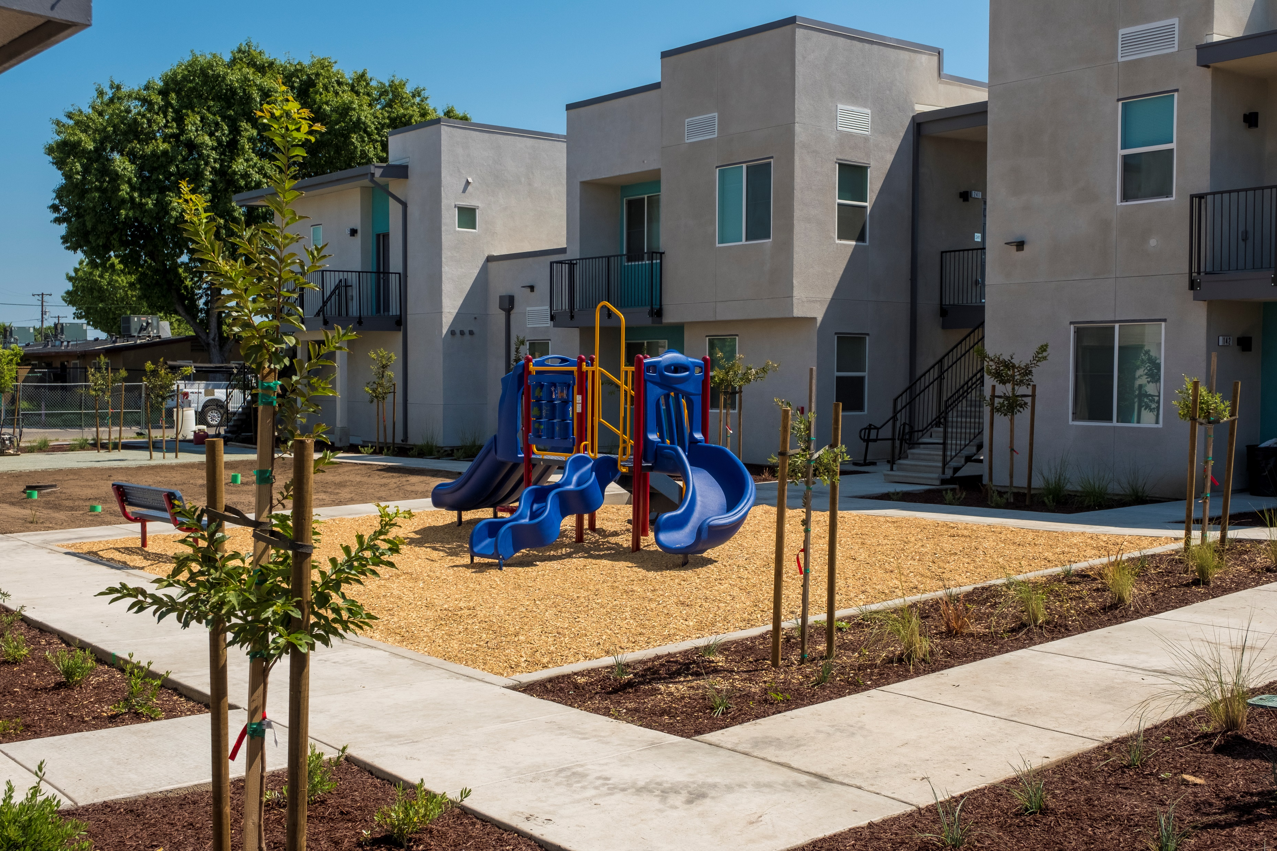
Sierra Vista I
Developed by the Housing Authority County of San Joaquin (HACSJ) through its nonprofit subsidiary and development arm Delta Community Developers Corp. (DCDC)
Annual LIHTC Base Rent Revenue $709,114
Annual PBV Rental Subsidy (Over LIHTC Rents) $1,255,949
Additional Revenue Available for Debt Service $546,835
15 Year Loan at 7.45% Interest | PBV Rents Debt Service | LIHTC Rents Only Debt Service | Increased Leverage with PBV Rents
Principal | $ 9,437,407 | $ 5,328,438 | $ 4,108,969
Interest | $ 6,261,832 | $ 3,535,483 | $ 2,726,349
Total Principal & Interest | $ 15,699,239 | $ 8,863,921 | $ 6,835,318
115 Units Affordable Housing
25 One-Bedroom Units
36 Two-Bedroom Units
39 Three-Bedroom Units
15 Four-Bedroom Units
Funding included:
9% Low Income Housing Tax Credits
HACSJ Capital Contribution
HACSJ Ground Lease
Permanent Financing

Slide 14
HACSJ’s voucher allocation, funding & Project-Based Vouchers
Project-Based Vouchers (PBV) are a component of a Housing Authority’s Housing Choice Voucher program.
Housing Authorities are not allocated additional funding for PBV units. Housing Authorities can use up to 20 percent of its voucher allocation to project-base units. An additional 10 percent can be used for special circumstances (i.e. homeless or permanent supportive housing for seniors or disabled)

