Slide 1

Proposition 6 and Campaign Rules
What You Can Say, What You Can’t Say
Kiana Valentine, Sr. Legislative Representative
Jennifer Henning, Exec. Dir. County Counsels Association
Gregg Fishman, Communications Coordinator
July 16, 2018

Slide 2
SB 1-The Road Repair and Accountability Act of 2017
Approximately $5.4 billion/year in new revenue – no sunset
  $1.5 billion for cities and counties
  $1.8 billion for state highways
  $300 million for bridges and culverts
  $750 million for transit agencies
  $550 million in competitive grant programs
  $200 million matching funds for self-help counties
Accompanied by ACA 5 (Frazier)/Prop 69 (passed June 5)
SB 1 revenue is 100 % protected for transportation purposes

Slide 3
The Repeal Effort
Repeal effort qualified for the ballot June 25
Now designated as Proposition 6
CSAC is part of a large and diverse coalition to defeat it
CSAC is using non-public funds for this purpose
Several counties and other jurisdictions have also adopted a “No on Proposition 6” position

Slide 4
Proposition 6 Would:
Repeal the taxes and fees associated with SB 1
Loss of $5.4 Billion per year for transportation infrastructure
All revenue collected prior to election is still valid
Future revenue would be gone
1000s of projects “in the pipeline” would be stalled/canceled

Slide 5
Public Education About SB 1 Funding
Taxpayers have a right to know about how and where SB 1 revenue is being spent
  State projects
  Local projects
  Transit
  Movement of goods, etc.
What will happen if those funds are repealed – short and long terms impacts

Slide 6
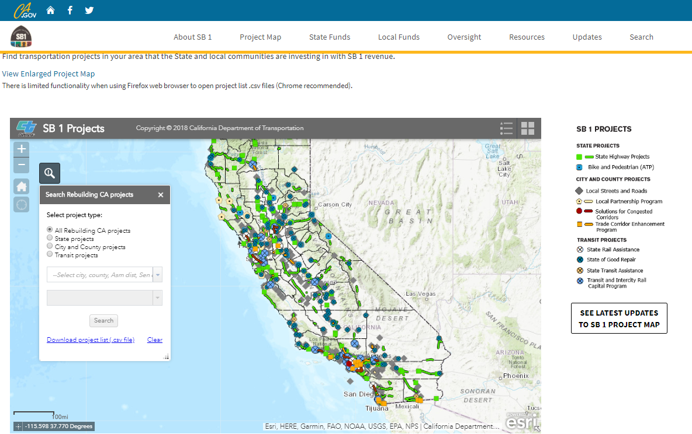
1000’s of Projects are Underway

Slide 7
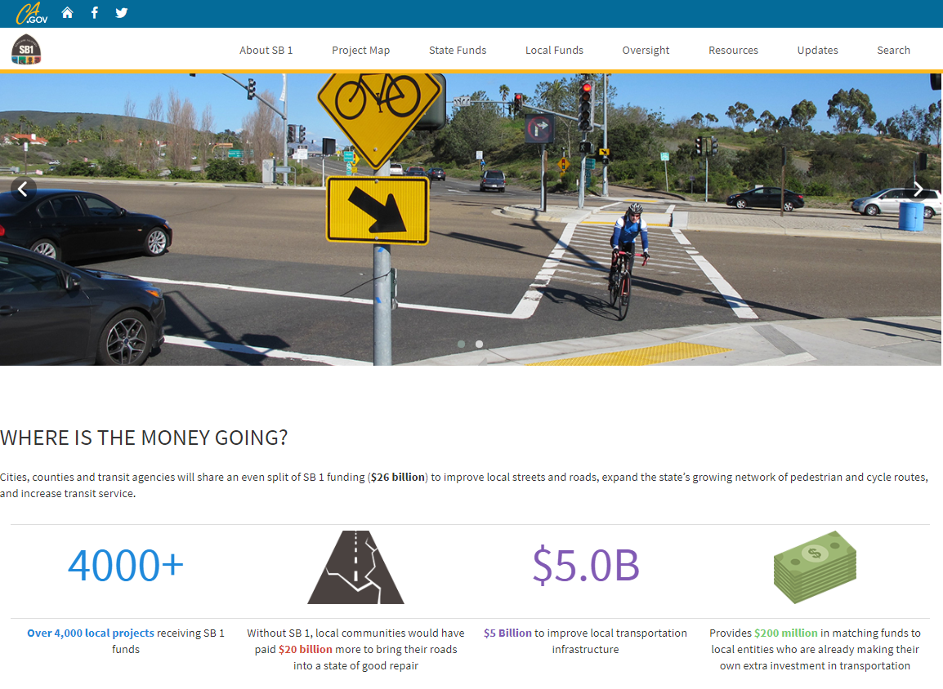
http://rebuildingca.ca.gov/local-funding.html

Slide 8
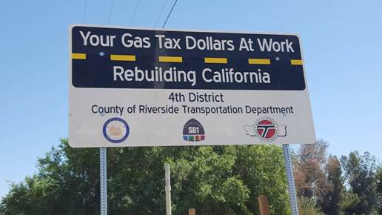
Local Projects, Too.

Slide 9
Public Agencies Are Allowed to:
Prepare an analysis on the impact of a ballot measure
Present that information in a manner consistent with the county’s usual means of communication
Respond to inquiries about the impact of the ballot measure with a fair presentation of the facts
Accept invitations to present the county’s views before organizations that are interested in the impact of its effects

Slide 10
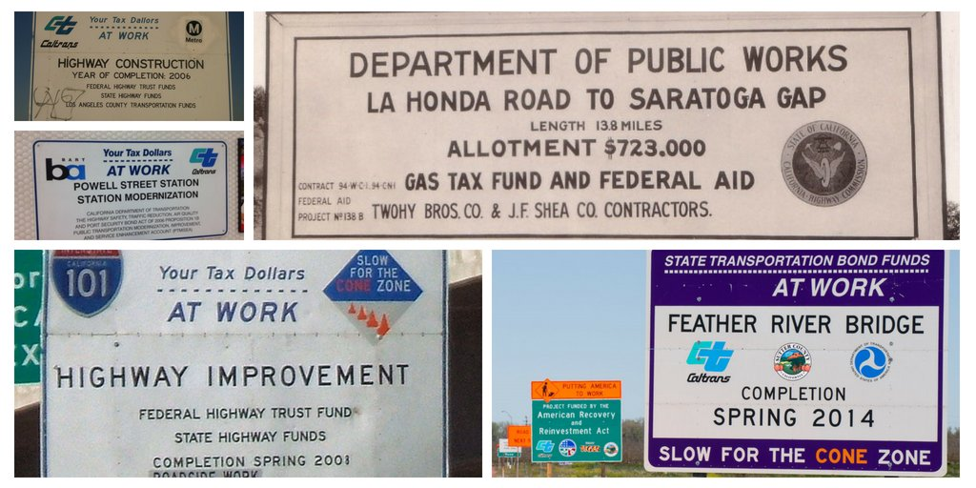
Informing the Public About How Taxes Are Being Spent

Slide 11
Institute for Local Government http://www.ca-ilg.org/
Public Agency Resources May Be Used To:
Prepare and distribute an objective and fact-based analysis on the effect a ballot measure may have on the agency and those the agency serves
Express the agency’s views about the effect of the measure on the agency and its programs, provided the agency is exceedingly careful not to advocate for or against the measure’s passage

Slide 12
Adopt a position on the measure, as long as that position is taken at an open meeting where all voices have the opportunity to be heard
Respond to inquiries about the ballot measure in an objective and fact-based manner
Vargas Case “style, tenor and timing” of communications
You can Educate,
But you may not
Advocate

Slide 13
Public Agencies Are NOT Allowed to:
Use public resources (including staff time) to campaign
Urge the public to vote “no”
Link to just one side of the debate on a ballot measure
When in Doubt
Consult County Counsel

Slide 14
Examples:
“This project is funded by SB 1” (good)
“This project (or others like it) will lose their funding if Proposition 6 is passed.” (likely good)
“Therefore you should vote no on Proposition 6”
(NOT GOOD)

Slide 15
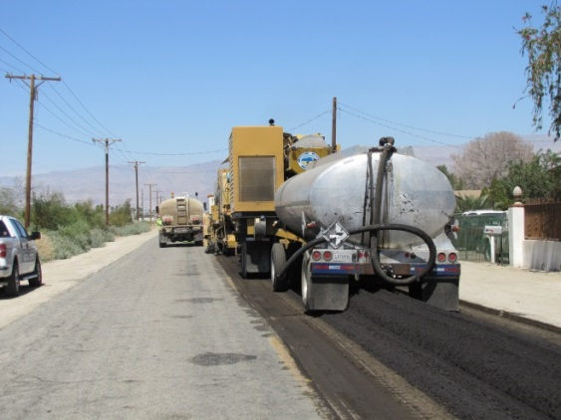
What Can You Do?
Publicize SB 1-funded road and bridge repair projects through normal means
Share your work with us at CSAC
  Photos, video, blogs, etc
Respond, when appropriate, to misinformation about transportation funding
Projects, Projects, Projects

Slide 16
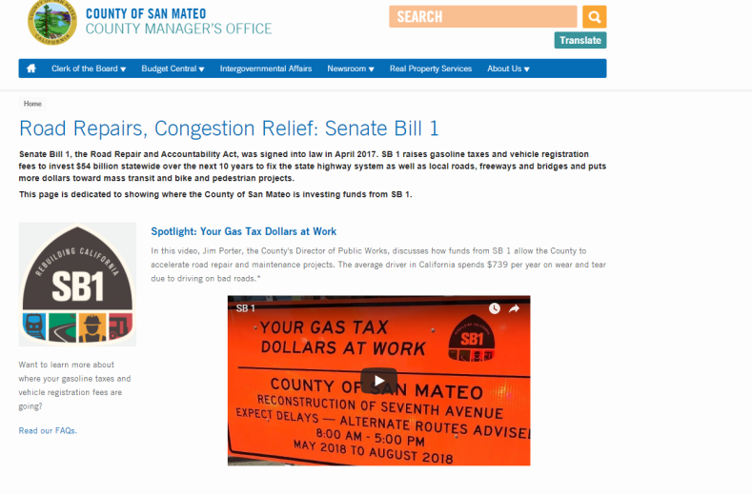
Publicize Your SB1-Funded Projects
You’re all pro’s but:
  News release or media event for major projects
  Pictures and Video
  Social Media/Website

Slide 17


Slide 18
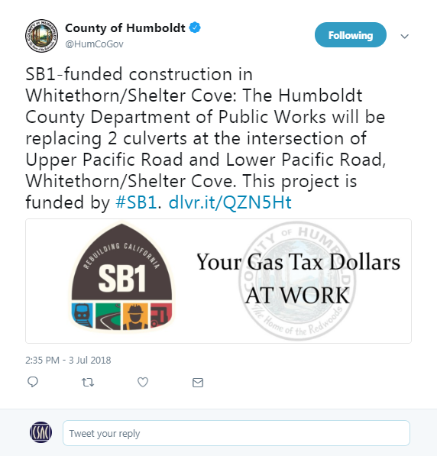
Humboldt County Tweet

Slide 19
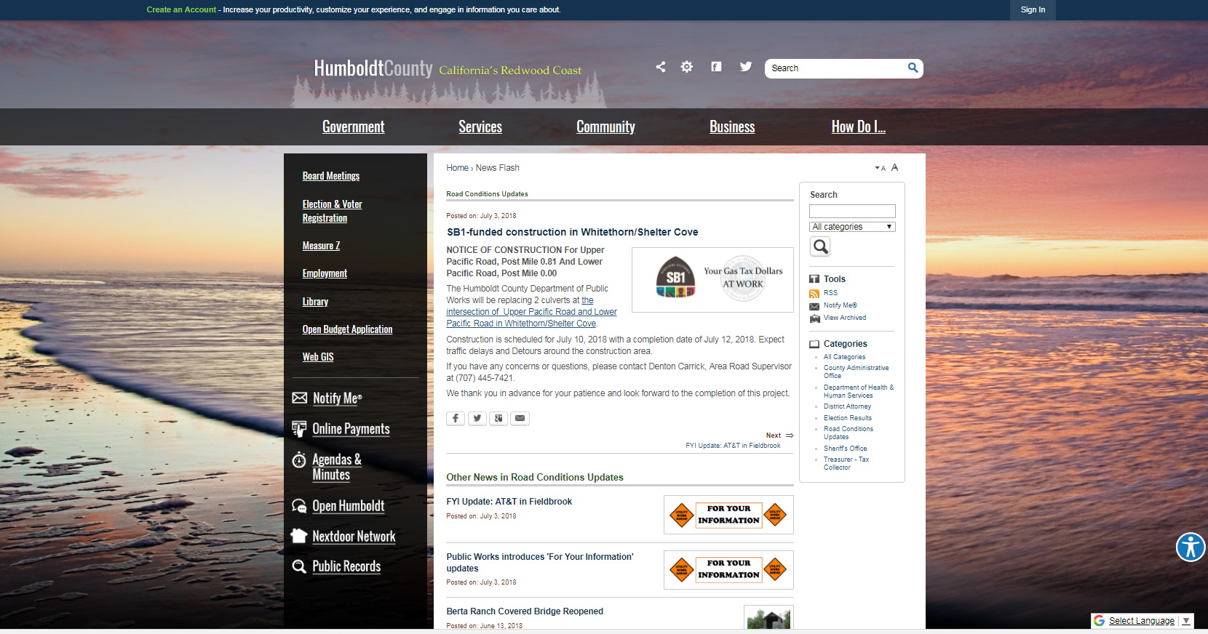
Humboldt County Webpage

Slide 20
Resources
CSAC SB1 Webpage
http://www.counties.org/post/sb-1-road-repair-and-accountability-act-2017
RebuildingCA.gov
http://rebuildingca.ca.gov
San Mateo County Video https://www.youtube.com/embed/_yyCZDD5Do0
ILG Document
http://www.ca-ilg.org/document/three-explanatory-resources-ballot-measure-activities

Slide 21
Questions?
Contact Information:
Kiana Valentine kvalentine@counties.org
916-327-7500 ext. 566
Jennifer Henning Jhenning@counties.org
916-327-7535
Gregg Fishman gfishman@counties.org
916-327-7500 ext. 516

