Slide 1
California’s Sharing Economy
CSAC

Slide 2
The Sharing Economy
What is it?
Renting goods and contracting for short-term services is not new, but was limited in the past due to information limits and other barriers
Sharing economy leverages the internet to connect consumers and suppliers with goods and services
Peer-to-peer or business-to-consumer

Slide 3
The Policy Debate
Why does the sharing economy prompt a policy debate?
Affects industries that have historically had significant regulatory frameworks
Affects areas where the government traditionally has collected taxes
Notes:
Land use, business, and consumer protections
TOT, business licenses

Slide 4
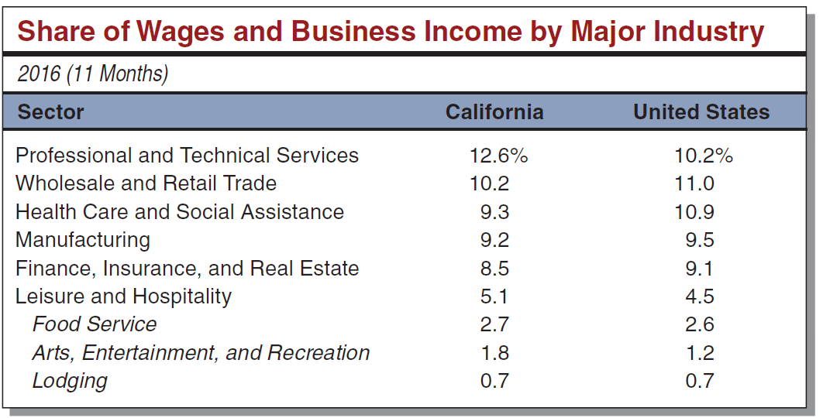
Trends in Leisure and Hospitality
California Tourism
Leisure and Hospitality relatively large sector

Slide 5
Trends in Leisure and Hospitality
Over 263 million person trips in 2015
Over 80 percent of these trips were for leisure
Over 90 percent of visitors were from within the US
Direct spending in California was almost $123 billion in 2015

Slide 6
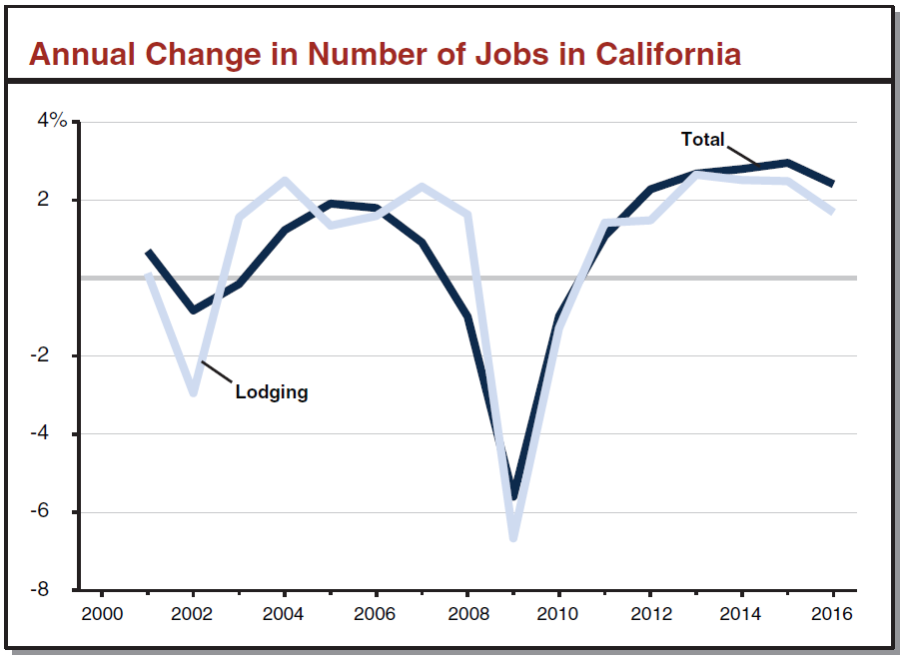
Lodging Jobs
Changes in Lodging Jobs Track Overall Employment

Slide 7
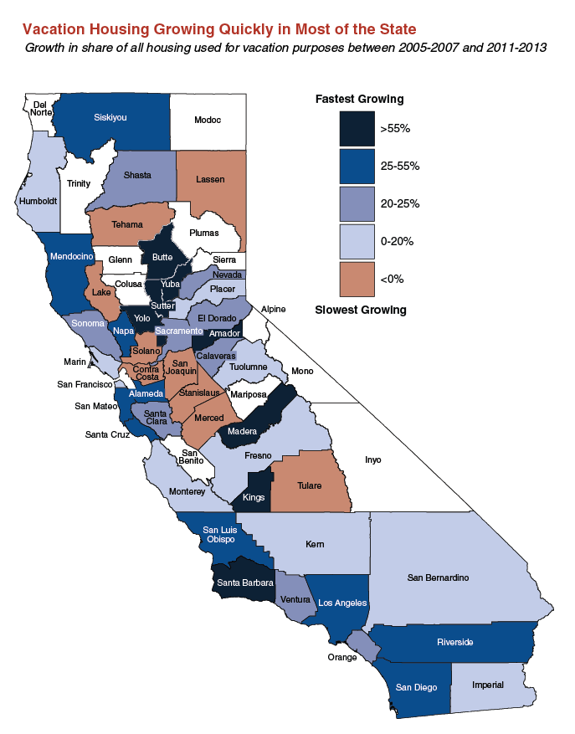
Second Home Trends
Notes:
This chart only goes up through 2011-13 estimates from the ACS, but this was in the run up…trends have flattened out now…still representative of picture.

Slide 8
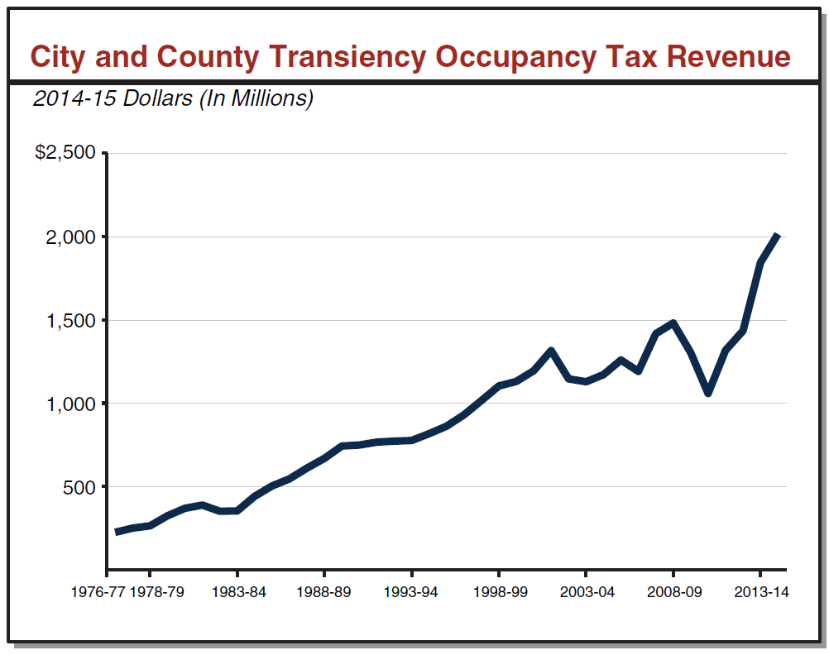
State and Local Revenues
Visit California estimates local tax revenue related to travel was $4.6 billion in 2015
Generally, TOT have
grown steadily over
the years

Slide 9
Collecting Transient Occupancy Taxes
Airbnb enters into agreements with local governments to remint local taxes for owners
Airbnb has agreements with three counties and 13 cities in California
AirDNA reports 110,854 active listings in California
HomeAway (including VRBO) requires owners to pay TOT themselves
Notes:
Do not know how Airbnb reaches these agreements. Recent Kansas agreement.
AirDNA has information by city for the state. Maps show where all the listings are located. Can pay for services for more information.
AirDNA lists the following as the most popular Airbnb cities:
Los Angeles
San Francisco
San Diego
San Jose
Oakland
Palm Springs
Venice
South Lake Tahoe
Berkeley
Big Bear Lake

Slide 10
Attributes of Home-Sharing
Generates income for providers
Visitors save money
Increases lodging infrastructure
Can provide additional tax revenue for local governments

Slide 11
Concerns with Home-Sharing
Can be inconsistent with land use policies
Many communities have land use policies that limit rentals of less than 30 days, but websites have listings throughout the state

Slide 12
Some Recent Efforts to Address Short-Term Rentals
Coastal Commissions concerns with affordability for visitors
San Francisco and San Diego recently vetoed cap on short-term rentals
Oakland moving to legalize and regulate short-term rentals
Palm Springs limited ownership and rentals
Notes:
Coastal Commission: View that short-term rentals offer lower cost alternative, giving more families the opportunity to visit the coast
San Francisco: …but the fines for not listing rental with city were upheld by federal court
Oakland: currently rentals must be greater than one week
Palm Springs: competing measures
Host Compliance: San Francisco startup that uses Internet meta data to find the location of homes offered on short-term rental sites to allow cities to curb listings

