Slide 1
San Juan Apartments
Promoting Green Means Go and Infill
Community Development
Planning and Environmental Review

Slide 2
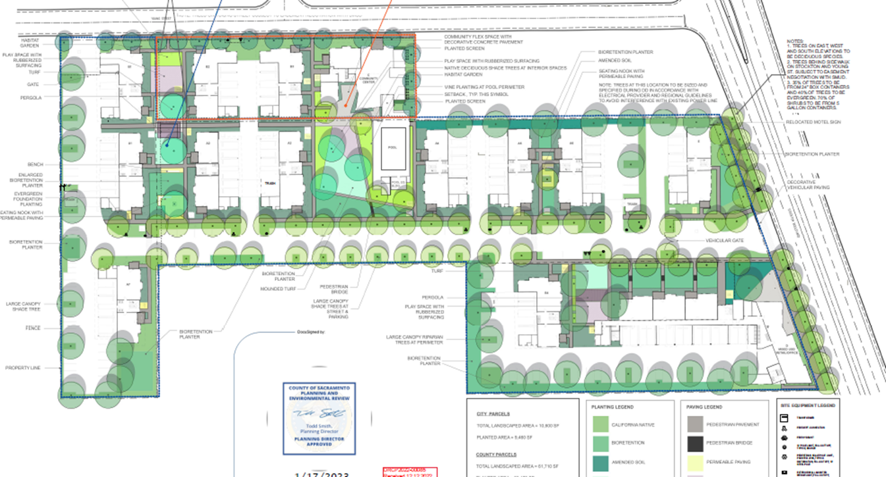
San Juan Apartments
160 dwelling units, infill, 100% affordable (below 60% AMI)
Community Building & Retail Uses

Slide 3
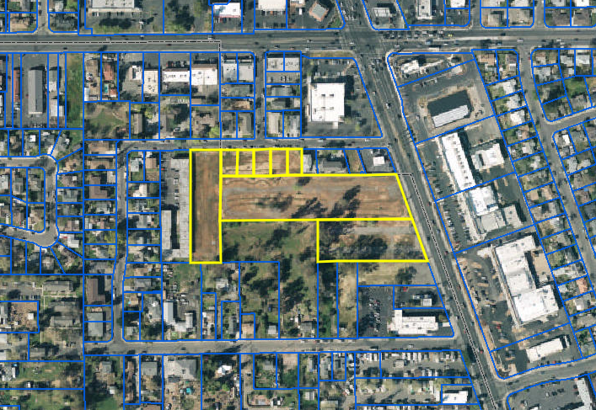
San Juan Apartments
Fruitridge Road
City of Sacramento
Stockton Blvd
County of Sacramento

Slide 4
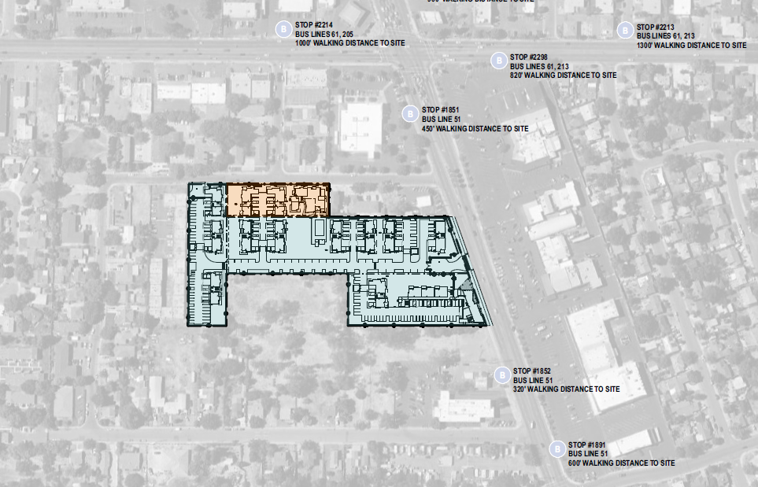
San Juan Apartments
City of Sacramento
County of Sacramento

Slide 5
San Juan Apartments
Coordination between the City, the County & SHRA
Former San Juan Motel site (County) and 5 single-family (City).
Dilapidated property obtained by respective Redevelopment Agencies in 2008-2012.
On Stockton Blvd. both County and City have efforts to promote infill and increase density.
Development in two jurisdictions
Coordination between the City, and the County was necessary to find consistency for overall design guidelines & drainage requirements.
Applicant worked closely with both jurisdictions to provide cohesive design for the project that met both Design Guidelines.
County acted as lead agency for CEQA.
Located in the County’s South Sacramento Environmental Justice Community
Supports additional development of housing to ease overcrowding
Supports County’s EJ & Housing Element Goals to support additional affordable housing in the EJ Community.

Slide 6
Green Means Go
Project received $2 million Green Means Go grant from SACOG
Category A - “Early Activation” project to fund offsite infrastructure improvements for San Juan Apartments.
Joint application
Sacramento County, City of Sacramento, Mutual Housing.
This grant would pay for:
Extension of domestic water, sewer, and stormwater service
Undergrounding of power lines.
Undergrounding power lines on Young St.
Water & sewer extension on Stockton Blvd.
Final Engineering TBD.

Slide 7
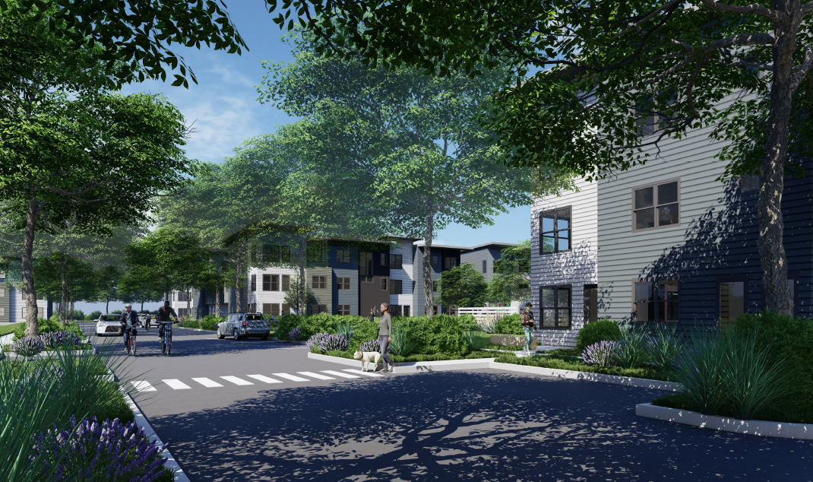
San Juan Apartments

