Slide 1
The Solano County Safety Net Consortium – A collective impact initiative to address poverty
Presentation to CSAC
Stephan Betz, PH.D.
Deputy Director, Solano County Health and Social Services
April 22, 2015

Slide 2
The Consortium: Steering Committee consists of representatives from County agencies, County Administrator’s Office, First5Solano, Kaiser Permanente and community based organizations. - Four workgroups: Community Schools – build a pipeline from HS to job placement, use health and social services as wrap around (AB 86 now added) Work for All – created an Employment First Initiative – all human services contacts include a question regarding employment and career Word Gap – 7,000 by 7: reach out to schools to teach 7,000 words to young children before the age of 7 Safety Net – address food security by bridging food deserts to food banks

Slide 3
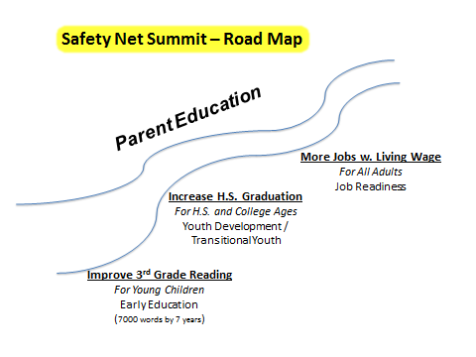
PLTI:
Community Ambassadors:
25 parents

Slide 4
Steps to Action
Reached out to seven cities, seven school districts, the County Board of Supervisors and created a Statement of Commitment - Resolution
Clarified and continue to clarify roles and responsibilities of community based organizations – mapped out who is doing what – Network of Care website
Identified a Taxonomy of services needed to address poverty issues
Connected to regional efforts – Alignment with the Road Map and Northbay Employment Connection, Contra Costa County, Rise Together
• Increased community wide communication – Network of Care groups
Members of the Board addressed seniors in poverty,
• Put infrastructure in place for programmatic activities - Future

Slide 5
A Special Case: “Employment First” Why are “middle skill” occupations important? Top two reasons: 1.The category that will create the most new jobs over the next 10 years is middle skill jobs 2.Middle skill jobs pay substantially more than low skill jobs median annual wages: $25K for low skill jobs $43K for middle skill jobs Every human services case management “touch” includes a conversation about gaining employment / advancing career.

Slide 6
The Networking Effect: A Case Study

Slide 7
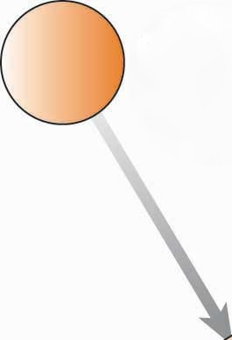
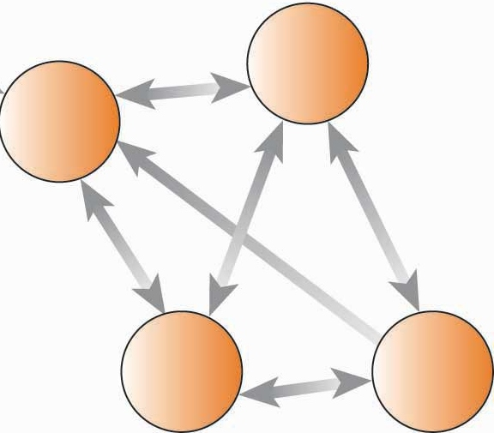
Social Network
Apt
FIA Volunteers
Apt
Robert/FIA
Marie
Apt
Rochelle
Senior Coalition
Maggie
Villages of Solano
Alma
Tracee/PEAS
Sandy
PEAS/AAA
Dollie
Dianna Chronic Disease
Laura Fall Prevention

Slide 8
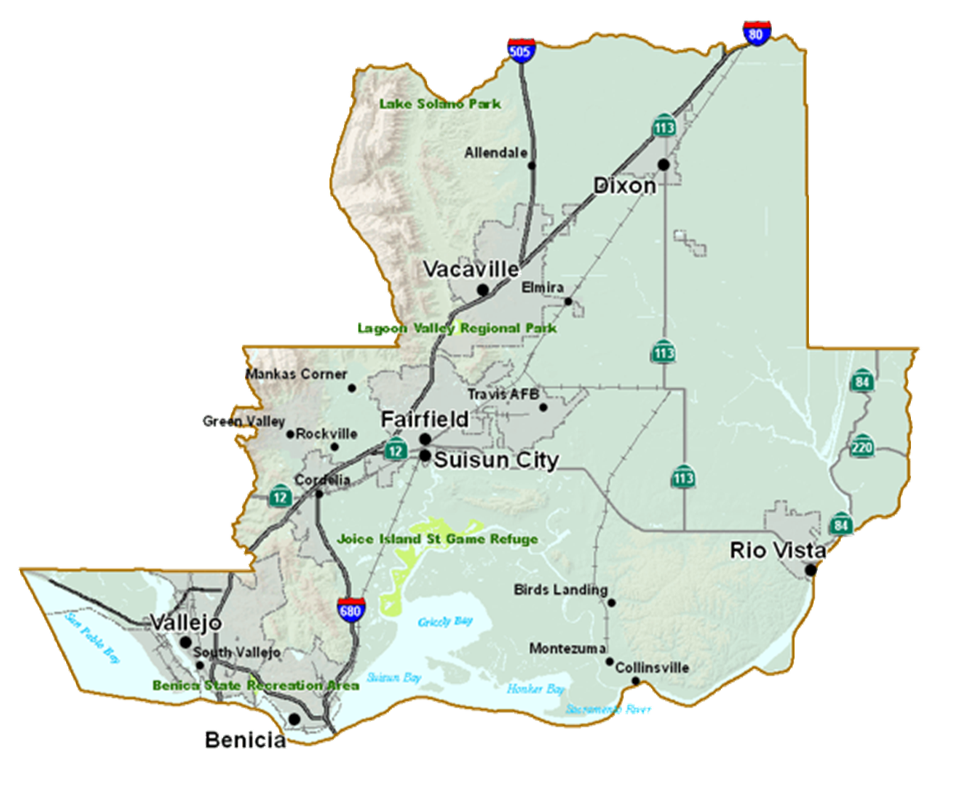
Social Network Clusters
Local civic groups, services, business, churches
FIA
YANA
Parkway Pl
Local civic groups, services, business, churches
Local civic groups, services, business, churches
Sr Manor
AAA
Kare Bears
Food Bank
SCSC

