Slide 1


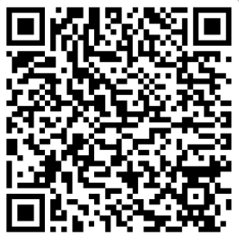

HLT Materials are:
Available on the table corner
Can be downloaded with the QR Code:
Welcome
Notes:
For today’s presentation I’m covering…

Slide 2
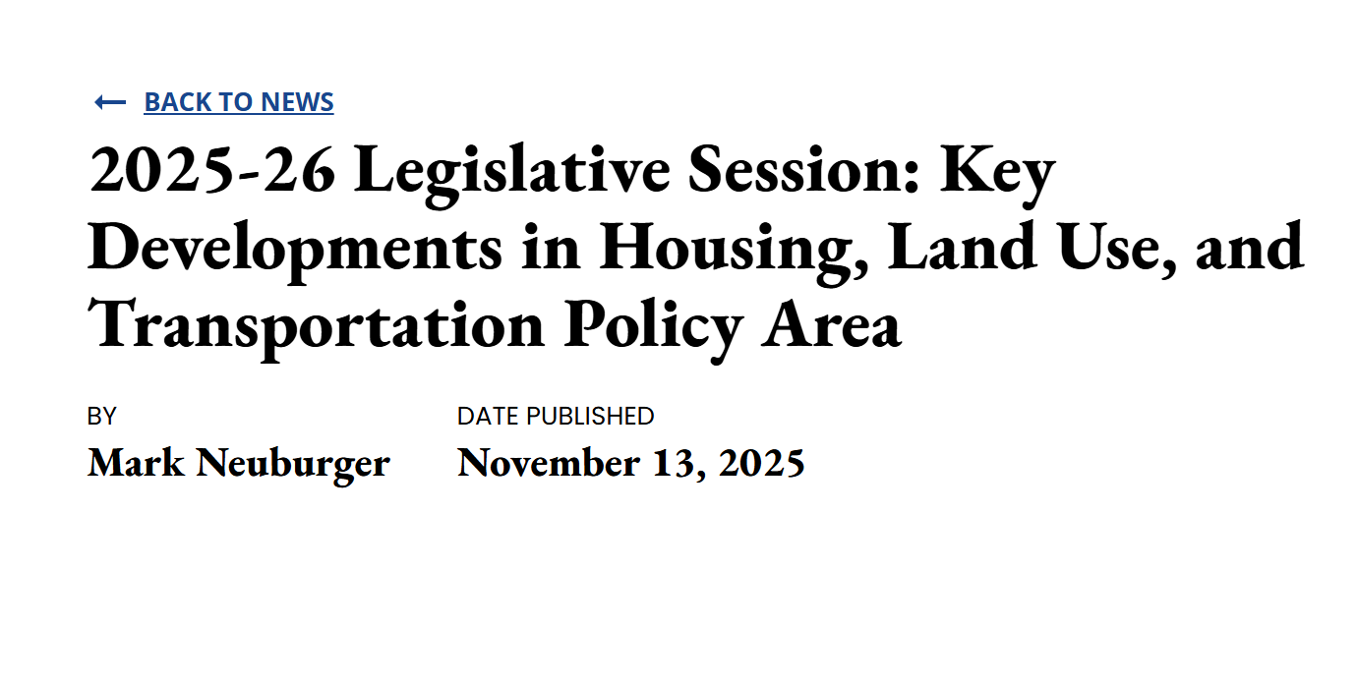
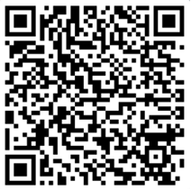
2025 Legislation Update
More available in the CSAC Bulletin:
Or in the HLT Annual Meeting Packet:

Slide 3
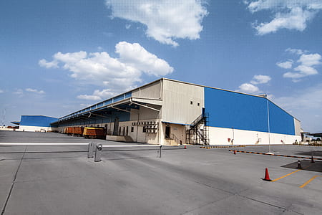
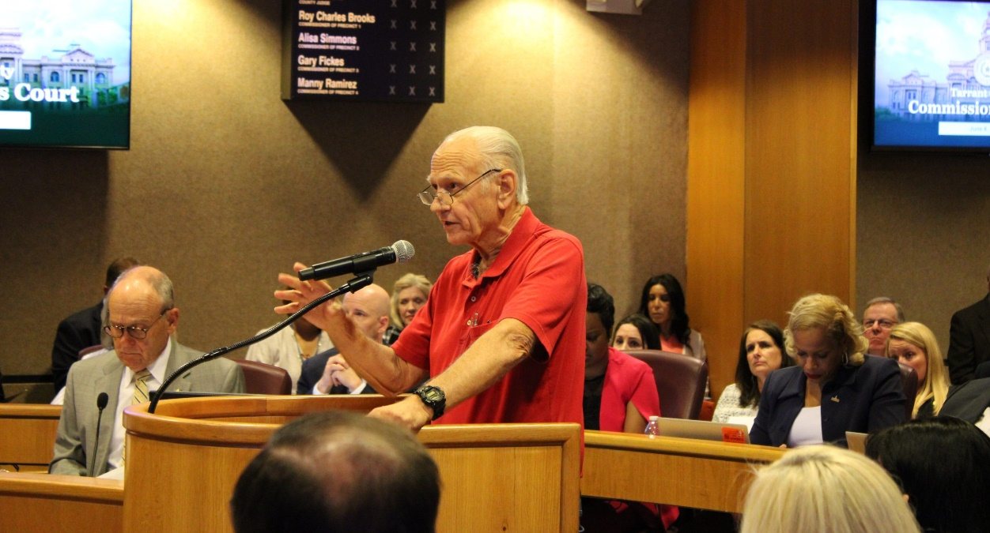
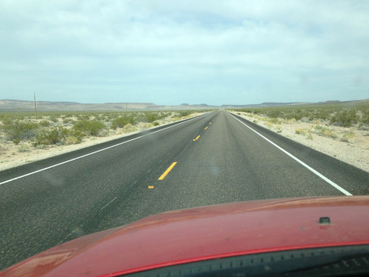
2026 Legislative Outlook
What to expect in 2026…
Affordability
Any bill that developers can make the ‘time is money claim’
Development & Mitigation Fees
Developer effort to eliminate, delay or transfer fees to homeowners
Transportation
State Efforts to Extend SB 1
Federal efforts on Surface Transportation Reauthorization
Notes:
What to expect in 2026…more of the same.

Slide 4
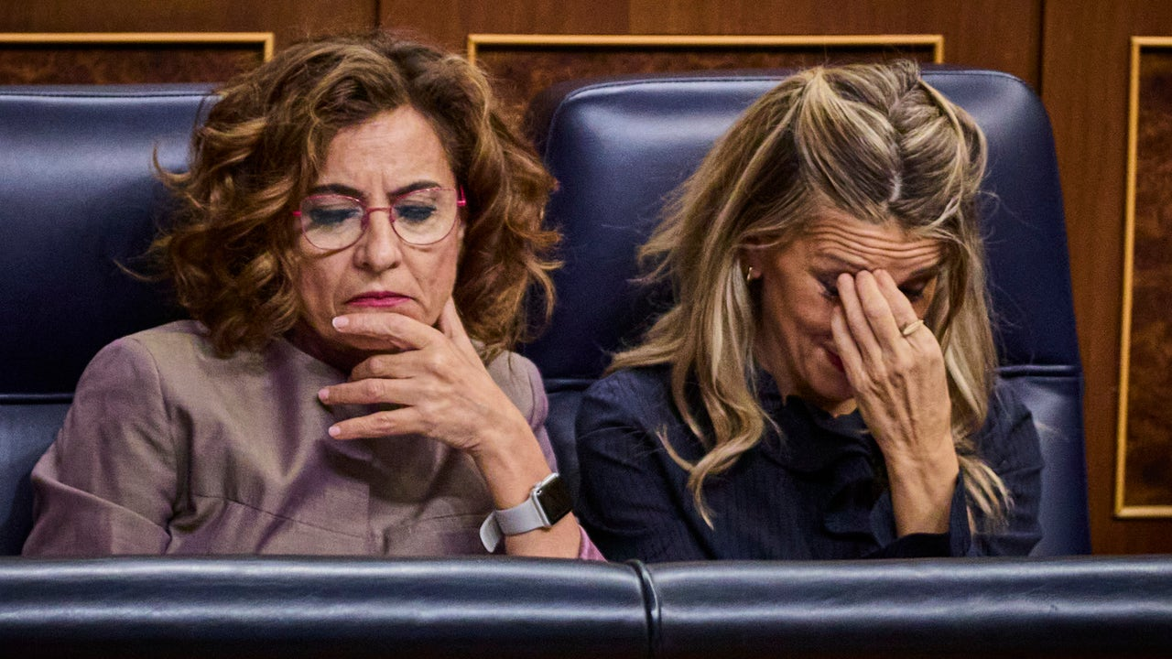
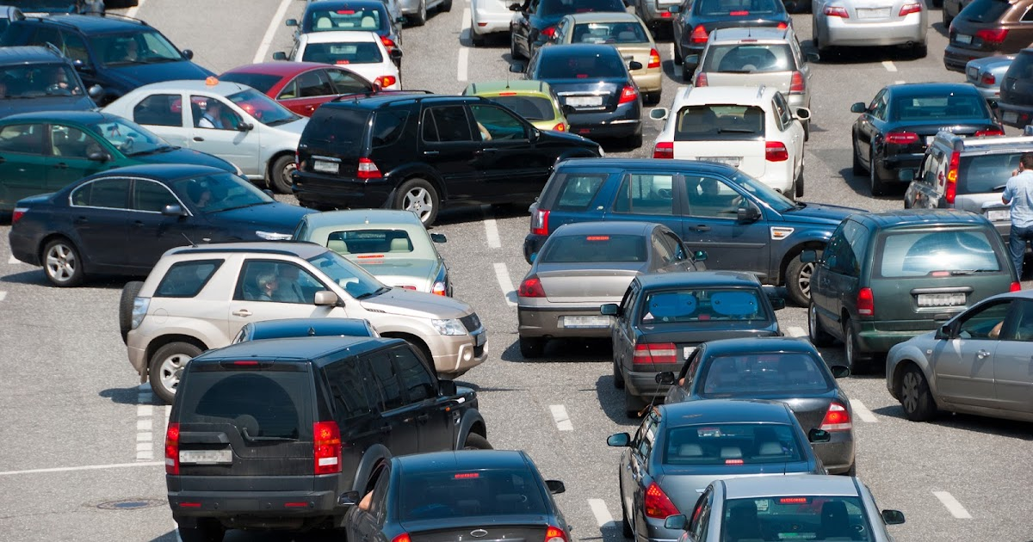
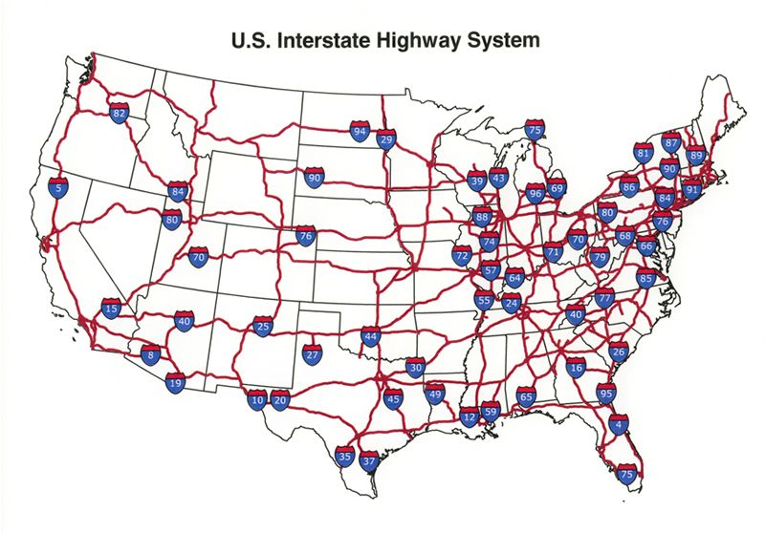
2026-27 Budget
Top Line:
LAO estimates a $18 billion budget deficit
Forecasting deficit will expand to $35 billion in 2027-28 Budget
What To Expect:
Efforts on state Housing Bond
Proposal includes funding for housing & infrastructure
Initial Efforts on State Transportation Funding
Potential for Road User Charge
Depends on ‘revenue solutions’ in General Fund Budget
May include mix of fuels and registration changes
Federal Surface Transportation
Timing of these developments may alter state efforts
Notes:
Top line, transportation programs retained $1.3 billion in General Fund allocations provided in past budgets and almost $600 million in GGRF, also known as Cap and Trade funding, f
However, many of the programs had their funding commitments shifted to out years and are dependent on optimistic GGRF auction revenue estimates.
Finally, despite a notable cut, the ATP program still received $100 million in funding in the budget.

Slide 5
2026 HLT Priorities- ACTION ITEM
HLT Committee Leadership is proposing the following priorities for the HLT unit to advocate on in 2026:
Advocate for Stable Transportation Funding
Balance Support for More Housing with County Land Use Oversight
Permit Processing Efficiency and Staff Cost Recovery
Notes:
What to expect in 2026…more of the same.

Slide 6
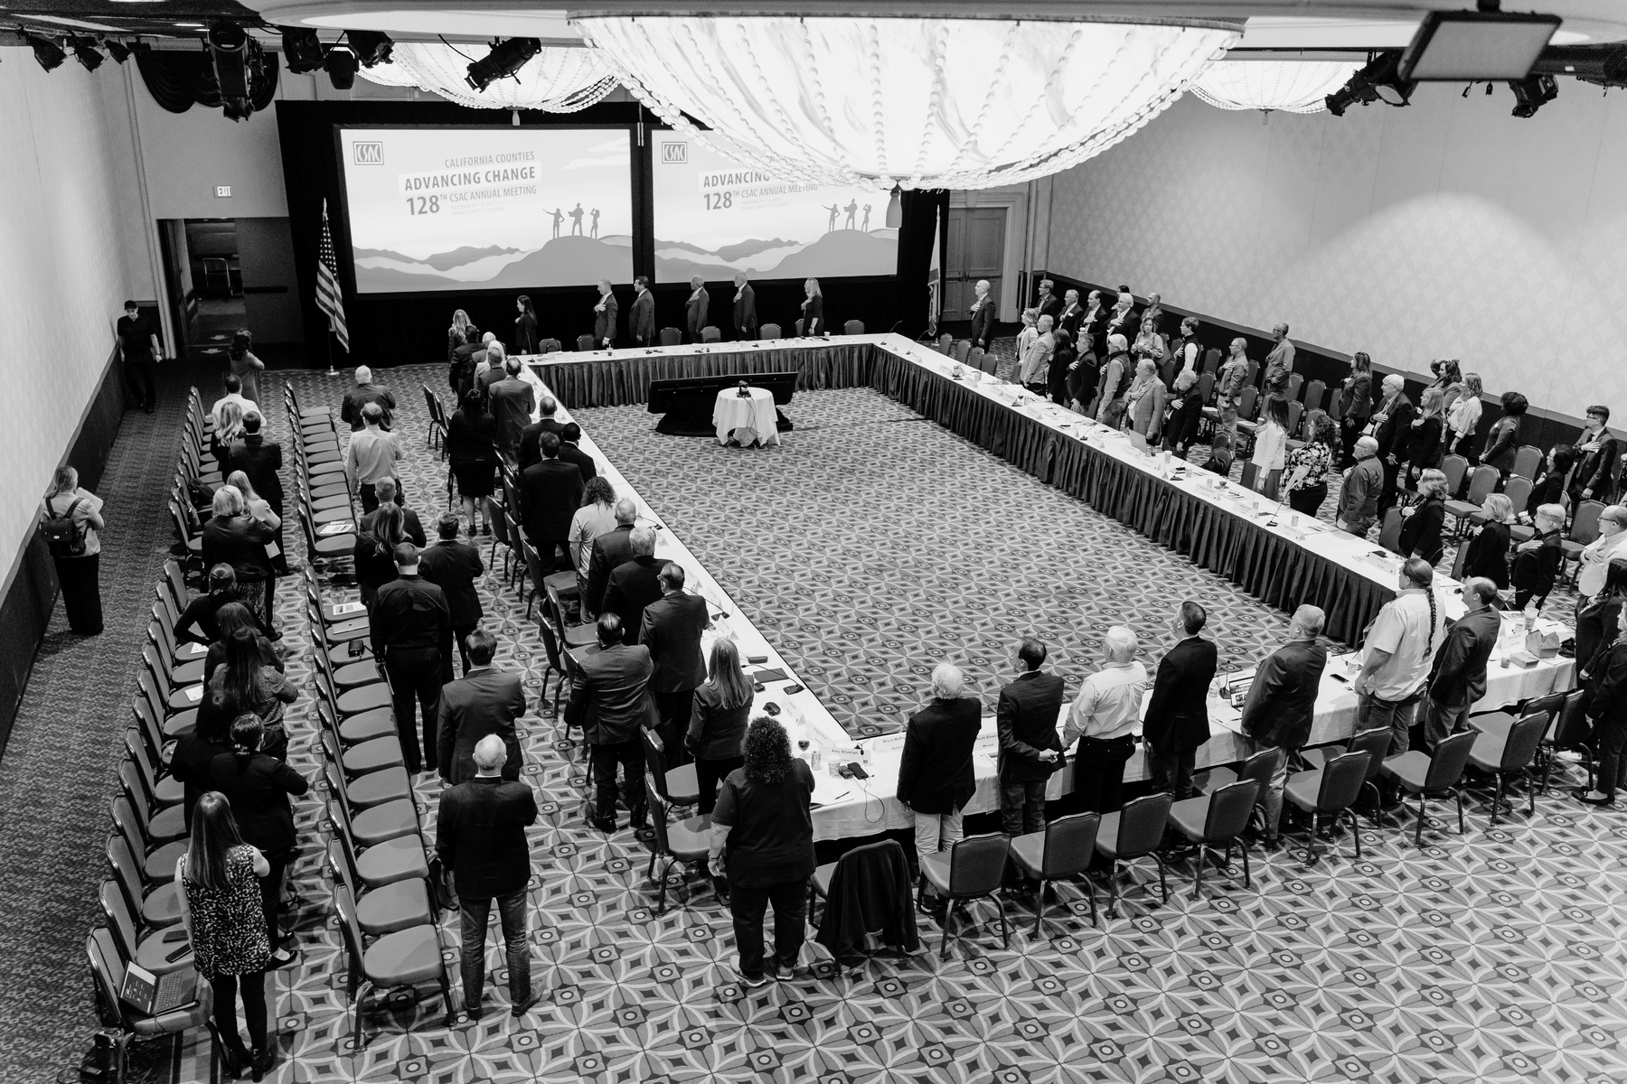

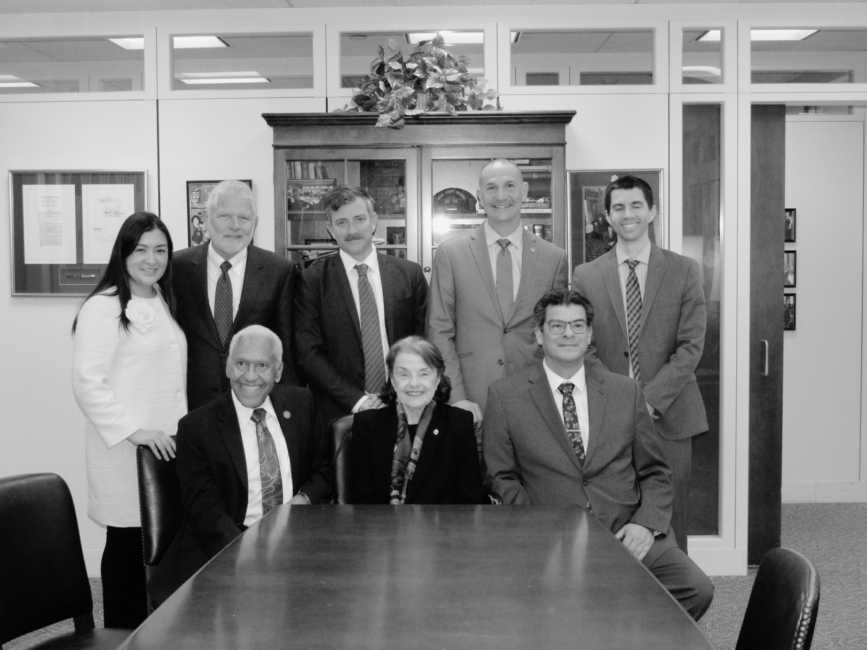

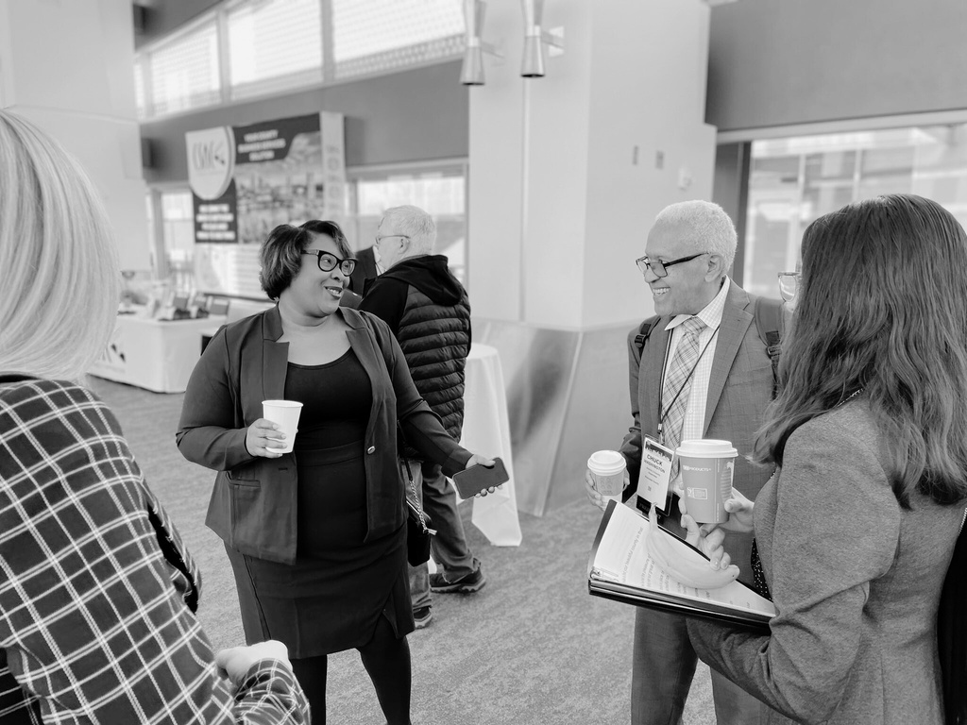
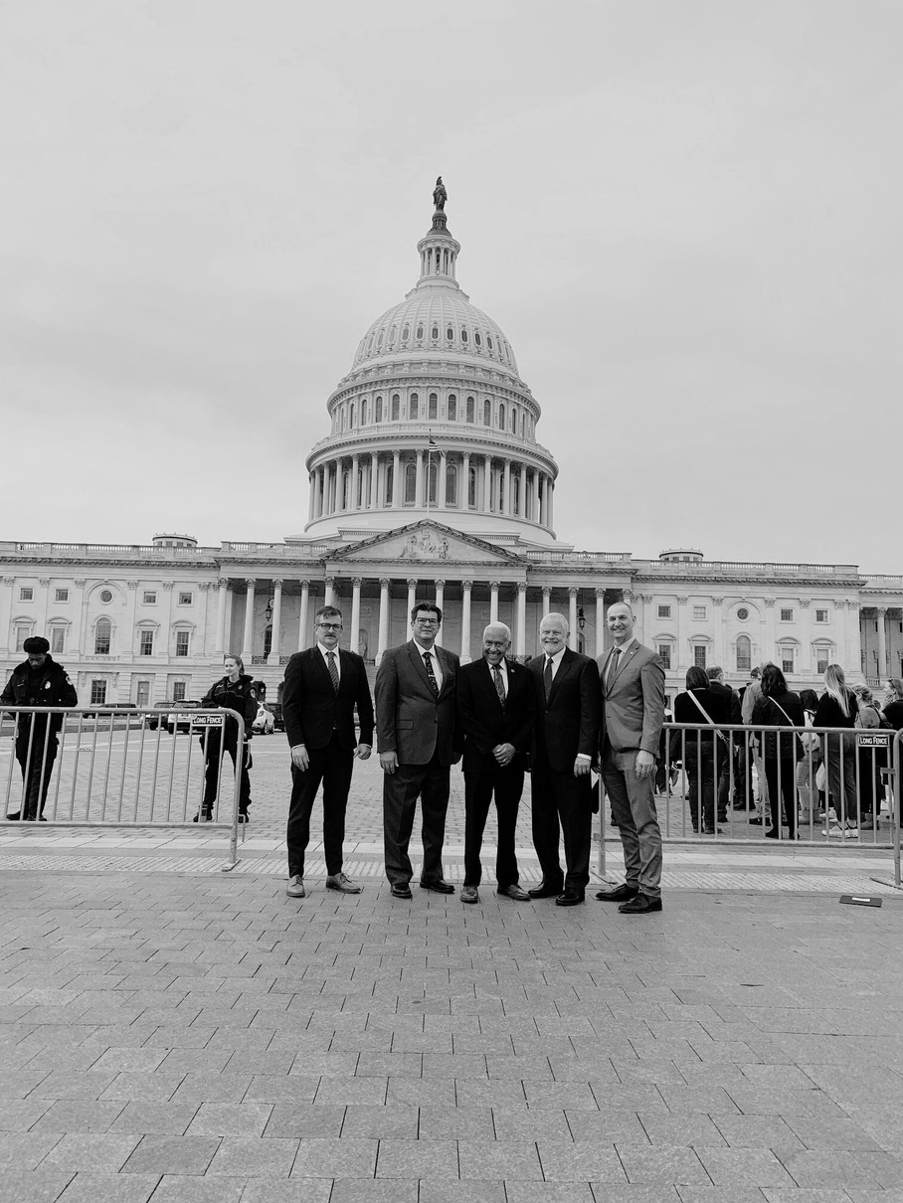
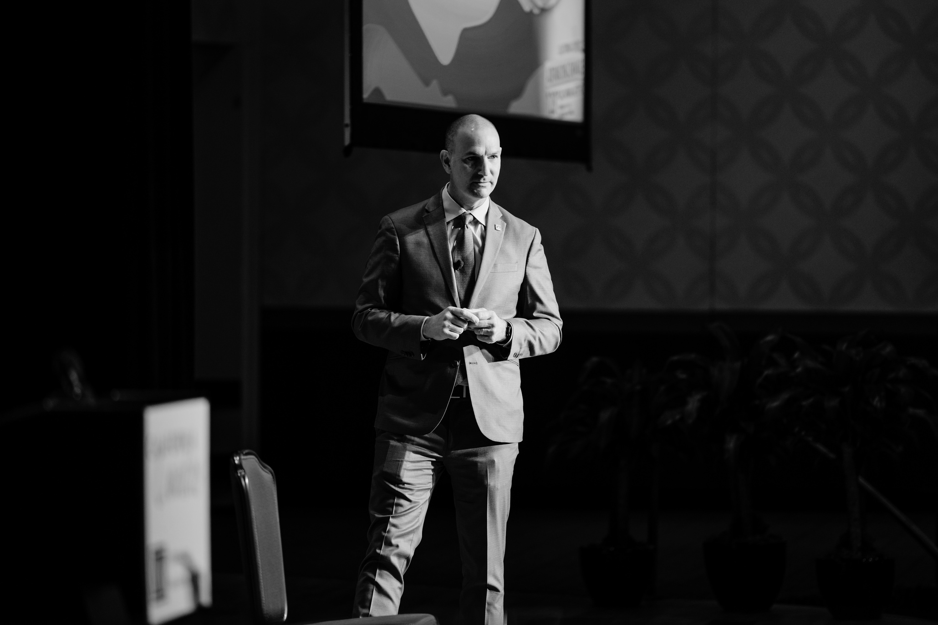
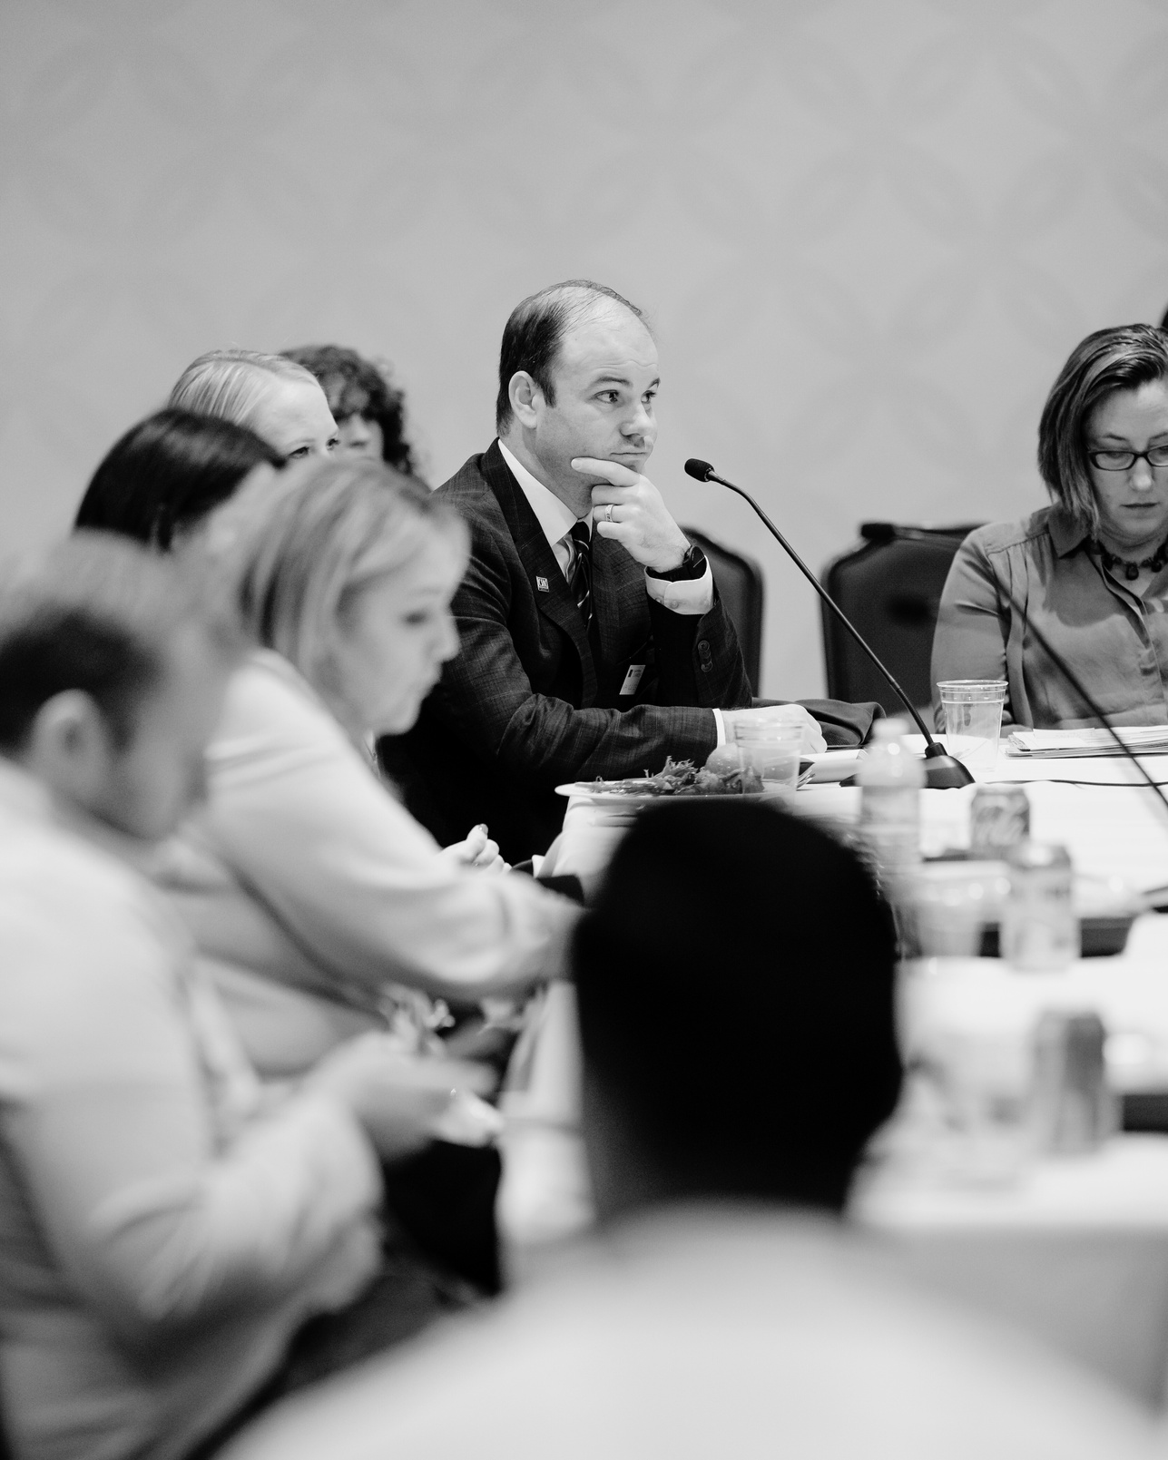
THANK YOU
Mark Neuburger
Housing, Land Use & Transportation Committee
mneuburger@counties.org
Copyright 2025 by California State Association of Counties®
Notes:
Thank you all for attending and for your attention today.

