Slide 1
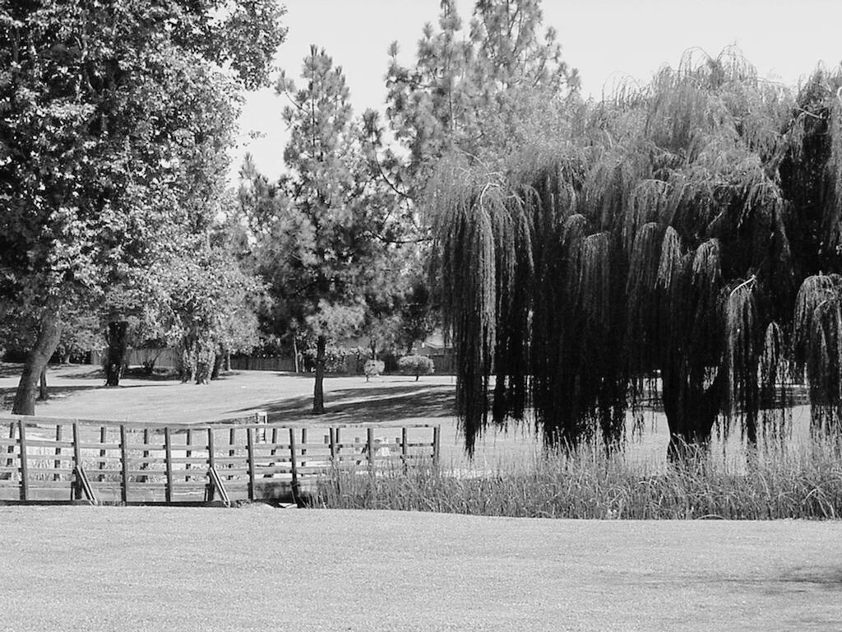

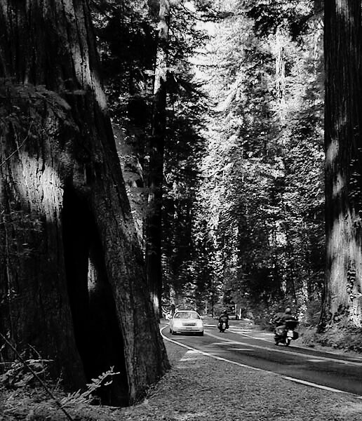
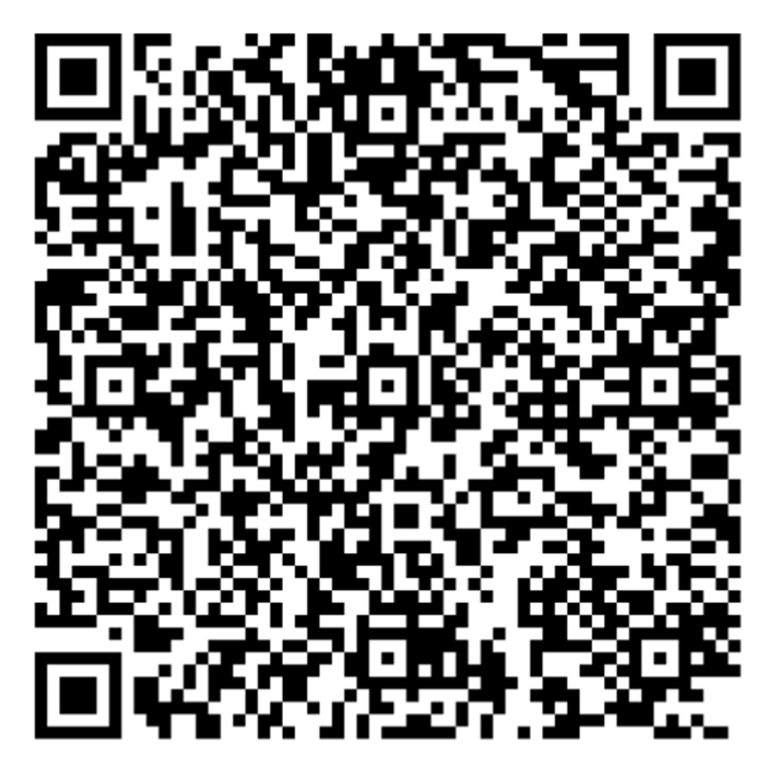

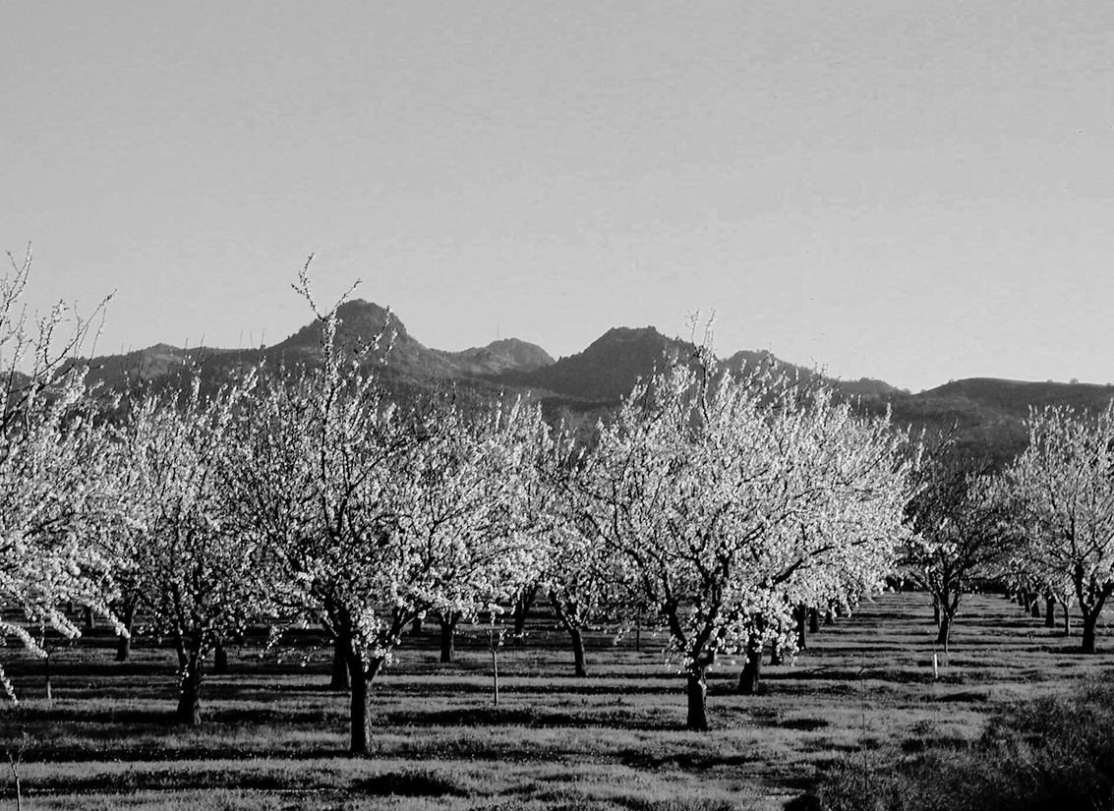
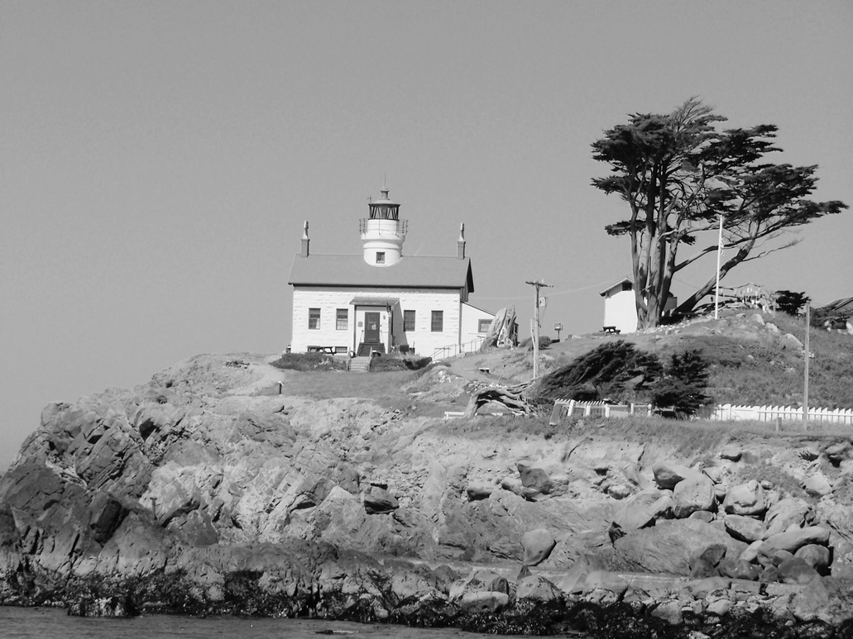
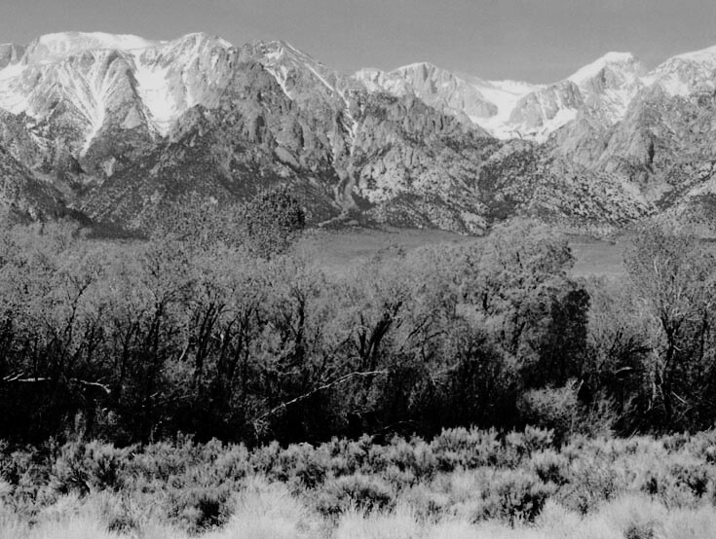
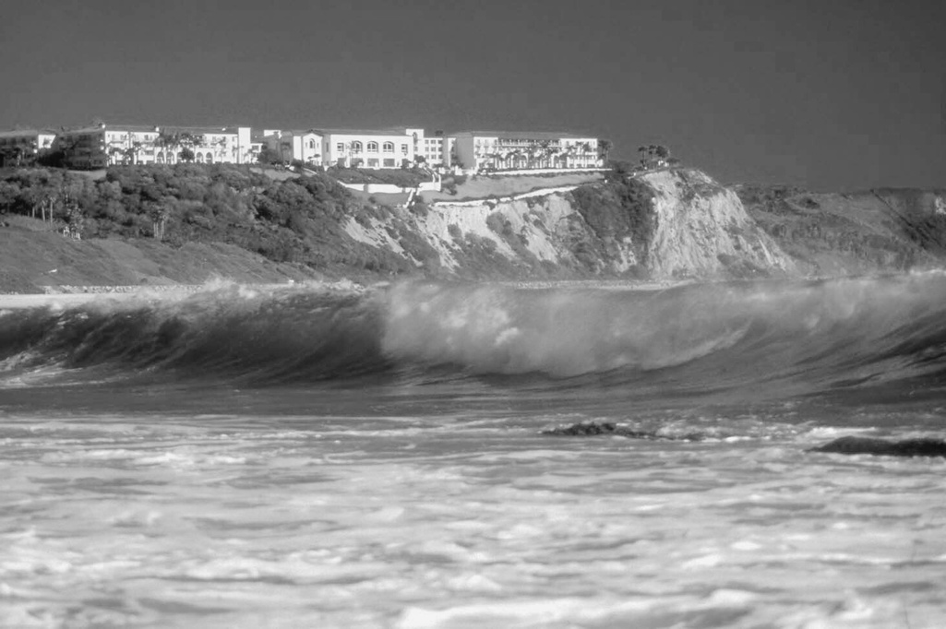
Legislative & Budget Update
Mark Neuburger, HLT Advocate
May 2026
Notes:
Good Morning, I’ll be providing you all with a quick update on a few legislative and budget issues.

Slide 2
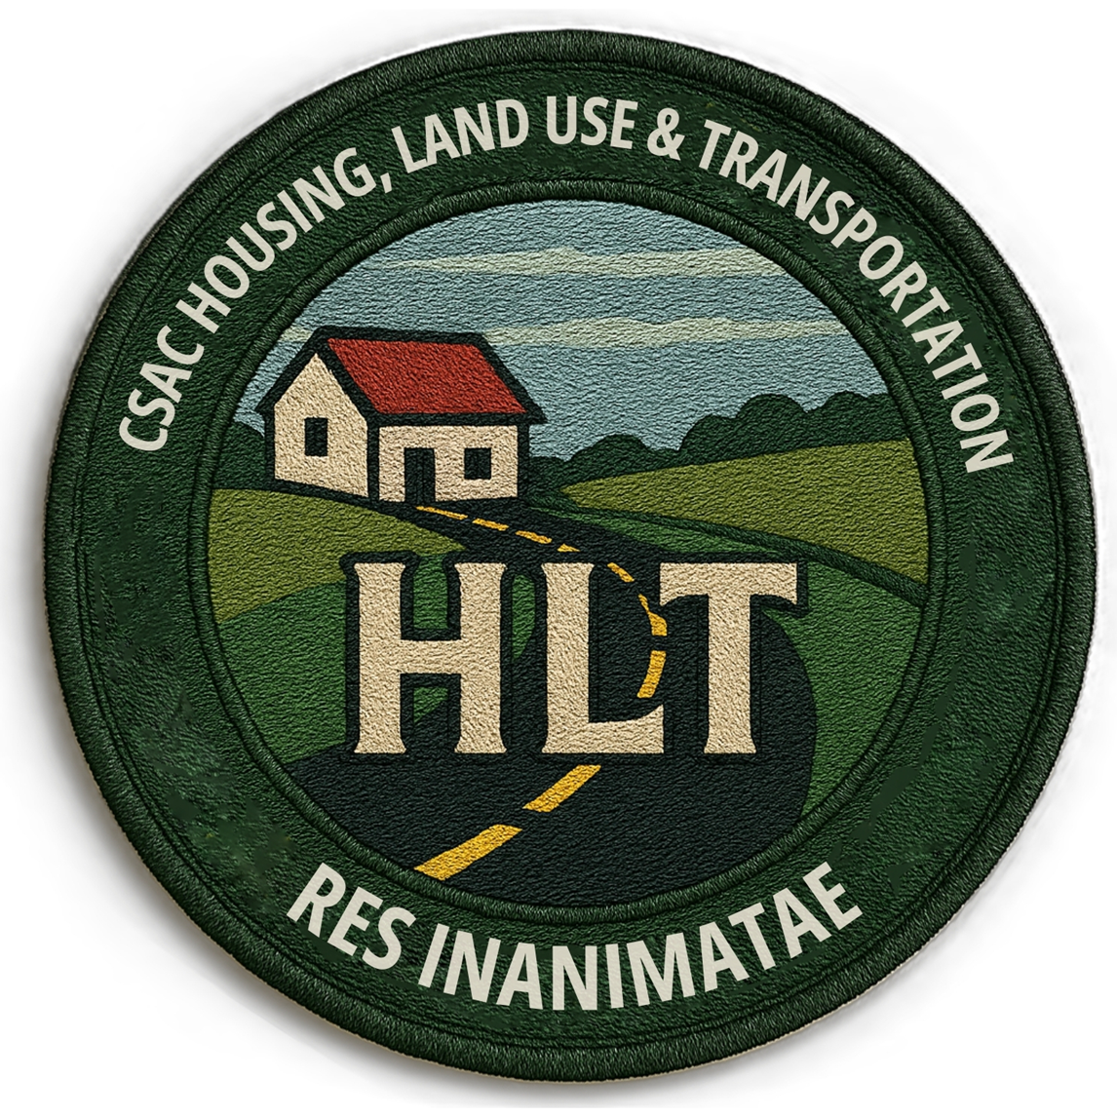

Welcome
  HLT Materials are:
  Available on the table corner
  Can be downloaded with the QR Code:
Notes:
For today’s presentation I’m covering…

Slide 3
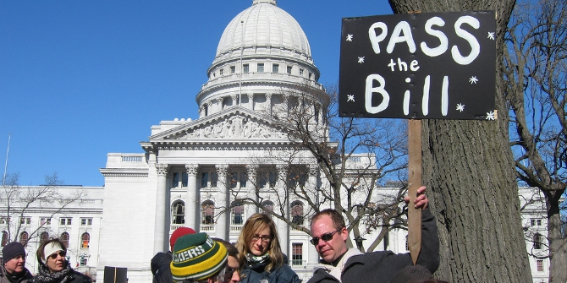

2026 Legislative Update
Notes:
Now on to a quick update of relevant bills from this past session and their outcomes.

Slide 4
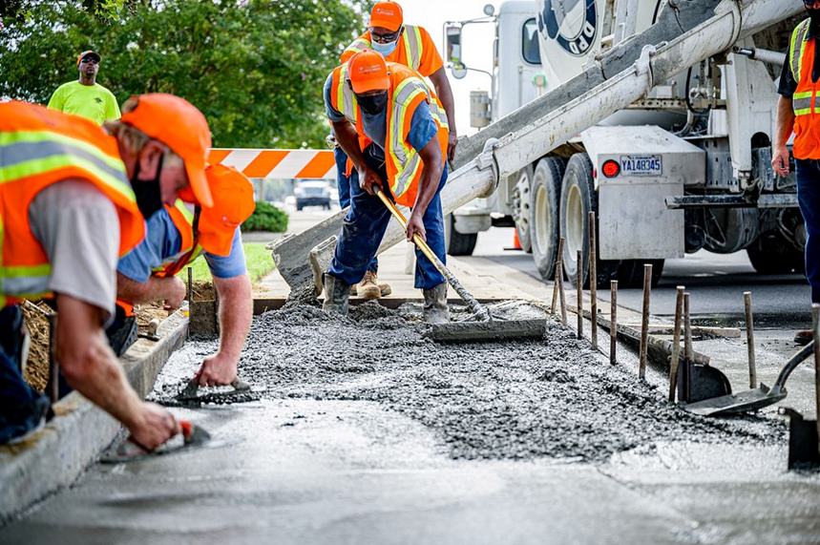
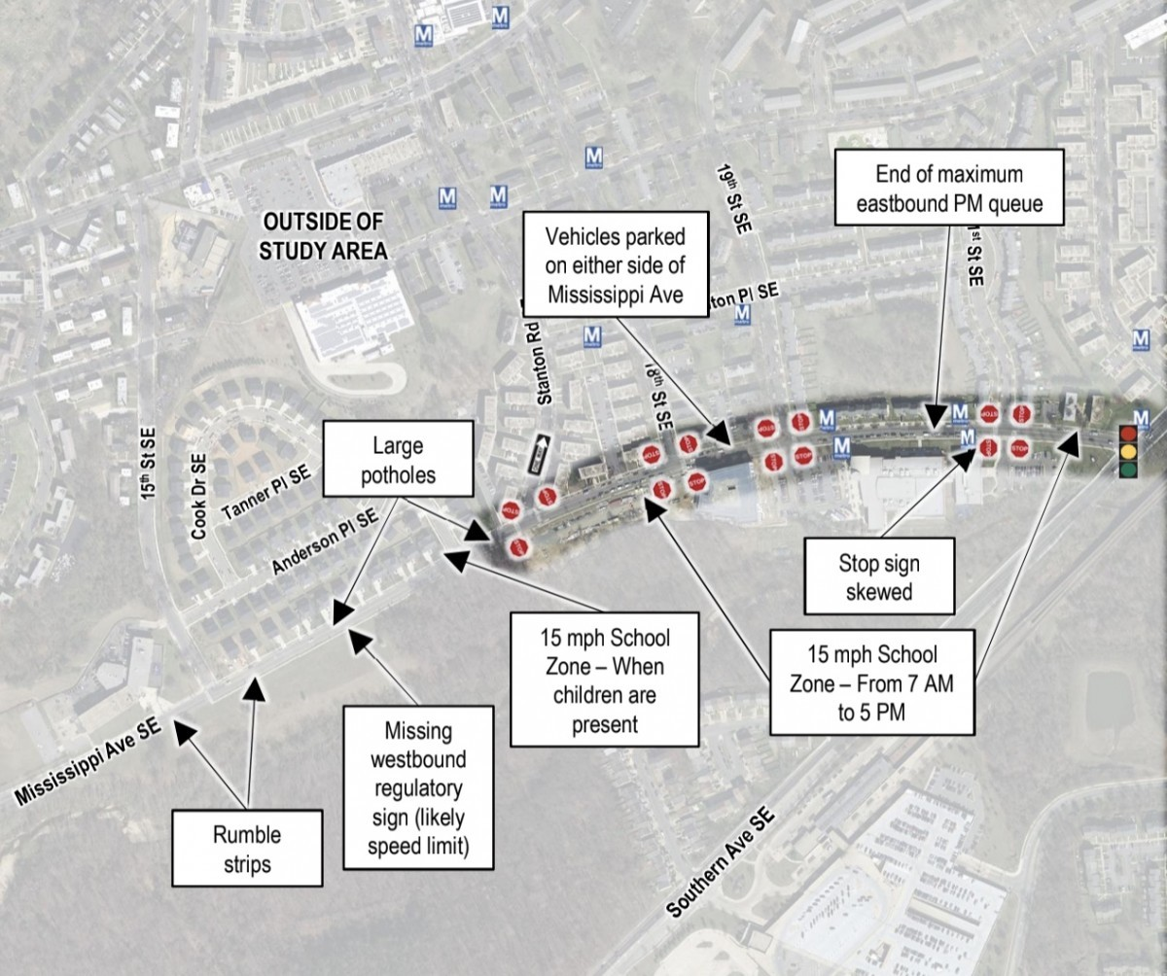
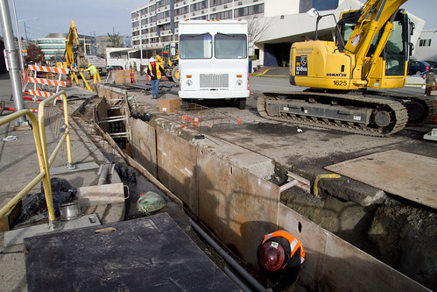
2026 Legislation Update
Land Use & Planning
  CHECK POST-APPROPS BILL
Building Issues
CHECK POST-APPROPS BILL
Public Works
  AB 1198: Requires wage increases to take effect during construction phase of PW project.
  AB 1859: Requires counties to give labor reps access to construction site if “consistent w/ job safety & security” to confirm wage compliance
  SB 935: Makes Design-Build Auth Permanent
Notes:
First up AB 2535, I’m citing this more of an example of the continuing policy discussions on how and to what extent state transportation funding programs are modified with the notion of furthering the states GHG reduction goals.
SB 768 would have required the Transportation Agency to conduct a study of VMT’s impact as a metric in assessing transportation project impacts, but the bill sadly died in the process.
Finally, SB 1216 limits the roads on which shared bikeways, also known as ‘sharrows’ can be used. I note that CSAC participated in the discussions to make the bill workable for counties.

Slide 5
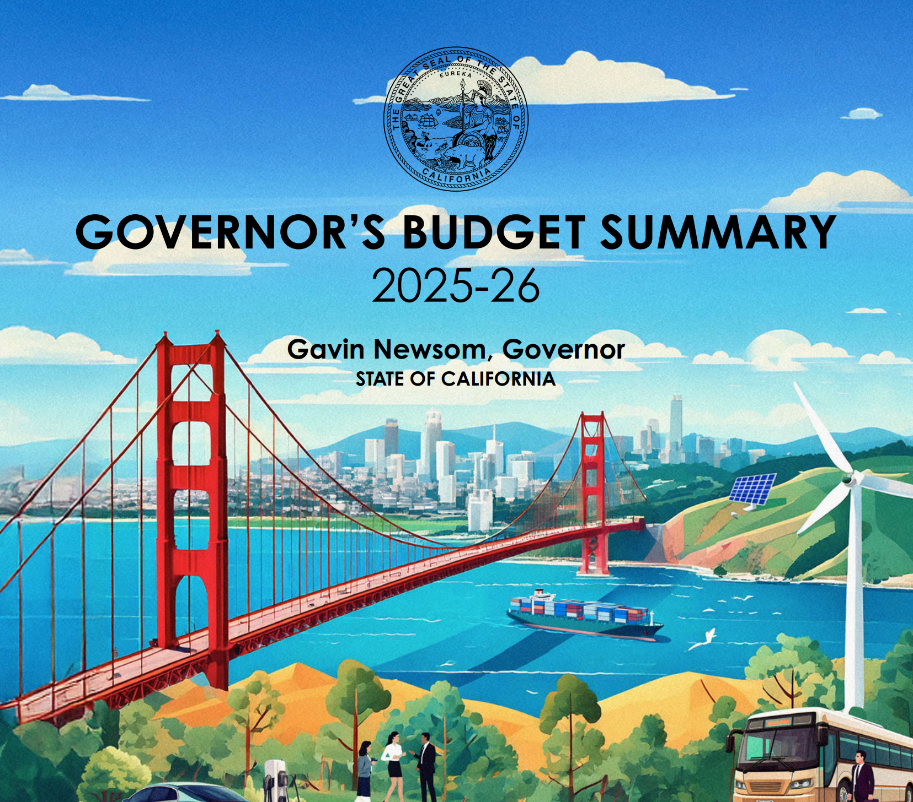
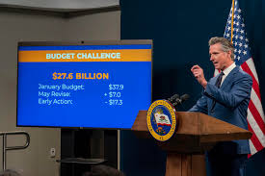
2026 Budget Update & Outlook
Notes:
Now on to a quick update on the 2024 state budget.

Slide 6
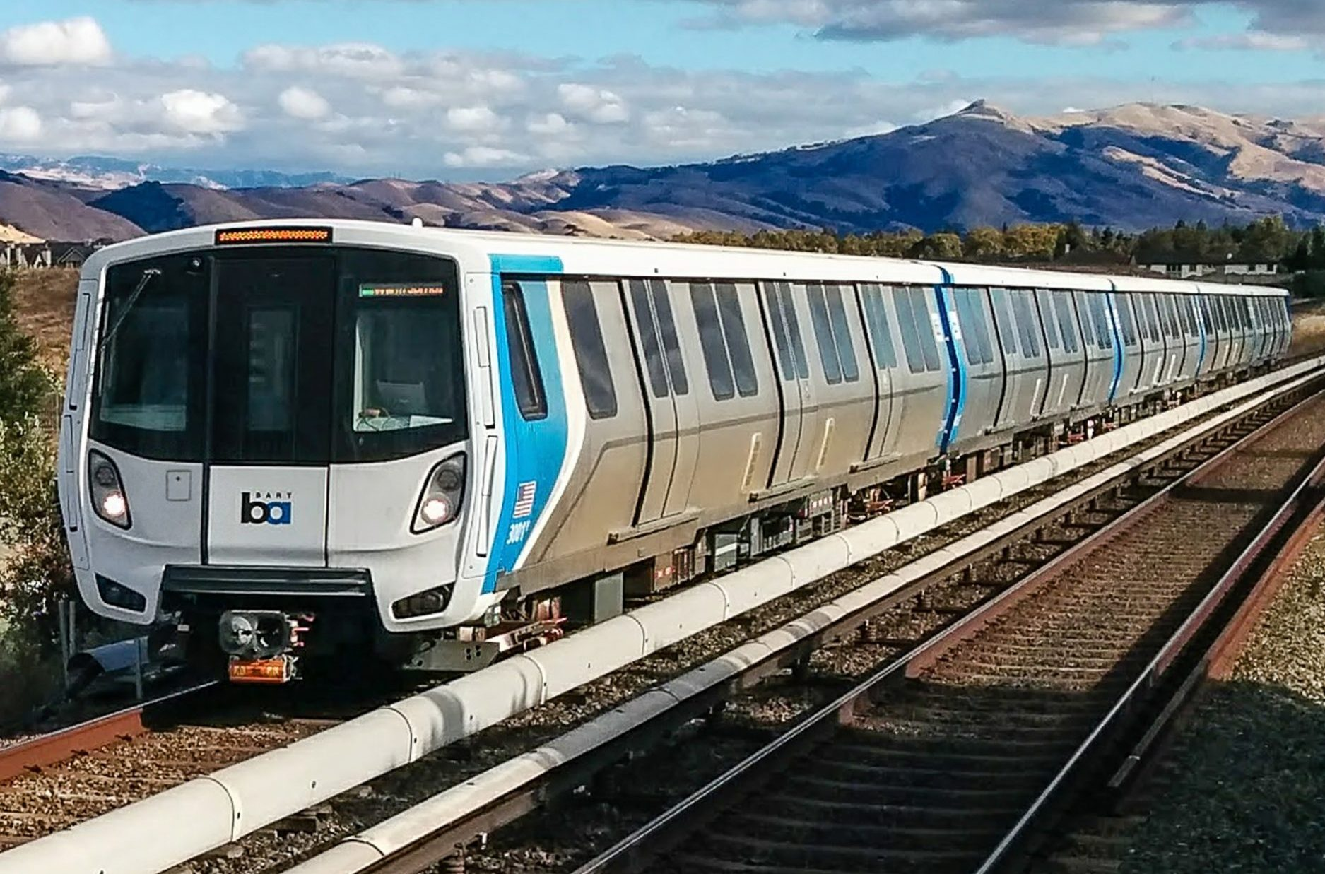

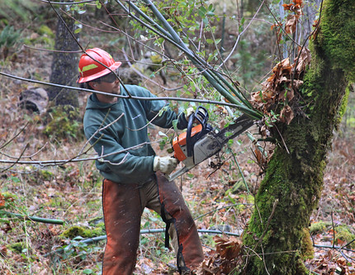
2026-27 May Revision Budget
Transportation:
No new notable funding proposals for roads or ATP in Transportation area
Proposal for Sustainable Aviation Fuel (SAF) would divert funding form county Local Streets & Road (LSR) Program revenues.
Affordable Housing Impact Fee
In applications for competitive state housing funding after 7/2027:
Incentive: Gives project credits as ‘local match’ when a county defers, reduces or waives impact fees.
Mandatory: Requires waiver of county impact fees when the county is the lead or co-applicant for funding.
LCI: CEQANet Fee
LCI (fmr. OPR) is levying filing fees on counties for materials that are required to be submitted to the state
This Photo by Unknown Author is licensed under CC BY
This Photo by Unknown Author is licensed under CC BY
Notes:
Top line, transportation programs retained $1.3 billion in General Fund allocations provided in past budgets and almost $600 million in GGRF, also known as Cap and Trade funding, f
However, many of the programs had their funding commitments shifted to out years and are dependent on optimistic GGRF auction revenue estimates.
Finally, despite a notable cut, the ATP program still received $100 million in funding in the budget.

Slide 7
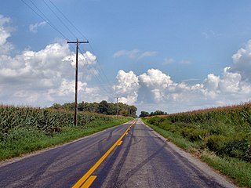
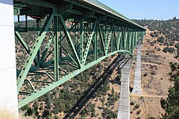
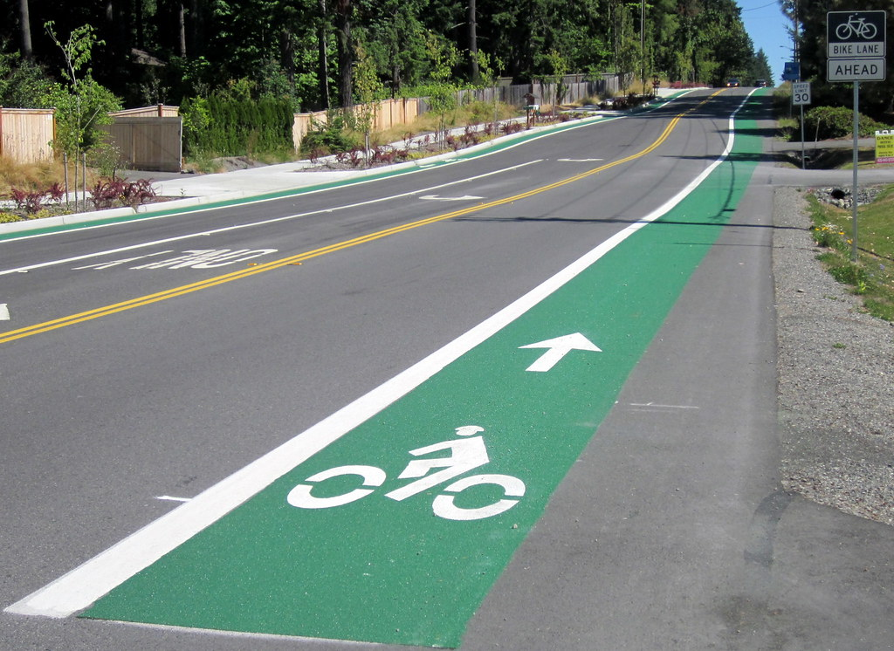
2026 Fed. Update
Fed. Surface Transp. CSAC-CEAC Advocacy Principles:
Priorities:
Roads 2) Bridges
3) Safety Projects 4) Active Transportation Projects
Build America Act 250
  Est. 22% of bill total bill funding to local governments funding through formula set-asides, suballocations and discretionary grant opportunities.
  Bridge Formula Program: Increase of $4.5B to $9B/year:
    25% percent set-aside for locally owned bridges
  Expanded Surface Transportation Block Grant program with regional suballocations for locally identified projects
  Preservation of the Safe Streets and Roads for All (SS4A) grant program and PROTECT grant programs
  EV Fee as one of many revenue sources
Notes:
Top line, transportation programs retained $1.3 billion in General Fund allocations provided in past budgets and almost $600 million in GGRF, also known as Cap and Trade funding, f
However, many of the programs had their funding commitments shifted to out years and are dependent on optimistic GGRF auction revenue estimates.
Finally, despite a notable cut, the ATP program still received $100 million in funding in the budget.

Slide 8
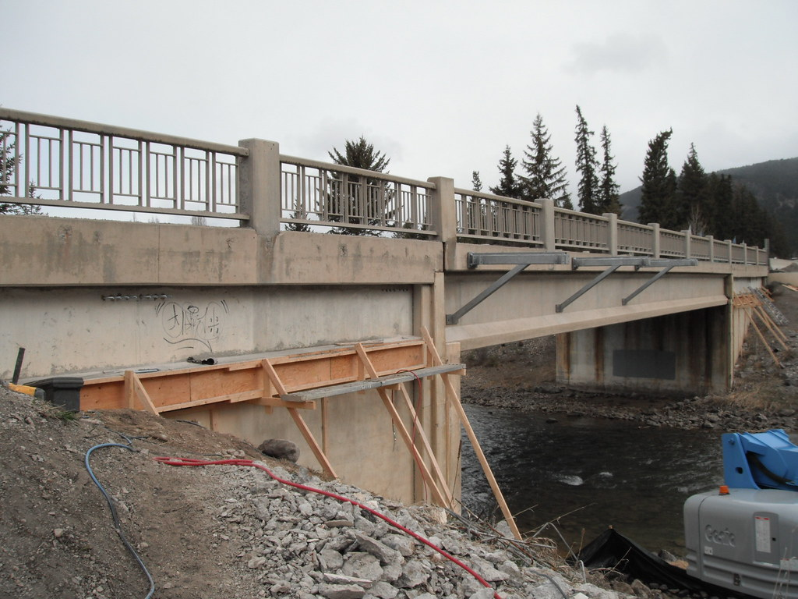
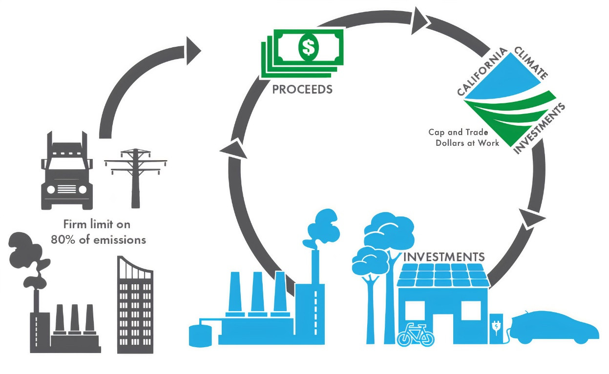
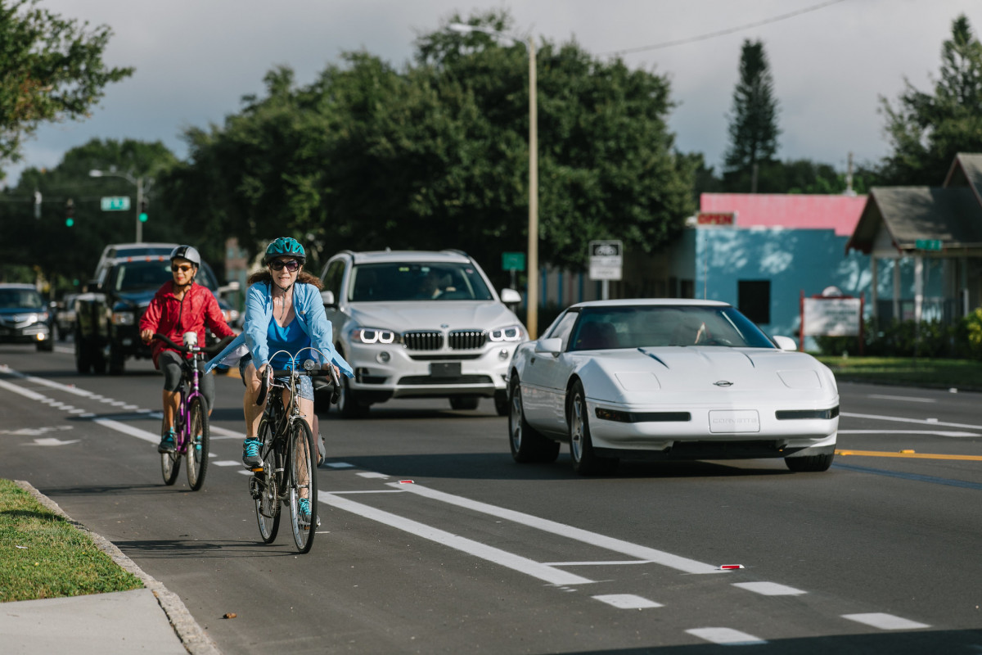
County Affiliate Workgroups
What is it:
The HLT unit has formed subject matter expert groups from HLT County Affiliates to obtain input on legislation.
Which Affiliates?
County Engineers Association
County Building Officials Association
County Planning Directors Association
Why?
Increasing legislative interest in complex issues:
  Building Codes
  General Plans
  Public Works contracting
Notes:
Top line, transportation programs retained $1.3 billion in General Fund allocations provided in past budgets and almost $600 million in GGRF, also known as Cap and Trade funding, f
However, many of the programs had their funding commitments shifted to out years and are dependent on optimistic GGRF auction revenue estimates.
Finally, despite a notable cut, the ATP program still received $100 million in funding in the budget.

Slide 9
County Affiliate Workgroups
Commitment:
Estimating 1 meeting of approx. 1 hour per month
Format
Pre-released agenda of bills (aim for 10 bills per meeting)
Goal is to focus groups on low # of bills, obtain input
Written input always accepted
Who’s it for
Directors and Deputies w/ extra time
Interested Building Dept, Planning, PW staff
Staff you’re trying to develop
Notes:
Top line, transportation programs retained $1.3 billion in General Fund allocations provided in past budgets and almost $600 million in GGRF, also known as Cap and Trade funding, f
However, many of the programs had their funding commitments shifted to out years and are dependent on optimistic GGRF auction revenue estimates.
Finally, despite a notable cut, the ATP program still received $100 million in funding in the budget.

Slide 10
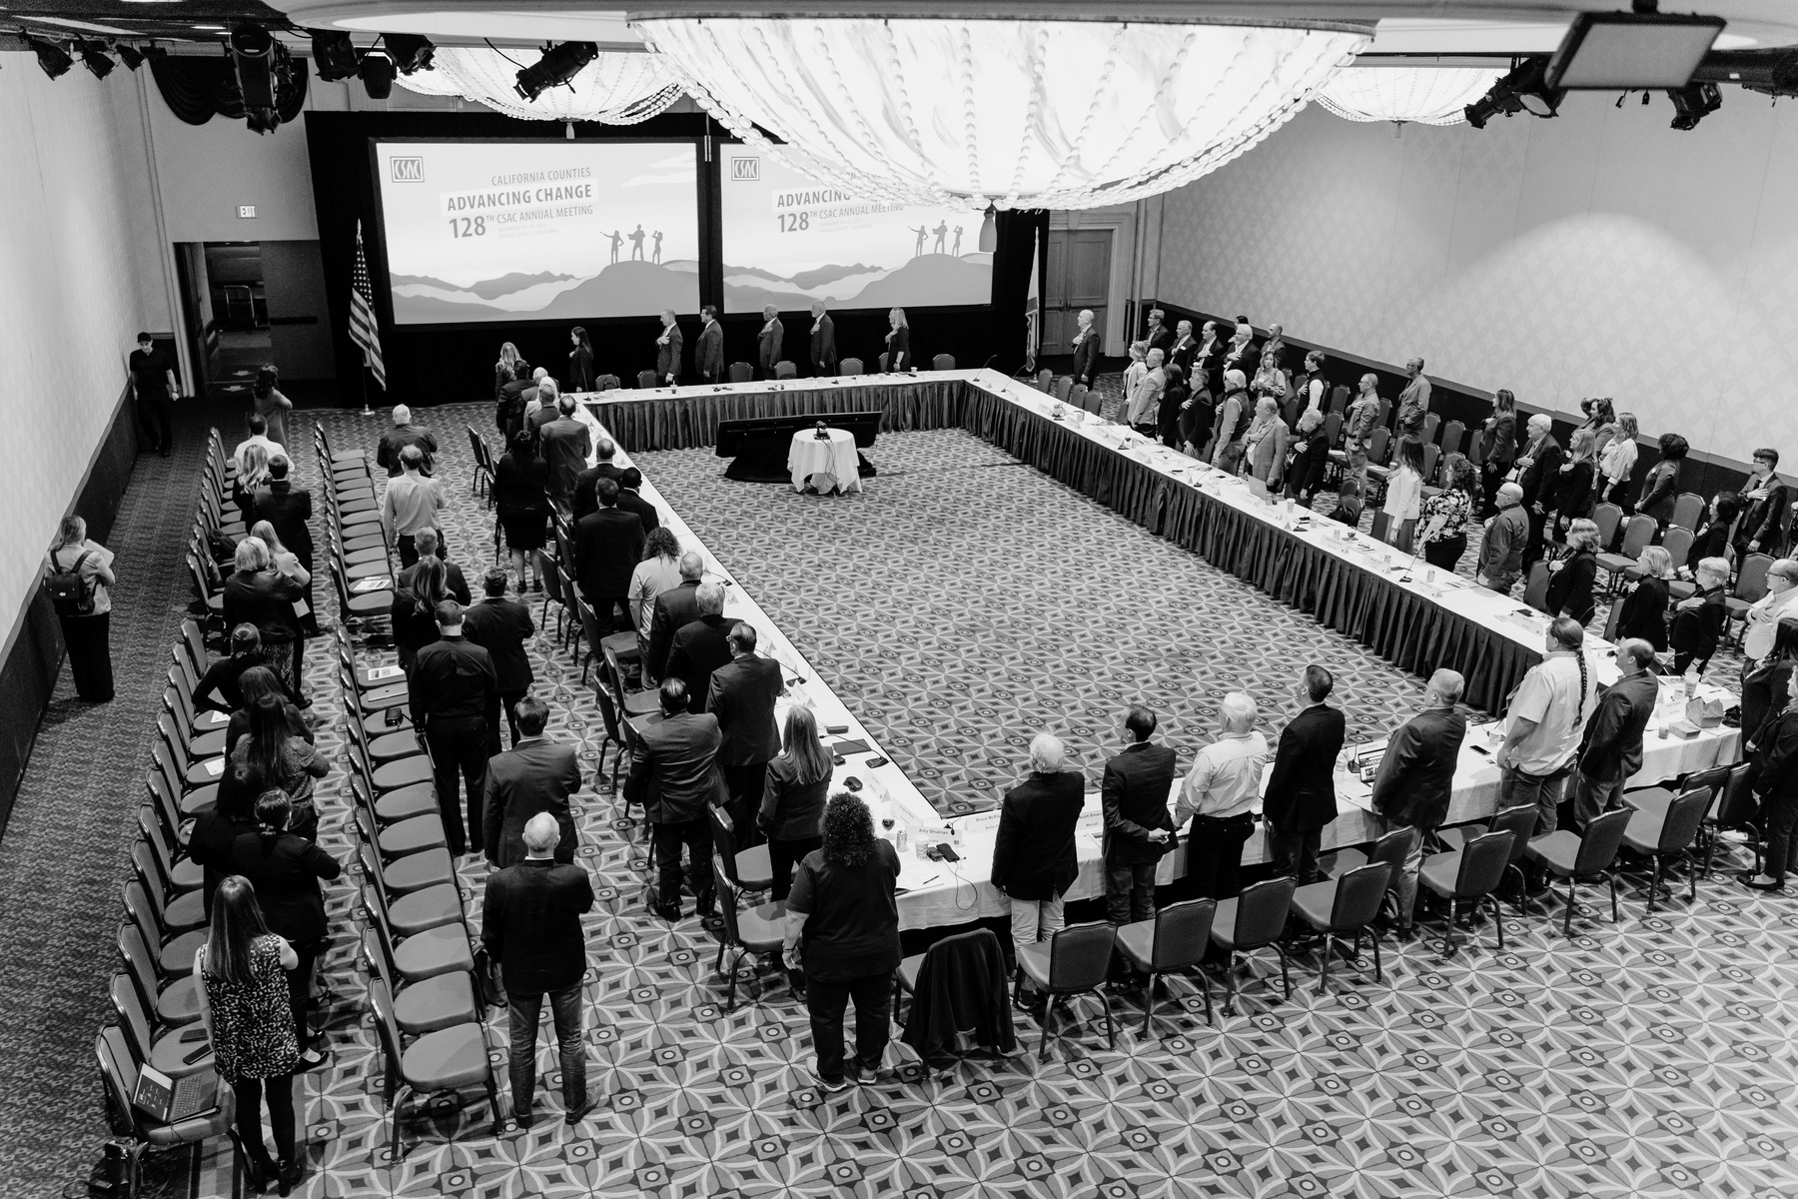
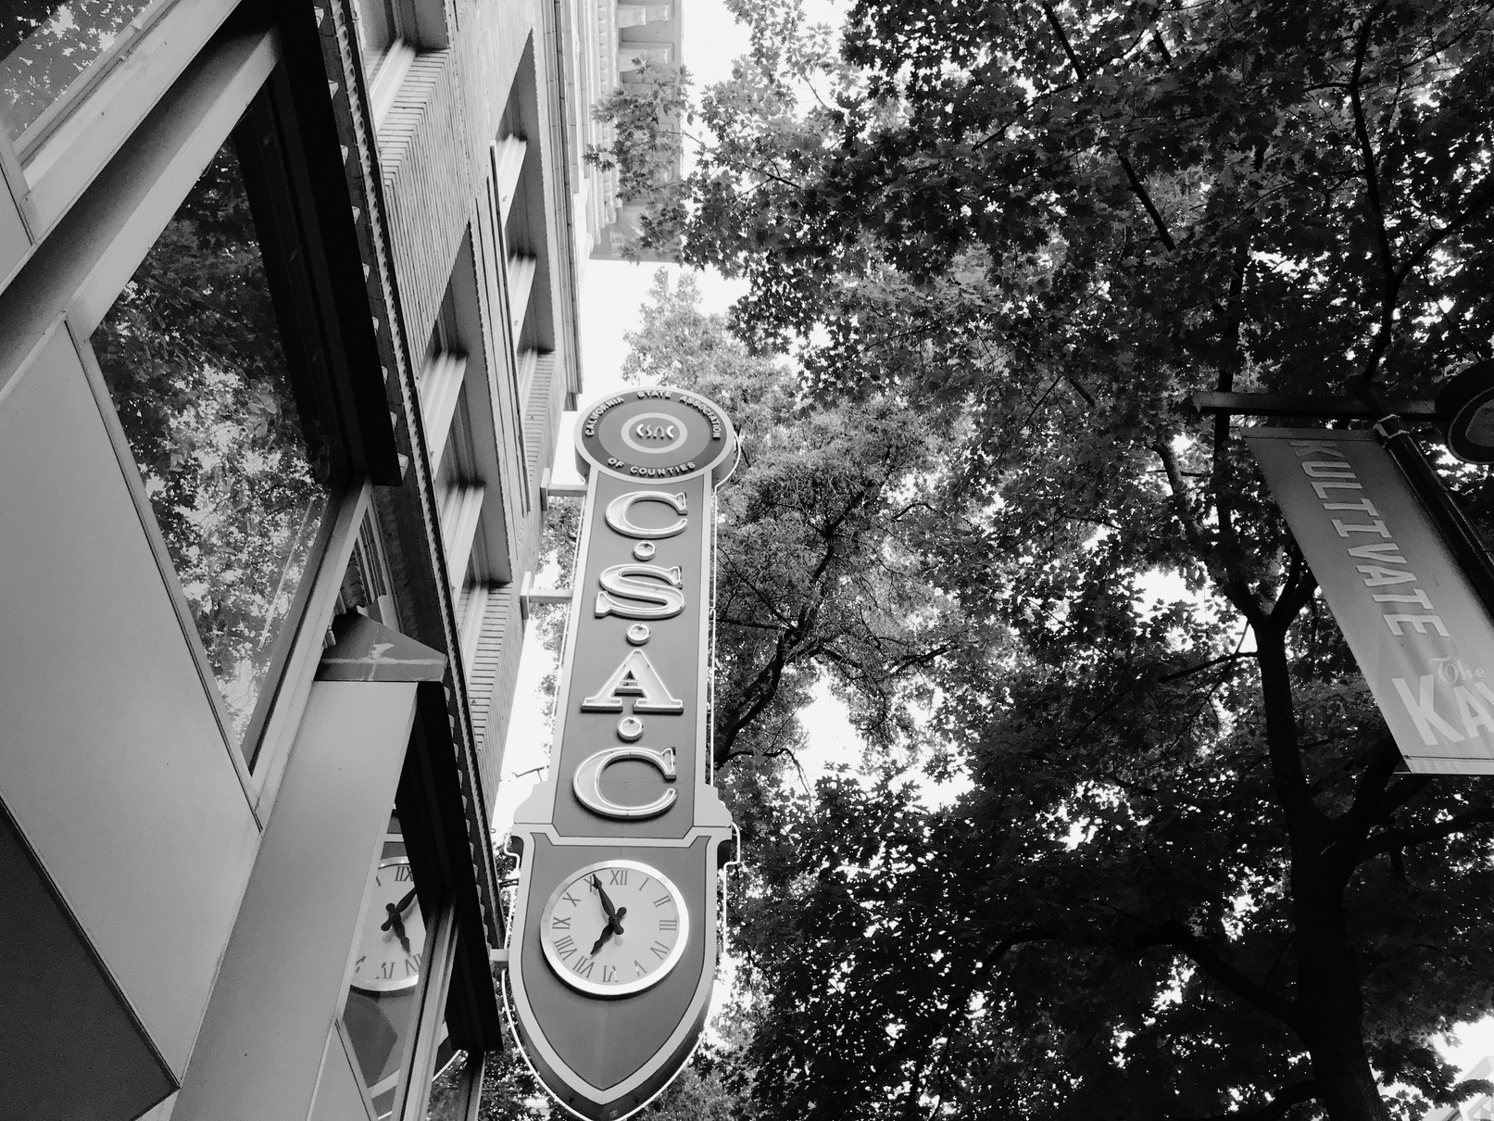
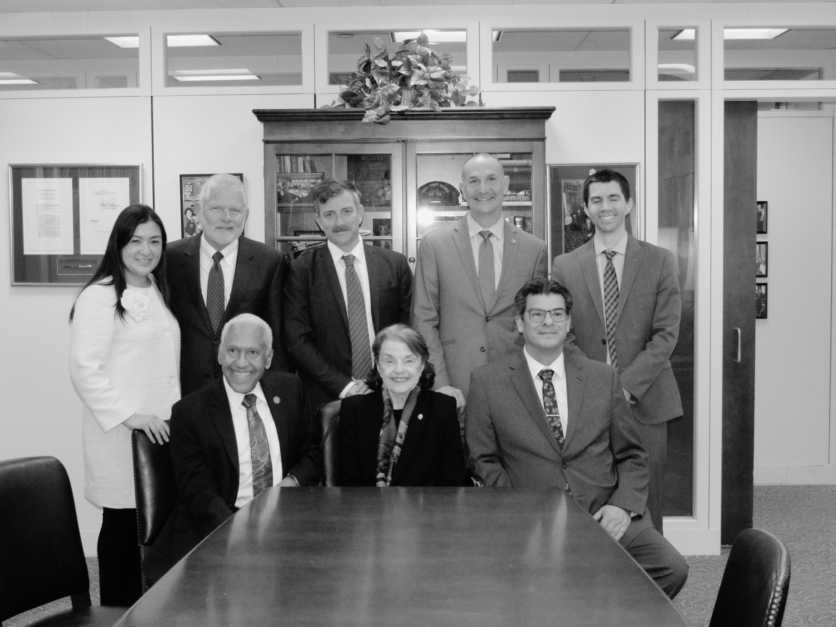
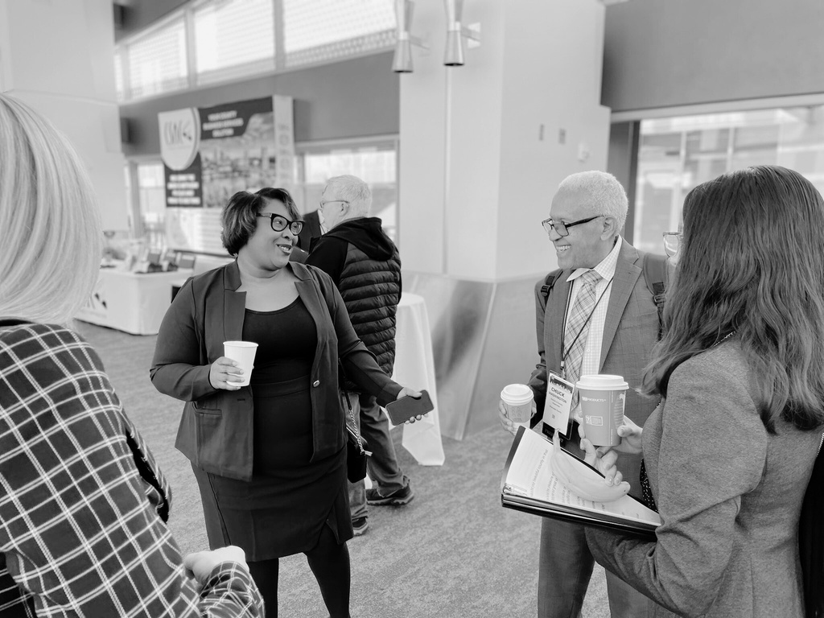
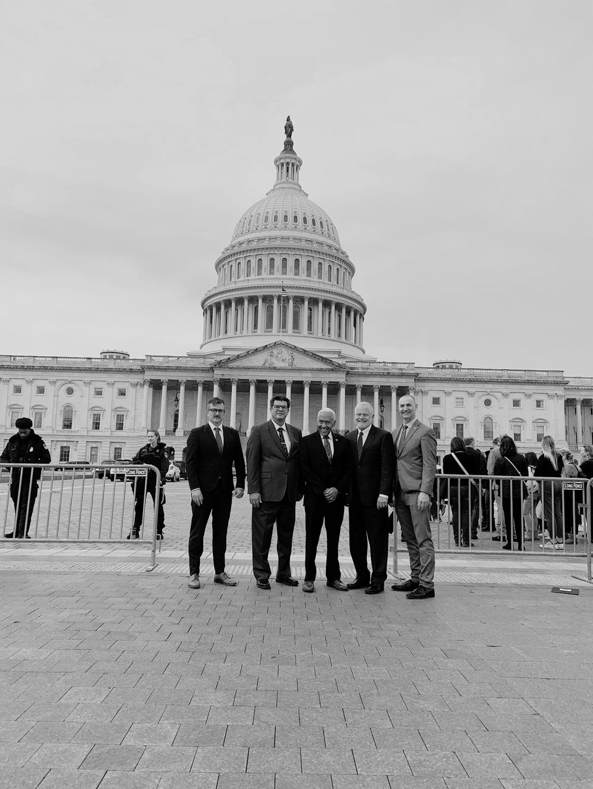
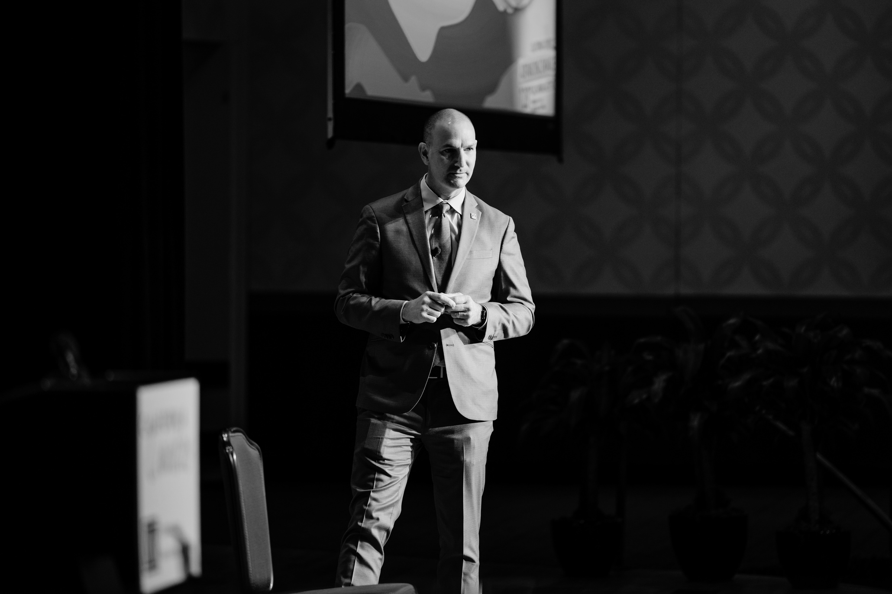
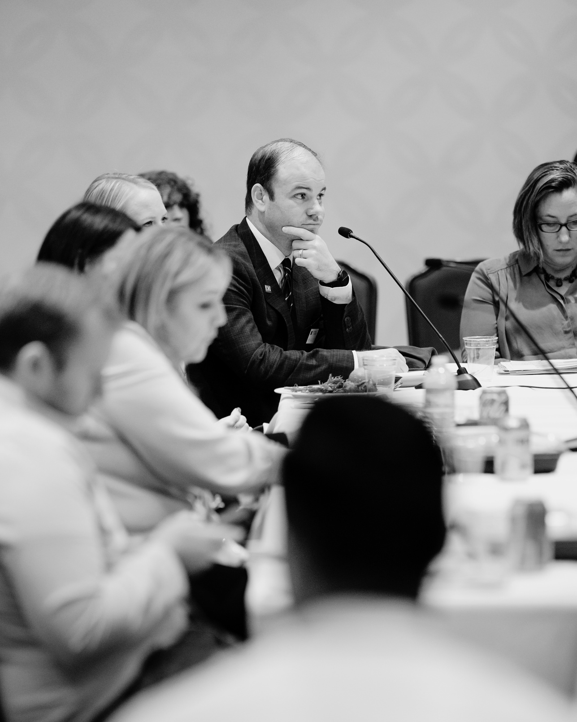
THANK YOU
Mark Neuburger
Housing, Land Use & Transportation Committee
mneuburger@counties.org
Copyright 2025 by California State Association of Counties®
Notes:
Thank you all for attending and for your attention today.

